Slide 1
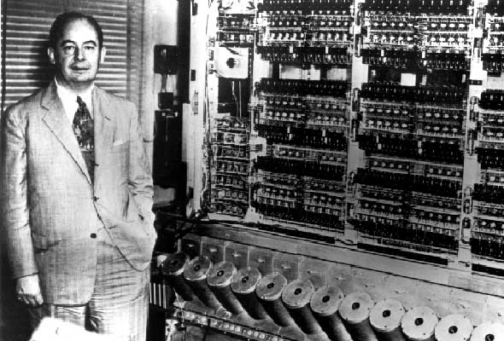
The von Neumann Machine
1945: John von Neumann
Wrote a report on the stored program concept, known as the First Draft of a Report on EDVAC
also Alan Turing… Konrad Zuse… Eckert & Mauchly…
The basic structure proposed in the draft became known as the “von Neumann machine” (or model).
a memory, containing instructions and data
a processing unit, for performing arithmetic and logical operations
a control unit, for interpreting instructions

Slide 2
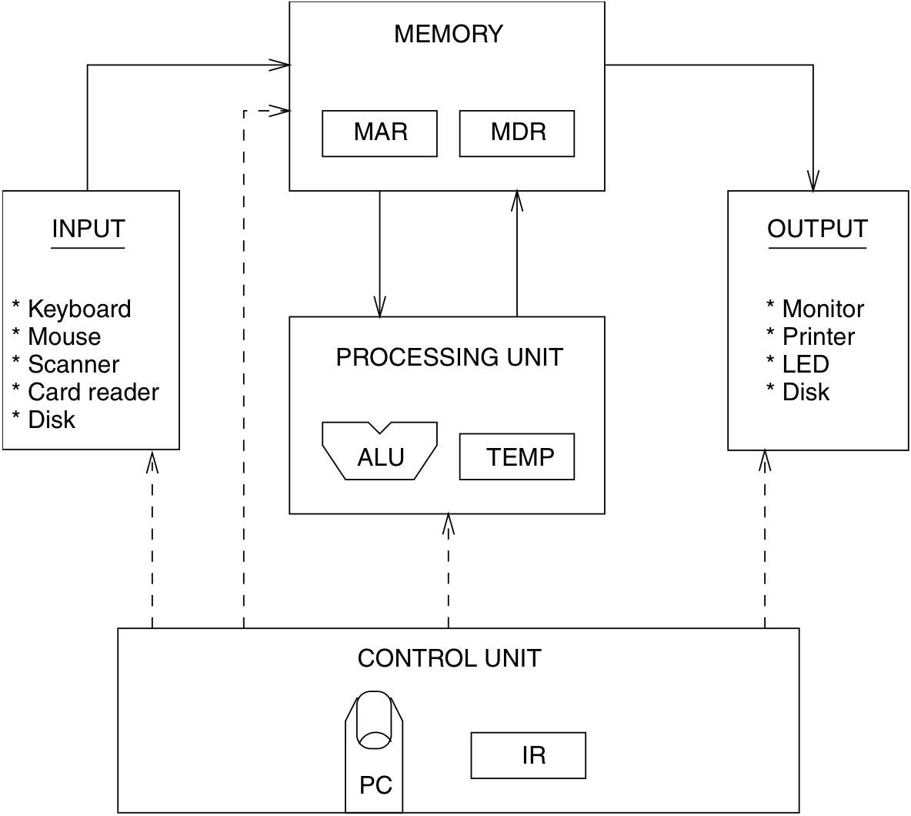
The von Neumann Machine
Abstraction of von Neumann Architecture
stores both program instructions and data
decodes current instruction,
manages processing unit to carry out instruction
program counter: points to the next instruction to be fetched
instruction register: stores current instruction

Slide 3
Intel x86 History
Totally dominate laptop/desktop/server market
Evolutionary design
Backwards compatible up until 8086, introduced in 1978
Added more features as time goes on
Complex instruction set computer (CISC)
Many different instructions with many different formats
But, only small subset encountered with Linux programs
Hard to match performance of Reduced Instruction Set Computers (RISC)
But, Intel has done just that!
In terms of speed. Less so for low power.

Slide 4
Intel x86 History
Name Date Transistors MHz
8086 1978 29K 5-10
First 16-bit processor. Basis for IBM PC & DOS
1MB address space
80386 1985 275K 16-33
First 32 bit processor , referred to as IA32
Added “flat addressing”
Capable of running Unix
32-bit Linux/gcc uses no instructions introduced in later models
Pentium 4F 2004 125M 2800-3800
First 64-bit processor, referred to as x86-64
Core i7 2008 731M 2667-3333
Our shark machines

Slide 5
Intel x86 History
Architectures
Processors
X86-16
8086
286
X86-32/IA32
386
486
Pentium
Pentium MMX
Pentium III
Pentium 4
Pentium 4E
MMX
SSE
SSE2
SSE3
X86-64 / EM64t
Pentium 4F
Core 2 Duo
Core i7
time
SSE4

Slide 6
Intel x86 History
Intel Attempted Radical Shift from IA32 to IA64
Totally different architecture (Itanium)
Executes IA32 code only as legacy
Performance disappointing
AMD Stepped in with Evolutionary Solution
x86-64 (now called “AMD64”)
Intel Felt Obligated to Focus on IA64
Hard to admit mistake or that AMD's approach is better
2004: Intel Announces EM64T extension to IA32
Extended Memory 64-bit Technology
Almost identical to x86-64!
All but low-end x86 processors support x86-64
But, lots of code still runs in 32-bit mode

Slide 7
von Neumann View of x86
CPU
Memory
Registers
Addresses
PC
Object Code
Program Data
OS Data
Data
Condition
Codes
Instructions
Stack

Slide 8
High-level x86 CPU
Programmer-Visible State
PC: Program counter
Address of next instruction
Called “EIP” (IA32) or “RIP” (x86-64)
Register file
Heavily used program data
Condition codes
Store status information about most recent arithmetic operation
Used for conditional branching
CPU
Registers
PC
Condition
Codes

Slide 9
IA32 Integer Registers
CPU
16-bit virtual registers
(backwards compatibility)
Registers
PC
Condition
Codes
%eax
%ax
%ah
%al
%ecx
%cx
%ch
%cl
%edx
%dx
%dh
%dl
general purpose
%ebx
%bx
%bh
%bl
%esi
%si
%edi
%di
%esp
%sp
%ebp
%bp

Slide 10
x86-64 Integer Registers
%rax
%r8
%eax
%r8d
%rbx
%r9
%ebx
%r9d
%rcx
%r10
%ecx
%r10d
%rdx
%r11
%edx
%r11d
%rsi
%r12
%esi
%r12d
%rdi
%r13
%edi
%r13d
%rsp
%r14
%esp
%r14d
%rbp
%r15
%ebp
%r15d
Extend existing registers. Add 8 new ones.
Make %ebp/%rbp general purpose

Slide 11
High-level x86 Memory
Memory
Byte addressable array
Code, user data, (some) OS data
Includes stack used to support procedures
Memory
Object Code
Program Data
OS Data
Stack

Slide 12
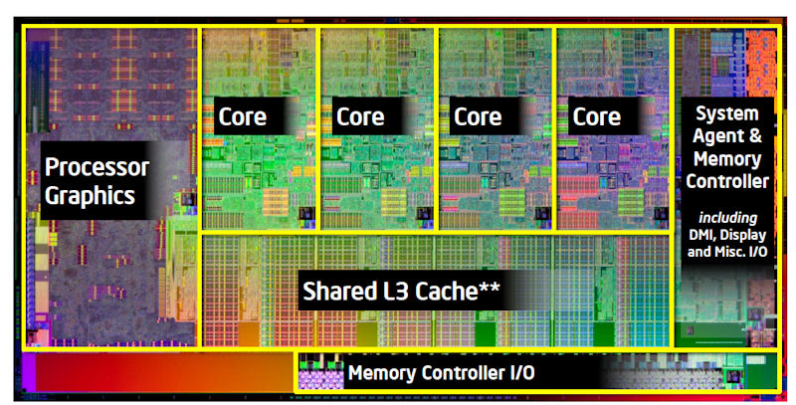
Programming the Machine
// C code
. . .
int imax(int first, int second) {
if ( first >= second )
return first;
return second;
}
But the hardware only "understands" binary representations

Slide 13
Programming the Machine
int imax(int first, int second) {
if ( first >= second )
return first;
return second;
}
gcc -O0 -c –m64 -std=c99 imax.c
457f464c010100010000000000000000
00010003000100000000000000000000
00bc0000000000000034000000000028
0009000689558be50845453b7c0c8b05
084503eb458b5d0c00c3000047004343
203a55287562746e2f75694c616e6f72
3420352e322e382d62756e7575742934
. . .
But who wants to program in binary?

Slide 14
Programming the Machine
int imax(int first, int second) {
if ( first >= second )
return first;
return second;
}
. . .
imax:
pushq %rbp
movq %rsp, %rbp
subq $8, %rsp
movl %edi, -4(%rbp)
movl %esi, -8(%rbp)
movl -4(%rbp), %eax
cmpl -8(%rbp), %eax
jl .L4
movl -4(%rbp), %eax
jmp .L5
.L4:
movl -8(%rbp), %eax
.L5:
popq %rbp
ret
. . .
Solution:
translate high-level language code into intermediate-level code which is more human-friendly,
then translate that "assembly" code into the machine's langauge.

Slide 15
Explanation: moving data
Source
Dest
Src,Dest
C Analog
Reg
movl $0x4,%eax
tmp = 0x4;
Imm
Mem
movl $-147,(%rax)
*p = -147;
Reg
movl %eax,%edx
tmp2 = tmp1;
movl
Reg
Mem
movl %eax,(%rdx)
*p = tmp;
Mem
Reg
movl (%rax),%edx
tmp = *p;

