Slide 1
Programming Tools
Most of the programming assignments will require using the C language.
We will use a current version of the GCC C compiler.
What’s GCC?
- the Gnu Compiler Collection (see gcc.gnu.org)
- a collection of freeware software development tools, including support for C, C++, Objective-C, Fortran, Java, and Ada
- available as part of all Linux and most UNIX-derived operating systems
How do you get it?
- run Linux
- use a remote Linux environment (rlogin cluster)
You will have to use the CS Department’s rlogin cluster for some assignments in any case.

Slide 2
Linux
Read Chapter 1 of the Sobell book for a history of Linux… really…
There are many Linux distributions (distros)… superiority is a matter of religion.
- the CS Department’s rlogin cluster and other servers (more later) are running CentOS
- I use CentOS
- CentOS will be the official platform for testing your assignments
- If you run another distro, any difficulties that arise will be your problem
Linux distributions come in 32-bit and 64-bit versions; I recommend running 64-bit, but that will entail your installing some additional packages.
In any case, we require you to run CentOS on your own computer.
If you do not do so, expect to have problems.

Slide 3
Running Linux on a Windows Host
Here’s my advice:
- Install VirtualBox (virtualbox.org).
- I'm using version 5.1.22, but later versions should be fine.
- Follow the installation instructions carefully.
- Download a CD/DVD image for installing your chosen distro.
- I used CentOS-7-x86_64-DVD-1611.iso.
- Follow the instructions in the VirtualBox manual:
- for installing a guest OS on Windows
- for installing the VirtualBox Guest Additions (these are essential)
Once you’re done, you can boot and run Linux within a virtual machine.
This minimizes your chances of disrupting your existing system setup.
This works best if your computer has at least 8GB of RAM.

Slide 4
Running Linux on an OS X Host
Essentially, follow the instructions for a Windows Host, but install the version of VirtualBox for OS X.
Note:
- OS X is not Linux (or UNIX), and that prior students have experienced issues when trying to use the OS X native version of the GCC C compiler in this course.
- Those problems will go away if you run Linux.
- If you decline to do that, you may have to use the rlogin cluster (more later) for all of the UNIX-related and C programming assignments.

Slide 5
Dual-booting Linux with Windows
You may also install Linux so that you can choose between Linux and Windows when you boot your computer.
The website for your chosen Linux distro will include installation instructions for dual-booting.
This generally works as advertised as long as:
- Your computer does not have any unusual issues, especially with respect to the partitioning of the hard disk.
- You follow the instructions carefully.
That said…
- YMMV.
- I have had dual-boot installations go sour and trash my system.
- Using VirtualBox (or some other virtualization software) allows you to switch seamlessly between your native host OS and Linux.

Slide 6
Safer Dual-booting Linux
You may also install Linux so that you can boot it from a CD or a flash drive.
The website for your favorite distro will have instructions for creating a bootable CD installation (often called a Live CD).
This doesn’t usually give you the ability to update or save changes.
See pendrivelinux.com for instructions on creating a bootable Linux flash drive.
This generally works as advertised as long as you follow the instructions carefully.
This should pose no risk to your existing machine setup.
That said…
- YMMV.
- With some distros it is allegedly possible to perform updates and save changes. YMMV with this as well.

Slide 7
SLO Accounts
The CS Department uses a single-logon system (SLO) for many of its resources.
If you are a CS major and have previously taken a CS course at VT, you should already have an account.
If not, or if you’ve forgotten your SLO password, go to the following link and rectify the problem:
https://admin.cs.vt.edu/
Note that you will need this to access some of the resources necessary for this course.

Slide 8
SSH: secure shell for remote access
Secure shell is a network protocol for secure communication.
An SSH client is supplied with UNIX/Linux, and with OS X.
Windows users should Google for “SSH Secure Shell Client” or for “PuTTY”, which are freely available for non-commercial use.
See software.cs.vt.edu for downloads.
You will use an SSH client to access the rlogin cluster for certain assignments.

Slide 9
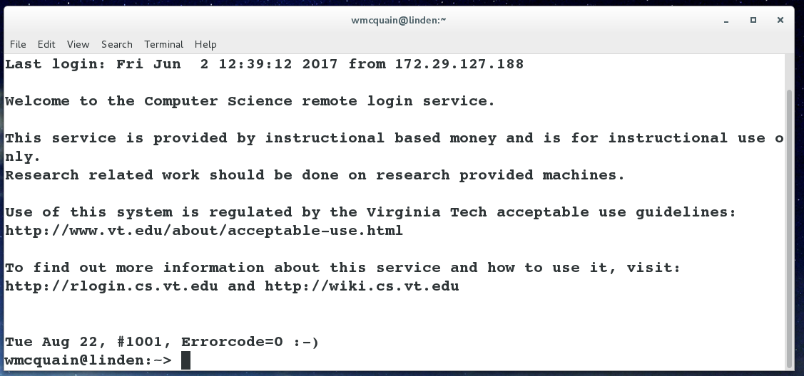
rlogin Cluster
The rlogin cluster is a collection of computers, each running CentOS, that are available to for students taking CS courses at VT.
To access the cluster, open a Linux terminal and enter the following command using your VT email PID:
ssh <PID>@rlogin.cs.vt.edu
Status and other information can be found at:
http://rlogin.cs.vt.edu/

Slide 10
SSH: login without a password
You can set up keys that allow you to ssh to your rlogin account without using a password.
From a Linux or Cygwin terminal on your machine, use the ssh-keygen command to create a key pair; the session will resemble this:
1003 wmcquain@centosvm in ~> ssh-keygen
Generating public/private rsa key pair.
Enter file in which to save the key (/home/wmcquain/.ssh/id_rsa):
Enter passphrase (empty for no passphrase):
Enter same passphrase again:
Your identification has been saved in /home/wmcquain/.ssh/id_rsa.
Your public key has been saved in /home/wmcquain/.ssh/id_rsa.pub.
The key fingerprint is:
38:ca:59:93:13:e7:94:41:7d:d9:21:a0:a0:54:2e:fc wmcquain@centosvm
The key's randomart image is:
+--[ RSA 2048]----+
| ..o.o....o.. |
| o o . +. o.. |
| + o = . |
| o B |
| E S |
| . + + |
| + |
| |
| |
+-----------------+

Slide 11
SSH: login without a password
Then, use the ssh-copy-id command to install the key on the remote system:
1004 wmcquain@centosvm in ~> ssh-copy-id -i ~/.ssh/id_rsa.pub rlogin.cs.vt.edu
. . .
wmcquain@rlogin.cs.vt.edu's password:
. . .
Now try logging into the machine, with: "ssh 'rlogin.cs.vt.edu'"
and check to make sure that only the key(s) you wanted were added.
1005 wmcquain@centosvm in ~> ssh rlogin.cs.vt.edu
Last login: Mon Jun 26 20:04:56 2017 from c-73-251-28-86.hsd1.va.comcast.net
Welcome to the Computer Science remote login service.
. . .
Tue Aug 22, #1001, Errorcode=0 :-)
wmcquain@hornbeam:~>

Slide 12
SSH: login without a password
You should now ssh to your rlogin account and see if your key file only contains what you would expect:
wmcquain@hornbeam:.ssh> cat authorized_keys
ssh-rsa
. . . wmcquain@centosvm
wmcquain@hornbeam:.ssh> A
The only authorized key entry corresponds to my login from my local machine.
Now, I can ssh to the cluster without having to provide a password.

Slide 13
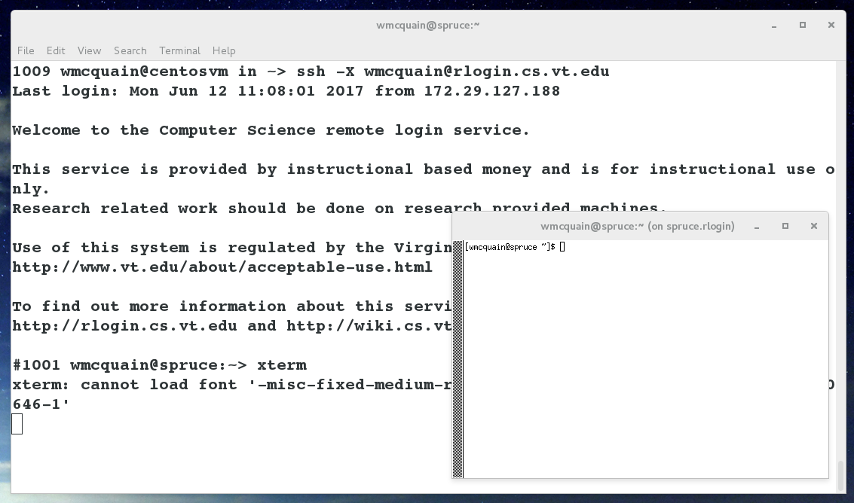
SSH: opening an X tunnel
Many Linux applications have a graphical user interface; you can execute those on the server (rlogin cluster machine) by using the –X switch when you invoke ssh:

Slide 14
So…
Get to work!
Create an installation of Linux on your laptop/tablet.
- Use VirtualBox or not, your choice.
- Use CentOS 7
Get an SLO account (if you don't already have one) and make sure you know your password.
If you like, set up password-free login (via ssh) to your rlogin.cs.vt.edu account.

