Slide 1
Array Algorithms Reviewing Concepts

Slide 2
Nodes
Linked Chains in Java

Slide 3
head references an object of type Node
class Node {
int data;
Node next;
.
.
.
}
head
Node head;
head.data
head.next
In this example Node is Class with two fields, data and next.
In this example data is of type int and next is of type Node.
Notes:
Double check big java book as a reference

Slide 4
head references an object of type Node, which has a field that references another node
head
5
27
head.data
head.next
head.next.data
head.next.next
head
head.next
In this example data is type int and next is type Node.

Slide 5
A linked chain of nodes referenced by head
head
5
27
13
81
When next is null, it is the end of the chain

Slide 6
A linked chain of nodes referenced by head (animated)
head
p
q
r
5
27
13
81
…
Node p = head;
Node q = head.next;
Node r = q.next;

Slide 7
Iterating through a linked chain of nodes referenced by head (animated)
head
curr
curr
curr
curr
5
27
13
81
…
Node curr = head;
while (curr.next != null)
{
curr = curr.next;
}

Slide 8
Removing a node from a chain (animated)
head
p
q
q
5
27
13
81
p.next
q.next
q.next
…
//Remove node referenced by q
p.next = q.next;
q = p.next;
//garbage collection removes dangling node

Slide 9
Show an addition at the head
head
8
16
32
64
…
Node newNode = new Node();
newNode.data = 8;
newNode.next = head;
head = newNode;

Slide 10
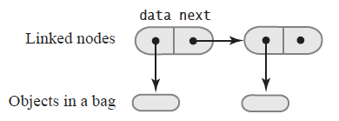
Linked Nodes when Node’s data field is a reference type

Slide 11
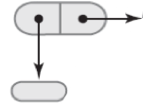
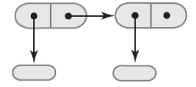
Linked Chain

