Slide 1
The 2 eggs problem (Google interview)
You have a 100-story building, 2 eggs, and you are a busy man. Your goal is to find the
highest floor from which you can still drop an egg without breaking it. Assume that if dropped from below that critical floor an egg always survives, while if dropped at or above – always breaks.

Slide 2
Approach step-by-step, from simple to more complex solutions.

Slide 3
Approach step-by-step, from simple to more complex solutions.
What if you have just one egg? What is the algorithm and the worst case?
What can you do with the second egg?
You can partition the building into, say, 10 block: 1-10, 11-20, … 91-100, drop the 2nd egg from floor 10*n, when it breaks, go
one by one from floor 10n -9.
Is this optimal? What if we partition the building as 1-14, 15-28, 29-42… ? Fewer floors in the last interval.
Why equal partitioning of floors? Try equal partitioning of dropped eggs: 1-14, 15-27,

Slide 4
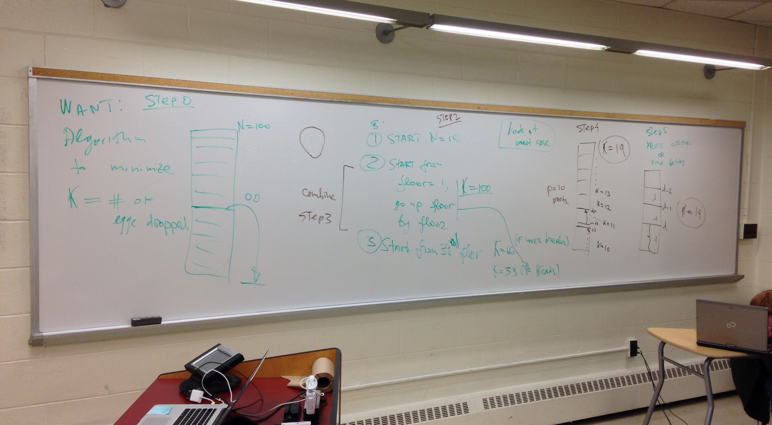
Solution sketch:

