Slide 1
Ok, now a real real one. Use ANY source of information available, including the web. In fact, you have to, to solve it. Start by figuring out what is being asked. Read about it a bit.
The problem: Prove that even with the best of today’s computers
the protein folding problem can not be solved by an algorithm that performs
an exhaustive search for the minimum energy configuration of
the polypeptide chain.
φ₄
φ₂
φ₁
φ₃
Here is what a polypeptide chain looks like. Angles between links can take on any value from 0 to 360 degrees. The set of angles { φ_k } uniquely
specifies the chain. In a typical protein there are k=100 or more links. The
biologically functional folded state of the chain ( protein ) has the absolute lowest energy E(φ₁ φ_{2 …}) of all possible configurations. Assume functional form of E is given. Any two configurations in which all
angles differ by less that 36 degrees (error margin between the two configurations ) can be considered identical.
φ_{ι}

Slide 2
Solution Steps:
Google for unknown terminology. Read about the “protein folding” problem.
Estimate the number of conformations that you would need to go through (exhaustive search - all of them).
φ₄
φ₂
φ₃
φ₁
A typical protein is a chain of ~ 100 mino acids.
Assume that each amino acid can take up only 10 conformations (vast underestimation)
Total number of possible conformations: 10¹⁰⁰
Suppose each energy estimate is just 1 float point operation. Suppose you have a Peta-Flop supercomputer (find out what “peta-flop” is).
An exhaustive search for the global minimum would take 10⁸⁵ seconds ~ 3*10⁷⁸ years. Age of the Universe ~ 2*10¹⁰ years.

Slide 3
Well, an exhaustive search is really bad. How about something more clever? Tons of methods exist for minimization of a multi-dimensional functions. But, in the case of protein folding we have 1000-dimensional space and very rugged landscape. Lost of local minima. Need just one global one. Very hard.

Slide 4
The protein folding problem: the “Grand Challenge” of computational science
THIS MATERIAL (slides 5-13) IS NOT GOING TO BE ON THE EXAM OR QUIZZES. Intended for those curious about their discipline.
But keep scrolling: slides at the very end are useful for the exam/quizzes.

Slide 5
2
3
Free energy
1
Finding a global minimum in a multidimensional case is easy only when the landscape is smooth. No matter where you start (1, 2 or 3), you quickly end up at the bottom -- the Native (N), functional state of the protein.
Folding coordinate
Adopted from Ken Dill’s web site at UCSF

Slide 6
Realistic landscapes are much more complex, with multiple local minima – folding traps.
Proteins “trapped” in those minima may lead to disease, such as Altzheimer’s
Adopted from Ken Dill’s web site at UCSF

Slide 7
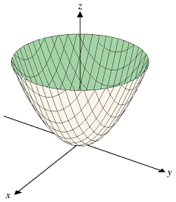
Additional complication: protein folding problem = highly constrained minimiazation
E(x,y,z) = x² + y² ⁺ z² – easy to solve. Min = (000).
Becomes much more complex if a complex constraint is added e.g. Sin²(x) + y + z = const.
In the case of protein folding, constraint comes from the specific amino-acid connectivity – beads on a string chain.

Slide 8
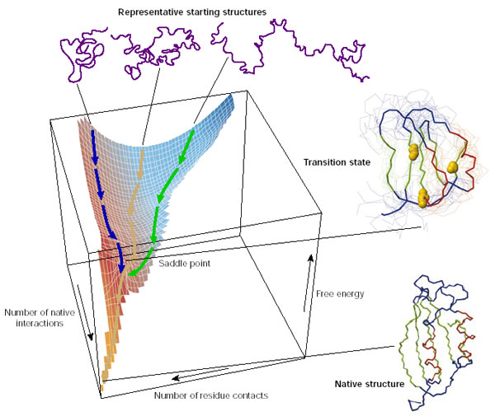
Adopted from Dobson, NATURE 426, 884 2003

Slide 9
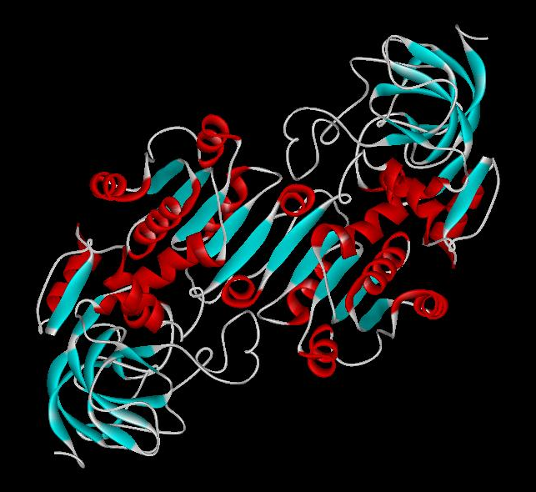
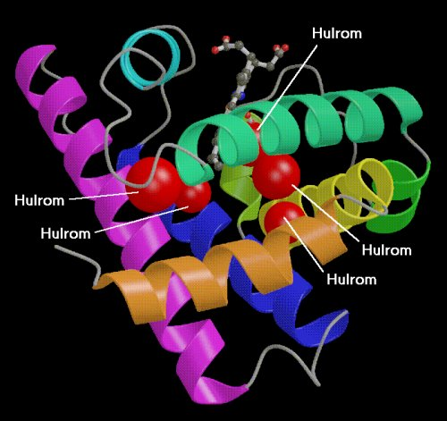
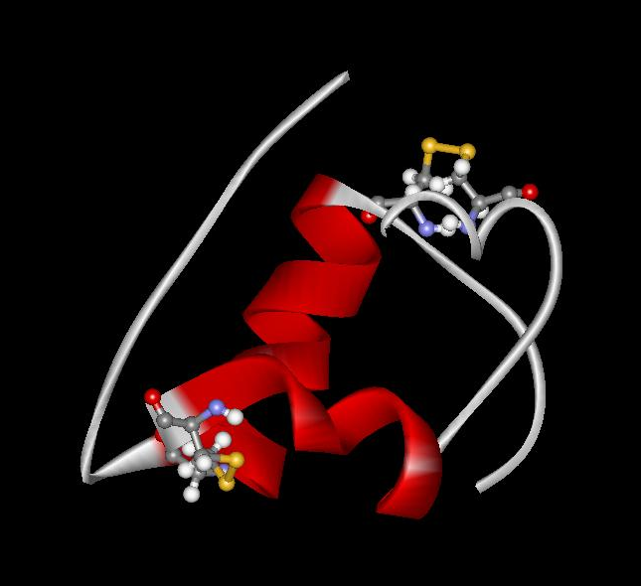
Proteins play key roles in a living system
Three (out of many many) examples of protein functions
Catalysis: Almost all chemical reactions in a living cell are catalyzed by protein enzymes.
Transport: Some proteins transports various substances, such as oxygen, ions, and so on.
Information transfer: For example, hormones.
Alcohol dehydrogenase oxidizes alcohols to aldehydes or ketones
Myoglobin stores oxygen
Insulin controls the amount of sugar in the blood

Slide 10
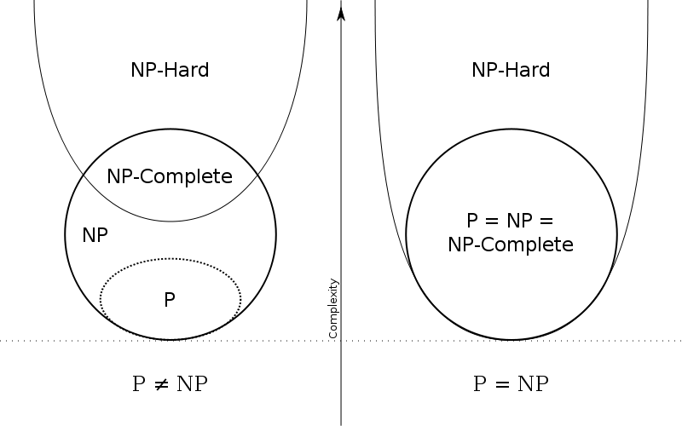
Computational complexity
Protein folding,
exhaustive search for minimum

Slide 11
How are proteins folded computationally?
One possibility: find minimum energy by simulated annealing:
use temperature to “kick” the system out of local minima

Slide 12
Simulated annealing folding of a real small protein

Slide 13
Intrigued?
Suggested reading:
1.“Protein Folding and Misfolding”, C. Dobson, Nature 426, 884 (2003).
2. “Design of a Novel Globular Protein Fold with Atomic-level Accuracy, Kuhlman et al. , Science, 302, 1364, (2003)
+ references therein.

Slide 14
Quick estimates of what is feasible
Very relevant for exams/ quizzes

Slide 15
The list sorting problem.
You have a list of current VT students and your laptop (with nothing on it but your favorite compiler). Can you sort the list in ascending order by students’ birthday, in a reasonable time (one day)?

Slide 16
The list sorting problem
This is typical problem. You need to compare your task size with your available resource.
You can start with the task size. Ok, about 30,000 students. The most naïve sorting algorithm would pick a random name, and assign it to the bottom of the list (oldest). Then check if next entry’s birthday is before that. If not, keep the original. If “yes”, replace. Go down the list. That will cost you N=30,000 comparisons, and will result in the oldest student placed where should be.
Repeat the procedure for the remaining N-1 entries. You get the second oldest student. Cost: N-1 comparisons.
Repeat till the last one.
Total cost = N + N-1 + N-2 + .. 1 = N(N+1)/2 operations. Assume N^2 for simplicity. (3*10^4)^2 ~ 10^9 operations.

Slide 17
The list sorting problem
Now let’s discuss the resources.
Typical laptop. Operating speed 3 GHz = 3*10^9 operations per second.
Even assuming that DOB comparison costs 100 elementary operations, we can still sort the list in ~ 100 seconds.

Slide 18
The list sorting problem
Further considerations:
One can come up with a better sorting algorithm, like quick sort, which costs ~ N Log N operations. You will learn about those in a year or two.
Your grandma would use an even quicker one: make bins with all the birthdays that span ~ 20 years, then place each student in the bin. Cost O(N).
But notice that the feasibility was shown based on the most naïve and expensive algorithm, which means that you can certainly do it with a faster one, if you know it. However, in this class, you do not have to come up (or known) anything fancy.
Finally, you do want to mention that you can whip up the code for it within a reasonable time.

