Slide 1
Today’s agenda
WASI test results
Quiz or HW?
Your stage 2 reports
Individual activity points

Slide 2
Invariants
An invariant is some aspect of a problem that does not change.
Similar to symmetry
Often a problem is easier to solve when you focus on the invariants

Slide 3
Invariants
An invariant is some aspect of a problem that does not change.
Simplest example: PARITY.
The parity of a sum of integers is odd, if and only if the number of odd elements is odd.
The parity of a product of a set of integers is odd if and only if …
Notes:
3

Slide 4
Chessboard Problem
A domino
Problem: Completely tile (single layer) this defective chessboard with dominos.
Notes:
4
4

Slide 5
Chessboard Problem
A domino
Strategy: solve a simple problem first. A 2x2 board. 3x3? What’s your conclusion?
Notes:
5
5

Slide 6
Chessboard Problem
Claim: Tiling the defective chessboard with dominos is impossible.
Proof?
Must be a convincing argument. Find a “tiling invariant”, a number that does not change upon adding a single tile. Or, a number whose property (e.g. odd, even) does not change.
Notes:
6
6

Slide 7
First Proof Attempt
There are more black squares than white squares.
Therefore, tiling the defective chessboard with dominos is impossible.
Why is this not an adequate argument?
Notes:
7
7

Slide 8
Second Proof Attempt
Every domino covers one black square and one white square. Thus, adding one domino tile does not change (# white sqrs - # black sqrs) = I =
invariant. Originally, this invariant I = 2. A complete tiling would mean that all squares are covered, I=0. Impossible.
Notes:
8
8

Slide 9
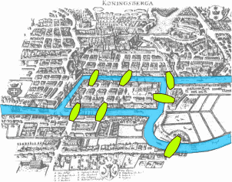
The seven bridges of Konigsberg
Can you pass all 7 only once and come back?

Slide 10
The seven bridges of Konigsberg
B
C
D
A
Can you pass all 7 only once and come back to the same
land mass (A, B, C or D)?

Slide 11
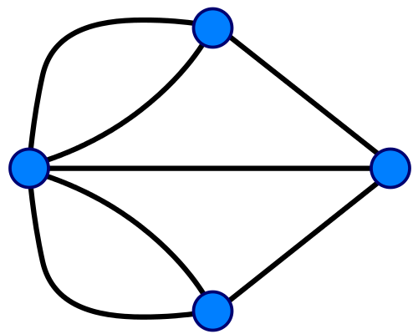
The seven bridges of Konigsberg =
B
D
C
A
Can you start and and at the same vertex, traversing every edge only once?

Slide 12
Each vertex has k=3 edges, incoming (+1) or outgoing (-1).
B
I₃ = -1
I₂ = +1
D
C
I₁ = +1
A
Start at A. Return to A. Number of people at D is 0 in the beginning and end = invariant. Can not be 0 for k = odd.

Slide 13
The seven bridges of Konigsberg =
The Birth of Graph Theory
B
D
C
A
Can you start and and at the same vertex, traversing every edge only once?

Slide 15
Invariant Problem
Let a1, a2…. an be an arbitrary arrangement of the numbers 1,2,3… n. Prove that, if n is odd, the product:
(a1 -1)(a2 -2 )… (an - n) is an even number.
Hint: products are difficult to deal with. Consider sum of the terms.
Notes:
15

Slide 16
Invariant Problem
Let a1, a2…. an be an arbitrary arrangement of the numbers 1,2,3… n. Prove that, if n is odd, the product:
(a1 -1)(a2 -2 )… (an - n) is an even number.
Solution. Step 1. Remember, products are difficult. Consider the sum of the terms.
(a1 -1) + (a2 - 2) + … (an - n) = (a1 + a2 + … an ) - (1 + 2 + …n) =
= (1 + 2 + … n) - (1 + 2 + … n) = 0.
INVARIANT (does not change with n). Step 2. A sum of an odd number of integers that is equal to
an even number must contain at least one even number.
Notes:
16

Slide 17
Invariant Problem
At first, a room is empty. Each minute, either one person enters or two people leave. After exactly 3¹⁹⁹⁹ minutes, could the room contain 3¹⁰⁰⁰ + 2 people?

Slide 18
Invariant Problem
At first, a room is empty. Each minute, either one person enters or two people leave. After exactly 3¹⁹⁹⁹ minutes, could the room contain 3¹⁰⁰⁰ + 2 people?
If there are n people in the room at a given time, there will be either n+3, n, n-3, or n-6 after 3 minutes. In other word, the increment is a multiple of 3. Thus, population after 3k minute P(3k minutes) = 3*N, N - integer. Since we have 3k = 3^1999 we CAN NOT have 3^2000 + 2 – not divisible by 3.
Notes:
18

Slide 19
Invariant Problem (CS)
An image generated by a Mars rover is
10,000x10,000 matrix of pixels A. Its entries are 0 or 1 only.
A lossless compression algorithm is employed that uses
a similarity transformation B = SAS⁻¹, where S is some
other 10,000x10,000 matrix (stored on Earth); the resulting
diagonal matrix B is sent to Earth. Propose at least one
quick check that tests if B might have been corrupted
in transmission. (Such checks are necessary conditions
that B is correct).
USE THE WEB TO REFRESH YOUR MATRIX ALGEBRA.

Slide 20
Invariant Problem (CS)
Hint: find an invariant of the similarity transformation, a single number that does not change when you do the transformation. Google is your friend.

Slide 21
Invariant Problem (CS)
det(B) = det (SAS⁻¹) = det (SS⁻¹ A) = det(1xA) =
det(A).
But det(B) is really simple, just the product of
its diagonal elements (all others are zero). Since original A had only integer entries, det(A) must be an integer, and so must be det(B). Although
the problem did not specify it, if you could send that integer from Mars
along with the main data package, that would be an even more precise check.

Slide 22
Invariant Problem
If 127 people play in a singles tennis tournament, prove that at the end of the tournament, the number of people who have played an odd number of games is even.

