Slide 1
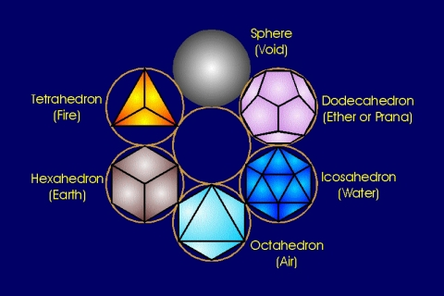
A powerful strategy: Symmetry
The world is full of symmetry, so use it!

Slide 2
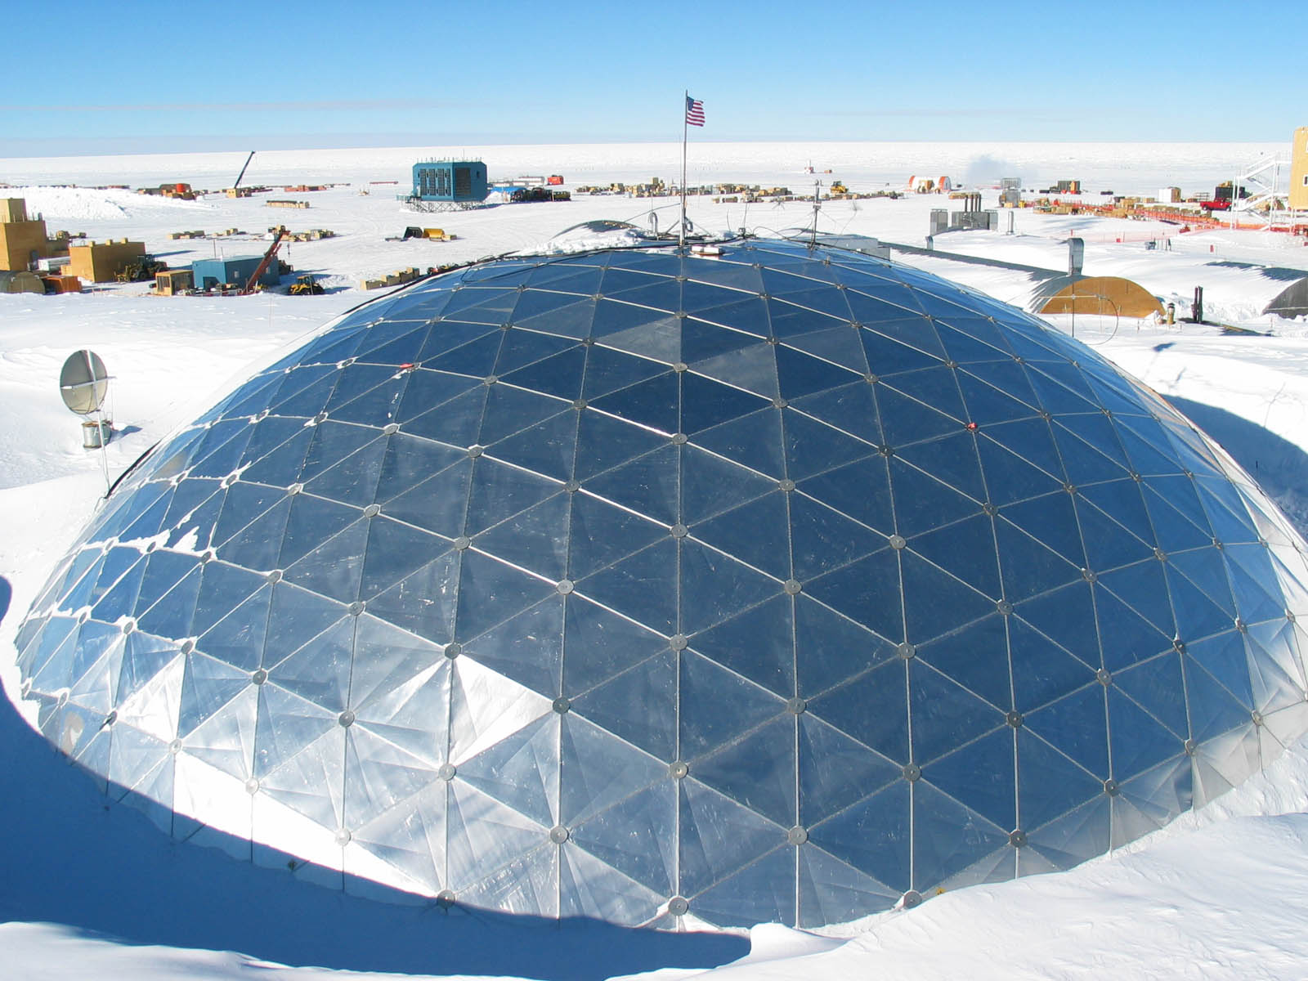

Slide 3
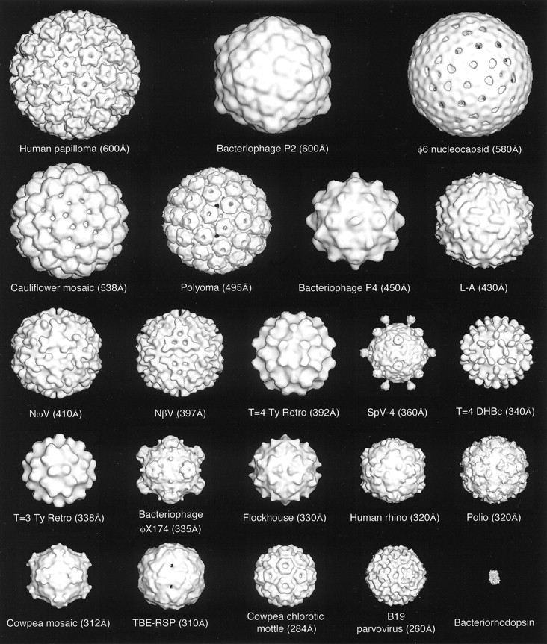
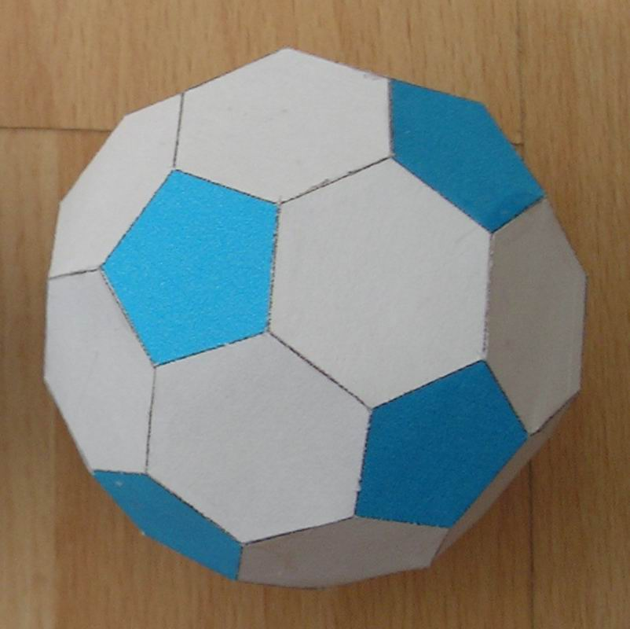
The ubiquitous symmetry
Truncated icosahedron. Paper model.
Icosahedral symmetry in viruses. From Robijn Bruinsma’s web site

Slide 4
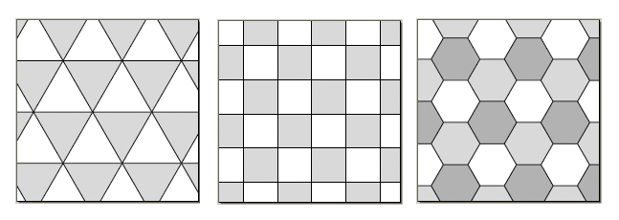
The ubiquitous symmetry

Slide 5
Heuristic: Look for Symmetry
If you find a symmetry, you might be able to exploit it
Symmetries give you “free” information, cut down on what to look at
Symmetries define an invariant
Symmetries indicate “special” points

Slide 6
Symmetry Problem (2D)
A
B
Is molecule “A” the same chemical compound as “B”?

Slide 7
Symmetry Problem (2D)
A
B
Is molecule “A” the same chemical compound as “B”?

Slide 8
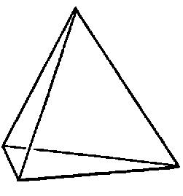
Symmetry Problem (3D)
B
A
Is molecule “A” the same chemical compound as “B”?

Slide 9
Symmetry Problem
An NxN matrix “A” is such that for any
element a_ij = a_ji. How much memory will it take to store the matrix? You do not
want to waste precious storage space.
Assume 32 bits per float.

Slide 10
Symmetry Problem
How many N-bit strings contain anywhere from
none to (N-1)/2 zeros (inclusive)? N is odd.
Hint: There are exactly the same number of
strings with K zeroes as there are strings
with (N - K) 1s. Say, N=3. (000) <=> (111)
(010) <=> (101)
Notes:
----- Meeting Notes (3/31/11 13:46) -----
First heuristic: get your feet wet.
Then look for a hidden symmetry.
If you start doing combinatorial counts, you are on a wrong track - the solution is simple and elegant.

Slide 11
Symmetry Problem
How many N-bit strings contain anywhere from
none to (N-1)/2 zeros (inclusive)? N is odd.
Let C(N,k) be the number of substrings that have exactly k zeroes. Then
C(N, k) = C(N, N-k). The problem is symmetric under 1 -> 0 exchange. A substring with N-k zeroes contains k 1s. Now, C(N,0) + C(N, 1) + … + C(N,N) = all possible substrings = 2^N.
We need the first 1/2 terms of the sum, which equal the second half.
Thus, the answer is 2^N/2 = 2^(N-1).

Slide 12
Symmetry Problem
What is the ratio of the areas of the two squares?

Slide 13
Symmetry Problem
IS it clear now?
What is the ratio of the areas of the two squares?

Slide 14
Symmetry Problem
Your cabin is two miles due north of a stream that runs east-west. Your grandmother’s cabin is located 12 miles west and one mile north of your cabin. Every day, you go from your cabin to Grandma’s, but first visit the stream (to get fresh water for Grandma). What is the length of the route with minimum distance?
Stuck? Draw a picture!

Slide 15
Problem:
Compute 1 + 2 + 3 + …. + N

Slide 16
A more difficult one:
Give an approximate estimate to N!, where N=2718.

Slide 17
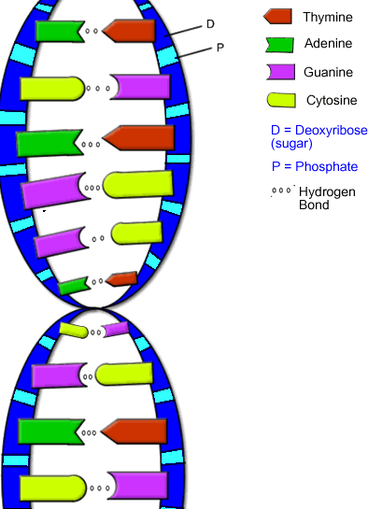
Symmetry in encodings and error correction. First error correction algorithm?
First known encoding:
Copyright: around 6,000 years ago.
The genetic code. 4 letters, words of 3 letters each. 64 words in total. Error tolerance: extremely good. (the double helix. Two-fold redundancy)

Slide 18
Symmetry applied to CS: encodings and error correction
Second attempt:
Author: Baudot, 1874.
English alphabet. Strings of 5 zeroes or ones. 32 different letters. (e.g. 10111 = X, 10101 = Y, etc.
Error tolerance: none. How about English language? Is it error tolerant?

Slide 19
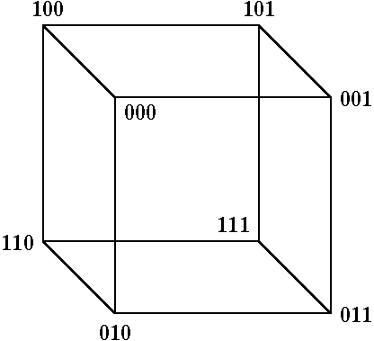
Symmetry applied to CS: error correction
Two code words: (000) and (111).
What if one bit is erred in transmission? How
do you recover?

Slide 20
Symmetry applied to CS: error correction
Two code words: (000) and (111).
What if one bit is erred in transmission? How
do you recover? Go to the nearest vertex that is a legitimate word!

Slide 21
Symmetry applied to CS: error correction
Pretty poor solution…. First spacecraft to
send back pictures of Mars (Mariner 4,
1965). Each picture ~ 4,000 pixels, 64 shades
of grey. On-board power supply allowed only 8 bits per second to be sent…

Slide 22
Symmetry applied to CS: better error detection:
code words: (000), (011), (110), (101).
Corners of a tetrahedron. How do you detect an error?

Slide 23
Symmetry applied to CS: better error detection:
code words: (000), (011), (110), (101).
Corners of a tetrahedron. How do you detect an error?
An error in one digit move the word off the tetrahedron.

Slide 24
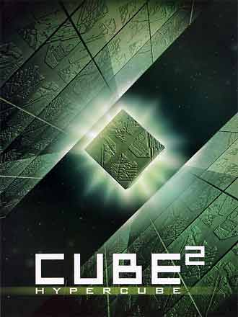
Symmetry applied to CS: realistic error correction:

Slide 25
Symmetry applied to CS: realistic error correction:
0 | 1 | 1 Parity bit. (odd # of 1s in row)
1 | 1 | 0 Parity bit.
1 | 0
To transmit (0111) you send (01111010).
In fact, this error correcting code defines a symmetric shape on an 8-dimensional hypercube

Slide 26
Quiz highlights
Probability of the song coming up after one press: 1/N. Two times? Gets difficult. The first or second? Or both? USE THE MAIN HEURISTICS: Compute probability of the opposite event. P(song never played after k presses) = P(not after 1)*P(not after 2)…. = (1 - 1/N) * (1 - 1/N)*… = (1 - 1/N)^k. Thus, P(k) = 1 - (1 - 1/N)^k
2. X = (1 - 1/N)^k . What do we do with products? Take a ln(X) = k*ln(1 - 1/N). Now, N >> 1 (N=100). So ln(1 - 1/N) ~ -1/N. Thus ln(X) ~ k*(-1/N) = -1 for k=N=100. Hence X ~ e^-1 ~ 1/3. Thus P(k) = 1 - X
3. Just use the MISSISSIPI formula, but don’t divide by 4!

Slide 27
HW highlight
http://tinyurl.com/dbbkkv

