Slide 1
Critique by Dr. Onufriev
Over-all: Very good idea to use more than one source. Good motivation (use of graphics). Good use of simplified, loosely defined -- but intuitive -- terms (e.g. "undisturbed"). Very good use of illustrative graphics for introduction of new concepts. Obviously, took quit a bit of effort to prepare the talk. This very serious effort offsets some of the drawbacks, see below.
Critiques: 0. Outline!
1. Perhaps too much time spent on "set up" details. Do we really need to deeply understand the differences between various vertex types? Wouldn't it be enough to know that there are several types, from simple to complex?
2. Likewise, just explain removal criterion for the "simple", and then mention that similar criteria exist for other types as well.

Slide 2
Critique (cont……)
3. A good idea is to present a flow-chart of the whole algorithm e.g. classify -> decimate -> re-triangulate...[inserted]
4. I would avoid going into the gory details of defining the error metric..., just give some kind of high level explanation (the key idea).
5. Conclusions missing. [inserted]

Slide 3
DECIMATION ALGORITHMS
Presented By
Tridib Dutta

Slide 4
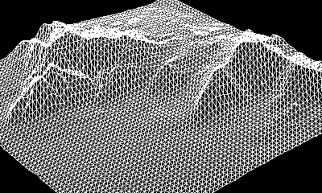
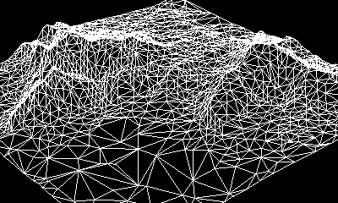
A bit of History…..why the trouble ?
COMPUTER GRAPHICS (surface reconstruction)
Terrain modeling
As a result, significant demand for mesh simplification algorithm
Terrain Modeling
Notes:
Include graphics example , change the title may be

Slide 5
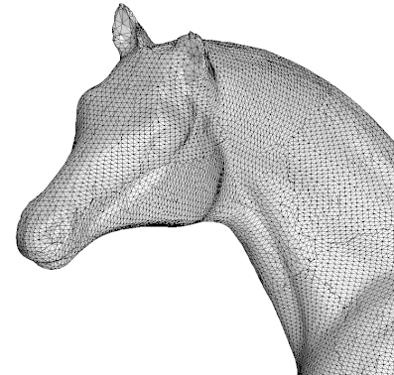
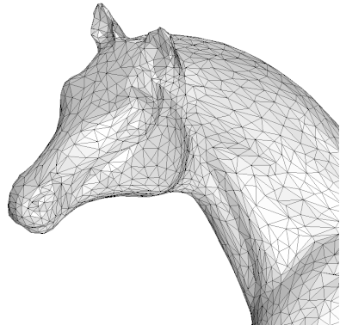
What is Decimation ?
Reduction of the number of triangles in a triangular mesh
Keep the original topology “undisturbed”
Example:
Notes:
Change the above pics horse head(see folder)….foot doesn’t look nice

Slide 6
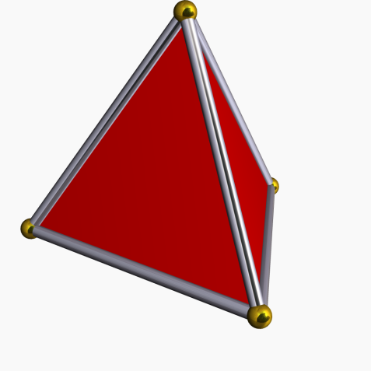
Formal Definition of a Mesh
A pair (V,K), where is a set of vertex positions and K is “simplical complex”, representing connectivity of the mesh
What is a “Simplical Complex”?
Example:
0-simplex is a point
1-simplex is a line
2-simplex is a triangle
Simply, a mesh is a collection of vertices and a list of triangles in 3-space
Pyramid

Slide 7
Basic Requirements For A Good Decimation
Original Topology must be preserved
Decimated mesh must be a good approximation to the original
Optional: Vertices of the decimated mesh must be a subset of the original mesh to preserve the appearance

Slide 8
Basic idea of Decimation algorithm
Triangulated Surface
Decimation
Re -Triangulation

Slide 9
Simplification Strategies
Local Strategies
Global Strategies
Vertex Decimation
Edge-Contraction
Vertex Clustering

Slide 10
Vertex Decimation (Schroeder’s algorithm)
Remove vertex from the mesh based on vertex classification characterizing local geometry
Evaluate decimation Criterion
Re-Triangulate the resulting hole

Slide 11
Classification of Vertices
Feature edge
Simple Vertex
Boundary Vertex
Corner Edge Vertex
All vertices except
the complex vertex
are candidates for
removal from the mesh
Complex Vertex
Interior Edge Vertex
Notes:
Dihedral angles are within specified value for simple vertex, boundary vertex, Feature edge exist when the dihedral angle is greater than the specified value.

Slide 12


Evaluating decimation Criterion
      Simple Vertex uses distance to plane criterion.
      Average plane is calculated as follows: For vertex consider all the neighboring triangles and their normals , centers
      and area . Then calculate a weighted average by
      The distance d =

Slide 13
Evaluating decimation Criterion
Boundary vertex:
Interior Edge Vertex
d
d
Distance is calculated from the vertex
To the line joining the end of opposite triangle
Distance is calculated from the imaginary line connecting the two opposite ends of the Feature edges
Corner Vertices are usually retained, but if deleted, it is based on vertex-to-
average plane distance criterion

Slide 14
Triangulation
If a vertex is eliminated, the loop created by removing the vertex is re-triangulated
Every loop is star shaped : recursive loop splitting triangulation schemes are used
If a loop cannot be re-triangulated, the vertex generating the loop is not removed.

Slide 15
Recursive Loop Splitting
A plane orthogonal to the average plane is determined
This plane splits the loop into two halves
If two halves are non-overlapping, the splitting plane is accepted
Above steps are repeated until a loop contains only 3 points, at which point the recursion is stopped
Split loop
Average plane
Split line
Split plane
Loop after vertex elimination

Slide 16
Recursive Loop Splitting
Best splitting plane is determined using an aspect ratio
Maximum aspect ratio gives best splitting plane

Slide 17
Edge Contraction
Well known graph-theoretical concept
{i} and {j} are two adjacent vertices, with N(i) and N(j) as their respective neighborhoods
{i}->{j}, say the new vertex be {h}, N(h)= N(i) U N(j).

Slide 18
How do we place the new vertex {h} ?
{h}={i} ?, {h}={j} ? Or {h} = ({i}+{j})/2 ?
Define an error function associated with the contraction, and try to minimize it
Ranfard and Rossignac (1996)
  Max. squared distance from {h} to the planes defined in C(i) U C(j)
Heckbert and Garland (1999)

Slide 19
Error Function (Heckbert, Garland)
-Little bit of background
A plane P is determined by a unit normal n and a point p on it
For a point v, d(v, P) = |n.(v- p)|.
fundamental quadric : Q = (A, b, c)
Assume {f_1,f_2,....,f_k} are k faces associated with vertex v, and for each face f_i, Q_i = (A_i, b_i, c_i), then the fundamental quadric Q = ∑Q_i.

Slide 20
Error Function (Heckbert, Garland)
(v_i, v_j) → v (suppose)
Q(v) = Q_i(v) + Q_j(v)
Error(v) := Q(v)
Note: Q(v) is a quadratic function in v.
We immediately know that the min occurs when
and min value is

Slide 21
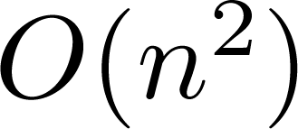
Conclusion
Vertex decimation is a algorithm.
It is a slower algorithm
But due to its careful decimation based on vertex classification, it captures the topology more accurately
Difficult to interpret into a programming language
Edge contraction also provides a good approximation
But the accuracy is somewhat less than the Vertex decimation
Faster than Vertex decimation
Easier to interpret into a programming language

