Slide 1
Intro into “real world” numerical libraries/packages

Slide 2
A realistic scenario:
You are solving Δφ = −4πρ
Using an iterative method (e.g. SOR). Leads to matrix equations A_{n} x = b_{n}. Iterate. Need to solve lots of them.
No need to write all of the code. Use well-developed code for the A_{n} x = b_{n} part.
Use your own for the rest.

Slide 3
Introduction to Numerical Recipes, GSL, GAMS, Netlib

Slide 4
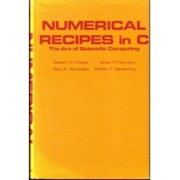
The starting point:

Slide 5
Numerical Recipes
Numerical Recipes: The Art of Scientific Computing" is the title of a series of books
"Numerical Recipes" also refers to the copyrighted computer software that is in those books.
There are approximately 200 routines, which cover a large range of subjects. The source code for the routines are available, and the book documents and explains the mathematics behind the routines.

Slide 6
Why is it good?
Intuitive, yet fairly rigorous description of key algorithms and ideas
And the code, all in one place
Good rules of thumb, examples.
Code from the classic book is available, free (or almost free). Ansi C – guaranteed to compile anywhere.

Slide 7
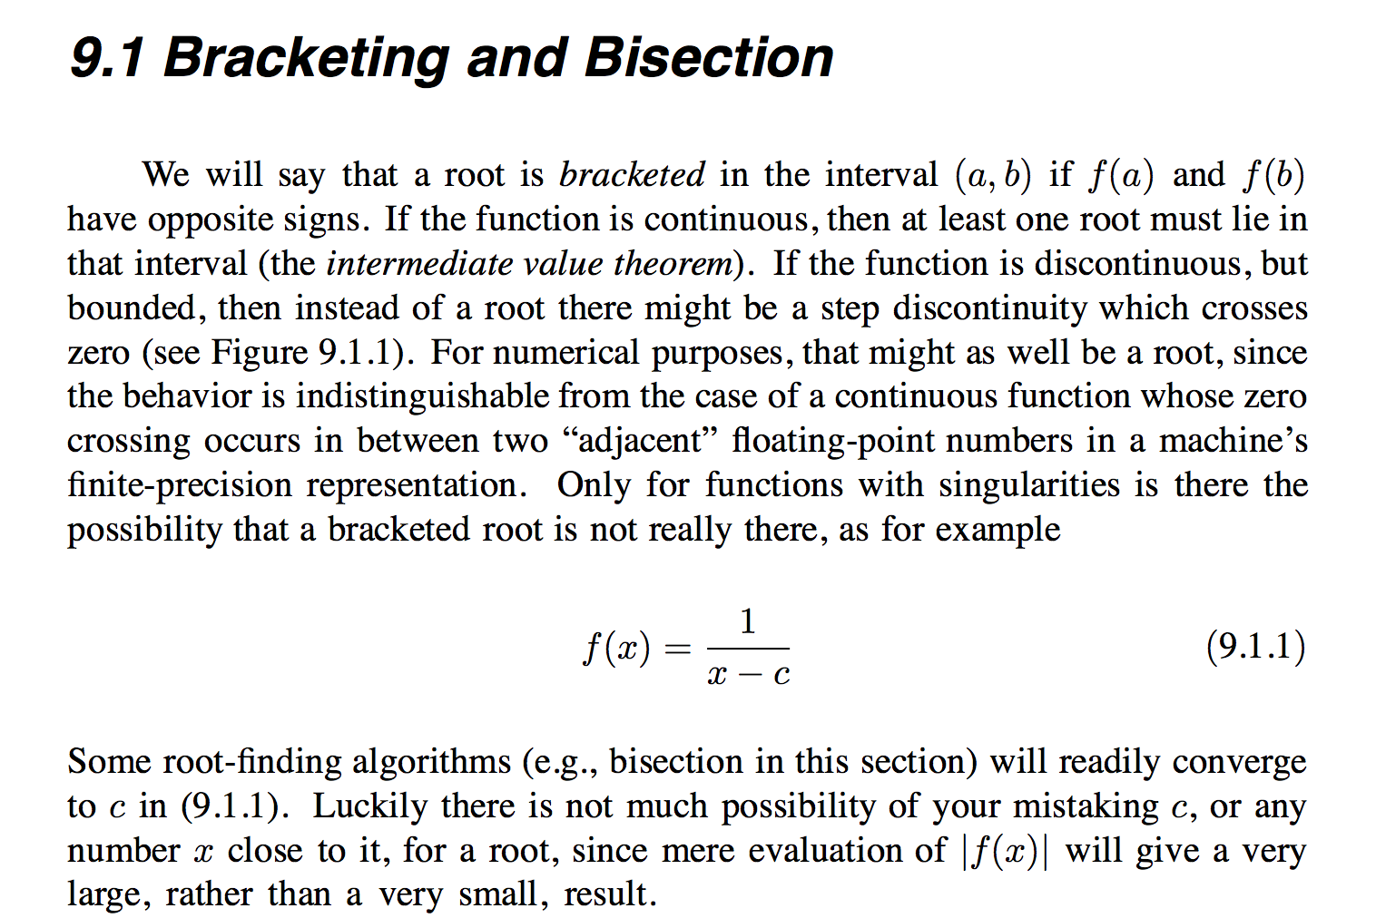
Numerical recipes. Example text

Slide 8
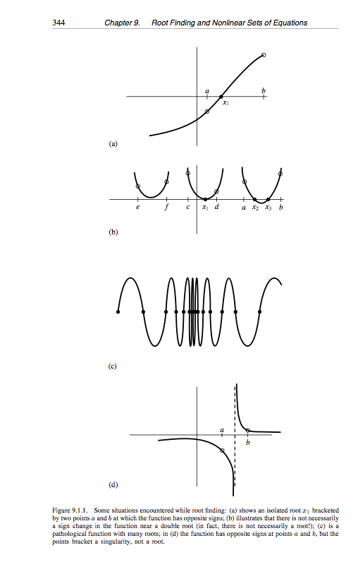
Numerical recipes

Slide 9
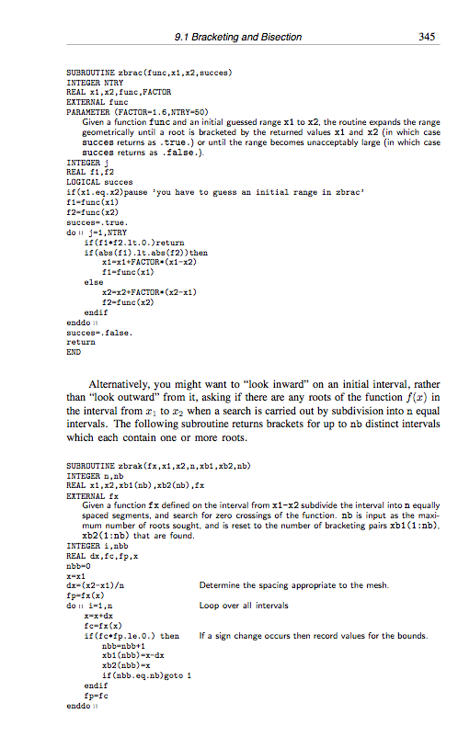
Numerical recipes

Slide 10
Compile and Link for C
Three header files
  complex.h
  nr.h
  nrutil.h
One library
  librecipes_c
gcc example.o –lm –lrecipes_c

Slide 11
Introduction to GSL

Slide 12
What is GSL?
The GNU Scientific Library
GSL is a numerical library for C and C++ programmers.
GSL is free software distributed under the terms of the GNU General Public License.

Slide 13
Functionality
GSL provides a well-defined C language Applications Programming Interface (API) for common numerical functions, such as:
  Random Numbers
  Least-Squares Fitting
  Fast Fourier Transforms
  Root-Finding
  Minimization
GSL is thread-safe.

Slide 14
Compiling and Linking
The library header files are installed in their own `gsl' directory. You should write include statements with a `gsl/' directory prefix like:
#include <gsl/gsl_math.h>
Compile: gcc -c example.c
Link: gcc example.o -lgsl -lgslcblas -lm

Slide 15
One dimensional Root-Finding
The header file `gsl_roots.h' contains prototypes for the root finding functions and related declarations.
The library provides low level components for a variety of iterative solvers and convergence tests. These can be combined by the user to achieve the desired solution, with full access to the intermediate steps of the iteration.

Slide 16
Root Finding Algorithms
Two classes
  root bracketing
    begin with a bounded region known to contain a root
    uses only function evaluations (not derivatives).
  root polishing
    improve an initial guess to the root
    require both the function and its derivative to be supplied by the user

Slide 17
Framework
The user provides a high-level driver for the algorithms.
The library provides the individual functions necessary for each of the steps.
There are three main phases of the iteration. The steps are,
  initialize solver state, s, for algorithm T
  update s using the iteration T
  test s for convergence, and repeat iteration if necessary
The state for solver is held in a gsl_root_fsolver /gsl_root_fdfsolver struct.

Slide 18
Initializing the Solver
gsl_root_fsolver * gsl_root_fsolver_alloc (const gsl_root_fsolver_type * T)
int gsl_root_fsolver_set (gsl_root_fsolver * s, gsl_function * f, double x_lower, double x_upper)
void gsl_root_fsolver_free (gsl_root_fsolver * s)

Slide 19
Providing the function to solve
Data Type: gsl_function
  This data type defines a general function with parameters.
  double (* function) (double x, void * params)
    this function should return the value f(x,params) for argument x and parameters params
  void * params
    a pointer to the parameters of the function

Slide 20
Iteration
int gsl_root_fsolver_iterate (gsl_root_fsolver * s)
  perform a single iteration of the solver s to update its state
double gsl_root_fsolver_root (const gsl_root_fsolver * s)
  The solver maintains a current best estimate of the root at all times.

Slide 21
Search Stopping Parameters
A root finding procedure should stop when one of the following conditions is true:
  A root has been found to within the user-specified precision.
  A user-specified maximum number of iterations has been reached.
  An error has occurred.

Slide 22
Precision Test
int gsl_root_test_interval (double x_lower, double x_upper, double epsabs, double epsrel)
  |a - b| < epsabs + epsrel min(|a|,|b|)
int gsl_root_test_delta (double x1, double x0, double epsrel, double epsabs)
  |x1 - x0| < epsabs + epsrel |x1|
int gsl_root_test_residual (double f, double epsabs)
  |f| < epsabs

Slide 23
Root Bracketing Algorithms
bisection algorithm - gsl_root_fsolver_bisection
false position algorithm - gsl_root_fsolver_falsepos
Brent-Dekker method - gsl_root_fsolver_brent

Slide 24
Root Finding Algorithms using Derivatives
Newton's Method - gsl_root_fdfsolver_newton
secant method (a simplified version of Newton's method which does not require the computation of the derivative on every step) - gsl_root_fdfsolver_secant
Steffenson Method - gsl_root_fdfsolver_steffenson

Slide 25
Resource
Read GNU Scientific Library Reference Manual at http://sources.redhat.com/gsl/ref/gsl-ref_toc.html

Slide 26
Netlib
Netlib Repository at UTK and ORNL
http://www.netlib.org/
A repository contains freely available software, documents, and databases of interest to the numerical, scientific computing, and other communities.

Slide 27
Search Netlib
Do a field search by using the syntax :
  fieldname=whatever
Use the GAMS class hierarchy

Slide 28
Field Names
file (global) -- any portion of the pathname for a regular file
lib (global) -- any portion of the pathname for a directory
for (global) -- problem solved or description
gams -- GAMS class
prec -- Fortran precision (single, double, complex, or doublecomplex)
title (global)
alg -- algorithm or method
by (global) -- author (name <email>)
keywords (global) -- terms as would be drawn from a subject thesaurus
lang -- programming language

Slide 29
Search Examples
To seach for single precision routines in the lapack directory that do Schur factorization:
  file=lapack and file=single and Schur
  since the lapack single precision routines are in the lapack/single directory
To search for curve fitting or gams class E1 and its subclasses:
  (curve and fitting) or gams=e1*
To do a literal search for 'cosine transform':
  'cosine transform'

Slide 30
GAMS
Guide to Available Mathematical Software (a sleek portal to NetLib)
http://gams.nist.gov/
An on-line cross-index of available mathematical software
A virtual software repository, providing centralized access to abstracts, documentation, and source code of software modules that it catalogs (including Netlib)

Slide 31
Search for Software by Problem
Each software module indexed in GAMS is assigned one or more problem classifications from the GAMS Problem Classification System.
Three ways to locate software modules:
  Use the taxonomy as a decision tree.
  Browse through the entire taxonomy.
  Search for problem classes that match a keyword.

Slide 32
Problem Decision Tree - Subclasses
  A Arithmetic, error analysis
  B Number theory
  C Elementary and special functions (search also class L5)
  D Linear Algebra
  E Interpolation
  F Solution of nonlinear equations
  G Optimization (search also classes K, L8)
  H Differentiation, integration
  I Differential and integral equations
  J Integral transforms
  K Approximation (search also class L8)
  L Statistics, probability
  M Simulation, stochastic modeling (search also classes L6 and L10)
  N Data handling (search also class L2)
  O Symbolic computation
  P Computational geometry (search also classes G and Q)
  Q Graphics (search also class L3)
  R Service routines
  S Software development tools
  Z Other

Slide 33
Other Ways for Search
Search by Packages
  Browse list of packages
Search by Modules
  Give Name of module
Search by keyword
  search for text in the abstracts of individual modules

Slide 34
Take home message
Buy Numerical Recipes
In real life, use Mathematica if you want to explore an algorithm
Then go to GSL and/or Num. recipes and take what you need.
When you become a pro, consider GAMP

