Slide 1
Inevitable errors in computing
"The purpose of computing is insight, not numbers", R. H. Hamming

Slide 2
Let’s compute df/dx numerically.

Slide 3


Definition of derivative of f(x) at x:

Slide 4




Slide 5

Also last time:
The course will introduce you to supercomputer on the desk:

Slide 6
RUN: numderivative.cc

Slide 7




Numerical Derivative Example
Math != Numerical Math

Slide 8

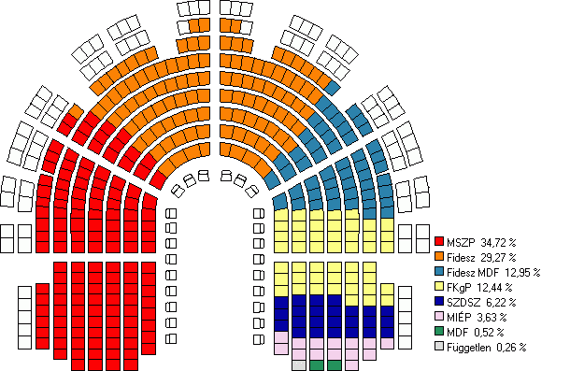
What is the common cause of these disasters/mishaps?
Patriot Missile Failure,
1st Gulf war. 28 dead.
Wrong parliament make-up,
Germany 1992.

Slide 9
Numerical math != Math

Slide 10
Numerical math != Math
KEY QUESTIONS TO ADDRESS:
(1) WHY?
(2) How to adapt math to work reasonably well
on the computer?
(3) How to make sure the above adaptation is fast
enough?

Slide 11
Errors.
Absolute error.
Relative error (usually more important):
|X_exact - X_approx|/|X_exact| *100%
Example. Suppose the exact
number is x = 0.001, but we
only have its approximation,
x=0.002. Then the relative error = (0.002 - 0.001)/0.001*100% = 100%.
(Even though the absolute error is only 0.001!)

Slide 12
Let’s compute the derivative:
A hands-on example. num_derivative.cc
F(x) = exp(x). Use the definition.
Where do the errors come from?

Slide 13
Today’s class. Background
Taylor Series: the workhorse of numerical methods.
F(x + h) =~ F(x) + h*F’(x)
Sin(x) =~ x - 1/3!(x^3), works very well
for x << 1, OK for x < 1.

Slide 14
Two types of error expected:
Trucncation (or, more generally, discretization) error. In our example from using the Taylor series.
Round-off error which leads to “loss of significance”.

Slide 15
Round-off error:
Suppose X_exact = 0.234.
But say you can only keep two
digits after the decimal point. Then X_approx = 0.23.
Relative error = (0.004/0.234)*100 = 1.7%.
But why do we make that error? Is it inevitable?

Slide 16
The very basics of the floating point representation
Decimal: (+/-)0.d₁d₂…. x10^n (d1 != 0). n = integer.
Binary: (+/-)0.b₁b_{2 …..} x 2^m. b1 = 1, others 0 or 1.
Example: 1/10 = (0.0001100110011…..) (infinite series).
KEY: MOST REAL NUMBERS CAN NOT BE
REPRESENTED EXACTLY

Slide 17
A simple example: 3 digits.
Example. Assume only 3 significant digits, that is
Possible numbers are (+/-)(0.b₁b₂b₃)x2^k,
K= +1, 0, or -1. b= 0 or 1.
Then the next smallest number above zero
Is 1/16 = 0.001x2^-1.
Largest = ?

Slide 18
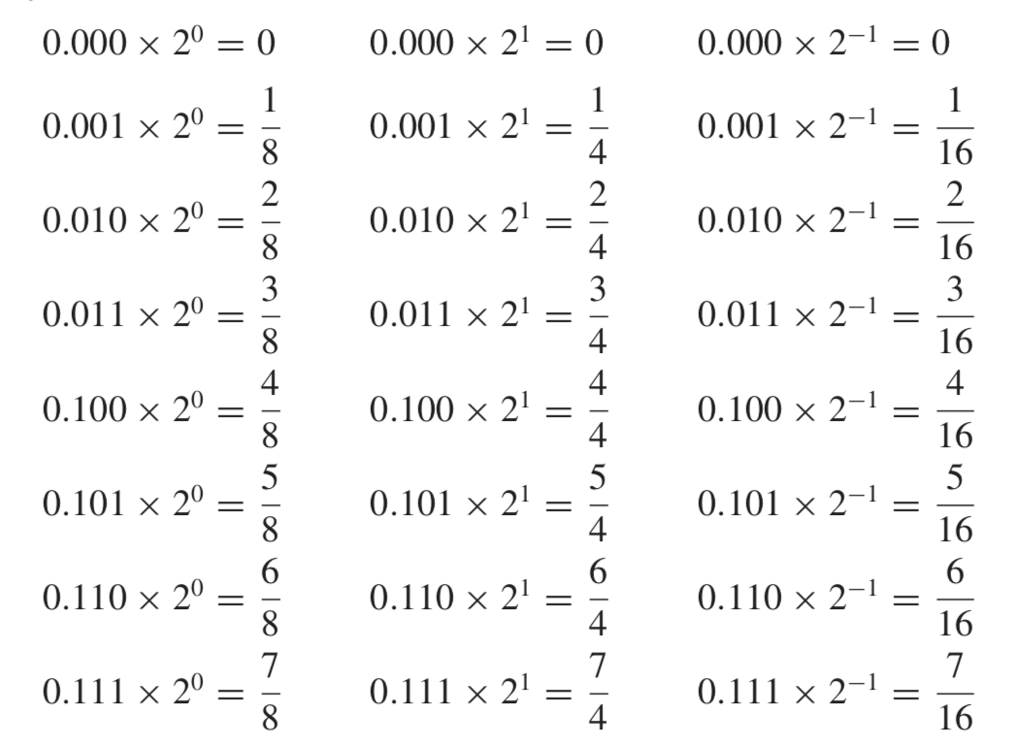
All possible numbers with 3 significant digits.

Slide 19
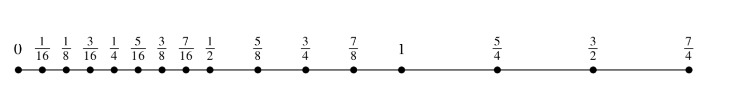
Machine real number line has holes!
GAP

Slide 20
Realistic machine: 32 bit
Float-point number = (+/-)q x 2^m. (IEEE standard)
Sign of q -> 1 bit
Integer |m| 8 bit
Number q 23 bits
Largest number ~ 2^128 ~ 3*10^38
Smallest positive number ~ 10 ^-38
MACHINE EPSILON: smallest e such that
1 + e > 1. Very important!

Slide 21
In rounding off, the relative error is at most ε
ε
Say, x= is between 1 and 5/4
Will get round off to 1.0 (assume the computer chops off
the extra bits in 1.1 = 1.00001100110011… )
Max possible relative error for 1 < x < 5/4 : ε/1

Slide 22
In rounding off, the relative error is at most ε
ε/2
ε
Say, true x is between 1 and 5/4
Will get round off to 1.0 (assume the computer chops off
the extra bits as in 1.1 = 1.00001100110011… )
Max possible relative error for x: ε/1
Now let’s say x falls in-between ½ and 5/8:
Max possible relative error for x is: (ε/2)/(1/2) = ε

Slide 23
Errors in numerical approximations:
Exact Solution -> Approximate Solution -> Numerical approximation
No error. Truncation (Discretization) Error Round-off Error
Total error = truncation error + round-off error.
Example worked out in class: numerical derivative, f’(x) ≈ [f(x + h) – f(x)]/h
Total error ~ | f’’(x)|_{max}* h + |f(x)|_{max}*ε_{mach} /h.
Assuming that the function is not pathological, f’’ ~ f ~ 1 at x of interest. (as in our example). Minimum total error occurs at h ~sqrt(ε_{mach} ).
For pathological functions,| f’’| or |f| may be very large, leading to large errors (and the minimum at a different spot).

Slide 24






Numerical Derivative Example
Math != Numerical Math

Slide 25




Truncation error

Slide 26

Round off error

Slide 27





Optimal h that minimizes the error.

Slide 28
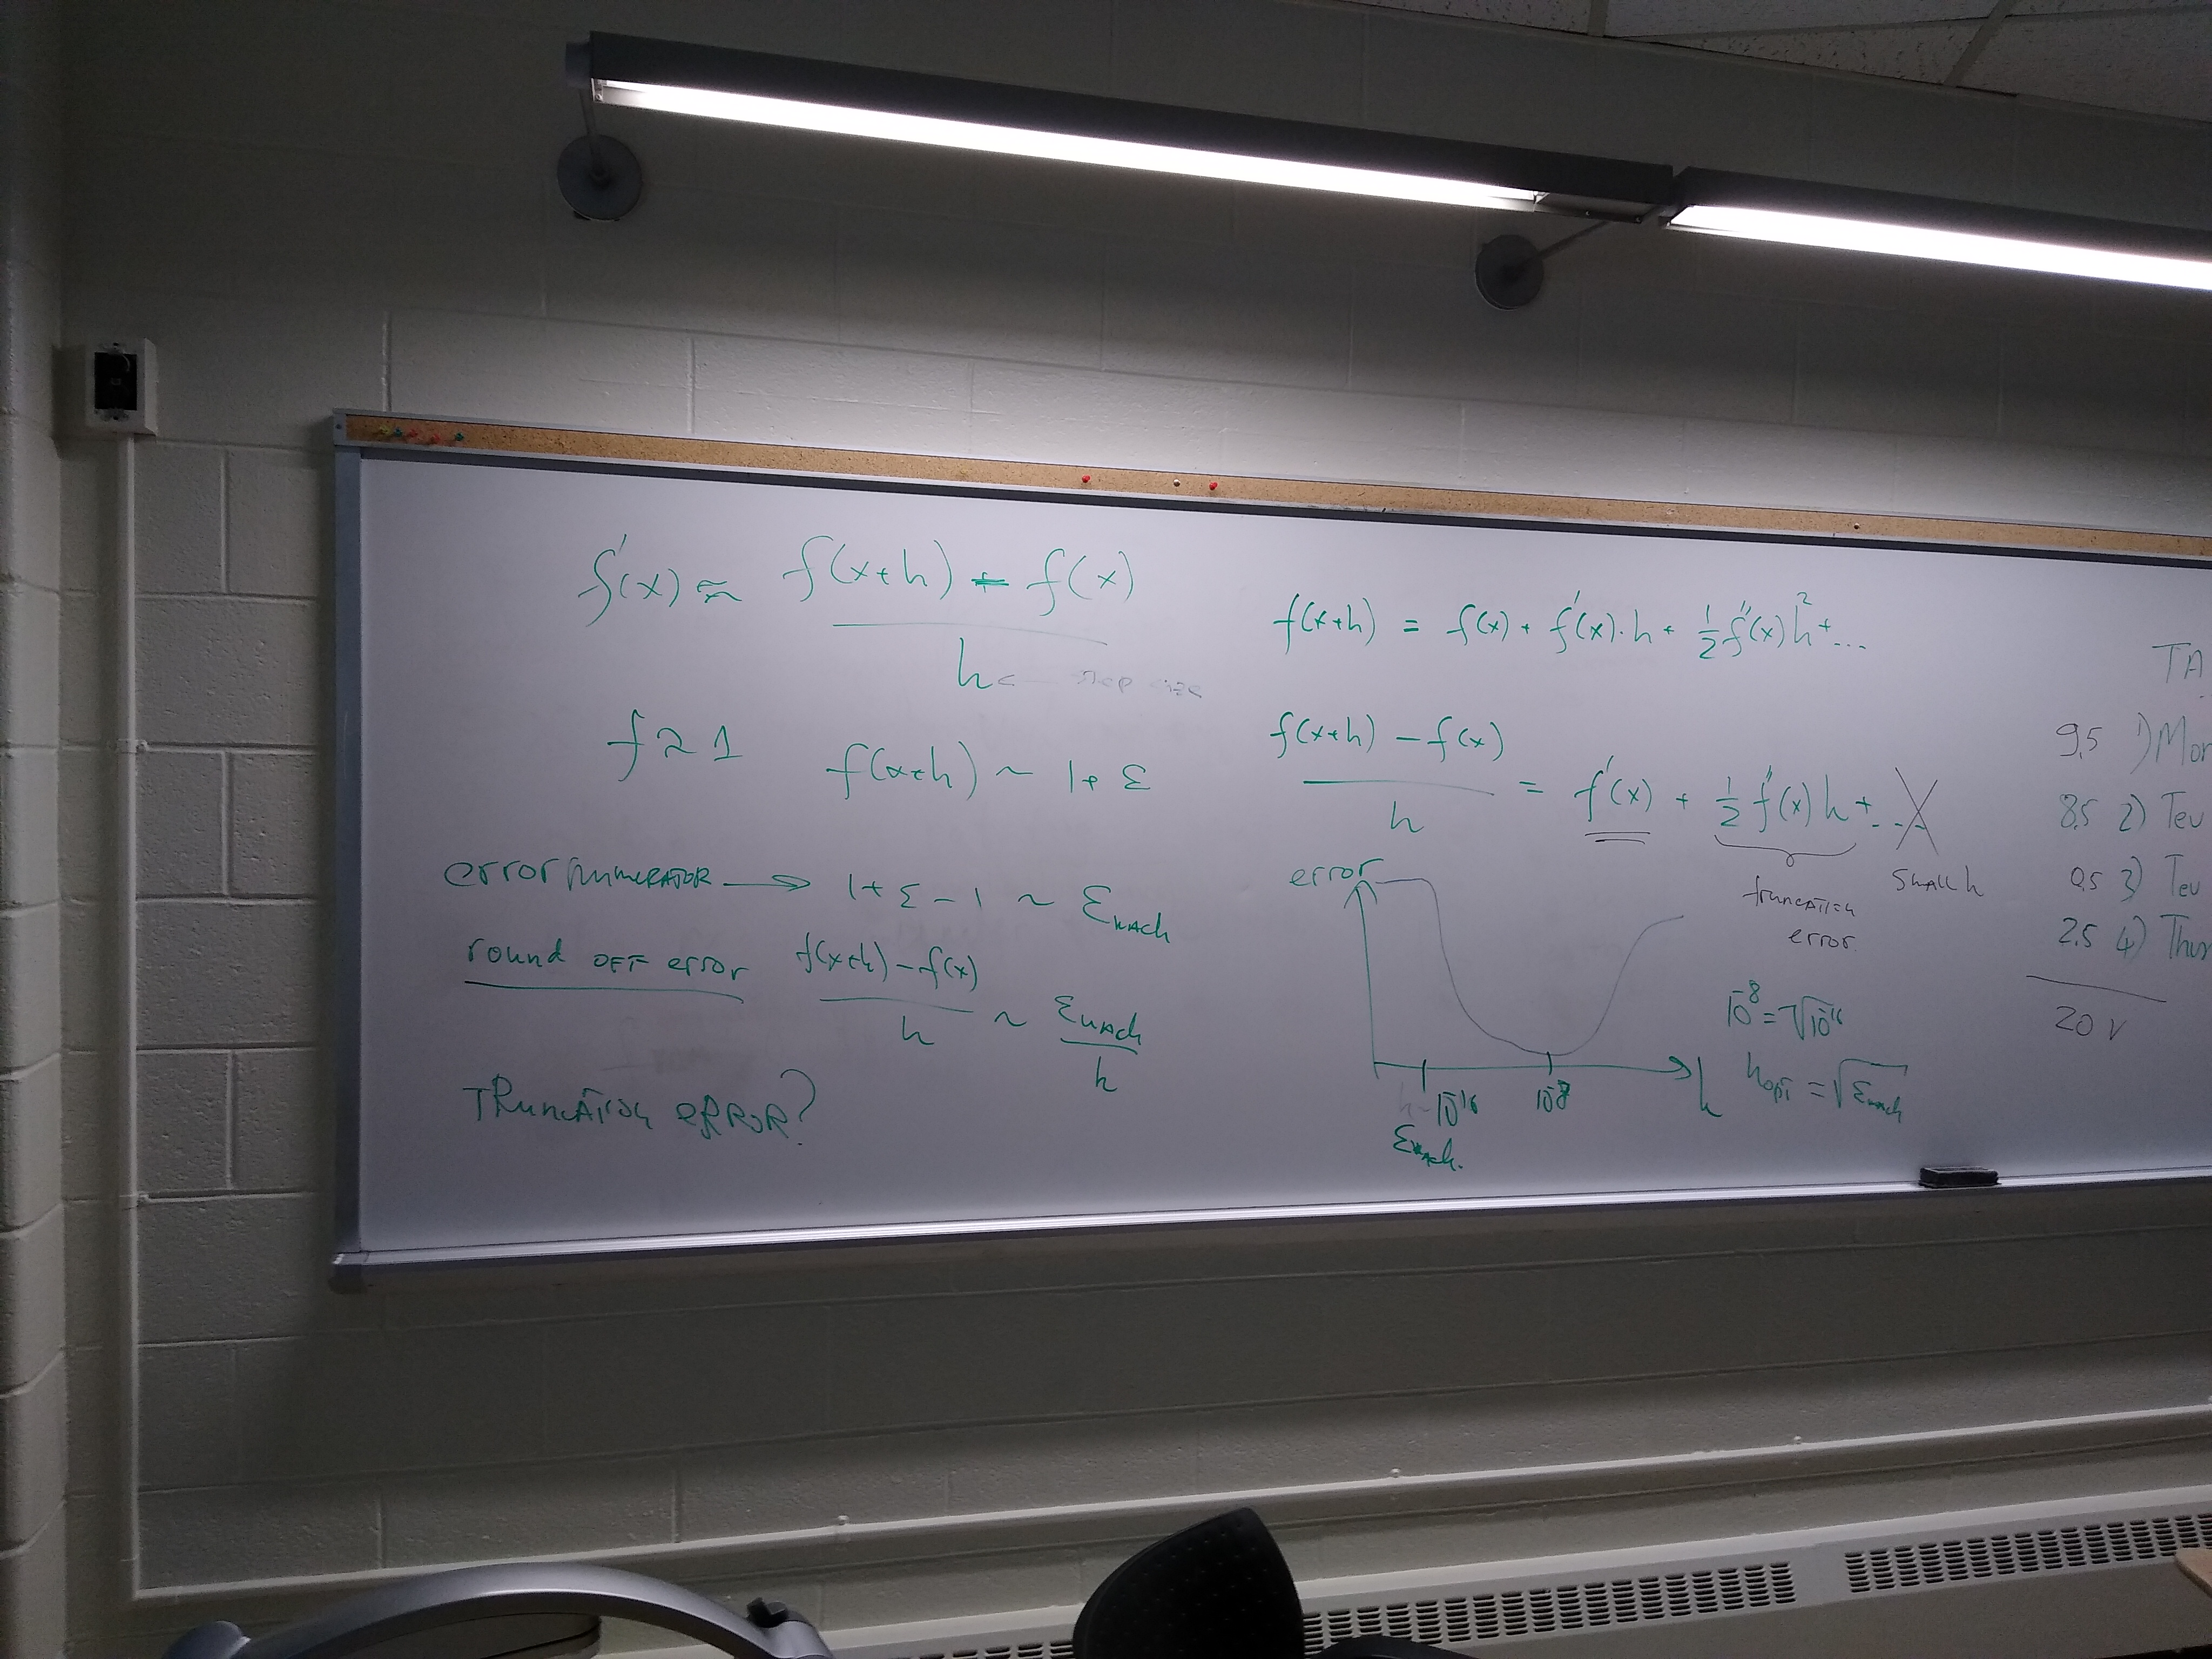
f’(x) error analysis (semi-quantitative)

Slide 29



An analysis of t original algorithm

Slide 30




Improved Algorithm

Slide 31
The Improvement: a symmetric formula:
f’(x) ~= [f(x+h/2) – f(x – h/2)]/h

Slide 32
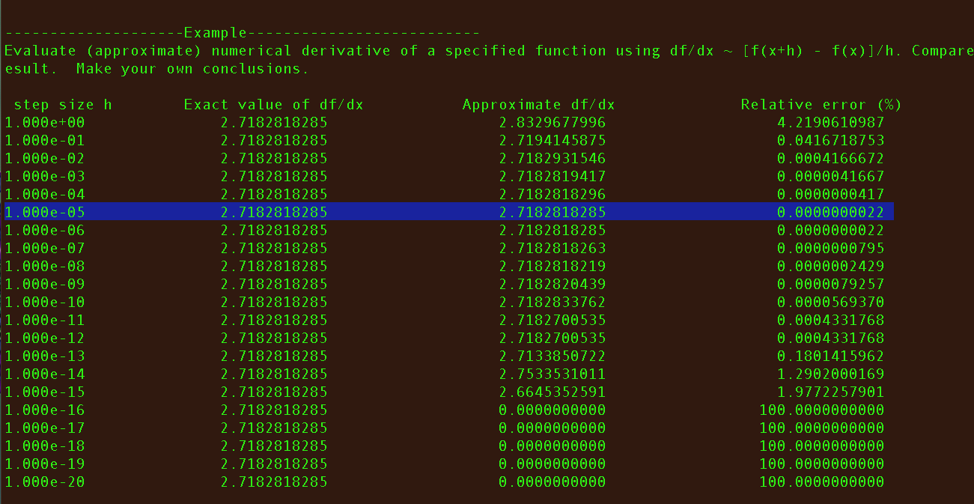
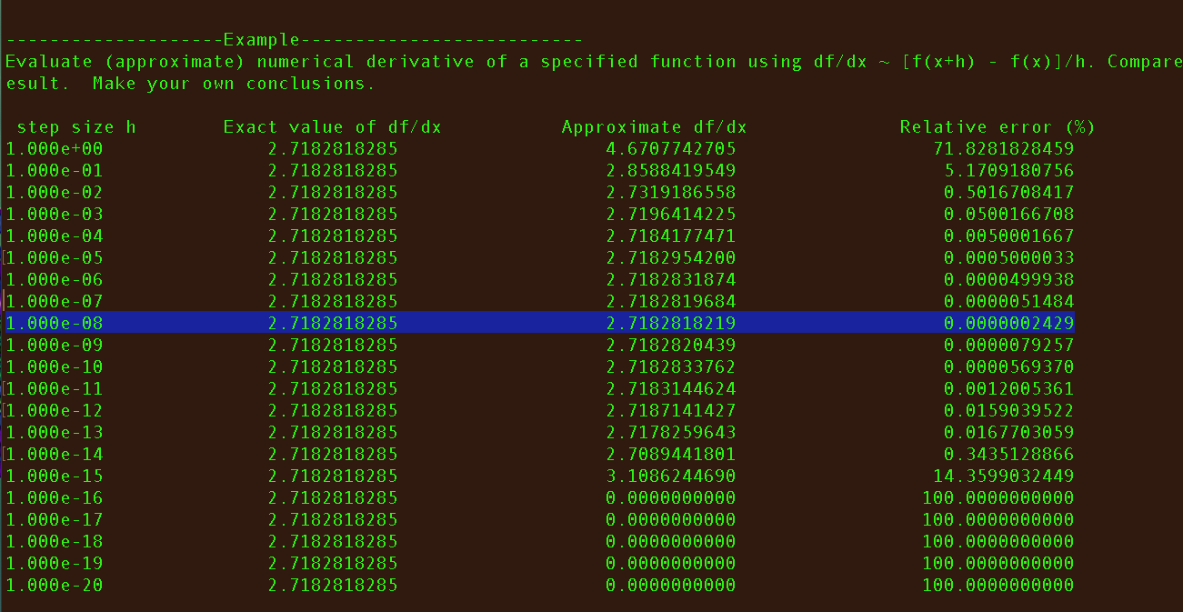
The new way (top) vs. old (bottom)

Slide 33
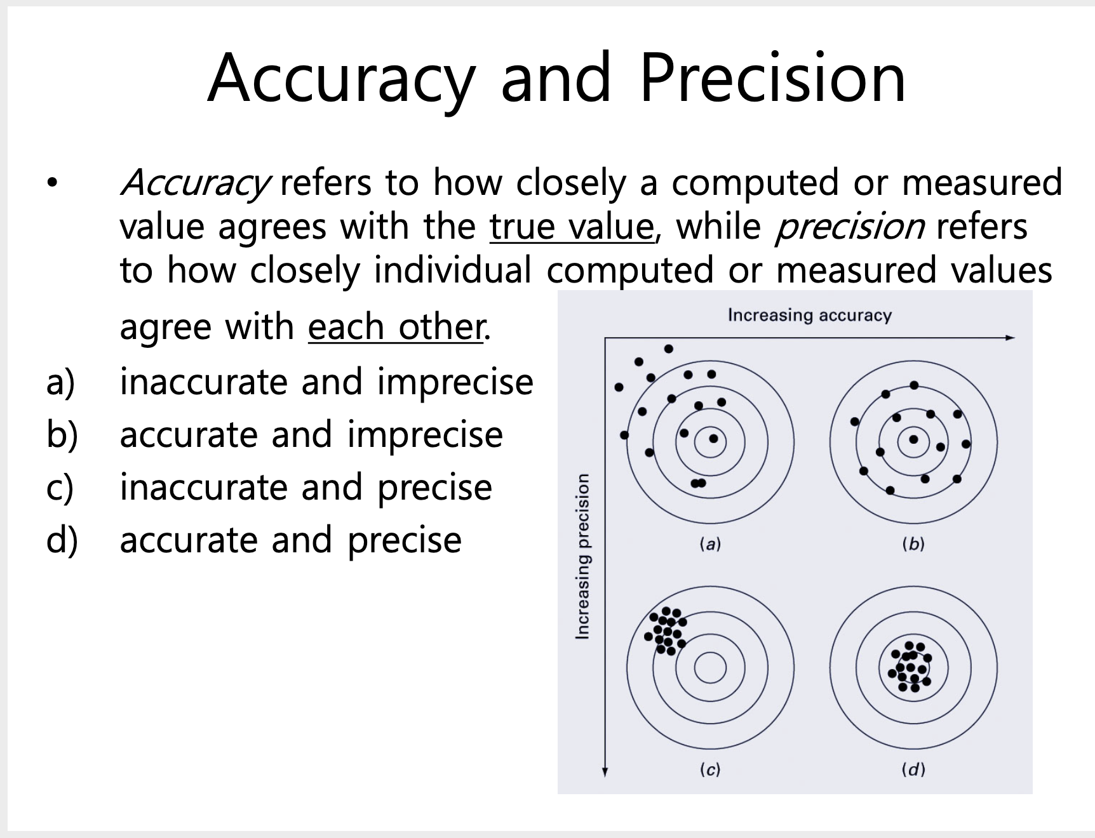
Accuracy vs. Precision

Slide 34
Accuracy vs. Precison.
π = 3.000000000 (precise, not accurate)
π = 3.1 (less precise, more accurate)
π = 3.1415….. If all the digits are there, then infinite precision, perfectly accurate. Exact.

