Slide 1
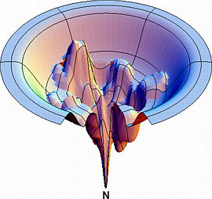
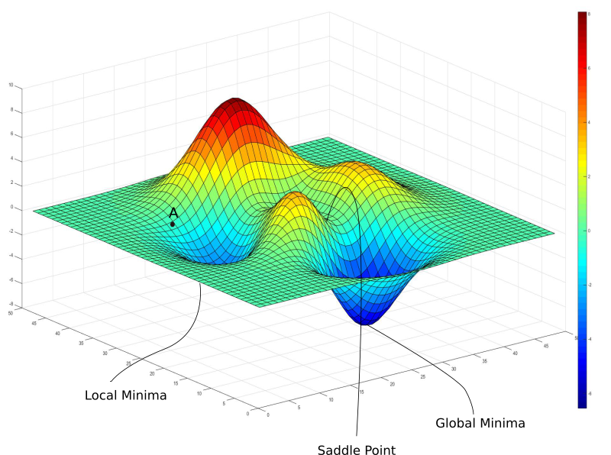

Minimization problems: from easy to hard to insanely hard.
Find global optimum.
function of N variables
Find Local optimum.
function of 1 variable
Find Local optimum.
function of N variables
Easy
Hard

Slide 2

Minimization problem
Find Local optimum.
function of 1 variable
Easy
Hard

Slide 3
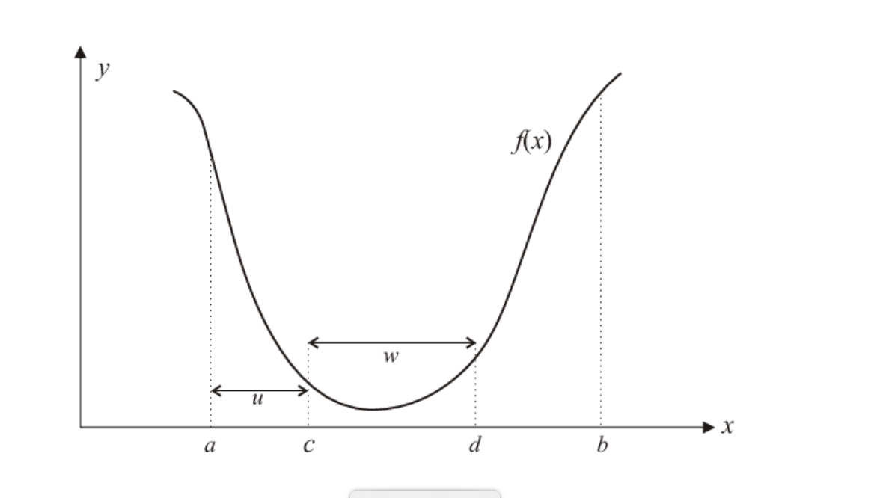
The “bisection” approach to finding single minimum:

Slide 4
The most efficient version: golden section.
Keeps on bracketing the root by dividing the initial interval and choosing the half where the minimum is by comparing value of the function “up hill” and “down hill”. Continues until the convergence criteria are met, e.g.
|x_{n+1} – x_{n}| < TOL (assuming x ~1. )
Linear convergence. Robust but slow.
https://www.youtube.com/watch?v=VBFuqglVW3c

Slide 5
Newton’s method for finding local minimum.
Motivation: utilize more information
about the function. Hope to be faster.

Slide 6
Simplest derivation
If F(x) -> minimum at x^{m,} then F’(x^{m}) = 0.
Solve for F’(x^{m}) = 0 using Newton’s for root finding.
Remember, for Z(x) = 0, Newton’s iterations are x_{n+1} = x_{n} + h,
where h = -Z(x_{n})/Z’(x_{n})
Now, substitute F’(x) for Z(x)
To get h = -F’(x_{n})/F’’(x_{n})
So, Newton’s iterations for minimization are: x_{n+1} = x_{n} - F’(x_{n})/F’’(x_{n})

Slide 7
Rationalize Newton’s Method
Let’s Taylor expand F(x) around it minimum, x^{m}:
F(x) = F(x^{m}) + F’(x^{m})(x – x^{m}) + (1/2)*F’’(x^{m})(x – x^{m})² + (1/3!)*F’’’(x^{m})(x – x^{m})³ + …
Neglect higher order terms for |x – x^{m}| << 1, you must start
with a good initial guess anyway.
Then F(x) ≈ F(x^{m})+ F’(x^{m})(x – x^{m}) + (1/2)*F’’(x^{m})(x – x^{m})²
But recall that we are expanding around a minimum, so F’(x^{m}) =0.
Then F(x) ≈ + F(x^{m}) + (1/2)*F’’(x^{m})(x – x^{m})²
So, most functions look like a parabola around their local minima!

Slide 8
Newton’s Method = Approximate the function with a parabola, iterate.
X₀
X^{m}

Slide 9
Newton’s Method

Slide 10
Newton’s Method

Slide 11
Newton’s Method

Slide 12
Newton’s method. More informative derivation.
Newton’s method for finding minimum has quadratic (fast) convergence rate for many (but not all!) functions, but must be started close enough to solution to converge.

Slide 13
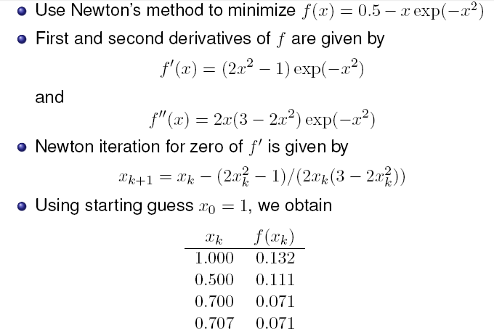
Example

Slide 14
Newton’s: convergence to local minimum.
If x₀ is chosen well (close to the min.), and the function is close to a quadratic near minimum, the convergence is fast, quadratic. E.g: |x0 – x^{m} | < 0.1,
Next iteration: |x1– x^{m} | < (0.1)²
Next: |x2– x^{m} | < ((0.1)²⁾² = 10⁻⁴
Next: 10⁻⁸, etc.

Slide 15
Newton’s: convergence to local minimum.
If x₀ is chosen well (close to the min.), and the function is close to a quadratic near minimum, the convergence is fast, quadratic. E.g: |x0 – x^{m} | < 0.1,
Next iteration: |x1– x^{m} | < (0.1)²
Next: |x2– x^{m} | < ((0.1)²⁾² = 10⁻⁴
Next: 10⁻⁸, etc.
In general, convergence to the minimum is NOT guaranteed (run-away, cycles, does not converge to x^{m}, etc. Sometimes, convergence may be very poor even for “nice looking”, smooth functions! )
Combining Newton’s with slower, but more robust methods such as “golden section” often helps.
No numerical method will work well for truly ill-conditioned (pathological) cases. At best, expect significant errors, at worst – completely wrong answer!

Slide 16
Choosing stopping criteria
The usual: |x_{n+1} – x_{n} | < TOL, or, better
|x_{n+1} – x_{n} | < TOL*|x_{n+1} + x_{n} |/2 to ensure that the given TOL is achieved for the relative accuracy.
Generally, TOL ~ sqrt(ε_{mach}) or larger if full
theoretical precision is not needed. But not smaller.
TOL can not be lower because, in general F(x) is quadratic around the minimum x^{m}, so when you are h < sqrt(ε_{mach}) away from x^{m}, |F(x^{m}) – F(x^{m}+h)| < ε_{mach,} and you can no longer distinguish between values of F(x) so close to the min.

Slide 17
The stopping criterion: more details
To be more specific, assume root bracketing (golden section). We must stop iterations when |F(x_{n}) – F(x^{m})| ~ ε_{mach*}|F(x_{n}) |, else we can no longer tell F(x_{n}) from F(x^{m}) and further iterations are meaningless.
Since |F(x_{n}) – F(x^{m})| ≈ |(1/2)*F’’(x^{m})(x_{n} – x^{m})²| , we get for this smallest |(x_{n} – x^{m})| ~ sqrt(ε_{mach})* sqrt(|2F(x_{n}) / F’’(x^{m}) |) = sqrt(ε_{mach})* sqrt(|2F(x_{n}) / F’’(x_{n}) |) = sqrt(ε_{mach})*|x_{n}|*sqrt(|2F(x_{n}) /(x_{n}² F’’(x_{n})) |) .
For many functions the quantity in green | | ~1, which gives us the rule from the previous slide:
stop when |x_{n+1} – x_{n} | < sqrt(ε_{mach})* |x_{n+1} + x_{n} |/2

