Slide 1
Machine arithmetic and associated errors
Introduction to error analysis (cont.)
Class III

Slide 2
Last time:
Absolute and relative errors.
We considered and ran the code numderivative.cc; observed two types of errors – truncation and round-off error.
Floating-point representation of real numbers in decimal in binary forms.
Consequences of a finite space in computer memory for representing real numbers: the hole at zero, the smallest and the largest real numbers, overflow to machine infinity, machine epsilon.
We started to analyze the behavior of the total error in the output of numderivative.cc which calculate the derivative of F(x) = exp(x) at x=1.

Slide 3

Accuracy vs. Precision.
Accuracy: how close the computed (estimated, measured) value is to some “gold standard” true value.
Precision: how many trustworthy digits are in the calculations you operate with.

Slide 4
Errors in numderivative.cc
The code calculates F’(x) = lim_{h-->0} (F(x+h)-F(x)) / h using approximate equation for finite values of h:
F’(x) =~ (F(x + h) - F(x))/h
More accurate equation with finite h for F’(x) (keeps 2 terms in the Taylor series):
F(x + h) =~ F(x) + h*F’(x) + h^2*F’’(x)/2!
leading to
F’(x) =~ [F(x + h) - F(x)]/h + h*F’’(x)/2!
Missed in our code blue term gives us a truncation error which goes down with h.
The error calculating the first term is the error in subtraction (or “+”) operation.

Slide 5
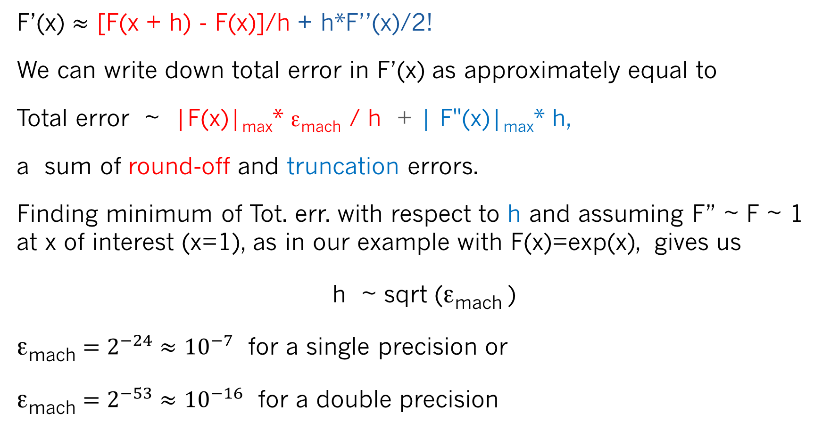
Coming back to our equation
F’(x) $≈$ [F(x + h) - F(x)]/h + h*F’’(x)/2!
We can write down total error in F’(x) as approximately equal to
Total error ~ |F(x)|_{max}* ε_{mach} / h + | F"(x)|_{max}* h,
a sum of round-off and truncation errors.
Finding minimum of Tot. err. with respect to h and assuming F” ~ F ~ 1 at x of interest (x=1), as in our example with F(x)=exp(x), gives us
h ~ sqrt (ε_{mach} )
ε_{mach} $=2^{−24}≈$ ${10}^{−7}$ for a single precision or
ε_{mach} $=2^{−53}≈$ ${10}^{−16}$ for a double precision

Slide 6
Significant digits
Suppose we measure a length of a desk with a ruler with metric scale and the smallest distance between ruler marks is 1mm.
Suppose the result of our measurement is 1m 21 cm 4mm or L=1.214 m
What is wrong if we write down this number as L=1.214238 m ?

Slide 7
Significant digits
Suppose we measure a length of a desk with a ruler with metric scale and the smallest distance between ruler marks is 1mm.
Suppose the result of our measurement is 1m 21 cm 4mm or L=1.214 m
What is wrong if we write down this number as L=1.214238 m ?
It’s misleading.
Why? Because the precision of our measurement is only 1mm or 0.001m and we have only 4 significant digits in the value of L.
Definition: significant digits are digits beginning with the leftmost nonzero digit and ending with the rightmost correct digit.
The quantity L=0.1214238 x 10^1 m is accurate to 4 significant digits. We can trust a total of 4 digits as being meaningful.

Slide 8

Significant digits
Example: diagonal of a square
D=s * $\sqrt{2}$ = 0.736 * 1.4142135623 … = 1.040861182 ... ?
D=1.041 m or (more conservatively, 3 significant digits!) D=1.04 m
D
s=0.736 m - length of the side of the square

Slide 9
Machine +/- operations
X1 = (0.1b₂b₃ … b₂₃b₂₄ ) x 2^k1
X2 = (0.1b₂b₃ … b₂₃b₂₄ ) x 2^k2
Z=X1 (+/-) X2 ? Case k2 < k1 (e.g. k2=k1 – 2)
(0.1 b₂b₃ …............b₂₃b₂₄ 0 0 0 0….0000) x 2^k1 in CPU
(0.0 0 1 b₄b₅ ..…b₂₃b₂₄b₂₅b₂₆0 0 …0000) x 2^k1 in CPU
Z = (0.b₁b₂b₃ b₄b₅ …b₂₃b₂₄ b₂₅b₂₆0 0 …0000) x 2^k1 in CPU
Rounding-off Z (down or up, depending on b₂₅ ) new b₂₄ could be 0 or 1 producing a round-off error of mantissa 2^(-24) , a difference between the two possible contributions of b₂₄ to Z. Note that this error corresponds to ε_{mach}

Slide 10
Loss of significance
Let us consider how a computational subtraction leads to a loss of significance (the number of significant digits) and how this loss can be reduced or eliminated.
Suppose we subtract two very close numbers X1 and X2. Each have 24 significant binary digits (or 7 decimal digits)
X1 = (0.1b₂b₃b₄b₅…..... b₂₀b₂₁b₂₂b₂₃b₂₄ ) x 2^k
X2 = (0.1b₂b₃b₄b₅…..... b₂₀b₂₁b₂₂b₂₃b₂₄ ) x 2^k
Z = (0.0000000…......... 0b₂₁b₂₂b₂₃b₂₄ ) x 2^k
Is Z accurate? Yes. But it has only 4 significant binary digits (about 1 decimal digit). I.e. Z=X1-X2 lost 20 significant binary digits (about 6 decimal digits).
Numerical subtraction can lead to a loss of significance!
-
=

Slide 11
Loss of significance
Example: X=0.6353 and Y=0.6311 (4 significant decimal digits)
Z = X – Y = 0.0042 (only 2 significant decimal digits), 2 significant digits are lost
A good way to estimate how close are X and Y or how many significant digits will be lost is to calculate the value of the function |1– (Y/X)|
= 0.0066110… This number starts at 3-d decimal digit. First two decimal digits are lost.

Slide 12
Numerical example:
loss_of_significance.cc

Slide 13
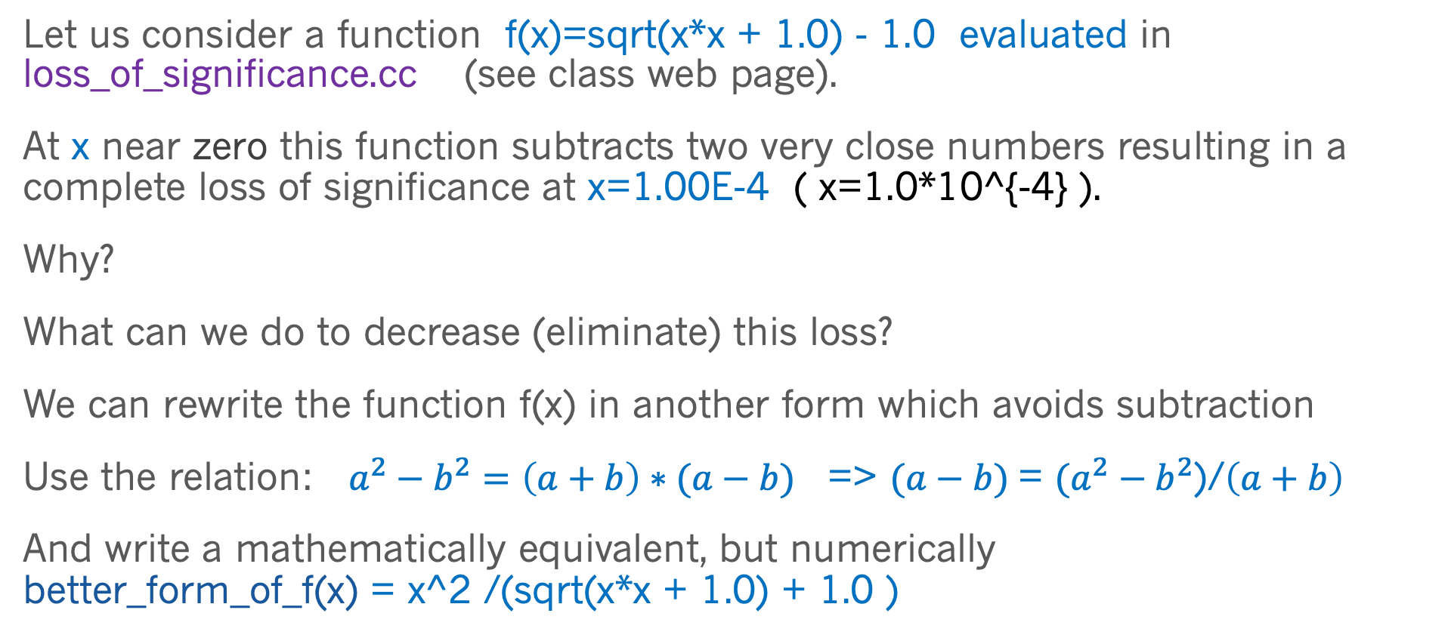
Loss of significance
Let us consider a function f(x)=sqrt(x*x + 1.0) - 1.0 evaluated in loss_of_significance.cc (see class web page).
At x near zero this function subtracts two very close numbers resulting in a complete loss of significance at x=1.00E-4 ( x=1.0*10^{-4} ).
Why?
What can we do to decrease (eliminate) this loss?
We can rewrite the function f(x) in another form which avoids subtraction
Use the relation: $a^{2}−b^{2}=\left(a+b\right)∗(a−b)$ => $(a−b)$= $(a^{2}−b^{2}$)/$\left(a+b\right)$
And write a mathematically equivalent, but numerically
better_form_of_f(x) = x^2 /(sqrt(x*x + 1.0) + 1.0 )

Slide 14
Summary of today Class
We recalled round-off and truncation errors in computer operations related to the real number representation in computers
We considered a concept of significant digits in a real numbers
Loss of significance at subtraction operation and how it can be avoided

