Slide 1
CONDITION AND STABILITY

Slide 2
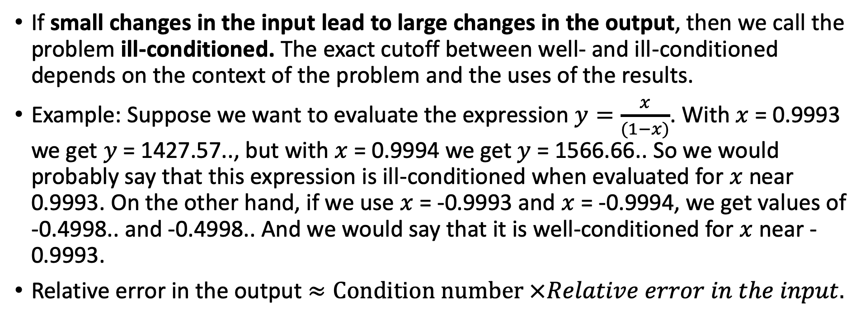
Condition of a Problem
If small changes in the input lead to large changes in the output, then we call the problem ill-conditioned. The exact cutoff between well- and ill-conditioned depends on the context of the problem and the uses of the results.
Example: Suppose we want to evaluate the expression $y=\frac{x}{(1−x)}$. With $x$ = 0.9993 we get $y$ = 1427.57.., but with $x$ = 0.9994 we get $y$ = 1566.66.. So we would probably say that this expression is ill-conditioned when evaluated for $x$ near 0.9993. On the other hand, if we use $x$ = -0.9993 and $x$ = -0.9994, we get values of -0.4998.. and -0.4998.. And we would say that it is well-conditioned for $x$ near -0.9993.
Relative error in the output $≈Condition number ×Relative error in the input.$

Slide 3
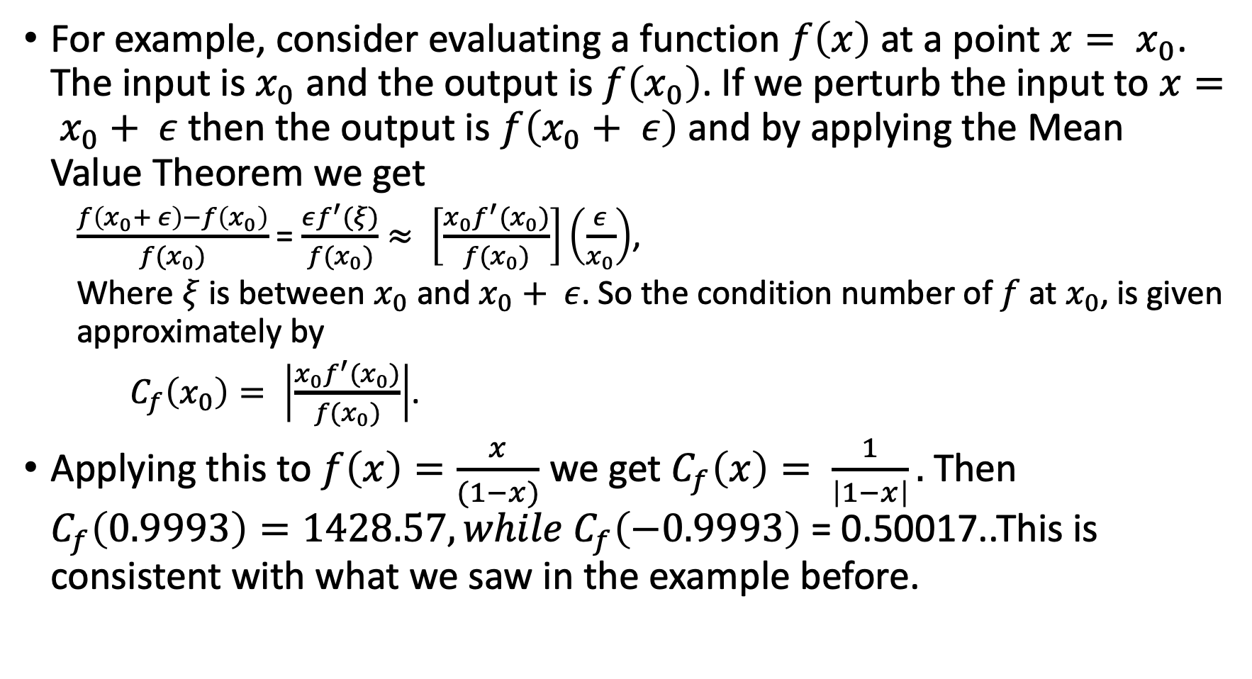
For example, consider evaluating a function $f\left(x\right)$ at a point $x= x_{0}$. The input is $x_{0}$ and the output is $f\left(x_{0}\right)$. If we perturb the input to $x= x_{0}+ ε$ then the output is $f\left(x_{0}+ ε\right)$ and by applying the Mean Value Theorem we get
  $\frac{f\left(x_{0}+ ε\right)−f\left(x_{0}\right)}{f(x_{0})}$ = $\frac{εf^{′}(ξ)}{f(x_{0})}$ $≈ \left[\frac{x_{0}f^{′}(x_{0})}{f(x_{0})}\right]\left(\frac{ε}{x_{0}}\right)$,
  Where $ξ$ is between $x_{0}$ and $x_{0}+ ε$. So the condition number of $f$ at $x_{0}$, is given approximately by
  $C_{f}\left(x_{0}\right)= \left|\frac{x_{0}f^{′}(x_{0})}{f(x_{0})}\right|$.
Applying this to $f\left(x\right)=\frac{x}{(1−x)}$ we get $C_{f}\left(x\right)= \frac{1}{\left|1−x\right|}.$ Then $C_{f}\left(0.9993\right)=1428.57, while C_{f}\left(−0.9993\right)$ = 0.50017..This is consistent with what we saw in the example before.

Slide 4
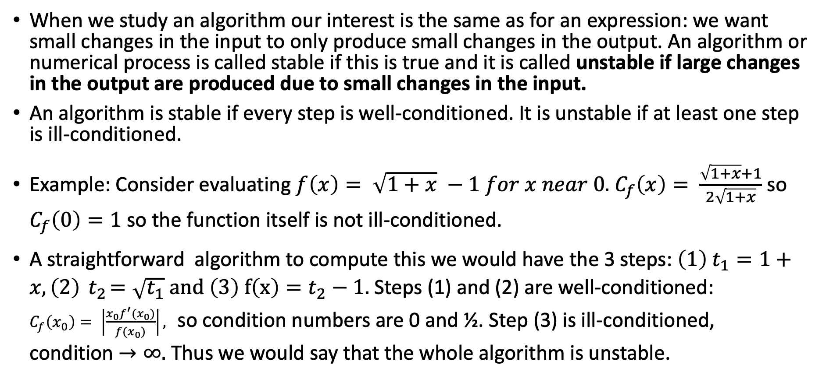
Stability of an Algorithm
When we study an algorithm our interest is the same as for an expression: we want small changes in the input to only produce small changes in the output. An algorithm or numerical process is called stable if this is true and it is called unstable if large changes in the output are produced due to small changes in the input.
An algorithm is stable if every step is well-conditioned. It is unstable if at least one step is ill-conditioned.
Example: Consider evaluating $f\left(x\right)= \sqrt{1+x} −1 for x near 0.$ $C_{f}\left(x\right)= \frac{\sqrt{1+x}+1}{2\sqrt{1+x}}$ so $C_{f}\left(0\right)=1$ so the function itself is not ill-conditioned.
A straightforward algorithm to compute this we would have the 3 steps: ${\left(1\right) t}_{1}=1+x, \left(2\right){ t}_{2}=\sqrt{t_{1}} and \left(3\right) f\left(x\right)=t_{2}−1.$ Steps (1) and (2) are well-conditioned:
$C_{f}\left(x_{0}\right)= \left|\frac{x_{0}f^{′}(x_{0})}{f(x_{0})}\right|,$ so condition numbers are 0 and ½. Step (3) is ill-conditioned,
condition $→∞.$ Thus we would say that the whole algorithm is unstable.

Slide 5
Numerical experiment:
loss_of_significance.cc

Slide 6

Subtraction of two numbers that are close to each other can lead to large relative errors.

Slide 7






Transforming the original problem to a mathematically equivalent one, for which all parts of the calculation are well-conditioned, and so the whole algorithm is stable.
Example:

Slide 8
Summary
Well-/ill-Conditioned refers to the problem; Stable/Unstable refers to an algorithm or numerical process.
If the problem is well-conditioned then there is a stable way to solve it.
If the problem is ill-conditioned then there is no reliable way to solve it numerically in a stable way. An analytical, or a partial analytical
solution may still exist. You may try to single out the ill-conditioned part of the problem, solve it analytically (exactly), while applying a stable numerical algorithm to the remaining well-conditioned part of the problem.
Mixing roundoff-error with an unstable process is a recipe for disaster.
With exact arithmetic (e.g. no roundoff-error for integers), stability is not a concern.

