Slide 1
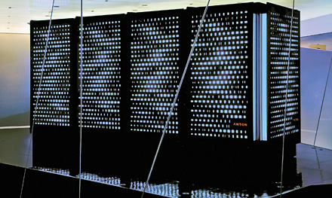
Anton Supercomputer
Brandon Dean
4/28/15

Slide 2
History
Named after Antonie van Leeuwenhoek – “father of microbiology”
Molecular Dynamics (MD) simulations were limited by rate at which they could be performed
First Anton machine constructed October 2008 (at least 4 have been constructed)
Notes:
- Antonie van Leeuwenhoek – first to use microscope to study microbes

Slide 3
Details
Built by D.E. Shaw Research in NY (David Shaw)
Designed specifically for modeling particle-particle interactions
Can view 1 millisecond of simulation in same amount of time used to create 10 microseconds on other machines
Rate of simulation: 15 microseconds (μs)/day
Notes:
David Shaw
1 millisecond = 1000 microseconds -> 100 times faster
http://www.hotchips.org/wp-content/uploads/hc_archives/hc20/2_Mon/HC20.25.421.pdf
Designed specifically for particle simulations – while off-the-shelf component machines are cheaper by economy of scale, designing a machine specifically for its purpose, as in this case, gets results that would take years otherwise
David Shaw – researcher left academia in late 80s to work on Wall Street. Returned in 2009 to fund his own research to not be beholden to grants.

Slide 4
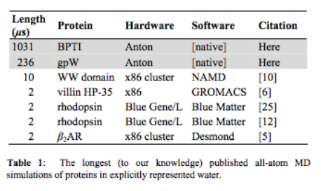
Anton’s Benchmarks

Slide 5
Long-Scale Simulations
Reveals behavior not evident in shorter simulations
Longest conducted previous to Anton: 10 μs, few reached~ 2μs (typically conducted on BPTI protein)
  Anton already conducted 1 ms by time of report [2].
Notes:
[2] page 9 – section 5.3
- Millisecond scale simulations models protein called bovine pancreatic trypsin inhibitor (BPTI)

Slide 6
Benefits?
Can learn more from behavior, not just looking at final folded protein
Glimpse into the future – simulation times only dreamed of a decade ago
Prototype for future machines taking advantage of specialized role

Slide 7
How it is used in Protein Folding?
"We grew up with the view that a folded protein is static like a rock, but in fact it's not," says structural biologist David Eliezer of Weill Cornell Medical College in New York, who was not involved in the study. "It's highly mobile. It breathes and transitions between conformations."

Slide 8
“How Fast Folding Proteins Fold”
Studied 12 proteins, ranging from 10 to 80 amino acid residues each.
Simulations all used single force field.
The Engrailed homeodomain proved unstable in simulation (all 11 others folded spontaneously to experimentally determined native structures).
  Folded different homeodomain with same structure to account for this.
Notes:
[6] http://www.sciencemag.org/content/334/6055/517.full
Kresten Lindorf-Larsen, Stefano Piana, Ron Dror, David E. Shaw

Slide 9
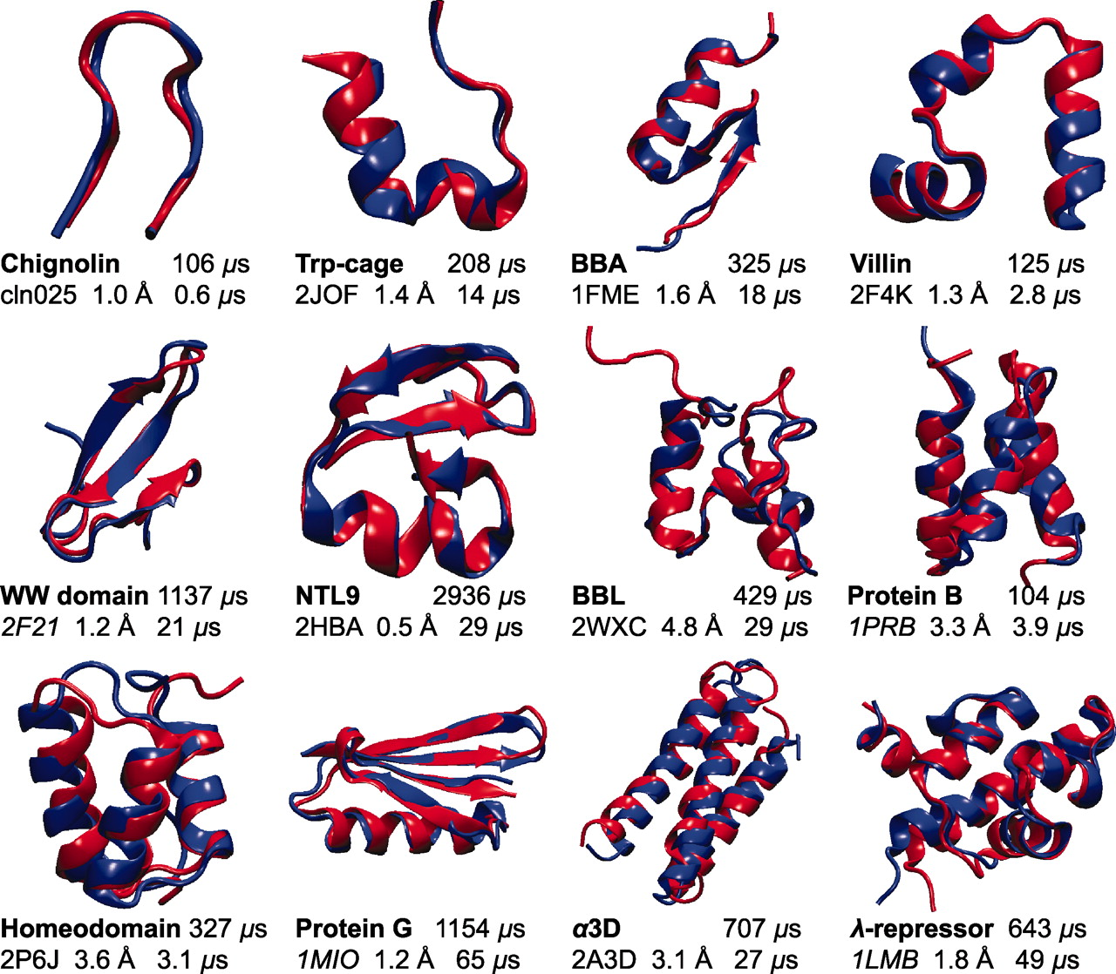

Slide 10
“How Fast Folding Proteins Fold”
Performed equilibrium MD simulations (near melting temperature) for all 12 proteins.
  Observed between 1 and 4 simulations each
  100 μs and 1 ms long each
  Observed at least 10 folding events and 10 unfoldings
Total: 8 ms of simulations containing more than 400 folding/unfolding events
Notes:
For all 12 proteins that folded in simulation, we were also able to perform simulations near the melting temperature, at which both folding and unfolding could be observed repeatedly in a single, long equilibrium MD simulation. For each of the 12 proteins, we performed between one and four simulations, each between 100 μs and 1 ms long, and observed a total of at least 10 folding and 10 unfolding events.

Slide 11
“How Fast Folding Proteins Fold”
Questions:
  (i) What is the general nature and order of events that lead to folding?
  (ii) What role, if any, is played by the residual structure in the unfolded state?
  (iii) How many distinct folding pathways are present, and how different are they from one another?
  (iv) Is there a free-energy barrier for folding, and what is its magnitude?

Slide 12
“How Fast Folding Proteins Fold”
Partitioned all trajectories into folded, unfolded, and transition-path segments.
Determined for each protein how many folding pathways are traversed that are distinct in the sense that native interactions are formed in different orders and that the pathways do not interconvert on the transition path time scale.
Examined the thermodynamics and kinetics of the folding process, and in particular the existence and size of the free-energy barrier for folding.
Notes:
Unfolding transitions were analyzed in reverse so that all transitions could be treated as folding events.

Slide 13
“How Fast Folding Proteins Fold”
Results show folding of 12 small proteins
Key Conclusion: Current molecular mechanics force fields are sufficiently accurate to make long–time scale MD simulation a powerful tool for characterizing large conformational changes in proteins.

Slide 14
Anton’s Architecture
512 node machine first version released (Oct. 2008)
Each node contains an ASIC with two major computational subsystems: a HTIS and a flexible subsystem.
ASIC also contains:
  pair of DDR2-800 DRAM controllers
  6 high-speed channels for communication to other ASICS
  I/O host interface to communicate with external computer
Notes:
Section 2.2 of [2]
HTIS – high throughput interaction subsystem
Each node includes an ASIC with two major computational subsystems (Figure 2). The first is the high-throughput interaction subsystem (HTIS) designed for computing massive numbers of range-limited pairwise interactions of various forms using an array of 32 hardwired pairwise point interaction pipelines (PPIPs). The PPIPs can compute interactions with a number of different functional forms, as determined by various mode settings and user-specified lookup tables and parameter values. The second is the flexible subsystem, which is composed of programmable cores used for the remaining, less structured part of the MD calculation. The flexible subsystem contains eight geometry cores (GCs) that were designed in-house to perform fast numerical computations, four Tensilica LX processors that control the overall data flow in the Anton system, and four data transfer engines that allow communication to be hidden behind computation.

Slide 15
Anton’s Architecture
HTIS (High-Throughput Interaction Subsystem): Computes massive numbers of range limited pairwise interactions using array of 32 PPIPs
Flexible subsystem: Programmable cores used for remaining “unstructured” calculations. Contains 8 geometry cores to perform fast numerical calculations.
PPIPs (Pairwise point interaction pipelines): Computes interactions via lookup tables and input parameters.

Slide 16
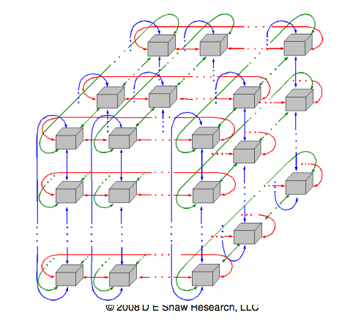
Notes:
http://www.hotchips.org/wp-content/uploads/hc_archives/hc20/2_Mon/HC20.25.421.pdf
Looking at one segment of 512 ASICS

Slide 17
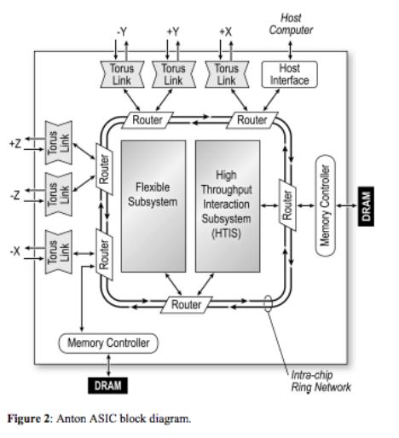

Slide 18
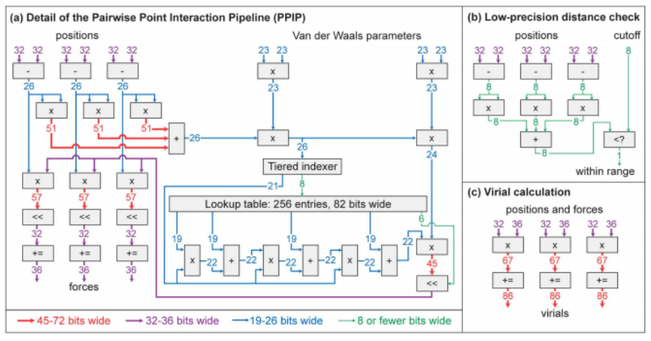

Slide 19
Future: Anton 2
Increased speed (more cores, pipelines)
Enhanced capability (new ASICs)
Simplified software (optimized compiler support)
Notes:
http://www.hotchips.org/wp-content/uploads/hc_archives/hc26/HC26-11-day1-epub/HC26.11-1-High-Performance-epub/HC26.11.130-Anton-2-Butts-Shaw-Shaw-Res-Search.pdf
-

Slide 20
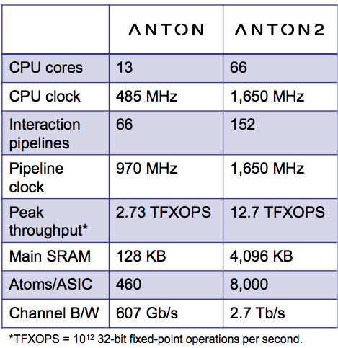
Future: Anton 2

Slide 21
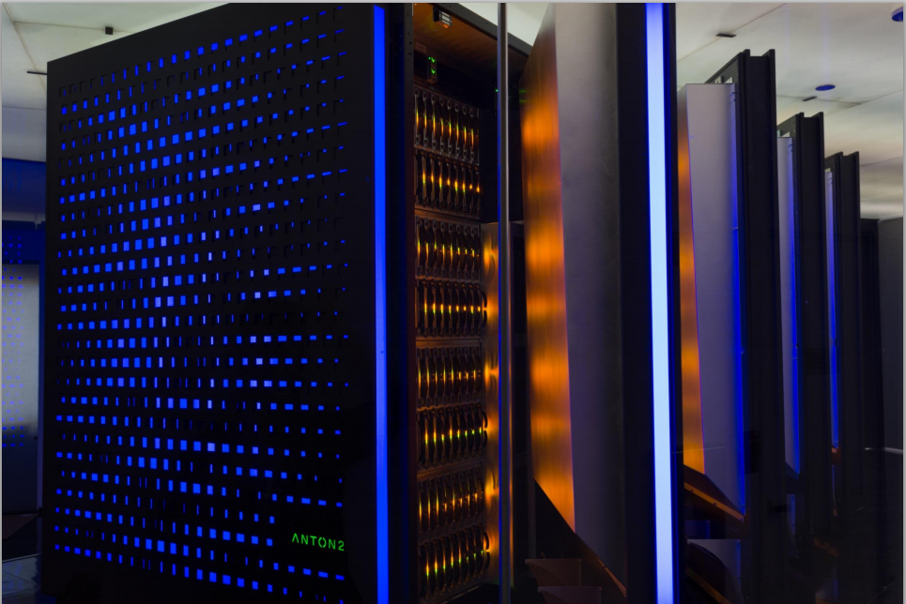
Notes:
http://www.hotchips.org/wp-content/uploads/hc_archives/hc26/HC26-11-day1-epub/HC26.11-1-High-Performance-epub/HC26.11.130-Anton-2-Butts-Shaw-Shaw-Res-Search.pdf

Slide 22
References
[title slide] https://cen.acs.org/content/dam/cen/88/42/8842notw1_Antoncxd.jpg
[1] http://www.nature.com/news/2010/101014/full/news.2010.541.html
[2] "Millisecond-Scale Molecular Dynamics Simulations on Anton" (Portland, Oregon). Proceedings of the ACM/IEEE Conference on Supercomputing (SC09) (New York, NY, USA: ACM): 1–11. doi:10.1145/1654059.1654099.
[3] http://www.hotchips.org/wp-content/uploads/hc_archives/hc20/2_Mon/HC20.25.421.pdf
[4] http://www.hotchips.org/wp-content/uploads/hc_archives/hc26/HC26-11-day1-epub/HC26.11-1-High-Performance-epub/HC26.11.130-Anton-2-Butts-Shaw-Shaw-Res-Search.pdf

Slide 23
References
[5] Science 28 October 2011:
Vol. 334 no. 6055 pp. 517-520
DOI: 10.1126/science.1208351
[6] http://www.sciencemag.org/content/334/6055/517
Lindorf-Larsen et al. "How Fast-Folding Proteins Fold", Science 28 October 2011: Vol. 334 no. 6055 pp. 517-520 DOI: 10.1126/science.1208351 [Makes sense to present after the intro to Anton supercomputer]

