Slide 1
Newton’s method for finding local minimum

Slide 2
Newton’s method:
If F(x) -> minimum at x^{m,} then F’(x^{m}) = 0.
Iterations are x_{n+1} = x_{n} + h,
How to find h?

Slide 3
Rationalize Newton’s Method
Let’s Taylor expand F(x) around it minimum, x^{m}:
F(x) = F(x^{m}) + F’(x^{m})(x – x^{m}) + (1/2)*F’’(x^{m})(x – x^{m})² + (1/3!)*F’’’(x^{m})(x – x^{m})³ + …
Neglect higher order terms for |x – x^{m}| << 1, you must start
with a good initial guess anyway.
Then F(x) ≈ F(x^{m})+ F’(x^{m})(x – x^{m}) + (1/2)*F’’(x^{m})(x – x^{m})²
But recall that we are expanding around a minimum, so F’(x^{m}) =0.
Then F(x) ≈ + F(x^{m}) + (1/2)*F’’(x^{m})(x – x^{m})²
So, most functions look like a parabola around their local minima!

Slide 4
Newton’s Method = Approximate the function with a parabola, iterate.
h
X₀
X^{m}

Slide 5
Newton’s Method

Slide 6
Newton’s Method

Slide 7
Newton’s Method

Slide 8
Newton’s Method = Approximate the function with a parabola, iterate.
h
X₀
X^{m}

Slide 9
Simplest derivation
If F(x) -> minimum at x^{m,} then F’(x^{m}) = 0.
Solve for F’(x^{m}) = 0 using Newton’s for root finding.
Remember, for Z(x) = 0, Newton’s iterations are x_{n+1} = x_{n} + h,
where h = -Z(x_{n})/Z’(x_{n})
Now, substitute F’(x) for Z(x)
To get h = -F’(x_{n})/F’’(x_{n})
So, Newton’s iterations for minimization are: x_{n+1} = x_{n} - F’(x_{n})/F’’(x_{n})

Slide 10
How to find the step size h?
Need to minimize F(x_{n} + h).
F(x_{n} + h) = F(x_{n}) + h F’(x_{n}) + ½ h² F’’(x_{n}) (to the 2nd order)
d/dh [F(x_{n}) + h F’(x_{n}) + ½ h² F’’(x_{n}) ] = 0
=> h = - F’(x_{n}) / F’’(x_{n})

Slide 11
Newton’s method. More informative derivation.
Newton’s method for finding minimum has quadratic (fast) convergence rate for many (but not all!) functions, but must be started close enough to solution to converge.

Slide 12
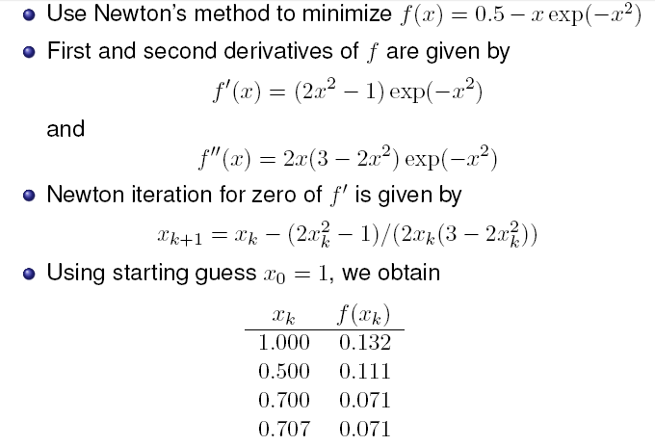
Example

Slide 13
Convergence.
If x₀ is chosen well (close to the min.), and the function is close to a quadratic near minimum, the convergence is fast, quadratic. E.g: |x0 – x^{m} | < 0.1,
Next iteration: |x1– x^{m} | < (0.1)²
Next: |x2– x^{m} | < ((0.1)²⁾² = 10⁻⁴
Next: 10⁻⁸, etc.
Convergence is NOT guaranteed, many pitfalls
(run-away, cycles, does not converge to x^{m}, etc. Sometimes, convergence may be very poor even for “nice looking”, smooth functions! )
Combining Newton’s with slower, but more robust methods such as “golden section” often helps.
No numerical method will work well for truly ill-conditioned (pathological) cases. At best, expect significant errors, at worst – completely wrong answer!

Slide 14
Choosing stopping criteria
The usual: |x_{n+1} – x_{n} | < TOL, or, better
|x_{n+1} – x_{n} | < TOL*|x_{n+1} + x_{n} |/2 to ensure that the given TOL is achieved for the relative accuracy.
Generally, TOL ~ sqrt(ε_{mach}) or higher if full
theoretical precision is not needed. But not smaller.
TOL can not be lower becasue, in general F(x) is quadratic around the minimum x^{m}, so when you are h < sqrt(ε_{mach}) away from x^{m}, |F(x^{m}) – F(x^{m}+h)| < ε_{mach,} and you can no longer distinguish between values of F(x) so close to the min.

Slide 15
The stopping criterion: more details
To be more specific: we must stop iterations when |F(x_{n}) – F(x^{m})| ~ ε_{mach*}|F(x_{n}) |, else we can no longer tell F(x_{n}) from F(x^{m}) and further iterations are meaningless.
Since |F(x_{n}) – F(x^{m})| ≈ |(1/2)*F’’(x^{m})(x_{n} – x^{m})²| , we get for this smallest |(x_{n} – x^{m})| ~ sqrt(ε_{mach})* sqrt(|2F(x_{n}) / F’’(x^{m}) |) = sqrt(ε_{mach})* sqrt(|2F(x_{n}) / F’’(x_{n}) |) = sqrt(ε_{mach})*|x_{n}|*sqrt(|2F(x_{n}) /(x_{n}² F’’(x_{n})) |) .
For many functions the quantity in green | | ~1, which gives us the rule from the previous slide:
stop when |x_{n+1} – x_{n} | < sqrt(ε_{mach})* |x_{n+1} + x_{n} |/2

