Slide 1
Machine arithmetic and associated errors
Numerical math != Math (cont.)
Loss of significance

Slide 2
In Previous Lectures:
Absolute and relative errors.
You considered and ran the code numderivative.cc; observed two types of errors – truncation and round-off error.
Floating-point representation of real numbers in decimal in binary forms.
Consequences of a finite space in computer memory for representing real numbers: 1) the hole at zero, 2) the smallest and the largest real numbers, 3) machine epsilon.

Slide 3
Errors in numderivative.cc
The code calculates F’(x) = lim_{h-->0} (F(x+h)-F(x)) / h using approximate equation for finite values of h:
F’(x) =~ (F(x + h) - F(x))/h
More accurate equation for F’(x) with finite h can be derived from a “better” formula
F(x + h) =~ F(x) + h*F’(x) + h^2*F’’(x)/2!
leading to
F’(x) =~ [F(x + h) - F(x)]/h + h*F’’(x)/2!
Missed in our code blue term gives us a truncation error which goes down with h.
The error calculating the first term is the error in subtraction (or “+”) operation.

Slide 4
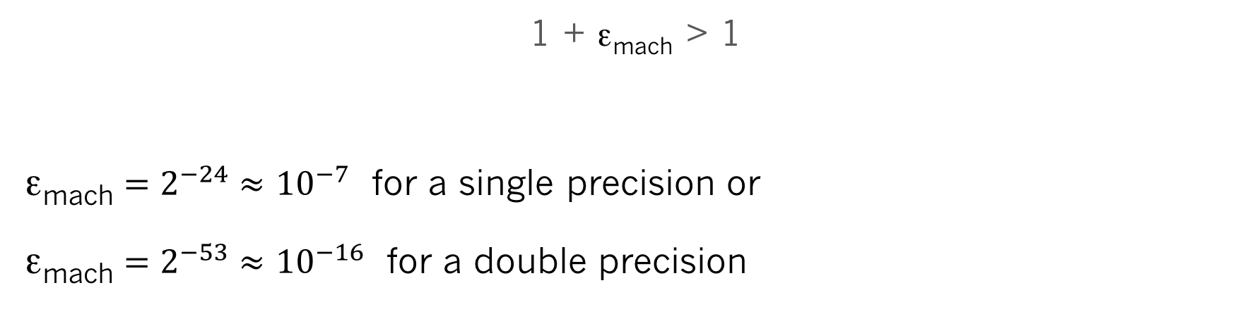
Machine epsilon
1 + ε_{mach} > 1
ε_{mach} $=2^{−24}≈$ ${10}^{−7}$ for a single precision or
ε_{mach} $=2^{−53}≈$ ${10}^{−16}$ for a double precision

Slide 5
Significant digits
Suppose we have a real number X represented in normalized floating point form:
X = 0.1234567 x 10^-2
Digits 1, 2, 3, 4, 5, 6, 7 have different significance because they represent different power of 10.
We can say that digit in the first position after decimal point (digit 1) is the most significant digit. The significance diminishes from left to right. Here digit 7 is the least significant digit.

Slide 6
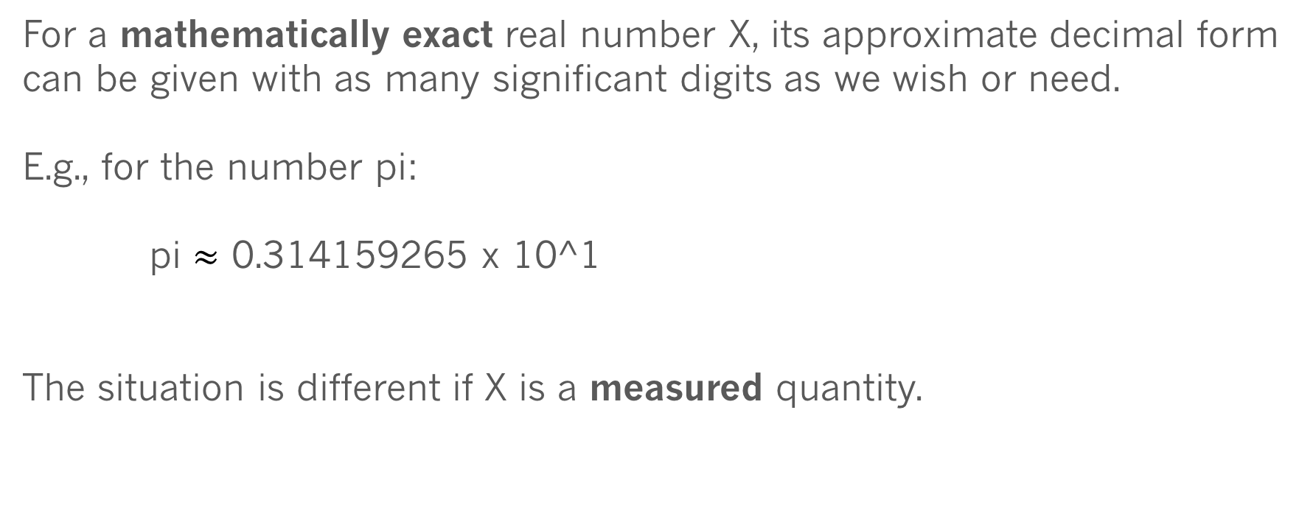
Significant digits
For a mathematically exact real number X, its approximate decimal form can be given with as many significant digits as we wish or need.
E.g., for the number pi:
pi $≈$ 0.314159265 x 10^1
The situation is different if X is a measured quantity.

Slide 7
Significant digits
Suppose we measure a length of a desk with a ruler with metric scale and the smallest distance between ruler marks is 1mm.
Suppose the result of our measurement is 1m 21 cm 4mm or L=1.214 m
What is wrong if we write down this number as L = 0.1214238 x 10^1 ?

Slide 8
Significant digits
Suppose we measure a length of a desk with a ruler with metric scale and the smallest distance between ruler marks is 1mm.
Suppose the result of our measurement is 1m 21 cm 4mm or L=1.214 m
What is wrong if we write down this number as L = 0.1214238 x 10^1 ?
It’s misleading.
Why? Because the precision of our measurement is only 1mm or 0.001m and we have only 4 significant digits in the value of L.
Definition: significant digits are digits beginning with the leftmost nonzero digit and ending with the rightmost correct digit.
The quantity L=0.1214238 x 10^1 m is accurate to 4 significant digits. We can trust a total of 4 digits as being meaningful.

Slide 9

Significant digits
Example: diagonal of a square
D=s * $\sqrt{2}$ = 0.736 * 1.4142135623 … = 1.040861182 ... ?
D=1.041 m or (more conservatively, 3 significant digits!) D=1.04 m
D
s=0.736 m - length of the side of the square

Slide 10
Loss of significance
Let us consider how a computational subtraction leads to a loss of significance (the number of significant digits) and how this loss can be reduced or eliminated.
Suppose we subtract two very close numbers X1 and X2. Each have 24 significant binary digits (or 7 decimal digits)
X1 = (0.1b₂b₃b₄b₅…..... b₂₀b₂₁b₂₂b₂₃b₂₄ ) x 2^k
X2 = (0.1b₂b₃b₄b₅…..... b₂₀b₂₁b₂₂b₂₃b₂₄ ) x 2^k
Z = (0.0000000…......... 0b₂₁b₂₂b₂₃b₂₄ ) x 2^k
Is Z accurate? Yes. But it has only 4 significant binary digits (about 1 decimal digit). I.e. Z=X1-X2 lost 20 significant binary digits (about 6 decimal digits).
Numerical subtraction can lead to a loss of significance!
-
=

Slide 11
Loss of significance
Example: X=0.6353 and Y=0.6311 (4 significant decimal digits)
Z = X – Y = 0.0042 (only 2 significant decimal digits), 2 significant digits are lost
A good way to estimate how close are X and Y or how many significant digits will be lost is to calculate the value of the function |1– (Y/X)|
= 0.0066110… This number starts at 3-d decimal digit. First two decimal digits are lost.

Slide 12
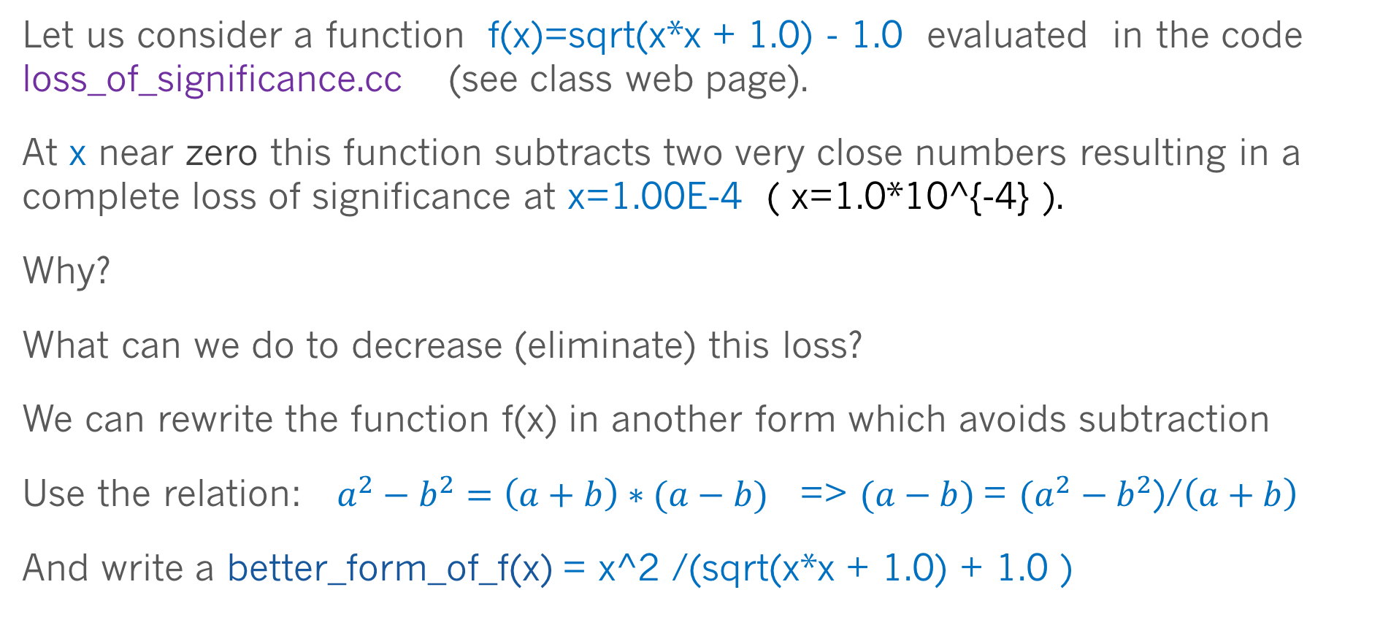
Loss of significance
Let us consider a function f(x)=sqrt(x*x + 1.0) - 1.0 evaluated in the code loss_of_significance.cc (see class web page).
At x near zero this function subtracts two very close numbers resulting in a complete loss of significance at x=1.00E-4 ( x=1.0*10^{-4} ).
Why?
What can we do to decrease (eliminate) this loss?
We can rewrite the function f(x) in another form which avoids subtraction
Use the relation: $a^{2}−b^{2}=\left(a+b\right)∗(a−b)$ => $(a−b)$= $(a^{2}−b^{2}$)/$\left(a+b\right)$
And write a better_form_of_f(x) = x^2 /(sqrt(x*x + 1.0) + 1.0 )

Slide 13
Summary of today Class
We considered a concept of significant digits in a real numbers
Loss of significance at subtraction operation and how it can be avoided

