Slide 1
Gradient Methods:
Steepest Descent (gradient descent), Conjugate Gradient.

Slide 2
Problem:
finding local minimum.

Slide 3
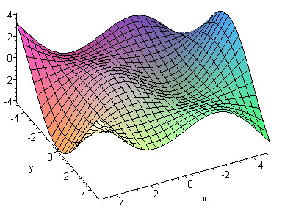
An example of a smooth differentiable function

Slide 4
Contour Plots:

Slide 5
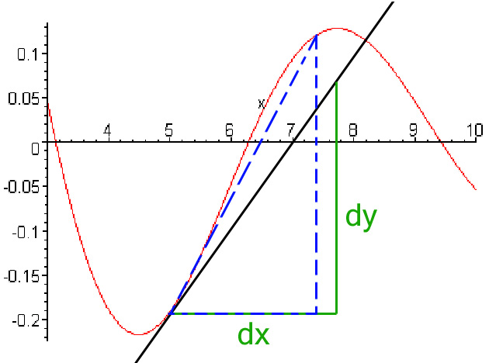
Directional Derivatives: first, the one dimension derivative:

Slide 6
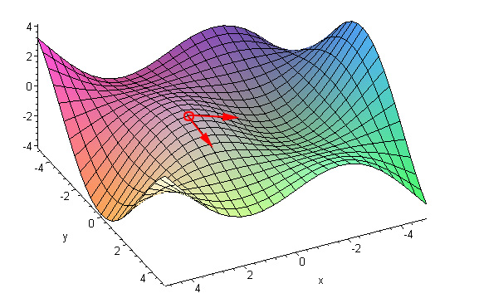
Directional Derivatives : Along the Axes…

Slide 7
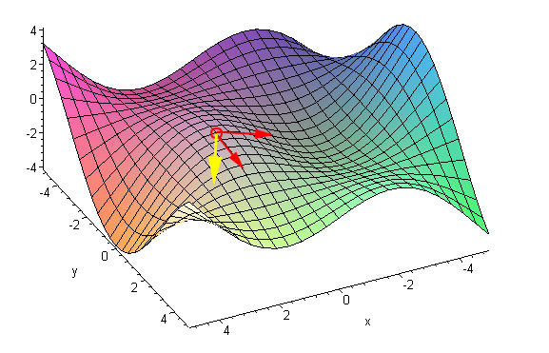
Directional Derivatives : In general direction…

Slide 8
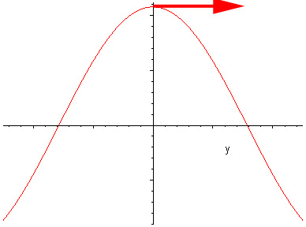
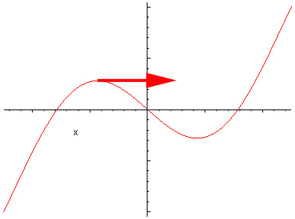
Directional Derivatives

Slide 9
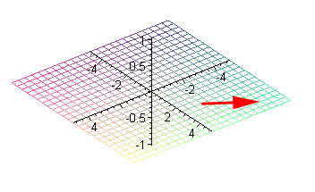
The Gradient: Definition in
In the plane

Slide 10
The Gradient: Definition

Slide 11
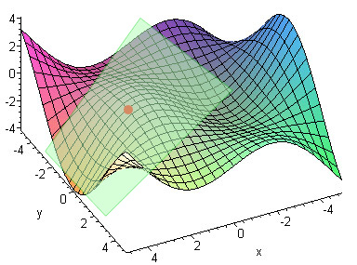
The Gradient Properties
The gradient defines (hyper) plane approximating the function infinitesimally

Slide 12
Multidimensional Taylor series
f(x) is differentiable at a point x* x* +h is a vector.
where the vector a is the gradient of f(x) evaluated at x*
The term <a,h> is called the 1-st variation.
and

Slide 13
Taylor series in multiple D
Note if f(x) is twice differentiable, then
where F(x) is an n*n symmetric, called the Hessian of f(x)
Then
1st variation 2nd variation

Slide 14
The “wine bowl" theorem
Theorem: If f(x) is twice diff and
pf :

Slide 15
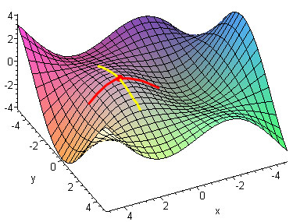
The Gradient is zero at the extremum (min or max)
Proof:
Intuitive:

Slide 16
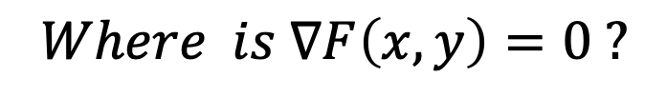
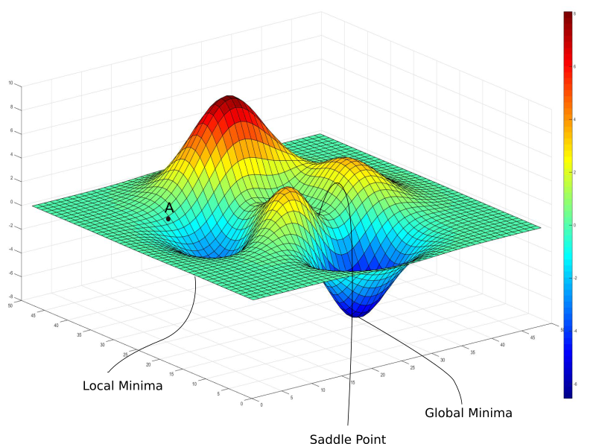
A more realistic landscape…

Slide 17
Locally, all the extrema are similar shape

Slide 18
The Gradient properties
is maximal when choosing
is minimal when choosing
(intuitive: the gradient points at the greatest change direction)

Slide 19
Directional derivatives
Let w be a directional vector of unit norm || w|| =1
Now consider
is a function of the scalar r.
Def : The directional derivative of f(x) in the direction w (unit norm)
at w* is defined as

Slide 20
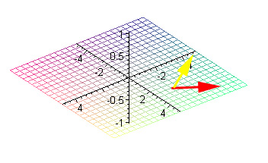
The Gradient properties
By the chain rule: (important for later use)

Slide 21
Directional derivatives
Example :
Let
Then
i.e. the partial derivative of f(x*) w.r.t x_{i} is the directional derivative
of f(x) in the direction e_{i.}
Interpretation of
Consider
Then
The directional derivative along a direction w (||w||=1) is the length of the projection vector of the gradient vector on w.

Slide 22
Unconstrained Minimization
[Q] : What direction w yield the largest directional derivative?
Ans :
[A]: The direction of the gradient is the direction that
yields the largest change (1st -variation) in the
function.
This suggests the steepest decent method:

Slide 23
Directional derivatives
Example:
Sol :
Let ,
w with unit norm =

Slide 24
Directional derivatives
The directional derivative in the direction of the gradient is
Notes :

Slide 25
Directional derivatives
Def : f(x) is said to have a local (or relative) minimum at x*,
if in a nbd N of x*
Theorem: Let f(x) be differentiable ,If f(x) has a local minimum
at x* , then
pf :
Note: is a necessary condition, not sufficient condition.

Slide 26
Minimization of Unconstrained function
Prob. : Let y=f(x) , . We want to generate a sequence
and such that it converges to the minimum of f(x).
Consider the kth guess, , we can generate provided that we have two of information
(1) the direction to go
(2) a scalar step size
Then
Basic descent methods
(1) Steepest descent
(2) Newton-Raphson method

Slide 27
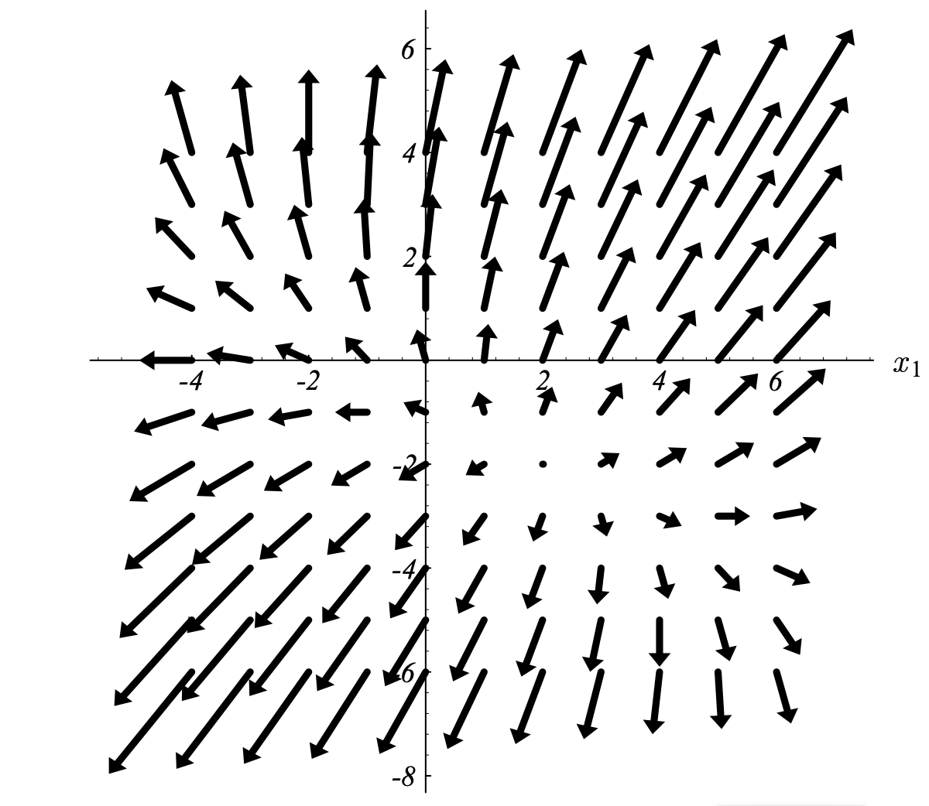
Basic Idea: go down the gradient.

Slide 28
Steepest Descent
Flow chart of steepest descent
Initial guess x⁽⁰⁾
Stop!
x^{(k)} is minimum
Compute ▽f(x^{(k)})
∥ ▽f(x^{(k)}) ∥﹤ε
Yes
k=k+1
No
α
{α₁，…α_{n}}
Polynomial fit : cubic ,…
Region elimination : …
Determine α^{(k)}
x^{(k+1)c}=x^{(k)}- α^{(k)} ▽f(x^{(k)})

Slide 29
Steepest Descent
Steepest descent :
Note
1.a. Optimum that minimizes
Search for minimum of a 1D function! (“exact line search”)

Slide 30
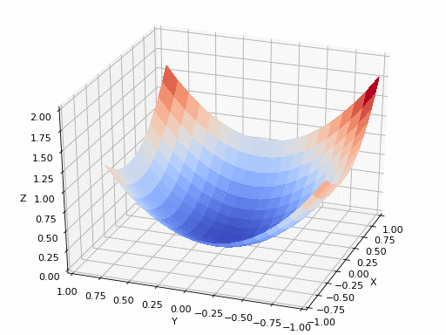
Steepest Descent in action:

Slide 31
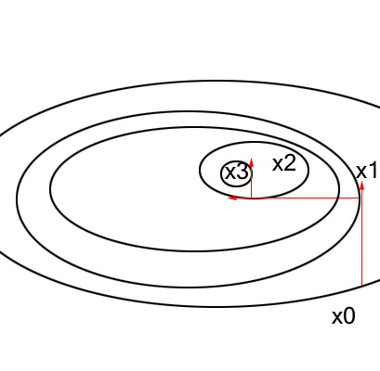
Steepest Descent

Slide 32
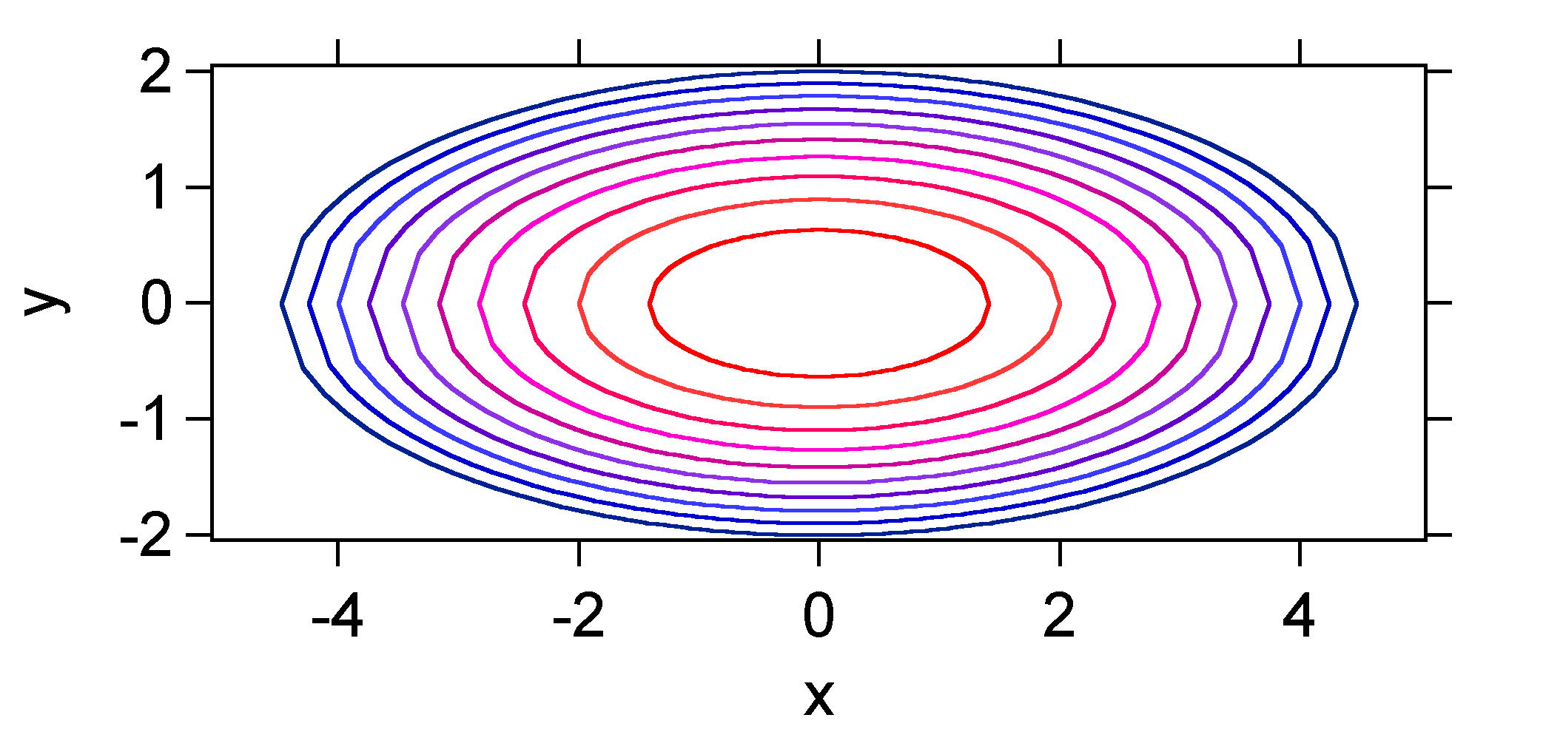
Steepest Descent Method
Contours are shown below

Slide 33
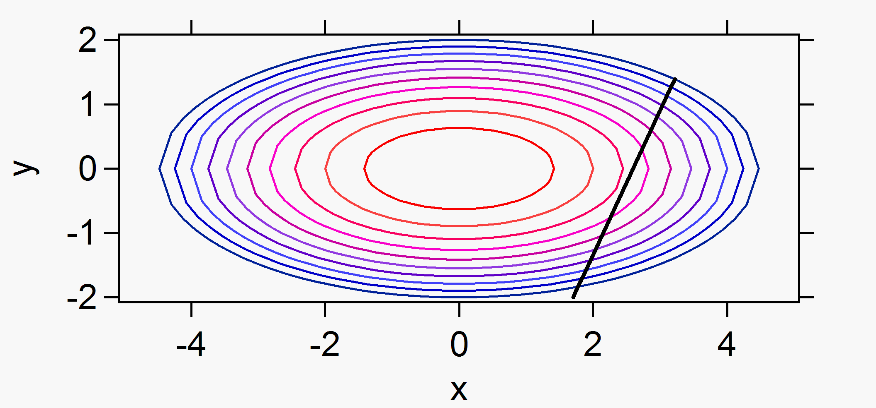
Steepest Descent
The gradient at the point is
If we choose x₁¹ = 3.22, x₂¹ = 1.39 as the starting point
represented by the black dot on the figure, the black line shown
in the figure represents the direction for a line search.
Contours represent from red (f = 2) to blue (f = 20).

Slide 34
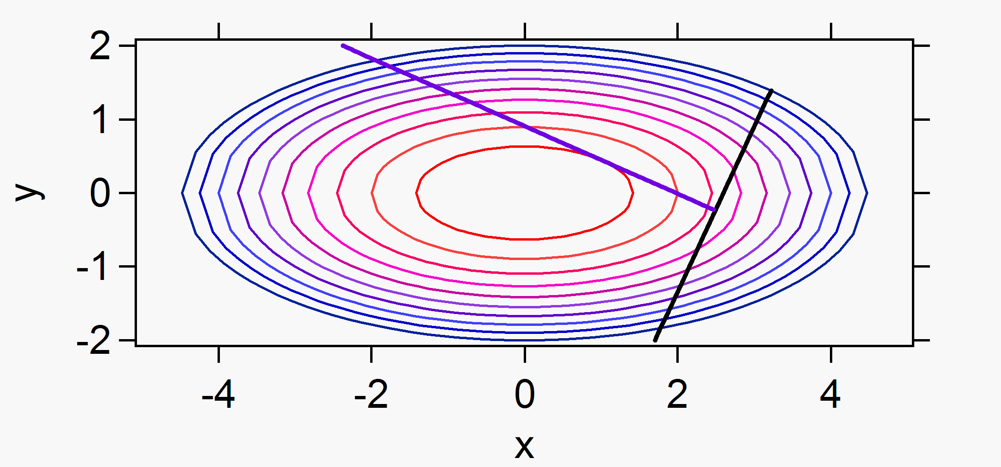
Steepest Descent
Now, the question is how big should the step be along the
direction of the gradient? We want to find the minimum along
the line before taking the next step.
The minimum along the line corresponds to the point where
the new direction is orthogonal to the original direction.
The new point is (x₁², x₂²) = (2.47,-0.23) shown in blue .

Slide 35
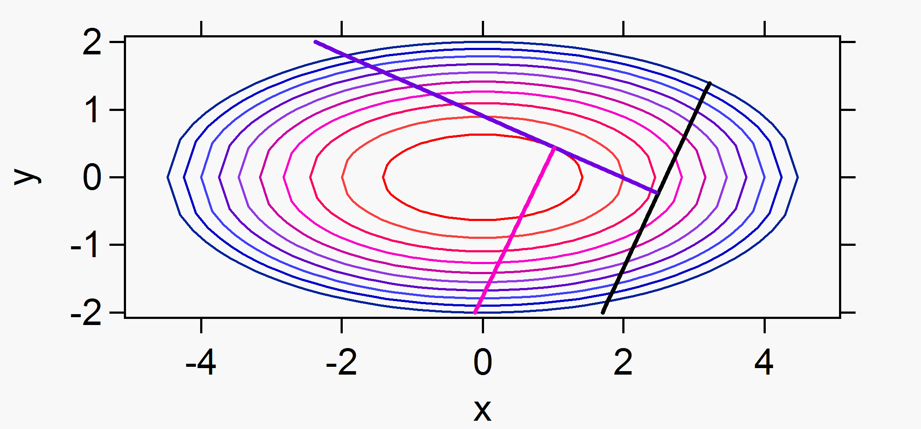
Steepest Descent
By the third iteration we can see that from the point (x₁², x₂²) the
new vector again misses the minimum, and here it seems that
we could do better because we are close.
Steepest descent is usually used as the first technique in a
minimization procedure, however, a robust strategy that
improves the choice of the new direction will greatly enhance
the efficiency of the search for the minimum.

Slide 36
Steepest Descent
Example :
Analytical approximations to α can be found for only a few rare cases.

Slide 37
How do we find the right step size in practice?
One option:
numerical optimization α = min {𝐹(x+ α𝑣)}, 𝑣=−∇𝐹(x)
using e.g. iterative Newton’s method.
Problem: Expensive.
The gradient ∇F has to be evaluated at each value of α you try.

Slide 38
Steepest Descent
1.b. other possibilities for choosing
Constant step size i.e.
advantage : simple
disadvantages : no idea of which value of α to choose
If α is too large diverge
If α is too small very slow
Variable step size

Slide 39
In practice: back-tracking line search.
What you want in practice is a cheap way to compute an acceptable α. This is a common approach in numerical computing.
The common way to do this for steepest descent is a backtracking line search. Start with an initial step size
α. Then check to see if that point x + αv is of good quality. A common test is the Armijo-Goldstein condition: 𝐹(x+α𝑣)≤𝐹(x)−𝑐α‖∇𝐹(x)‖² , for some 0< 𝑐 <1.
If the step passes this test, go ahead and take it---don’t waste any time trying to tweak your step size further. If the step is too large, then this test will fail, and you should cut your step size in half and re-try until the step size satisfies the AG condition above.

Slide 40
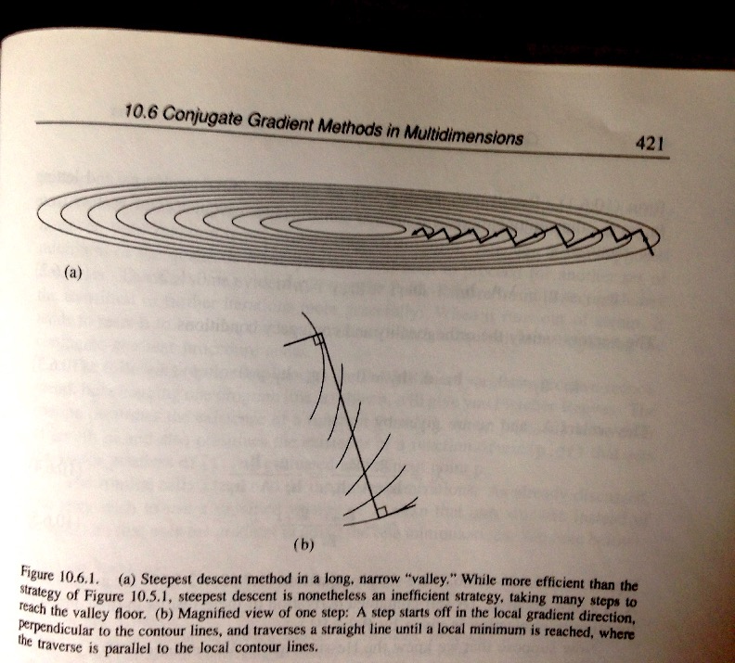
Trouble with steepest descent for some fairly common landscapes:
Convergence can be
very slow!

Slide 41
A good fix: Conjugate Gradient method.

Slide 42
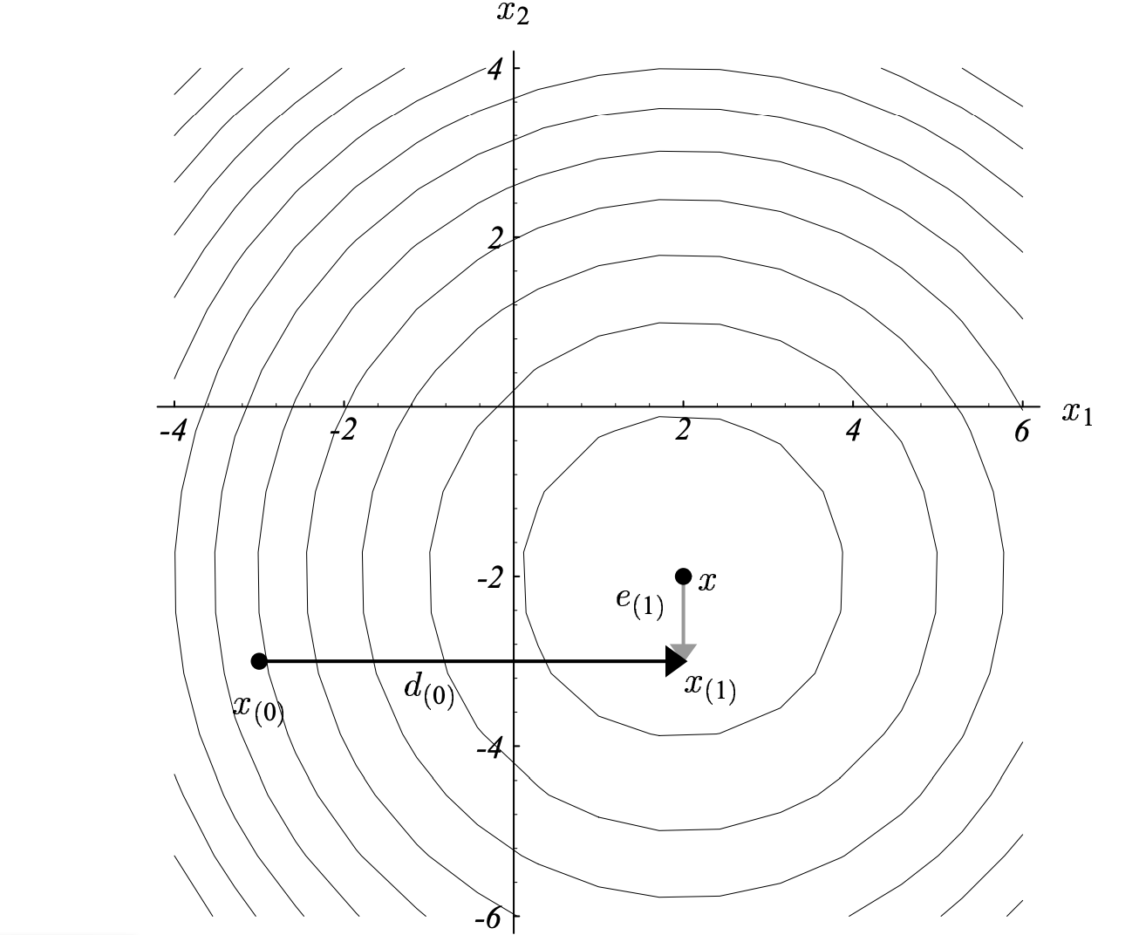
Idea: Method of orthogonal directions.
Done in 2 iterations!
For N-dimensional search, in N.

Slide 43
Conjugate Gradient
We from now on assume we want to minimize the quadratic function
MOTIVATION: In general, most functions look like this
near the minimum.

Slide 44
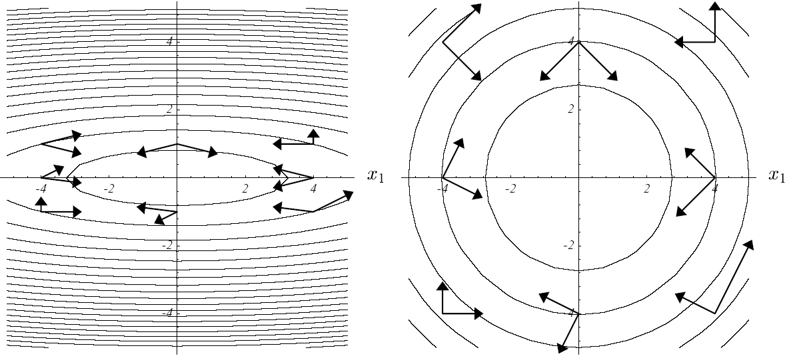
Conjugate Gradient
Choose
A - conjugate (- orthogonal) directions:

Slide 45
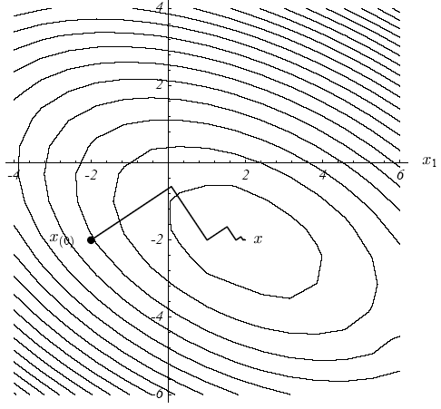
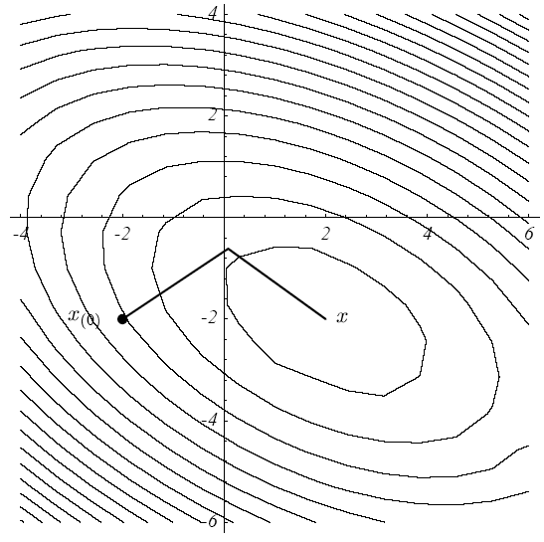
Conjugate Gradient
So the conjugate gradient algorithm for minimizing f:
Data:
Step 0:
Step 1:
Step 2:
Step 3:
Step 4: and repeat n times.

Slide 46
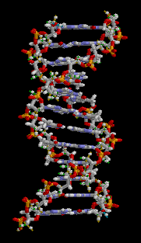
Practical Use:
SD only?
CG only?
CG followed by SD?
SD followed by CG?
Finding Local minimum of
a molecular structure:
50-500 steps SD followed by
50-500 steps CG

Slide 47
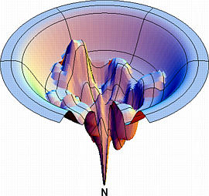
A 2D simplification of a protein
folding problem energy function
Adopted from Ken Dill’s web site at UCSF

Slide 48
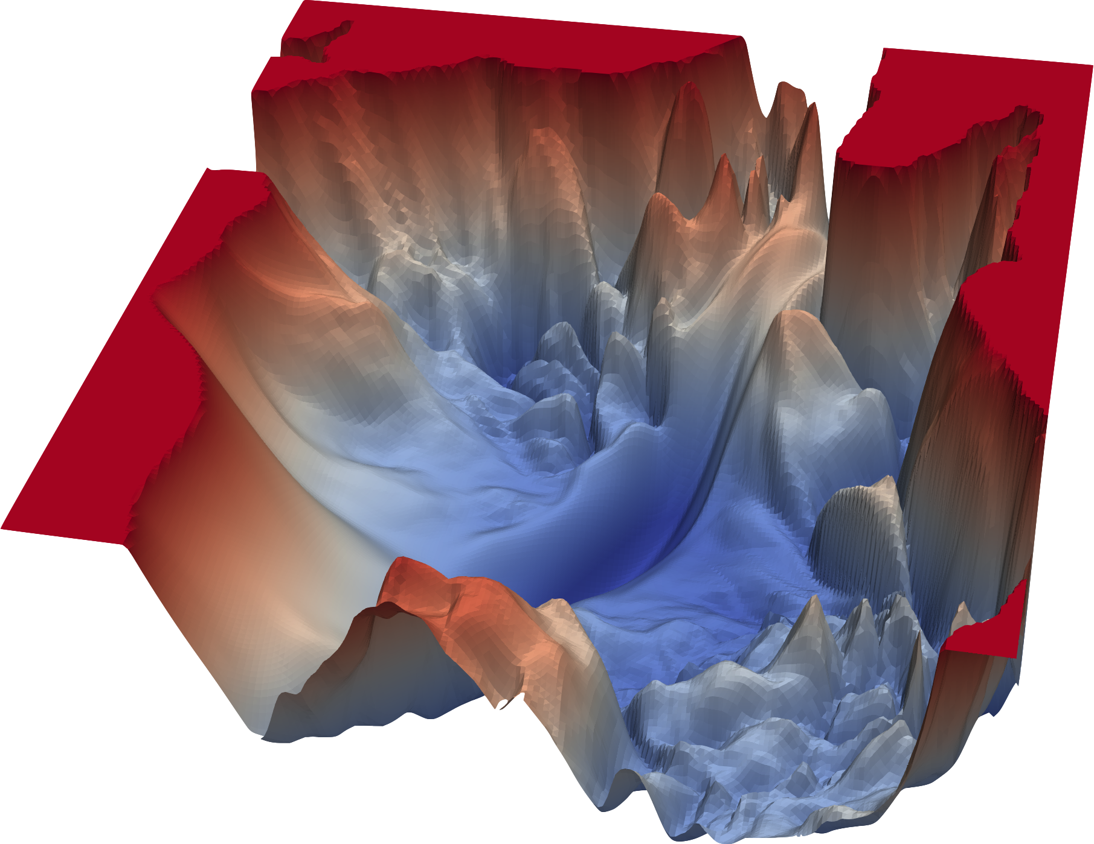
An optimization landscape that comes up in training of deep learning neural networks.
Learning rate
A Complicated Loss Landscape
Image Credits: https://www.cs.umd.edu/~tomg/projects/landscapes/

Slide 49
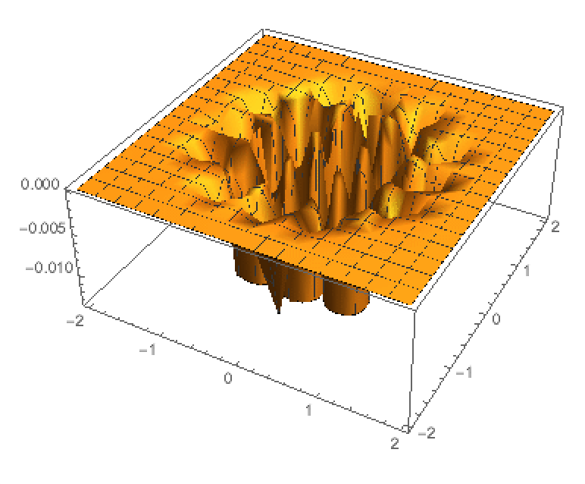
On to global optimization
F[x_, y_] := -Cos[5*x]*Cos[5*x]*Cos[5*y]*Cos[5*y]*Exp[-3*(x^2 + y^2)];
Global mimimum at (0,0).
A sure shot option: an exhaustive search. Define a fine enough grid (as above),
start LOCAL (gradient) search from each grid point.
Cost?

Slide 50
On to global optimization.
Cost of an exhaustive local search:
Say, 10 grid points in each dimension. Cost O(10^{N}).
Totally fine for N=1,2,3…
What about N=10? Or more?

Slide 51
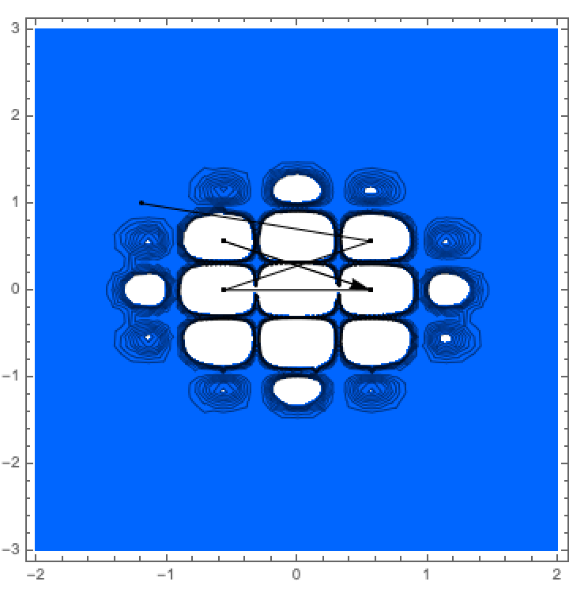
On to global optimization
Better idea: Start local search at a some set of random starting points. Number of points << 10^{N}
NMinimize[F[x, y], {x,y}, AccuracyGoal -> 2, Method -> {"RandomSearch", Method -> "Gradient", "SearchPoints" -> 5}]
Example: 5 random points. Mathematica finds “global minimum” at
(0.56, 0). Wrong! True minimum is at (0,0) by construction.

Slide 52
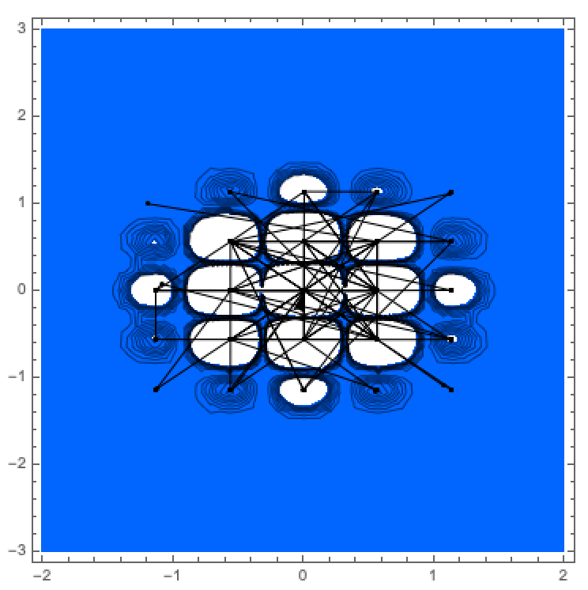
On to global optimization
Better idea: Start local search at a some set of random starting points. Number of random starting points 100.
Example: 100 random start points. Mathematica finds true global minimum at
(0,0). Is this a viable option?

Slide 53
On to global optimization
For large N, even a million starting points will sample only a tiny subset of all 10^{N} relevant points. The global minimum will most likely be missed.

