Slide 1
Protein Structure 101
Alexey Onufriev,
Virginia Tech
www.cs.vt.edu/~onufriev

Slide 2
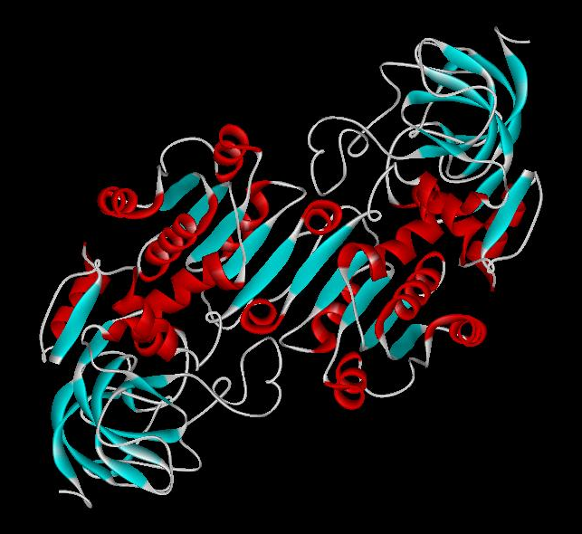
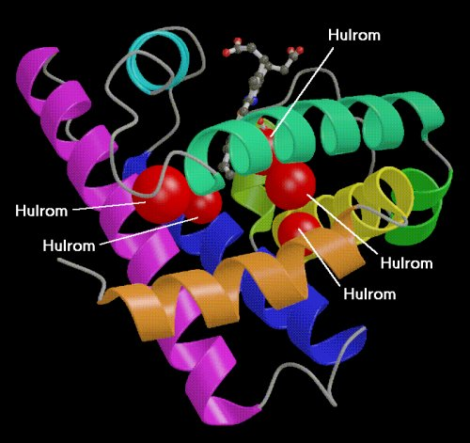
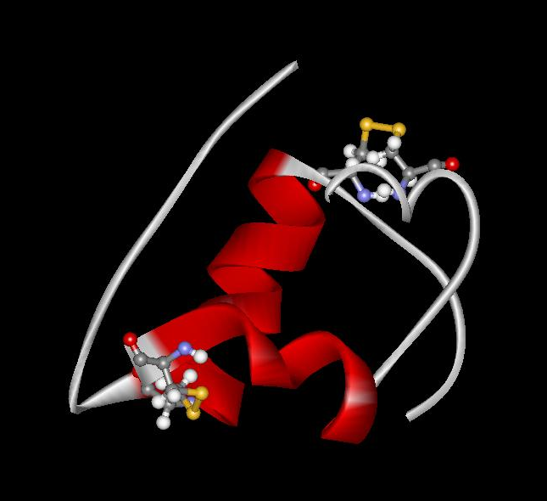
Proteins play key roles in a living system
Three (out of many many) examples of protein functions
  Catalysis:
  Almost all chemical reactions in a living cell are catalyzed by protein enzymes.
  Transport:
  Some proteins transports various substances, such as oxygen, ions, and so on.
  Information transfer:
  For example, hormones.
Alcohol dehydrogenase oxidizes alcohols to aldehydes or ketones
Myoglobin stores oxygen
Insulin controls the amount of sugar in the blood

Slide 3
Amino acid: Basic unit of protein
R
Different side chains, R, determin the properties of 20 amino acids.
NH₃⁺
C
COO⁻
Amino group
Carboxylic
acid group
H
An amino acid

Slide 4
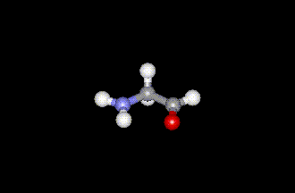
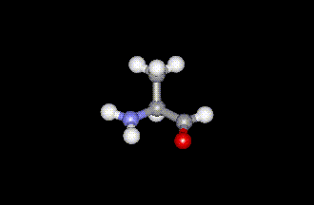
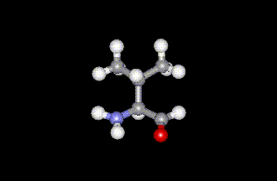
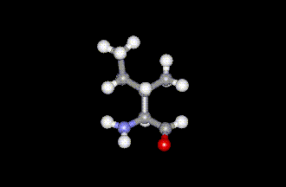
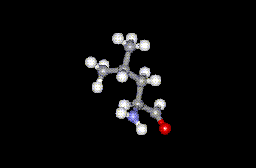
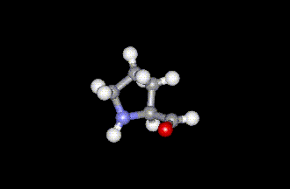
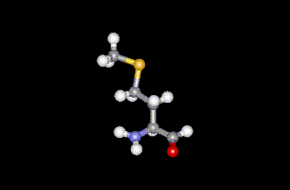
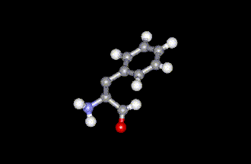
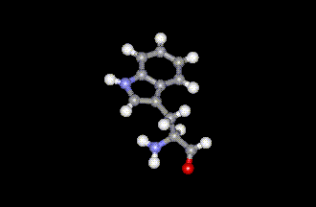
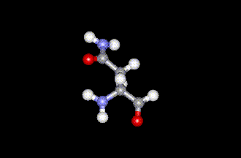
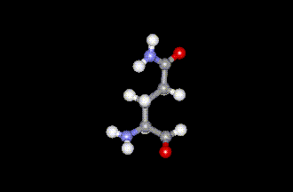
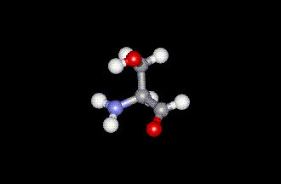
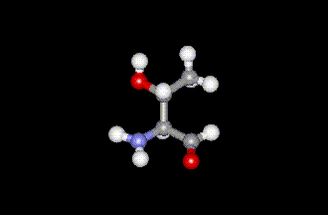
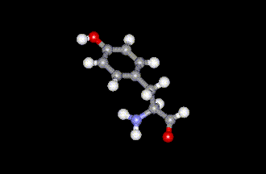
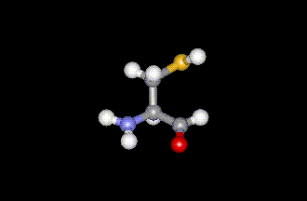
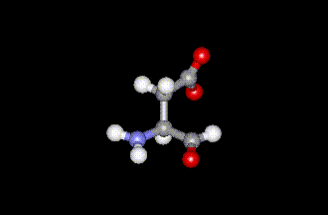
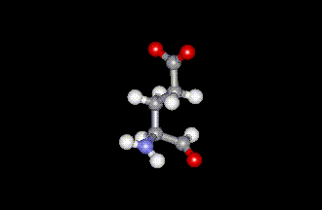
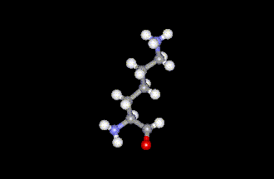
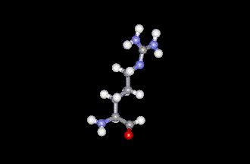
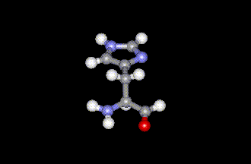
20 Amino acids
Glycine (G)
Alanine (A)
Valine (V)
Isoleucine (I)
Leucine (L)
Proline (P)
Methionine (M)
Phenylalanine (F)
Tryptophan (W)
Asparagine (N)
Glutamine (Q)
Serine (S)
Threonine (T)
Tyrosine (Y)
Cysteine (C)
Asparatic acid (D)
Glutamic acid (E)
Lysine (K)
Arginine (R)
Histidine (H)
White: Hydrophobic, Green: Hydrophilic, Red: Acidic, Blue: Basic

Slide 5
Proteins are linear polymers of amino acids
R₁
R₂
NH₃＋
C
COO^{ー}
＋
NH₃＋
C
COO^{ー}
＋
H
H
A carboxylic acid condenses with an amino group with the release of a water
H₂O
H₂O
R₁
R₂
R₃
NH₃＋
C
CO
NH
C
CO
NH
C
CO
H
Peptide bond
H
Peptide bond
H
The amino acid sequence is called as primary structure
A
F
G
S
T
D
K
A
N
G
S

Slide 6
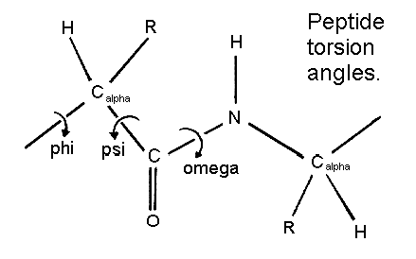
Protein Structure in 3 steps.
Step 2: Most flexible degrees of freedom:

Slide 7
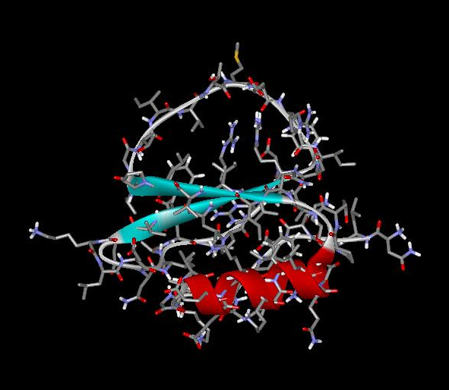
Each Protein has a unique structure
Amino acid sequence
NLKTEWPELVGKSVEEAKKVILQDKPEAQIIVLPVGTIVTMEYRIDRVRLFVDKLDNIAEVPRVG
Folding!

Slide 8
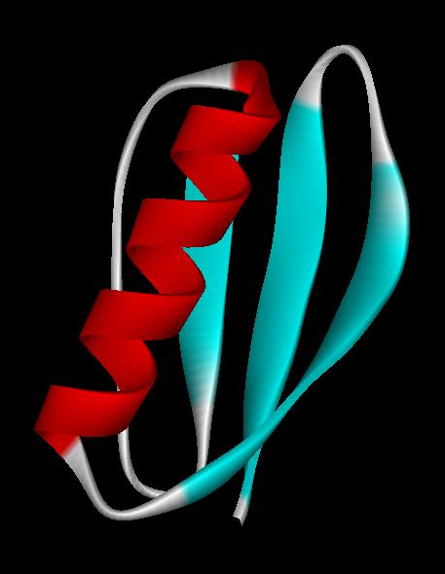
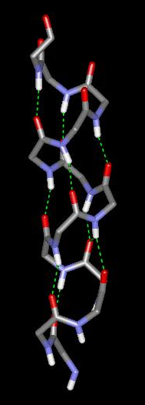
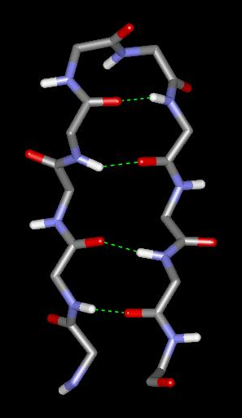
Basic structural units of proteins: Secondary structure
α-helix
β-sheet
Secondary structures, α-helix and β-sheet, have regular hydrogen-bonding patterns.

Slide 9
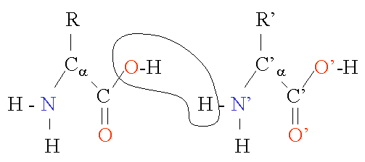
Protein Structure in 3 steps.
Step 1. Two amino-acids together (di-peptide)
Peptide bond
Amino-acid #1
Amino-acid #2

Slide 10
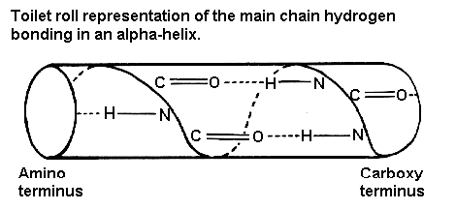
Protein Structure in 3 steps.
Sometimes, polypeptide chain forms helical structure:

Slide 11
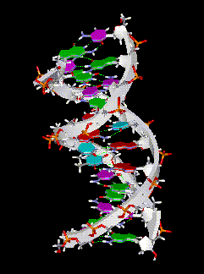
Amino acid sequence is encoded by DNA base sequence in a gene
DNA molecule
DNA base sequence
・
G
C
G
C
T
T
A
A
G
C
G
C
・
・
C
G
C
G
A
A
T
T
C
G
C
G
・
＝

Slide 12
Gene is protein’s blueprint, genome is life’s blueprint
DNA
Genome
Gene
Gene
Gene
Gene
Gene
Gene
Gene
Gene
Gene
Gene
Gene
Gene
Gene
Gene
Protein
Gene
Protein
Protein
Protein
Protein
Protein
Protein
Protein
Protein
Protein
Protein
Protein
Protein
Protein
Protein

Slide 13
Hydrogen Bonding
Involves three atoms:
  Donor electronegative atom (D)
    (Nitrogen or Oxygen in proteins)
  Hydrogen bound to donor (H)
  Acceptor electronegative atom (A) in close proximity
D – H
A

Slide 14

D-H Interaction
Polarization due to electron withdrawal from the hydrogen to D giving D partial negative charge and the H a partial positive charge
Proximity of the Acceptor A causes further charge separation
Result:
  Closer approach of A to H
  Higher interaction energy than a simple van der Waals interaction
δ-
δ+
δ-
D – H
A

Slide 15
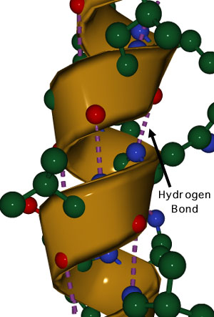
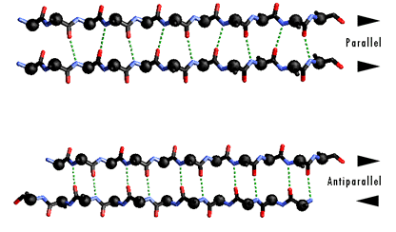
Hydrogen Bonding
And Secondary Structure
alpha-helix
beta-sheet

Slide 16
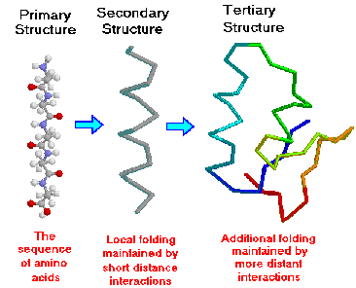
Protein Structure

Slide 17
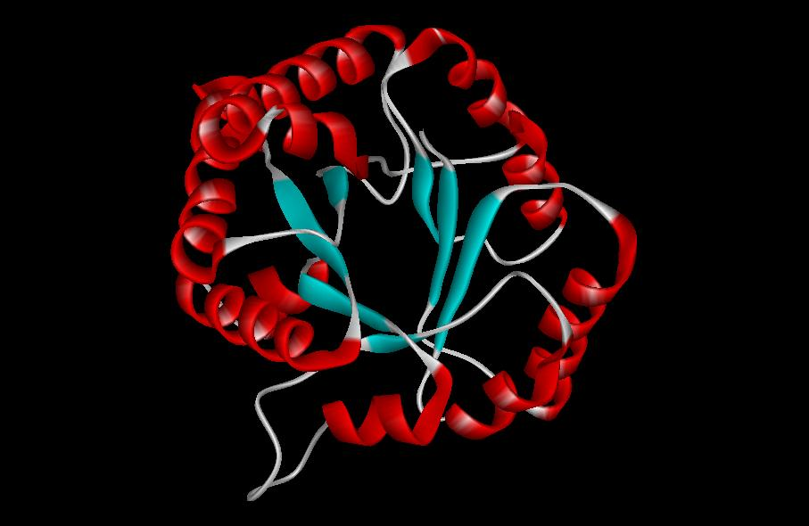
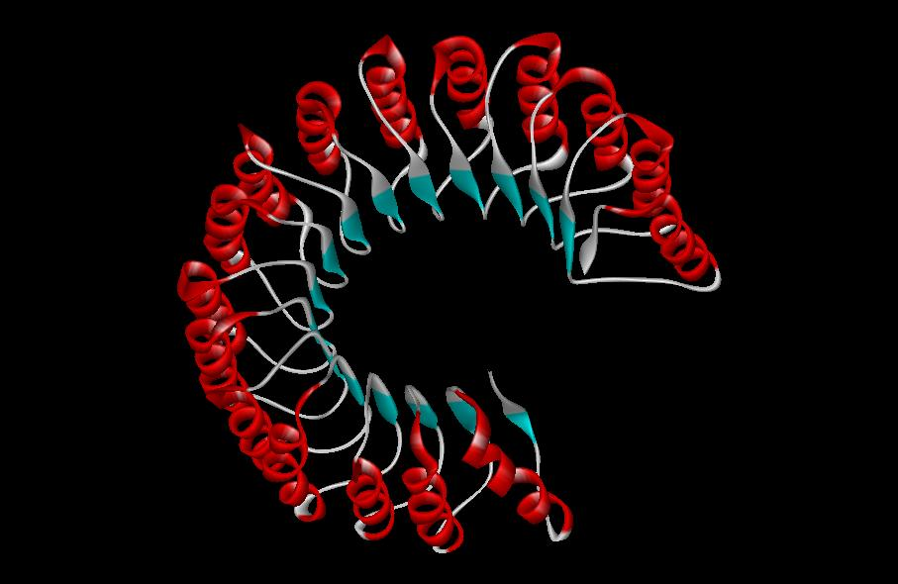
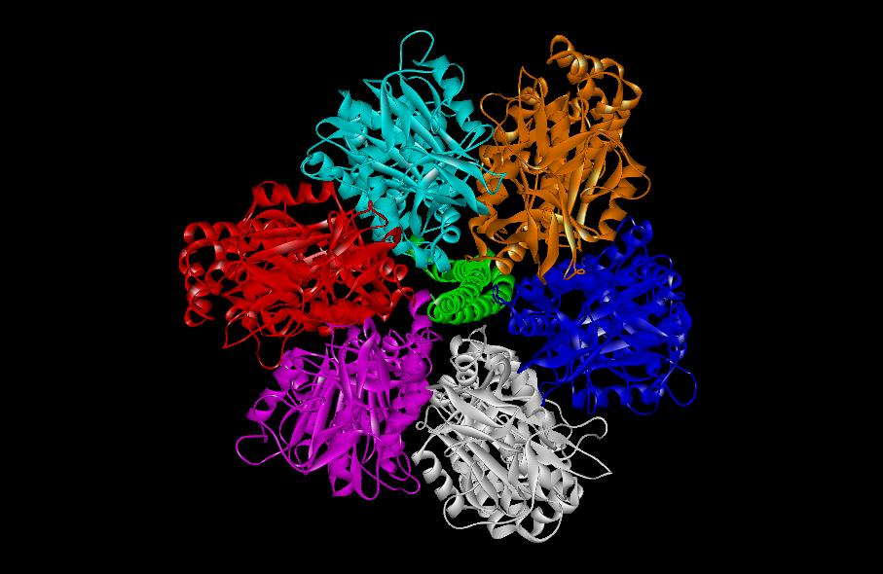
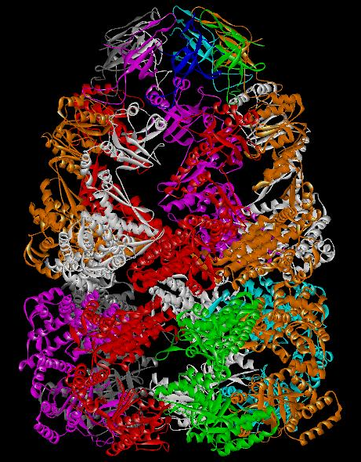
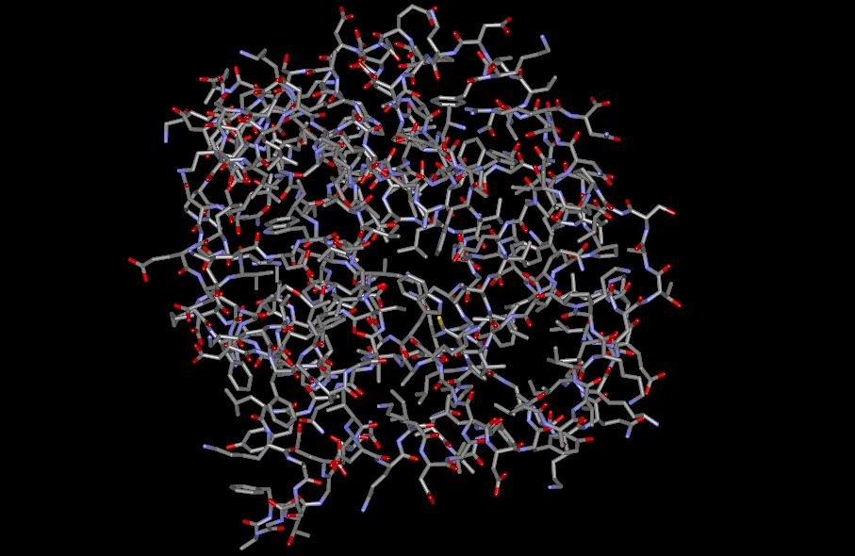
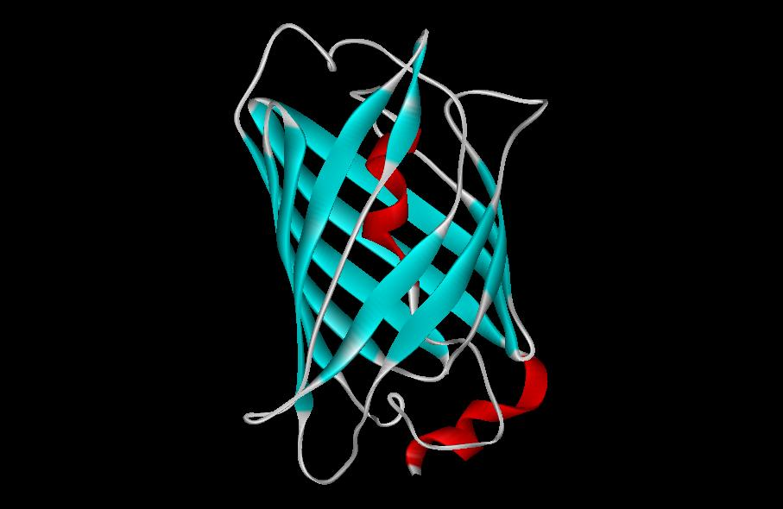
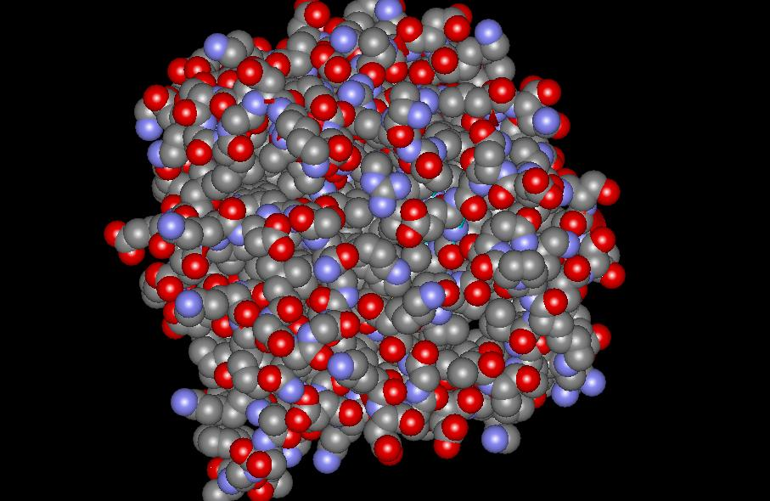
Three-dimensional structure of proteins
Tertiary structure
Quaternary structure

Slide 18
Hierarchical nature of protein structure
Primary structure (Amino acid sequence)
↓
Secondary structure （α-helix, β-sheet）
↓
Tertiary structure （Three-dimensional structure formed by assembly of secondary structures）
↓
Quaternary structure （Structure formed by more than one polypeptide chains）

Slide 19
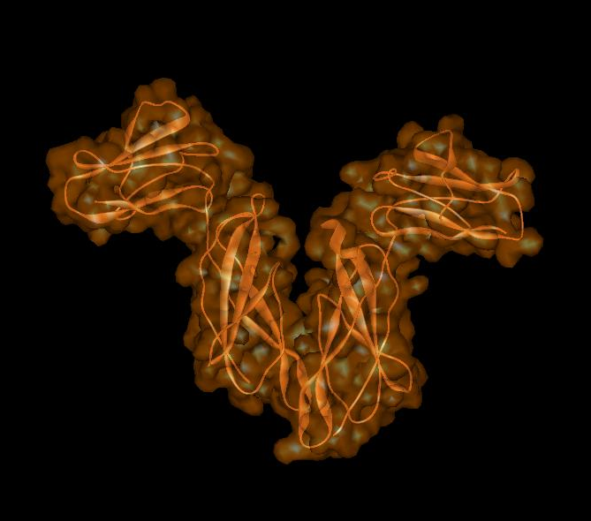
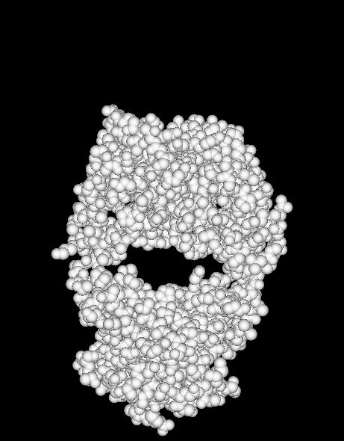
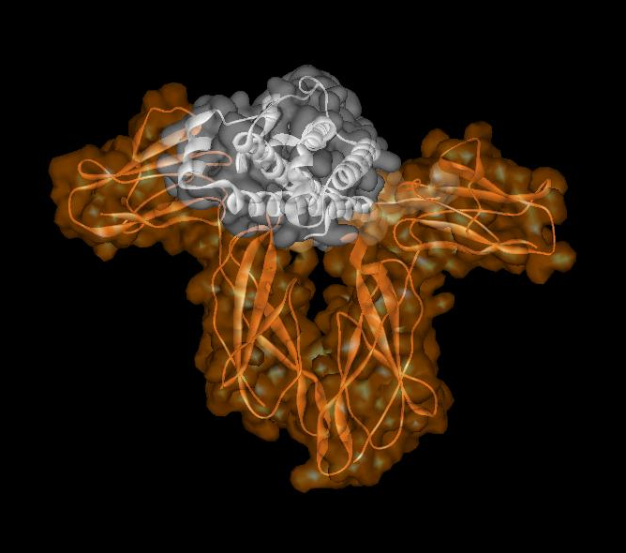
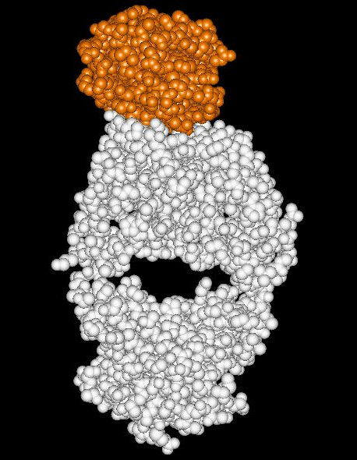
Close relationship between protein structure and its function
Example of enzyme reaction
Hormone receptor
Antibody
substrates
enzyme
A
enzyme
B
Matching the shape to A
Digestion of A!
enzyme
A
Binding to A

Slide 20
Protein structure prediction has remained elusive over half a century
“Can we predict a protein structure from its amino acid sequence?”
Still virtually impossible at atomic level accuracy (but there are some notable exceptions). Possible in some cases
if a rougher structure is acceptable.

Slide 21
So where do we get the high quality protein structures to work with?
THE PDB (Protein Data Bank. ~30,000 structurs)
PDB

Slide 22
Experimental methods:
X-ray // “Gold standard”. Atomic resolution.
// Crystal packing artefacts, not all proteins can be
crystallized well, problems with large ones, membrane proteins, missing hydrogens, and, sometimes, big chunks of structure
NMR // “true” structure in solution. Can get hydrogens.
Can trace some dynamics (e.g. in folding ).
// expensive, slow. Large errors -> low reolution
in many cases. Can’t get all atoms. No large structures.
Neutron Scattering // perfect for hydrogens. Dynamics. // proteins in powder state, very expensive. Only very few structures.
Crio-EM // very large structures (viruses). // low (10A) resolution.

Slide 23
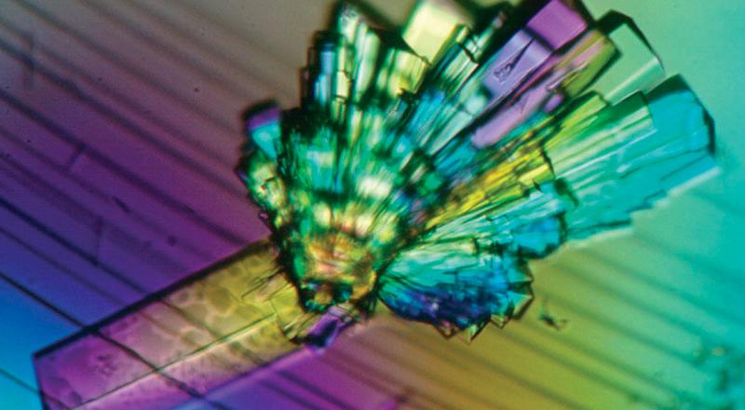
Protein Crystals need for X-ray diffraction

Slide 24
Theoretical Approaches.
Ab-initio
(just use the right
Physics and it will
fold… Really? )
Heuristic
(homology modeling).
Steps:
template recognition
backbone generation (threading)
Loop modeling
side-chain modeling
Optimization + Validation

Slide 25
Homology Modeling
Fast enough for approximate prediction of folds of fractions of whole genomes.
For small proteins (< 90 residues), predicts
structure to within 2-6 Angtroms error (compared to experiment)
Drawbacks: 1) no template: no go.
2) no atomic resolution
3) hard to use to learn about
the folding process.

Slide 26
Summary
Proteins are key players in our living systems.
Proteins are polymers consisting of 20 kinds of amino acids.
Each protein folds into a unique three-dimensional structure defined by its amino acid sequence.
Protein structure has a hierarchical nature.
Protein structure is closely related to its function.

