Slide 1
What is Optimization?
Optimization is the mathematical discipline which is concerned with finding the maxima and minima of functions, possibly subject to constraints.

Slide 2
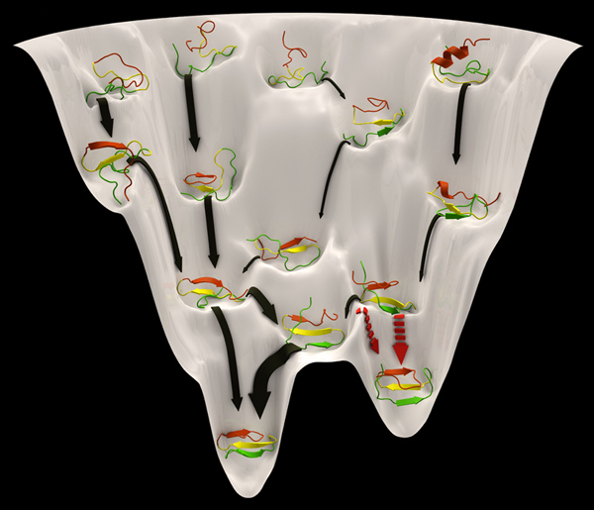
Protein Folding
Generally speaking the problem of protein folding can be viewed as an Optimization problem.

Slide 3
Finding parameters of your model
Often, experimental data is available. Suppose is necessary to find (fit) a model to reproduce the data.
y
x

Slide 4
Where would we used optimization?
Bioinformatics
Physics
Nutrition
Electrical circuits
Economics
Finance
Etc.

Slide 5
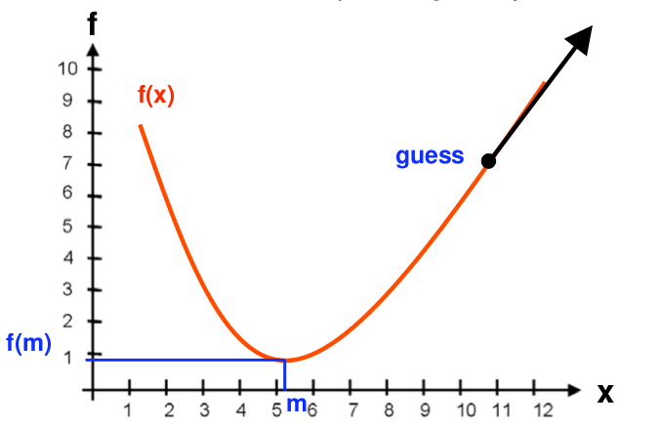
Gradient (steepest) descend algorithm

Slide 6
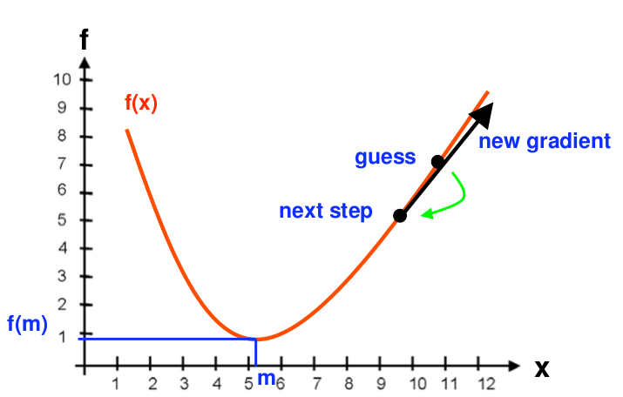
Gradient Descend Algorithm

Slide 7
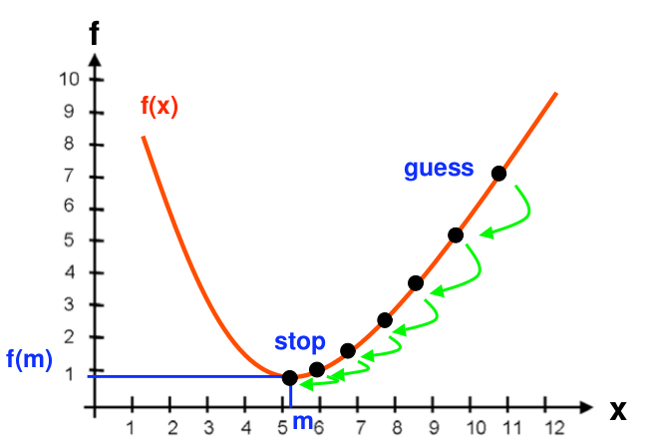
Gradient Descend Algorithm

Slide 8
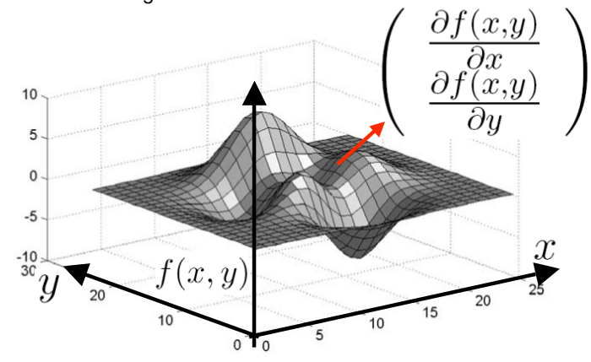
Gradient Descend Algorithm

Slide 9
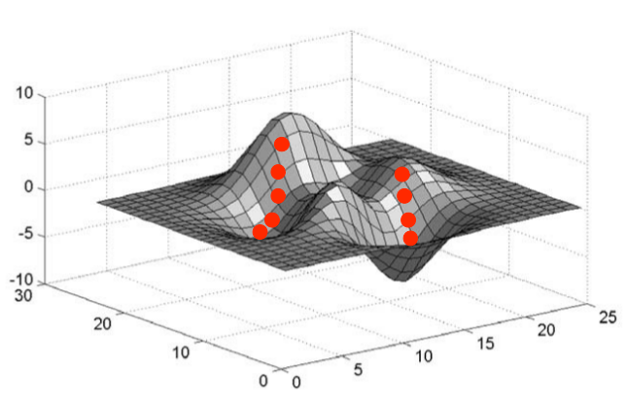
Gradient Descend Algorithm

Slide 10
What if derivatives are not available?
The Nelder-Mead algorithm or simplex search algorithm is one of the best known algorithms for multidimensional unconstrained optimization without derivatives

Slide 11
Definition: Simplex
A simplex or n-simplex is the convex hull of a set of (n +1) points. A simplex is an n-dimensional analogue of a triangle.
Example:
  a 1-simplex is a line segment
  a 2-simplex is a triangle
  a 3-simplex is a tetrahedron

Slide 12
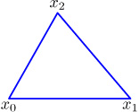
Step1 : Initial simplex
n the number of variables (dimension)
From an initial gues Xo, define an initial n-simplex (that is n+1 points),

Slide 13
Step2 : order the vertices of the current simplex
f(x_h) > f(x_s) > …. > f(l)
x_s
Compute centroid of the face oposite to x_h
(worst point)
x_h
x_l

Slide 14
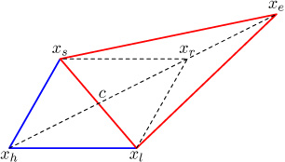
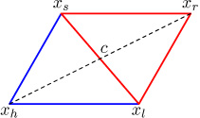
Step3 : transform simplex
Try to find a new point that is better than x_h
TRY REFLEXION
TRY EXPANSION

Slide 15
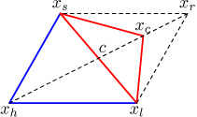
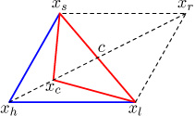
Step 3 : transform simplex
If we can not find a better point try the following operations:
CONTRACTION OUTSIDE
CONTRACTION INSIDE

Slide 16
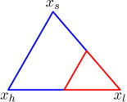
Step 3 : Transform the simples
If the previous operations did not find a better point then perform a shrink operation, using the best point (x_l) as reference.

Slide 17
Step 4 : Test convergence
If simplex is small enough : finish
If the functions are close enough : finish
If max. number of iteration is reached: finish
Otherwise go to step 2

Slide 18
MATLAB: fminsearch
fminsearch is a built-in MATLAB function. It is able to find a minimum for a scalar function of several variables.
x = fminsearch(fun,x0) starts at the point x0 and returns a value x that is a local minimizer of the function described in fun.

