Slide 1
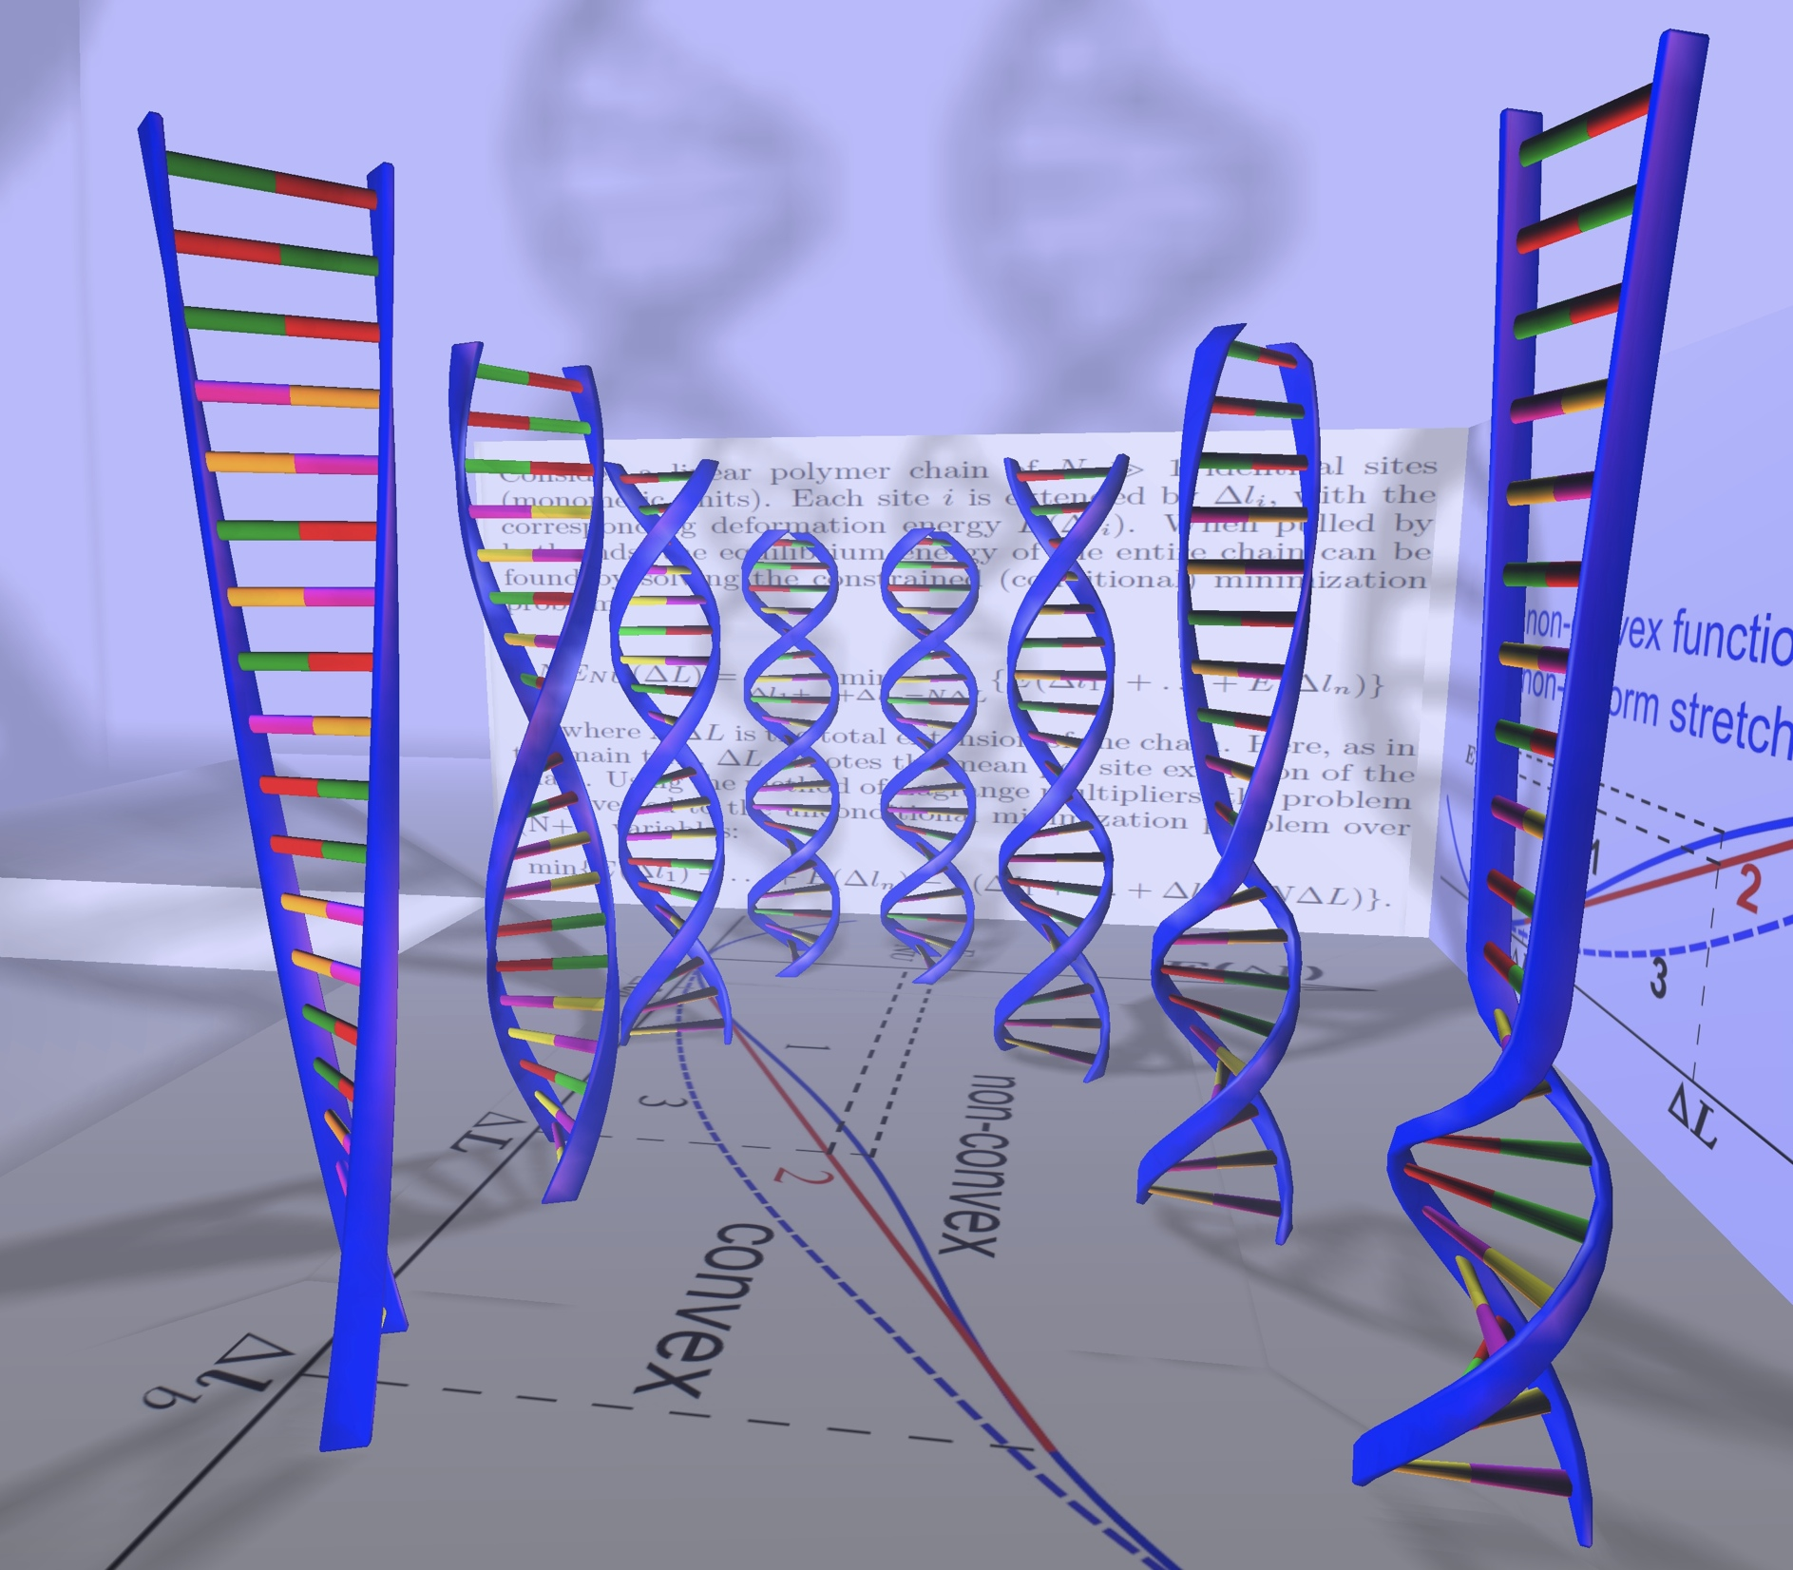
CS4414
Issues in Scientific Computing
Alexey Onufriev
Departments of CS and Physics
VT

Slide 2
Computational Science now: a paradigm shift
Experiment
From the Greeks to the recent past,
e.g. figuring out Earth’s radius
theory
Now
Computation

Slide 3
How it works
Image credit: http://www.physics.orst.edu/~rubin/INSTANCES/index.html

Slide 4
Computational Science/Scientific Computing in the grand scheme of things.
Natural Science
Computer Science
Computational Science
Math
Applied math
Computational Science:
solving science problems with computers
Pure CS: software and hardware,
Stand-alone algorithms (just like math)

Slide 5
Examples
Human Genome
Stealth Fighter
MRI
LHS
Weather Forecasts
Protein Folding
??? (input from class)

Slide 6
What can computational science accomplish?
Speed up finding a solution
Find additional solutions
Find solutions otherwise impossible to find
Discover new fundamental laws???

Slide 7
What is this class about?
Gives you a taste of what scientific computing is,
via realistic hands-on project (and homeworks).
Shows you how scientific computing is different from programming or math.
Introduces a number of useful tools and concepts
Teaches you how to work as part of a team
Will give you a glimpse of what computation can do for biology and modern medicine

Slide 8
What this class is not:
In-depth parallel computation course (e.g. CS5234)
In-depth numerical methods, where you learn everything there is to know about one or two common methods (e.g. finite elements, CS5484).
Focused on high performance libraries (e.g. LINPACK), you will get a good idea of what these are.

Slide 9
Specifics. Course structure.
Class websitehttp://courses.cs.vt.edu/cs4414/S13/

Slide 10
The nitty-gritty
By next class:
Access to a unix machine
Install Mathematica 9 (VT network software)
Pre-reqs, force adds

Slide 11
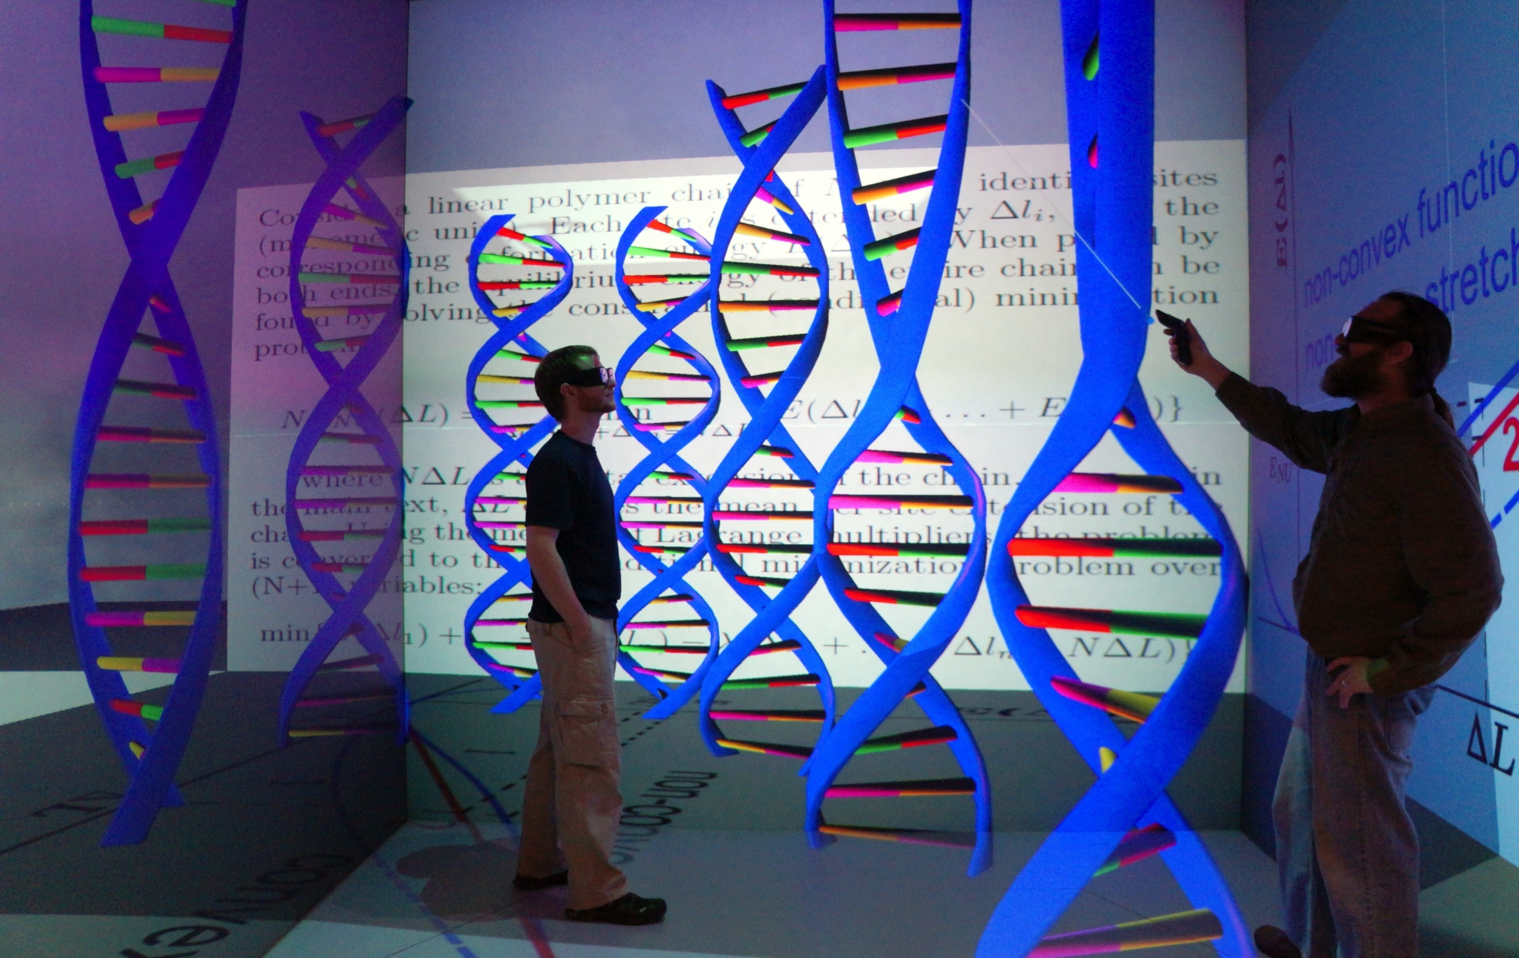
Enjoy!

