Slide 1
Molecular Mechanics (Molecular Force Fields)

Slide 2
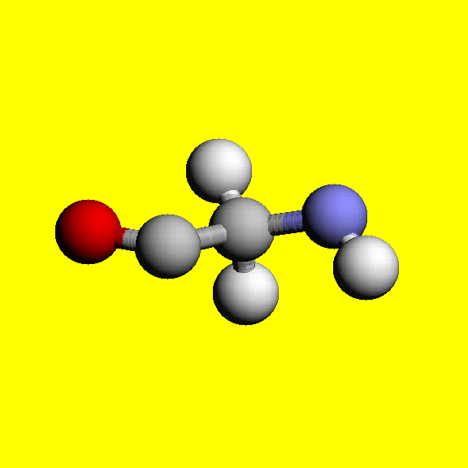
Principles of Molecular Dynamics (MD):
Y
Each atom moves by Newton’s 2nd Law: F = ma
F = dE/dr
System’s energy
+
-
Bond
spring
x
E =
Kr²
+ Q₁Q₂/r
+ …
+ A/r¹² – B/r⁶
Bond stretching
Electrostatic forces
VDW interaction
CHALLNGE: thousands or even millions of atoms to take care of

Slide 4
Molecular Dynamics:
PRICIPLE:
Given positions of each atom x(t) at time t, its position at next time-step
t + Δt is given by:
x(t + Δt) → x(t) + v(t) Δt + ½*F/m * (Δt)²
Key parameter: integration time step Δt. Controls accuracy and speed.
At every step we need to re-compute all forces acting on all the atoms
in the system.
force
Smaller Δt – higher accuracy , but need more steps. How many?

Slide 5
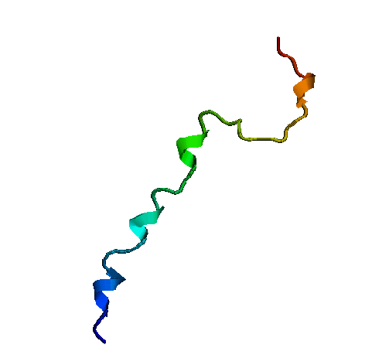
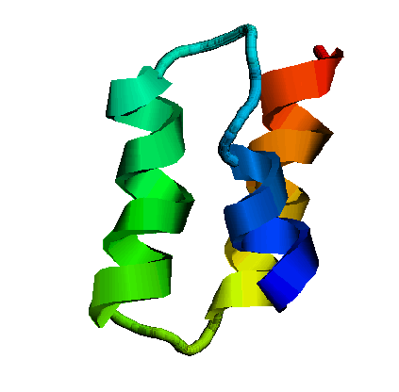
Main Hurdle: biology is too slow (compared to Δt).
biology
10⁻¹⁴
10⁻⁶
10⁰
Characteristic time scales [sec]
H-C bond vibration
Protein folding
For stability, Δt must be at least an order of magnitude less than the fastest motion, i.e Δt ~ 10⁻¹⁵ s. Example: to simulate folding of the fastest folding protein, at least 10⁻⁶/10⁻¹⁵ = 10⁹ steps will be needed .

Slide 6
A Classical Description
Balls and Springs
Hook’s Law
Bond Stretch
Energy
Bond Bend
Torsion about a Bond
Electrostatic Interaction
Van der Waals Interaction
Displacement from Equilibrium

Slide 7
Chemical Intuition behind
Functional Groups:
structual units behave similarly in different molecules.
Atom Types:
An atom‘s behavior depends not only on the atomic number, but also on the types of atomic bonding that it is involved in.
Example: Selected atom types in the MM2 force field
Type Symbol Description
1 C sp³ carbon, alkane
2 C sp² carbon, alkene
3 C sp² carbon, carbonyl, imine
4 C sp carbon
22 C cyclopropane
29 C• radical

Slide 8
Energy Decomposition
E_{total} = E_{stretch} + E_{bend} + E_{torsion} + E_{vdW} + E_{electrostatic}
Bonded energies
Non-bonded energies

Slide 9
Streching Energy: Morse Potential
A Morse potential describes the energy profile of a bond stretch quite accurately over a wide range of bondlength.
R
A Morse potential requires three parameters and is not efficient to calculate
Ε(R) = D_{e}{1 − exp [−α (R − R₀)]}²
where D_{e} = dissociation energy, α = ω(μ/2D_{e})^{1/2}, μ is the reduced mass, ω is related to the bond stretching frequency by ω = (k_{s}/μ)^{1/2}, k_{s} is the force constant, and R₀ is the equilibrium bondlength.

Slide 10
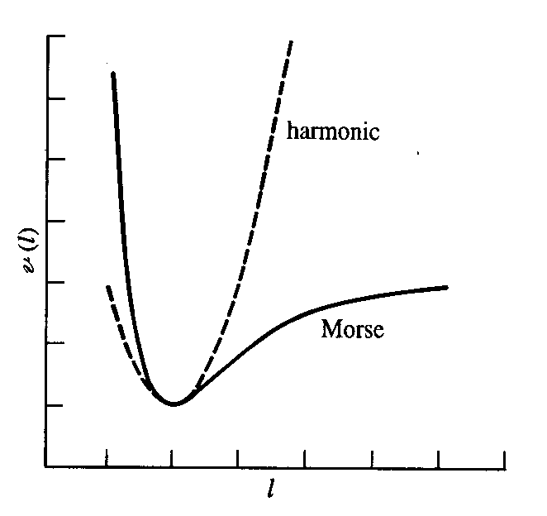
Stretching Energy: Harmonic Potential
R
In molecular mechanics simulations, displacement of bond length from equilibrium is usually so small that a harmonic oscillator (Hooke’s Law) can be used to model the bond stretching energy:
Ε(R) = 0.5∗k_{s}(R − R₀)²
E
R

Slide 11
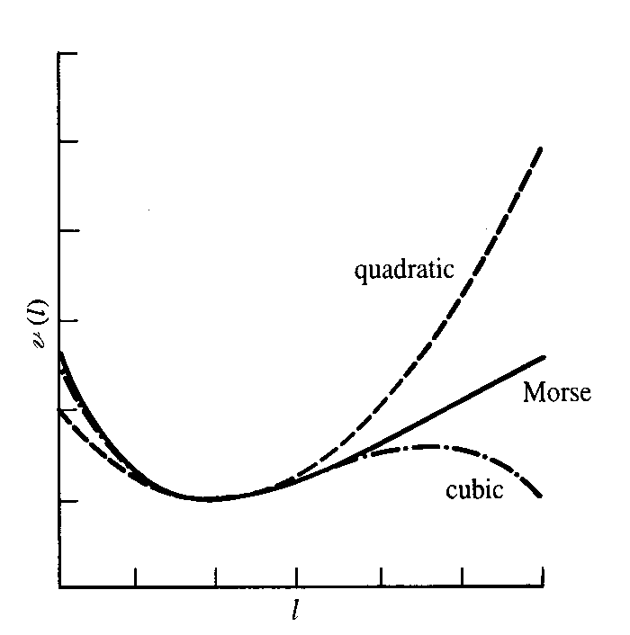
Refinement by High-order Terms
R
Higher-order terms such as cubic terms can be added for a better fit with however an increased computation cost:
Ε(R) = 0.5∗k_{s}(R − R₀)²
∗[1 + k′(R − R₀)
+ k″(R − R₀)² + …]
E
R

Slide 12
Bending Energy
Usually described by harmonic potentials:
Ε(θ) = 0.5∗k_{b}(θ − θ₀)²
Refinement by adding higher-order terms can be done.
θ

Slide 13
Torsional Energy
Associated with rotating about a bond
An important contribution to the torsional barrier (other interactions, e.g., van der Waals interactions also contribute to the torsional barrier).
φ
Potential energy profile is periodic in the torsional angle φ.

Slide 14
Torsional Energy: Fourier Series
φ
E(φ) = 0.5∗V₁ (1 + cos φ) + 0.5∗V₂ (1 + cos 2φ) + 0.5∗V₃ (1 + cos 3φ)

Slide 15
Out-of-plane Bending: Improper Torsional Energy
To keep 4 atoms in a plane, e.g., the three C atoms and one H atoms as indicated in C₆H₆
H
C
C
C
Ε_{imp}(φ) = 0.5∗k_{imp}(φ − φ₀)²
When ABCD in a plane, dihedral φ_{ABCD} is 0 or 180°.
When B is out of the plane, dihedral φ_{ABCD} deviated from the ideal value, and the enegy penalty tries to bring it back to the plane.
B'
B
C
D
A

Slide 16
Van der Waals Energy
Interactions between atoms that are not directly bonded
Very repulsive at short distances, slightly attractive at intermediate distances, and approaching zero at long distances
R
Repulsion is due to overlap of electron clouds of two atoms.
Attraction is due to the dispersion or induced multipole interactions (dominated by induced dipole-dipole interactions).

Slide 17
VDW: Lennard-Jones Potential
E_{LJ} (R)= ε [(R₀/R)¹² – 2(R₀/R)⁶]
R₀^{AB} = R₀^{A} + R₀^{B}
ε ^{AB} = (ε ^{AB} ∗ε ^{AB})^{1/2}
The use of R⁻¹² for repulsive is due to computational convenience.
There are other functions in use, but not popular because of higher computational costs.
Calculated pairwise but parameterized against experiemental data — implicitly include many-body effects.

Slide 18
Charge Distribution
Model the charge distribution by distributed multipoles: point charges, dipoles, ...
Atomic Partial charges: assigning partial charges at atomic centers to model a polar bond
Bond dipoles: a polar bond can also be modeled by placing a dipole at its mid-point (getting rare now).
O: −0.834 e
H: 0.417 e
C2: −0.120 e
H: 0.060 e
C1: −0.180 e
Partial Charges for H₂O and n-butane (OPLS-AA)

Slide 19
Electrostatic Energy
E_{el} (R) = (Q^{A}Q^{B})/(ε R^{AB})
ε is dielectric constant that models the screening effect due to the surroundings.
Calculated pairwise but parameterized against experimental or ab initio data, the many-body effects are implicitly accounted for
Explicit polarization is more difficult, and is now one of the hot topics in molecular mechanics development .

Slide 20
Special Terms
E_{cross} brings correction to energy due to the couplings between stretches, bends, and torsions.
E_{H-bond} is an additional term to improve the accuracy of H-bonding energy that is mainly due to electrostatic contributions.
Non-bonded interactions are not calculated for atom pair that are connected directly (1,2-interaction) , and are often scaled down by a factor if the atoms are connected via two bonds (1,3-interaction) or three bonds (1,4-interaction).

Slide 21
Use of Cut-offs
Non-bonded interactions are expensive to calculated — there are so many atom pairs!
Non-bonded interactions decrease as distance increases, and beyond a certain distance, they can be so small that we want to neglect them.
R_{m}
R
Use of Cut-offs (typically 10 to 15 Å) helps us out!
However, be careful when use them:
Are the neglected interactions really negligible?
Have we properly handled the discontinuity at the cut-off boundary?

Slide 22
Accounting for water is a must for any biological simulation. Two ways to incorporate water.
Explicit water
Implicit water
See next slide.

Slide 23
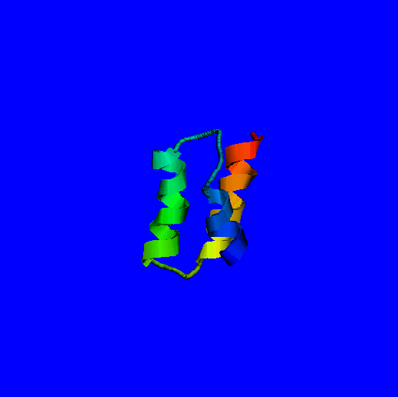
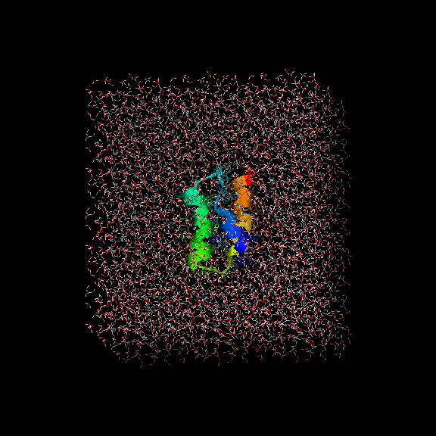
Disadvantage: Slow
Advantage: detailed, more accurate description
Implicit water as dielectric continuum
Explicit water (traditional)
Low computational cost. Fast dynamics.
Advantages: 1. Faster conformational search
(fewer degrees of freedom, no viscocity)
2. Easy ways to estimate energy of a structure.
Large computational cost. Slow dynamics.

Slide 24
Understand Force Fields
The zero of energy is arbitrary.
The absolute enegy is meaningless!
Comparisons should be made for systems having the same number and types of structural units, or for a system at different conformations.
The parameters are JUST parameters.
Parameters such as ideal bondlengths are not experimental equilibrium bondlengths, although they are close to each other.

Slide 25
Understand Force Fields (2)
The preditction power is limited.
The accuray is usually not very good, and depends heavily on parameterization.
It can only be used for systems having the functional groups that were included in parameterization.
A good strategy to claim how reliable the results could be.
Before apply your force field parameters to big molecules, validate them on small compunds where reliable experimental data are available for compasion.
(You never prove it, but you can show that how much it is likely to be.)

