Slide 1
Optimization Basis
Class XI

Slide 2
Minimization of Functions
The problem of finding the local minima (or maxima) of a function
Function can have one or several variables, e.g. F(x,y,z)
The principal technique from calculus:
$$\frac{∂F}{∂x}=\frac{∂F}{∂y}=\frac{∂F}{∂z}=0$$
This direct approach can be difficult to carry out for a function with many variables
Example: PROTEIN FOLDING problem

Slide 3
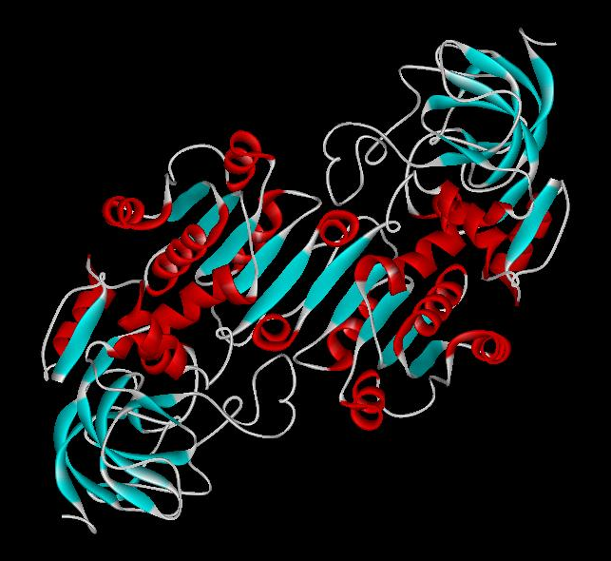
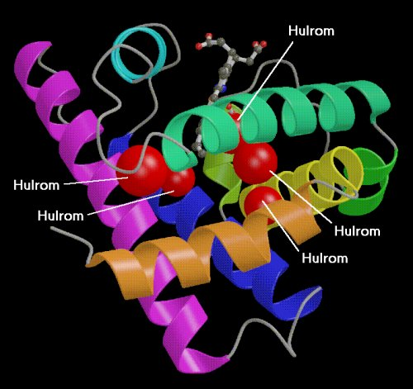
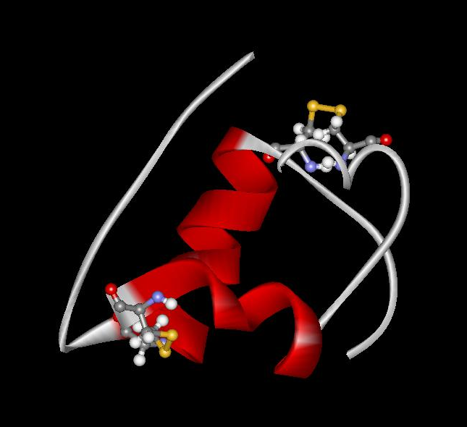
Proteins play most key roles in all living system; their miss-folding causes disease
Three (out of many many) examples of protein functions
Catalysis: Almost all chemical reactions in a living cell are catalyzed by protein enzymes.
Transport: Some proteins transports various substances, such as oxygen, ions, and so on.
Information transfer: For example, hormones (insulin), nerve impulse (membrane ion channels)
Alcohol dehydrogenase oxidizes alcohols to aldehydes or ketones
Myoglobin stores oxygen
Insulin controls the amount of sugar in the blood

Slide 4
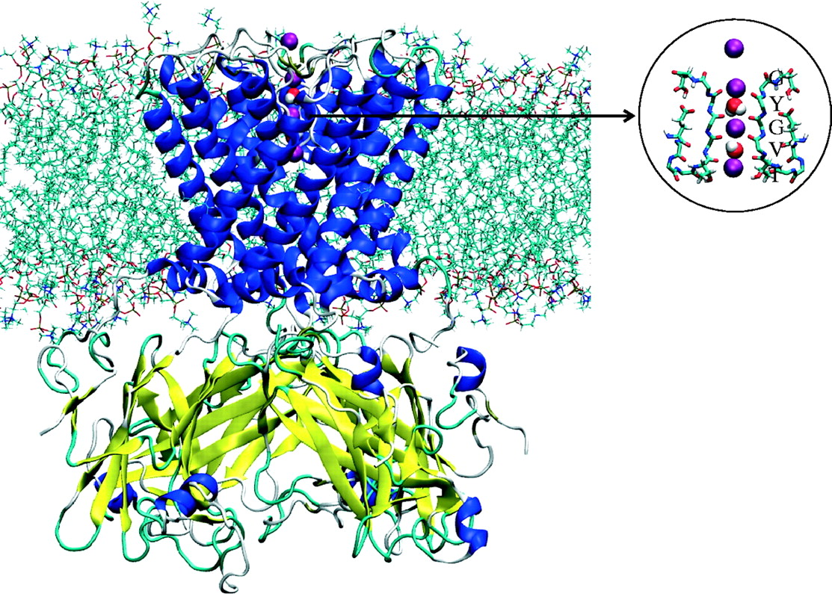
The KirBac1.1 potassium channel (PDB 1P7B) embedded in a lipid bilayer
Christopher J. Illingworth, and Carmen Domene Proc. R. Soc. A 2009;rspa.2009.0014
Copyright © 2009 The Royal Society
Notes:
The KirBac1.1 potassium channel (PDB 1P7B) embedded in a lipid bilayer, with individual lipids rendered as cyan chains. The transmembrane α-helices are rendered as blue ribbons and the extracellular domain is coloured according to its structure (yellow, beta sheet; white, random coil; cyan, turns). K+ ions are rendered as purple spheres, and water oxygen and hydrogen as red and white spheres, respectively. Only waters in the selectivity filter are shown. On the right, atomic detail of the selectivity filter (TVGYG motif) in a representative conductive structure is presented. For visual clarity, atomic detail is given only of two diametrically opposed subunits.

Slide 5
Nerve impulse (action potential) in neuron

Slide 6
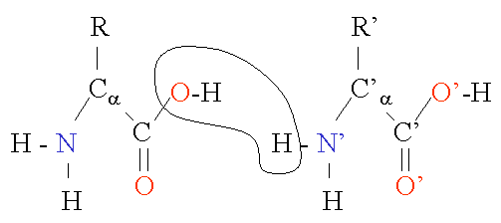
Protein Structure in 3 steps.
Step 1. Two amino-acids together (di-peptide)
Peptide bond
Amino-acid #1
Amino-acid #2

Slide 7
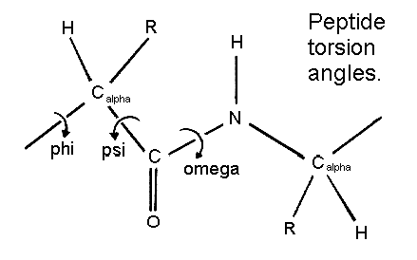
Protein Structure in 3 steps.
Step 2: Most flexible degrees of freedom:

Slide 8
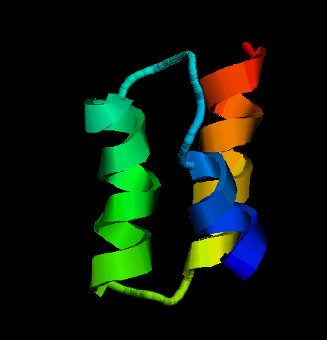
The protein folding challenge
Nature does it all the time. Can we?
Amino-acid sequence – translated genetic code.
MET—ALA—ALA—ASP—GLU—GLU--….
How?
Experiment: amino acid sequence uniquely
determines protein’s 3D shape (ground state).
Why bother ?:
Protein’s shape determines its biological function.

Slide 9
A protein is simply a chain of amino-acids:
φ₄
φ₂
φ₃
φ₁
Each configuration {Φ1, Φ2, …Φκ} has some energy.
The folded (biologically functional) protein has
the lowest possible energy - global minimum.
So, can we just find this conformation by some kind of a
minimization algorithm … what’s the big deal?

Slide 10
The magnitude of the protein folding challenge:
Enormous number of possible conformations of the polypeptide chain.
φ₄
φ₂
φ₁
φ₃
A typical protein is a chain of ~ 100 amino acids.
Assume that each amino acid can take up only 10 conformations (vast underestimation)
Total number of possible conformations: 10¹⁰⁰
Suppose Nature “makes” each energy estimate in just 10⁻¹⁵ seconds (which is about right, from how long it takes for these things to move). In today’s language, just 1 float point operation on a PetaFlop supercomputer.
An exhaustive search for the global minimum would take 10⁸⁵ seconds ~ 3*10⁷⁸ years. Age of the Universe ~ 2*10¹⁰ years.

Slide 11
The Levinthal’s paradox (1969)
Nature has to compute the protein it makes.
But the computation takes forever, hence protein folding is not possible.
Yet, we are alive.

Slide 12
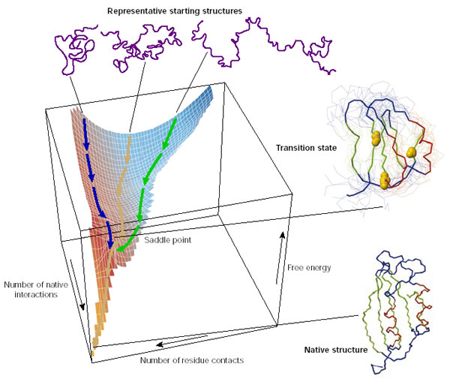
Adopted from Dobson, NATURE 426, 884 2003

Slide 13
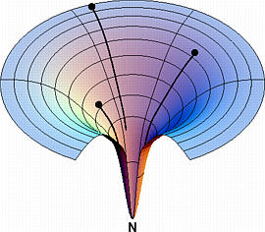
2
3
Free energy
1
Finding a global minimum in a multidimensional case is easy only when the landscape is smooth. No matter where you start (1, 2 or 3), you quickly end up at the bottom -- the Native (N), functional state of the protein.
Folding coordinate
Adopted from Ken Dill’s web site at UCSF

Slide 14
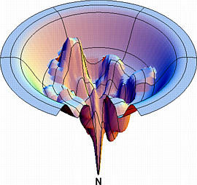
Realistic landscapes are much
more complex, with multiple
local minima – folding traps.
Proteins “trapped” in those
minima may lead to disease,
such as Altzheimer’s
Adopted from Ken Dill’s web site at UCSF

Slide 15
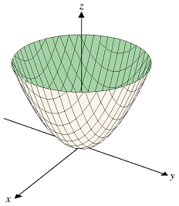
Additional complication: protein folding problem = highly constrained minimization
E(x,y,z) = x² + y² ⁺ z² – easy to solve. Min = (0,0,0).
Becomes much more complex if a complex constraint is added e.g. Sin²(x) + y + z = const.
In the case of protein folding, constraint comes from the specific amino-acid connectivity – beads on a string chain.

Slide 16
Since simple minimization won’t work, choose an alternative.
A method inspired by nature: just let it fold on its own, at normal temperature.
Method: Simulated Annealing

Slide 17
How are proteins folded computationally?
One possibility: find minimum energy by simulated annealing:
use temperature to “kick” the system out of local minima

Slide 18
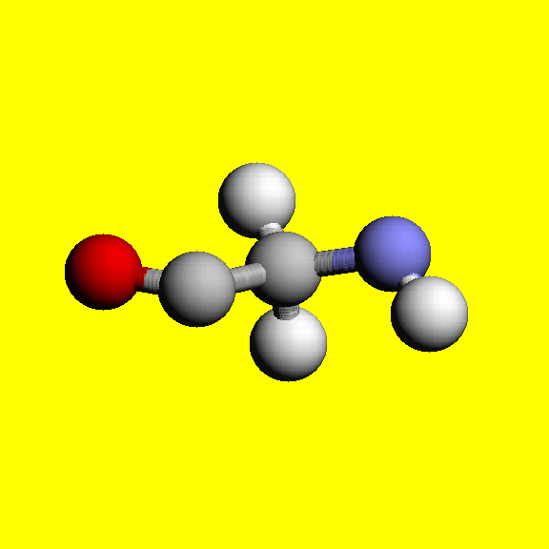
Principles of Molecular Dynamics (MD):
Y
Each atom moves by Newton’s 2nd Law:
F = ma
F = dE/dr
System’s energy
+
-
Bond
spring
x
E =
Kr²
+ A/r¹² – B/r⁶
+ Q₁Q₂/r
+ …
Bond stretching
VDW interaction
Electrostatic forces

Slide 19
Molecular Dynamics:
PRICIPLE:
Given positions of each atom x(t) at time t, its position at next time-step
t + Δt is given by:
x(t + Δt) → x(t) + v(t) Δt + ½*F/m * (Δt)²
Key parameter: integration time step Δt. Controls accuracy and speed of numerical integration routines.
force
Smaller Δt – more accurate, but need more steps.
How many needed to simulate biology?
How many can one afford?

Slide 20
Can compute statistical averages,
fluctuations;
Analyze side chain movements,
Cavity dynamics,
Domain motion,
Etc.
Now we have positions of all atoms
as a function of time.

Slide 21
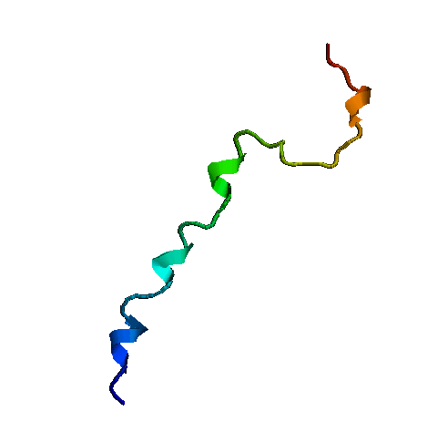
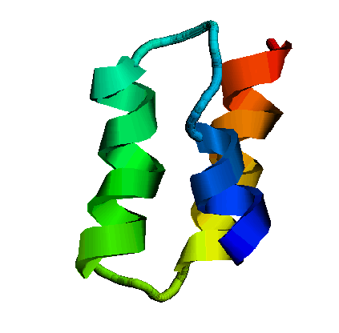
As a result, we can not quite get into the “biological” time scales.
Currently accessible times
biology
10⁻¹⁴
10⁻⁶
10⁰
Characteristic time scales [sec]
H-C bond vibration
Protein folding
Time-step, Δt
For stability, Δt must be at least an order of magnitude less than the fastest motion, i.e Δt ~ 10⁻¹⁵ s. Example: to simulate folding of the fastest folding protein, at least 10⁻⁶/10⁻¹⁵ = 10⁹ steps will be needed.

Slide 22
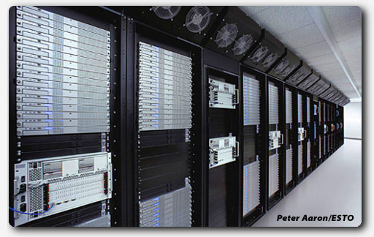
Massive parallel machines help.
Virginia Tech’s supercomputer, System-X

Slide 23
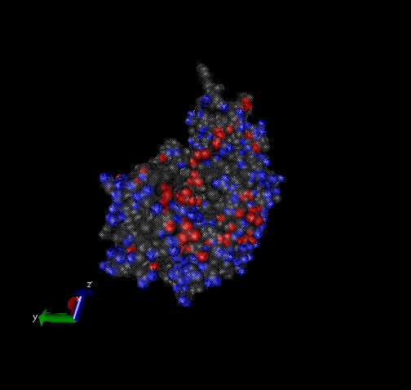
The “worst” problem for parallel computations:
Force acting on each atom depends upon positions of every other atom in the system.
Processor #1
Processor #2
X₁, F(on X₁)
X₂, F(on X₂)
Computed coordinates have to be communicated between all processors at each step
Processor #3
Processor #4

Slide 24
Modern resolution of Levinthal’s paradox: fast folding down very few pathways.

Slide 25
Intrigued?
Suggested articles:
1.“Protein Folding and Misfolding”, C. Dobson, Nature 426, 884 (2003).
2. “Design of a Novel Globular Protein Fold with Atomic-level Accuracy, Kuhlman et al. , Science, 302, 1364, (2003)
+ references therein.

