Slide 1
Numerical solutions of ODEs

Slide 2
Euler’s Method: grandfather of all modern approaches.

Slide 3
Euler’s Method: grandfather of all modern approaches.

Slide 4
Euler’s Method: grandfather of all modern approaches.

Slide 5
Euler’s Method: grandfather of all modern approaches.

Slide 6
Euler’s Method: grandfather of all modern approaches.

Slide 7
Euler’s Method: grandfather of all modern approaches.

Slide 8
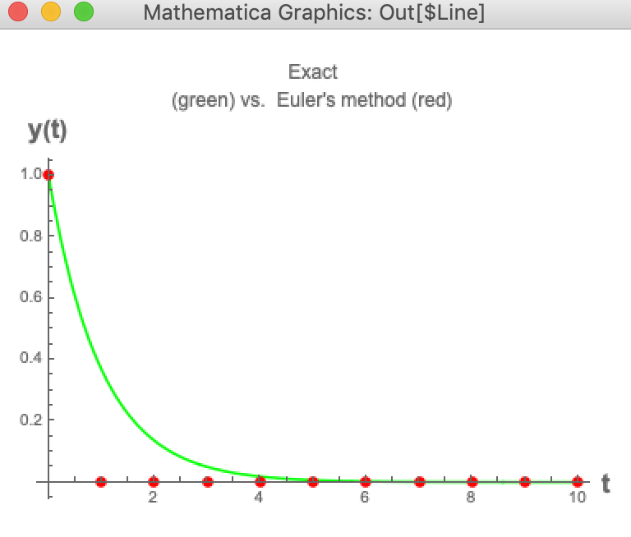
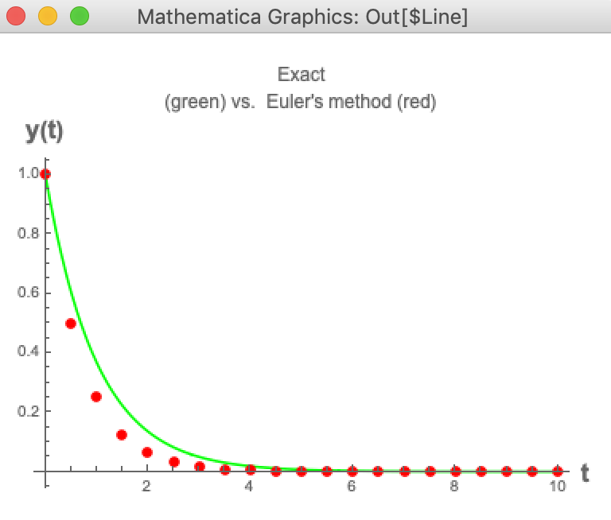
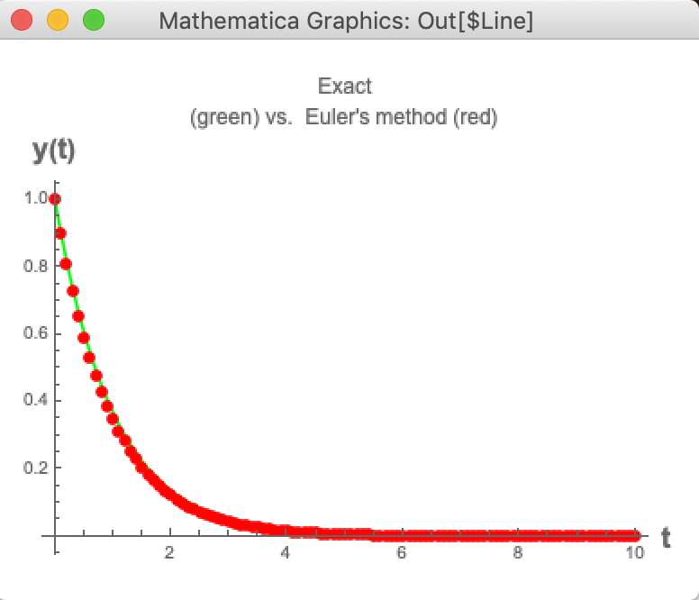
The effect of step size (discretization) h
Solving y’ = - y , y(0) = 1, Euler’s method, step size h.
h=1
h=0.5
h=0.1

Slide 9
Inevitable errors in numerical solutions of ODES. Several types of errors
AT EACH ITERATION STEP: (1) Truncation error (determines the accuracy as a function of step-size h. ) Example: Euler’s local truncation error ~ h². -> 0 as h -> 0.
(2) Round-off error: depends on machine precision. Always there.
BOTH types of error accumulate over the very many steps, yielding the global errors, both truncation and round-off. Example: Euler’s global truncation error ~ (# steps)*(local_error) ~ h. Round-off errors can also accumulate, typically ~ sqrt(# of steps).
Total global error is the sum of the above, and may be much higher than the total local. It usually increases with the number of steps. Need very clever algorithms to reduce/control.

Slide 10
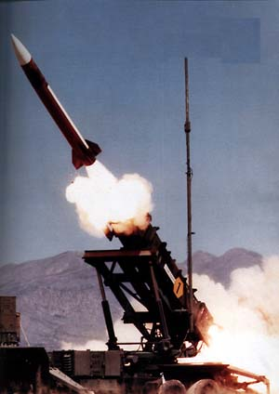
Local errors have accumulated….
Patriot Missile Failure,
1st Gulf war. 28 dead.

Slide 11
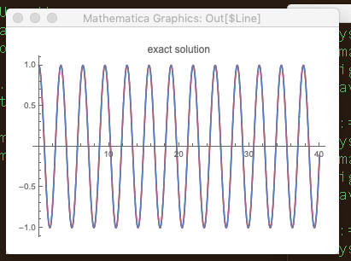
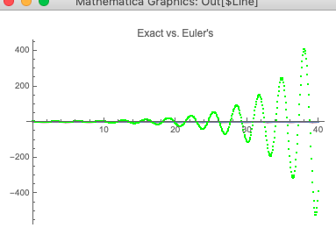
Stability of a method:
The method is said to be stable if small perturbations do not cause the solutions to diverge from each other without bound. Otherwise, the method is UNSTABLE.
Example: solving x’’ = -4x with Euler’s, with a pretty large step h.
Signature of an unstable method

Slide 12
Numerical Stability Analysis of Euler’s Method
ODE to solve: y’ = λy. Assume λ < 0 (solution does not “blow up” at large t )
Euler’s iteration: y_{n+1} =y_{n} + λh * y_{n}=(1+hλ)y_{n}, n=0,1,...
with y₀ = 1.
By induction, y_{n+1} =(1+hλ)^{n}, n≥0
The numerical solution y_{n} → 0 as n → ∞ if and only if |1 + hλ| < 1
In the case λ is real and negative, this is equivalent to −2<hλ<0, or h< 2 −λ
What happens when h is large? Small?

Slide 13
Choosing the iteration (time) step size h in practice
There is no single formula for this. Some cases may be tricky. Start with some reasonable first guess step size h. Obtain the solution. Then re-do the calculation with step h/2. If both answers are within the desired tolerance, you are OK for a stable ODE and stable method.
Some ODEs benefit from an adaptive step h, which changes along the way (we will not study those in this class).
A general rule of thumb: ”choose good guess h so that the function changes little over the h step. “ (Look at points where the rate of change is largest. ) But do not overdo it: h much smaller than needed will surely be costly (many steps) and also may lead to accuracy deterioration over a long run. (Why? Recall which kinds of errors are involved.)

Slide 14
The effect of step size (discretization) h
Solving y’ = - y , y(0) = 1, Euler’s method, step size h.
h=1
h=0.5
h=0.1

Slide 15
Choosing (a reasonable first guess) step size h in practice. An Illustration.
Example #1
Example #2

Slide 16
Choosing the (a reasonable first guess) step size h in practice. Example #1

Slide 17
Choosing the (a reasonable first guess) step size h in practice. Example #1.
General approach:
identify time interval τ over which the relative change of the function is large, in the ``worst case”.
Choose h << τ

Slide 18
Choosing the (a reasonable first guess) step size h in practice. Example #1.

Slide 19
Choosing the right h in example #1
Solving y’ = - y , y(0) = 1, Euler’s method, good first guess step size h << 1/k. In this example k = 1. h=0.1 is not too bad, h = 0.01 should be good (check!)
h=1
h=0.5
h=0.1

Slide 20
Choosing (a reasonable first guess) step size h in practice. An Illustration.

Slide 21
Choosing (a reasonable first guess) step size h in practice. An Illustration.

Slide 22
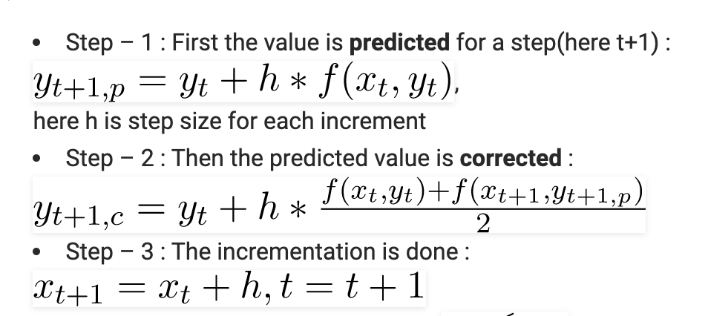
Much more accurate methods have been developed since Euler’s time.
Predictor– Corrector.
EXAMPLE: Runge-Kutta (4th order, error ~ h⁴). ”Simple” default in many packages.

Slide 23
Stability of ODE itself (regardless of method to solve it).
A solution of the ODE yʹ = f (t, y) is stable if for every ε > 0 there is a δ > 0 such that:
If yˆ(t) satisfies the ODE and |yˆ(t0)−y(t0)| ≤δ then | yˆ(t) − y(t)| ≤ ε for all t ≥ t0 (t0 = starting point).
This rules out exponential divergence if the initial value is perturbed (e.g. due to round-off error) : a small deviation from the initial condition will stay “small” for any t.
An unstable ODE is analogous to an “ill-conditioned problem”: small perturbations cause large deviations.

Slide 24
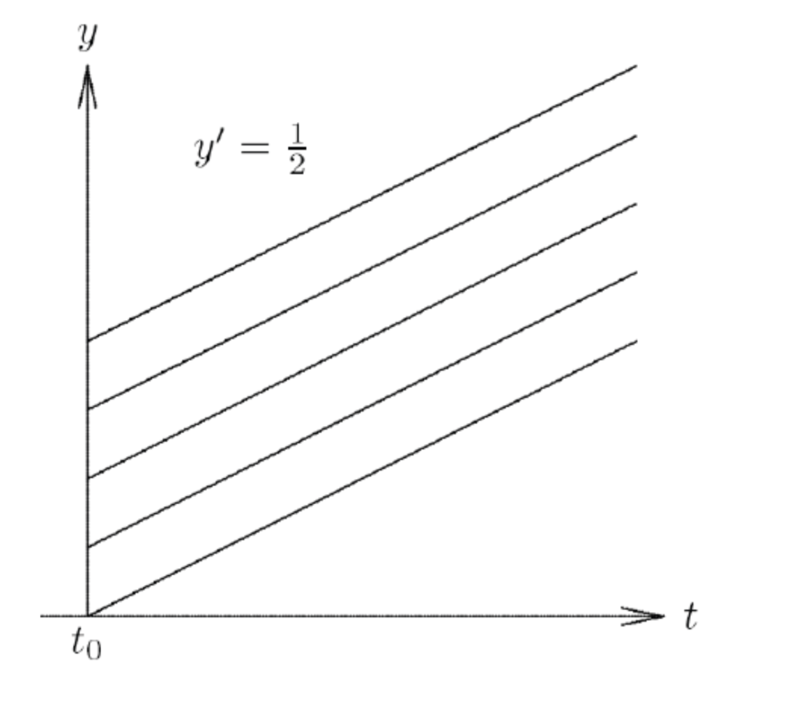
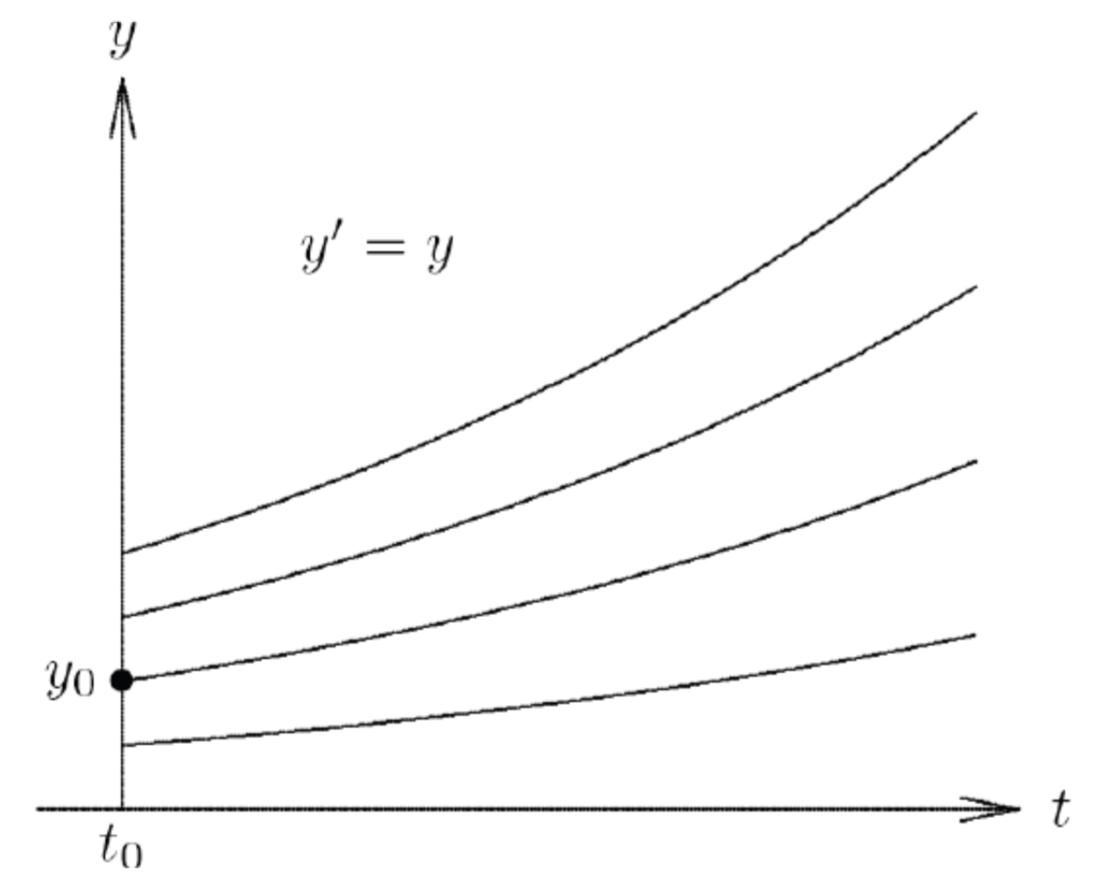
Stability of ODE (exact) solutions :
EXPLORE: ODE.stability.math
Initial condition y(0)
Stable
Stable
UNStable

Slide 25
Predicting Weather.

Slide 26
Predicting Weather: solving unstable ODEs.
The butterfly effect

Slide 27
Another famous example of an unstable ODE:
Two segments of the three-dimensional evolution of two trajectories for the same
period of time in the Lorenz attractor starting at two initial points that differ by only 10⁻⁵ in the x-coordinate.
Source: the Wiki.
t=30
t=30
t=0
t=0

Slide 28
Interlay between ODE stability and Method stability.
If the ODE is unstable, its numerical solution is likely not to converge to the correct solution even if the method itself is stable. Inevitable errors in the initial condition, round-off errors will get amplified.
For a stable ODE, but an unstable method, you are likely to run into problems, e.g. wildly oscillating or “run away” solutions.
For a given ODE, the method may be stable for small enough h, but typically becomes unstable for large h.
For a stable ODE and a stable method you are OK, but the local/global errors are still there. The combination of the method and the ODE will determine the step size needed for the given accuracy.

