Slide 1
Roots of equations

Slide 2
Last time
We started new topic: Roots of Equation
Definition of root or zero of function f(x). Examples.
Bisection method of finding roots at the interval [a,b]. After n steps the estimate of a root is $r=(a_{n}+ b_{n})/2$ i.e. root is trapped in the interval [$a_{n}, b_{n}$]
Error in Bisection method $ε≤(b−a)/2^{n+1}$
Linear convergence (slow).
We started to study Newton’s method of finding roots.

Slide 3
Newton’s Method
Function f(x) is differentiable, preferably analytically (or numerically).
Let point $x_{0}$ be a starting point and some initial approximation to the root

Slide 4
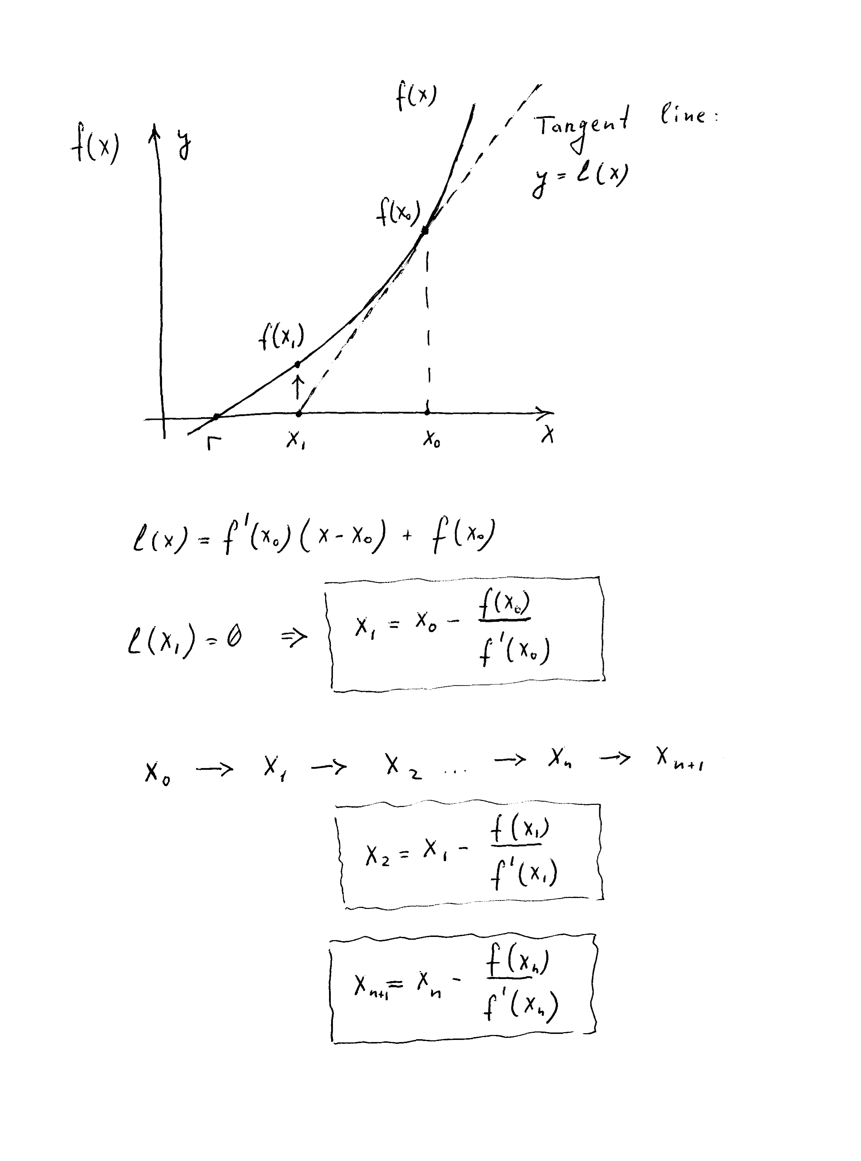

Slide 5
Newton’s Method
This method gives as a sequence:
$x_{0}$, $x_{1}$, $x_{2}$, …, $x_{n},{ x}_{n+1}$
where the n-th approximation to the root is
${r=x}_{n}$

Slide 6
Example
$f\left(x\right)=$ $x^{3}−2x^{2}+x−3$
Let us start finding root from ${ x}_{0}$=3, $f{(x}_{0})=$ 9
$f′\left(x\right)=$ $3x^{2}−4x+1$
In five steps (n=5) we will have
$x_{5}=2.1745594102932841$ and $f{(x}_{5})=1.97×{10}^{−12}$
Rather fast convergence of the sequence of ${ x}_{n}$ to the root.

Slide 7
Convergence analysis in Newton’s method
Function f(x): f(r)=0, derivatives f’ exist.
Newton’s method, if started sufficiently close to root r, converges quadratically:
$|{r−x}_{n+1}|$ $≤c$ ${|{r−x}_{n}|}^{2}$
${ x}_{n+1}$ has approximately twice as many correct digits as $x_{n}$
Suppose c=1 and $|{r−x}_{n}|$ $≤$ ${10}^{−k}$ ➔ $|{r−x}_{n+1}|$ $≤$ ${10}^{−2k}$
If k=2, error decreases from 0.01 to 0.0001

Slide 8
Contrast Newton’s Convergence to that of Bisection:
Function f(x) is continuous: f(r)=0.
Bisection: r converges linearly:
$|{r−x}_{n+1}|$ $≤c$ ${|{r−x}_{n}|}^{}$
${ x}_{n+1}$ has approximately as many correct digits as $x_{n}$
c=1/2 and $|{r−x}_{n}|$ $≤$ ${10}^{−k}$ ➔ $|{r−x}_{n+1}|$ $≤$ ${0.5∗10}^{−k}$
If k=2, error decreases from 0.01 to 0.005 only.

Slide 9
Explore Newton’s method
root2.math multiple examples.

Slide 10
ResourceFunction["FindRootPlot"][x^2 -1, {x, 0.2}, Method -> {"Newton", "StepControl" -> None}]
0.2

Slide 11
ResourceFunction["FindRootPlot"][x^2 -1, {x, 1.3}, Method -> {"Newton", "StepControl" -> None}, PlotRange->{{0.5, 1.5},{-1.0, 1.0}}, Frame -> True]

Slide 13
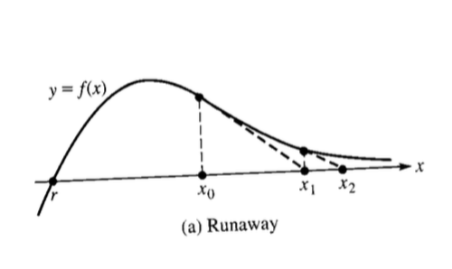
Pitfalls of Newton’s method
a) Runaway
Each successive point $x_{n}$ in Newton’s iteration recedes from r instead of converging to r. Pure choice of the initial point $x_{0}.$

Slide 14
Run Away: specific example.

Slide 15
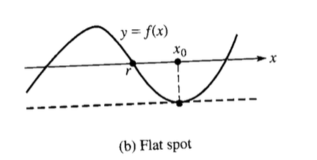
Pitfalls of Newton’s method
b) Flat spot
The tangent to the curve is parallel to the x-axis resulting in $x_{1}=±∞.$

Slide 16
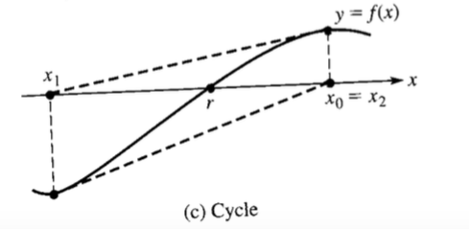
Pitfalls of Newton’s method
c) Cycle
The iteration values cycle because $x_{2}{=x}_{0}.$

Slide 17
Convergence analysis in Bisection method
Suppose error tolerance TOL has been prescribed in advance.
How to determine number of steps n required in the Bisection method that error in root estimate $ε<TOL$ ?
Recall that $ε≤(b−a)/2^{n+1}$ leading to $(b−a)/2^{n+1}$ < $TOL$
Taking logarithms: log(b-a) – n log 2 < log ($2∗TOL)$
We have inequality:
n > [ log(b-a) - log ($2∗TOL)$ ] / log 2

Slide 18
How do you stop iterations in general, in practice?
Remember: you don’t know the root value.

Slide 19
How to choose TOL?
Do not choose higher accuracy than you need for your specific problem – waste of time, possible instability when close to machine precision.
At any rate, for the root finding problem, the highest possible accuracy, or lowest TOL ~ e_mach. Can’t get any more accurate: when the difference between the n and n+1 iteration will get close to e_mach the algorithm (any) will stop converging as you will be getting zeros.

Slide 20
Examples of Mathematica functions for finding roots
Script roots.math:
function Solve[f(x)==0, x] - analytical solution for f(x)=0
function Nsolve[f(x)==0, x] - numerial solution for f(x)=0
These two Mathematica functions are good for solving linear fuctions or polynomials
More universal Mathematica function is FindRoot[] which uses Newton’s method
Script root2.math:
to eliminate the initial value problem FindRoot[f(x) == 0., {x, Random[]}]

Slide 21
Mathematica function for solving a system of nonlinear equations (just FYI, will not be on HW or exams ).
Script root2D.math:
Function FindRoot can be applied for solving a system of nonlinear equations
FindRoot[{f1(x,y,z)==0, f2(x,y,z)==0, f3(x,y,z)==0}, {x, a}, {y,b}, {z,c}]
where f1, f2 and f3 are different nonlinear functions. a, b and c are initial values for arguments x, y and z respectively.

