Slide 1
Roots of equations

Slide 2
Last time
We applied Taylor series to evaluate values of several functions and to estimated errors of these evaluations
We considered alternating series and the error in truncating the series with converging terms
We run Mathematica script Exp.math which estimates the value of function exp(z) expanded in Taylor series for different z and number of terms in expansion. We considered the case with z=-20 when the direct approach fails.
We learned how to avoid loss-of-significance in subtraction by using Taylor series expansion. We learned how to estimate the error in approximating functions using Taylor series expansion.

Slide 3

Work balance between in-class and out of class.
In-class

Slide 4
In this lecture:
We start new topic – roots of equation

Slide 5
Definition
If f(x) is a function of a real or complex variable x , then a number r (x=r) for which f(r)=0 is called a root or a zero of f(x).
Example: function f(x) = 12*x^2 - 11*x + 2 has two roots: 1/4 and 2/3
To verify this we can write f(x) in its factored form:
f(x) = (4x – 1)(3x – 2)
Another example:
f(x) = sin(x) – x
Roots? How many?

Slide 6






Do not Need a numerical method

Slide 7





Need one.

Slide 8
Another example
Function f(x) = cos(3x) – cos (7x)
Roots? x=0 ?

Slide 9
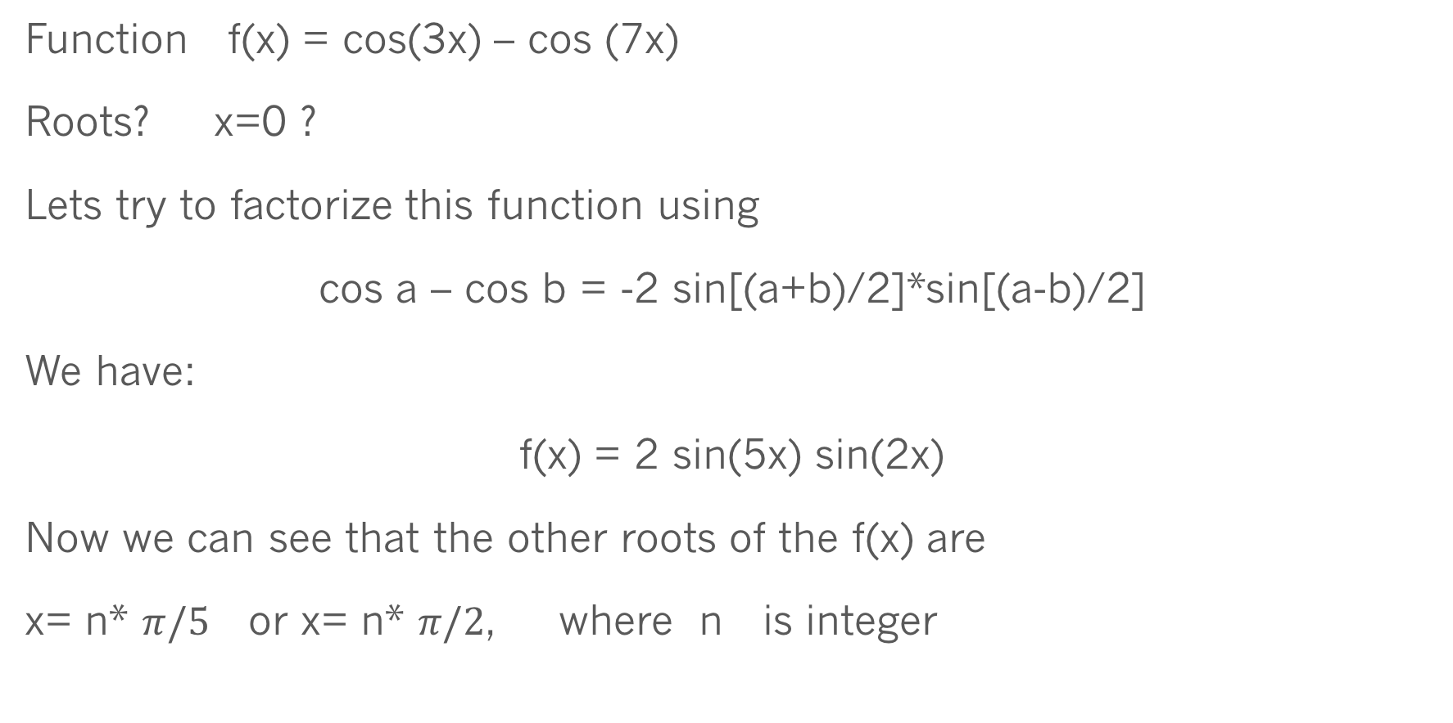
Another example where you do not need a numerical method
Function f(x) = cos(3x) – cos (7x)
Roots? x=0 ?
Lets try to factorize this function using
cos a – cos b = -2 sin[(a+b)/2]*sin[(a-b)/2]
We have:
f(x) = 2 sin(5x) sin(2x)
Now we can see that the other roots of the f(x) are
x= n* $π/5$ or x= n* $π/2$, where n is integer

Slide 10
Why roots are important?
Very often the solution of scientific or engineering problem is a number about which we know that it satisfies some equation, e.g.
F(x) = Y(x)
This equation can be written in a form
F(x) – Y(x) = 0
Then a desired number must be a root of the function
f(x) = F(x) – Y(x)

Slide 11
Real life engineering problem
In some electrical circuit, the current I and voltage V are related by two equations:
I = a [exp(bV) – 1]
c = dI + V
a, b, c and d are known constants
Combining these two Eqs. and eliminating I we have
ad [exp(bV) – 1] +V – c = 0
This equation has to be solved to find the value(s) of V

Slide 12
What do we need to find roots of a function ?
General-purpose numerical methods are needed that do not depend on special properties of functions except continuity and (sometimes) differentiability, which are very common attributes of most functions we usually deal with.
For the absolute majority of real life problems encountered in practice,
analytical closed-form solutions are unavailable -> need a numerical method.
We will cover two of them: bisection method and Newton’s method.

Slide 13


The bisection method: idea

Slide 14
Need:
Initial bracketing interval.
Stopping condition(s).
(Function must be continuous)

Slide 15
Bisection method
Function f(x) on the interval [a,b]
Suppose that f(a)*f(b) < 0 ( e.g. f(a) > 0 and f(b) < 0 )
f(x) has a root on [a,b], i.e. somewhere on [a,b] f(x)=0
(1) Let c= a + (b-a)/2 Two interval: [a,c] and [c,b]
(2) Compute f(c)
(3) If f(a)*f(c) < 0 (or sign[f(a)] != sign[f(c)] ) then root is on [a,c]
(4) b ⬅ c, f(b) ⬅ f(c), go to (1) [compute new c]
(3‘) If f(a)*f(c) > 0 then root is on [c,b]
(4‘) a ⬅ c, f(a) ⬅ f(c), go to (1) [compute new c]
How to end? A specified number of steps or (b_n – a_n)/2 < TOLERANCE

Slide 16

Errors in Bisection Method
After n steps the ERROR ~ (1/2)*(b-a)/(2^n)
The best estimate of the root would be $r=(a_{n}+ b_{n})/2$ where
[$a_{n}, b_{n}$] is the last interval in the procedure

Slide 17
Errors in Bisection Method.
Convergence Analysis.
After n steps the ERROR ~ (1/2)*(b-a)/(2^n)
Error(step n) ~ ½ *Error (step n-1).
In general, if Error(step n) = C* Error(step n-1). The method is said to be converging linearly (improvement in accuracy is a linear function of the previous step. Of course, |C| < 1.

Slide 18
root_via_bisection.c (and rtbis.c) code from class web page

Slide 19
Possible problems
f(a)*f(c) may underflow or overlow stopping the code
It‘s better to use sign() function
Question to class: examples when bisection will fail.

Slide 20

Where bisection fails

Slide 21



Where bisection fails

Slide 22




Where bisection fails

Slide 23

Pathological functions are always problematic…

Slide 24

Newton’s Method
$$x_{1}$$
is the first approximation to the
root r

Slide 25
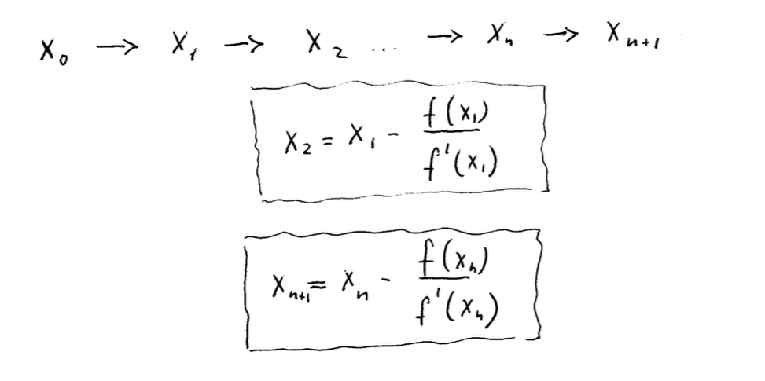

Substituting $x_{1}$ into $x_{0}$ we find $x_{2}$, etc. when after n+1 steps we find $x_{n+1 }$, the n+1 approximation to the root r

