Slide 1
Taylor series in numerical computations (review)

Slide 2
Last time
We finish to consider truncation and round-off errors using as an example calculation of the derivative of F(x)=exp(x)
Concept of significant digits
Loss of significance in numerical subtraction
How loss of significance can be avoided. Example – the code loss_of_significance.cc

Slide 3
Motivational Example

Slide 4
Motivational Example

Slide 5
Motivation
Our previous solution to avoid loss of significance in $\sqrt{x+1 } −1$ is “one off”, hard to generalize.
What if we need to estimate x – sin(x) for small x? (why this may be problematic? )
Need a general approach.
Also, how does computers compute sin(x) anyway?

Slide 6
Taylor’s theorem
Any function satisfying certain conditions can be expressed as a Taylor series.
A Taylor series is an expansion of a real function f(x) about a point x=c given by the power series
------------------|--------------------------------------------------- >
c x
$f\left(x\right)=f\left(c\right)+f^{′}\left(c\right)\left(x−c\right)+\frac{f^{′′}\left(c\right){\left(x−c\right)}^{2}}{2!}+\frac{f^{\left(3\right)}{(c)\left(x−c\right)}^{3}}{3!}+ …+\frac{f^{\left(n\right)}\left(c\right){\left(x−c\right)}^{n}}{n!}+E_{n+1}$
where the error term $E_{n+1}= \frac{f^{\left(n+1\right)}{\left(\left(ξ\right)(x−c\right)}^{n+1}}{(n+1)!}$ and c $< ξ<x$
If c=0, this expansion is also known as Maclaurin series:
(x-c) => x, $f^{(n)}$(c) = $f^{(n)}$(0) and $x< ξ<x+h$

Slide 7
The key idea:

Slide 8
Taylor series - examples
expansion at c=0 , e^(0) = 1
|x| < infinity
expansion at c=0, sin(0)=0
|x| < infinity
expansion at c=0, cos(0)=1
|x| < infinity

Slide 9
How to Compute exp(1.1) ?
Step 1:
Play with EXP.math example

Slide 10
How to Compute exp(1.1) ?
Step 1:

Slide 11
How to Compute exp(1.1) ?
Step 1:

Slide 12
How to Compute exp(1.1) ?
Step 1:
Exp(0.1) = 1 + 0.1 + (0.1)^2/2 + ….

Slide 13
How to Compute exp(1.1) ?
Step 1:
Exp(0.1) = 1 + 0.1 + (0.1)^2/2 + ….
Can we use the exact same series for exp(1.1)?

Slide 14
How to Compute exp(1.1) ?
Step 1:
Exp(0.1) = 1 + 0.1 + (0.1)^2/2 + ….
Can we use the exact same series for exp(1.1)?
Not a good idea!

Slide 15
How to Compute exp(1.1) ?
Step 1:

Slide 16
Exp(3.1) ?

Slide 17
Exp(3.1)
Exp(3.1) = exp(1)*exp(1)*exp(1)*exp(0.1).

Slide 18
Taylor series - examples
expansion at c=0
|x| < 1
expansion at c=0
-1 < x < or = 1

Slide 19
Why do we need to represent a function as a sum of terms?
For fast estimation of the value of function
To control the errors during estimating the value of the function
General way to avoid loss of significance in subtraction

Slide 20
Approximation of ln(1.1) using 5 terms in the expansion of ln(1+x) about c=0
ln(1.1) = ln(1+0.1) ~ 0.1 – 0.01/2 + 0.001/3 – 0.0001/4 + 0.00001/5 =
= 0.0953103333…
The result is correct to six decimal places of accuracy
The correct value is 0.09531018...

Slide 21
Experiment: Exp.math
Compute Exp(z) via a partial sum of the Taylor series for various values of z:
Z=1, z=20, z = -20.

Slide 22
Example of expansion: f(x) = exp(x)
A few partial sums of a Taylor series for exp(x)
f0 = 1
f1 = 1 + x
f2 = 1 + x + (x^2)/2
Let us plot the behavior of these partial sums

Slide 23
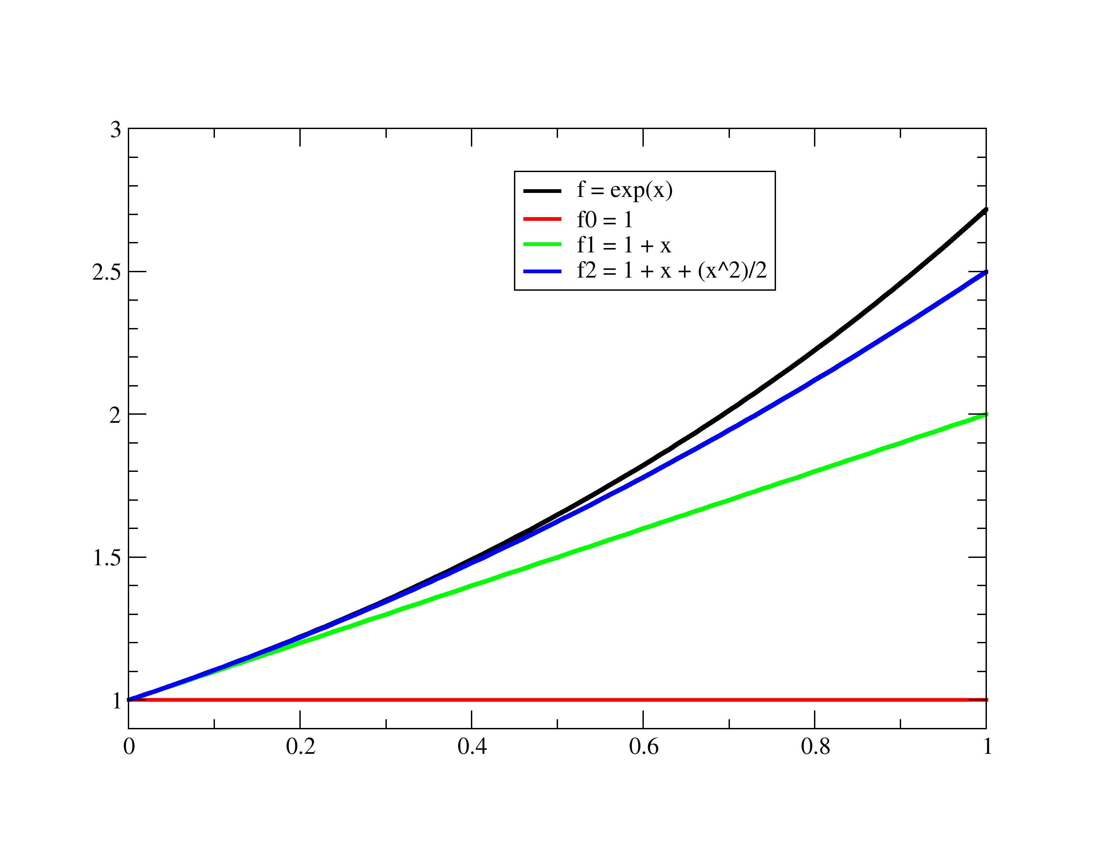

Slide 24
Approximation of exp(8) using 6 terms in the expansion of exp(x) about c=0
e^8 ~ 1 + 8 + 64/2 + 512/6 + 4096/24 + 32768/120 = 570.066665
Exact value (9 significant digits) e^8 = 2980.95798
Obviously that at x=8 six terms of expansion of exp(x) about c=0 is not sufficient even for very approximate evaluation of exp(8)
Summary of these two examples:
A Taylor series converges rapidly near the point of expansion (c=0 in our two cases) and slowly (or not at all) at more remote points.

Slide 25
Exp(-20.0)?

Slide 26
Example of expansions: y = sin(x)
A few partial sums of a Taylor series for sin(x)
S1 = x
S3 = x – (x^3)/6
S5 = x – (x^3)/6 + (x^5)/120
Let us plot the behavior of these partial sums

Slide 27
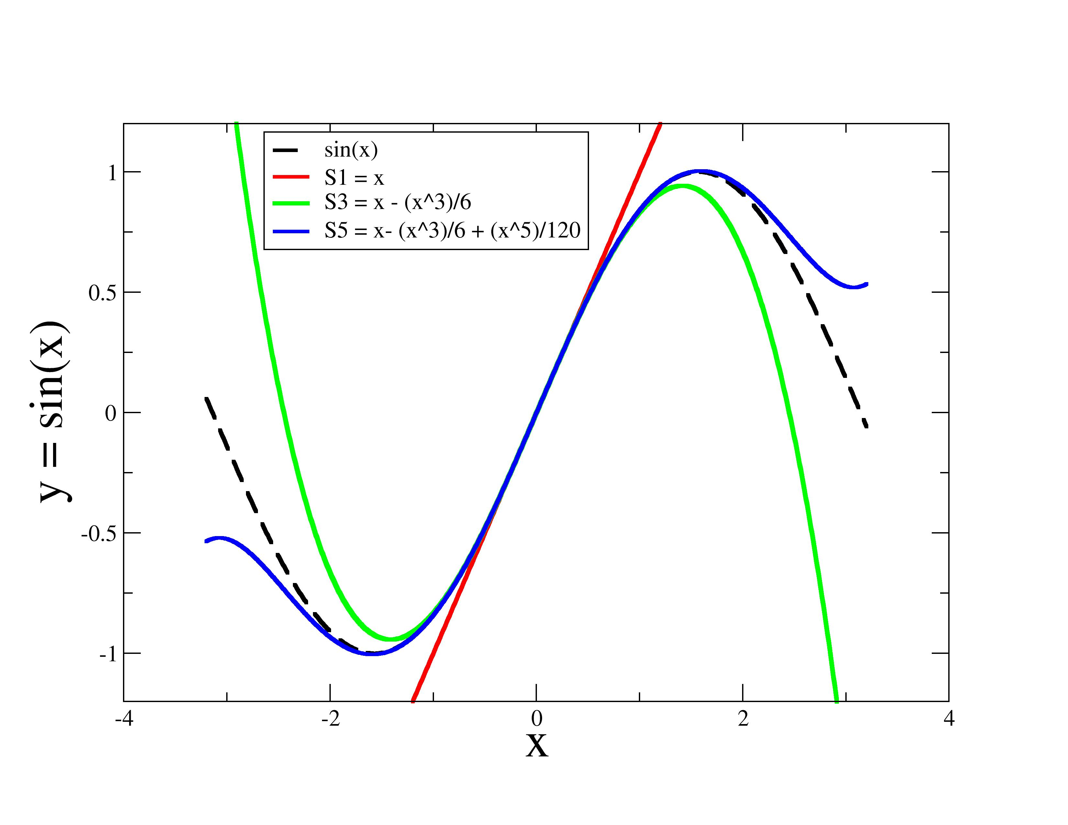

Slide 28
Taylor series of a polynomial function. Example
f(x) = 13 x^2 – 12 x – 5
What is the Taylor series of this function at the point c=2 ?
The expansion coefficients are:
f(2) = 52 – 24 - 5 = 23
f’(2) = 26* x -12 = 40
f’’(2) = 26
f’’’(2) = 0 . All higher derivatives are zero as well
Combining all nonzero terms, we have
f(x) ~ 23 + 40*(x-2) + (1/2)*26*(x-2)^2 =? f(x) Yes!

Slide 29
f(x+h)
In previous lectures we used notation for the function arguments x+h and x which correspond to our current notations as
(x+h) -> x, h -> (x-c) , f(x+h) -> f(x)
An expansion of f( ) about point x in these old notations can be written as
$$f\left(x+h\right)=f\left(x\right)+f^{′}\left(x\right)\left(h\right)+\frac{f^{′′}\left(x\right){\left(h\right)}^{2}}{2!}+\frac{f^{\left(3\right)}{(x)\left(h\right)}^{3}}{3!}+ …+\frac{f^{\left(n\right)}\left(x\right){\left(h\right)}^{n}}{n!}+E_{n+1}$$
where
$$E_{n+1}= \frac{f^{\left(n+1\right)}(ξ){\left(h\right)}^{n+1}}{(n+1)!}$$
is an error term and $x< ξ<x+h$

