Slide 1
Interpolation and Extrapolation.

Slide 2










Two problems to address:
Problem one: Run a continuous line (curve) that goes through each of the give data point exactly. (``connect the dots”) .
Problem Two: Fit the existing data in a ``best” way that shows the trend.
Makes sense if no error in the data points. No “noise”. need an exact fit.
Trend line.

Slide 3
Tools we have covered:
Polynomial Interpolation
Splines

Slide 4
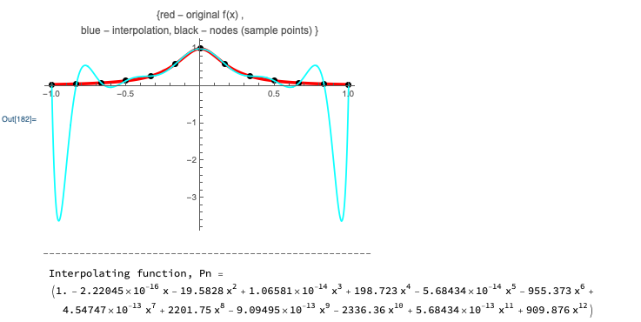
Polynomials are, generally, a bad idea for functions that do not look like polynomials.

Slide 5
What about extrapolation?
Do you expect splines to work well?

Slide 6
Two problems to address:
Problem one: Run a continuous line (curve) that goes through each of the give data point exactly. (``connect the dots”) .
Problem Two: Fit the existing data in a ``best” way that shows the trend.
Trend line.

Slide 7
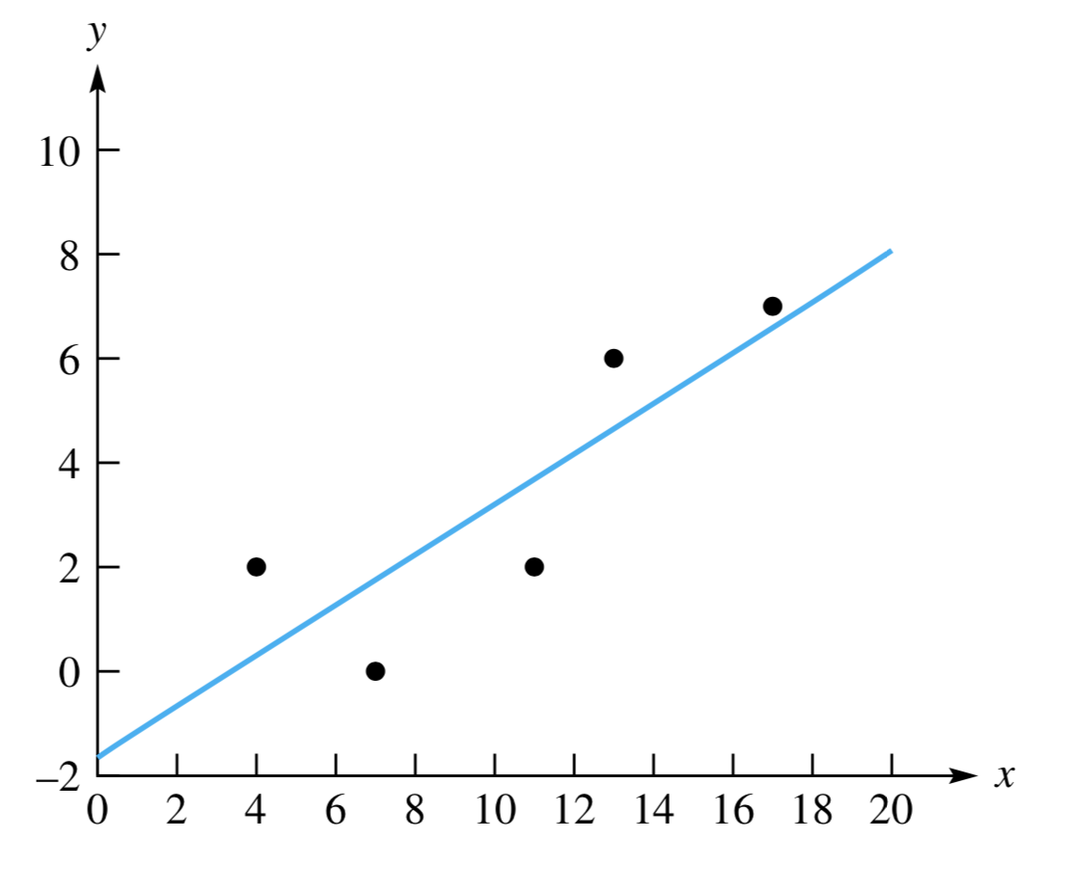
Least Squares Fitting
How to draw the “trend line”?

Slide 8









Least Squares Fitting: How to find the best “trend line”?
What is “best fit”?
y = ax + b
(x_{k}, y_{k})

Slide 9
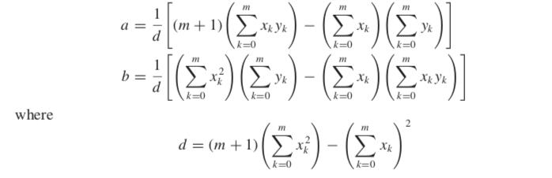
Least square line fit: analytical expressions

Slide 10




Polynomial least squares fit.
Mathematica Fit[] function. Fits data with a polynomial. Basis functions: 1, x, x², x³, ….

Slide 11




Non-linear least squares fit:
Mathematica NonlinearModelFit[] function. Fits data with any function f(t, a,b,c…) where a,b,c are its parameters.

Slide 12
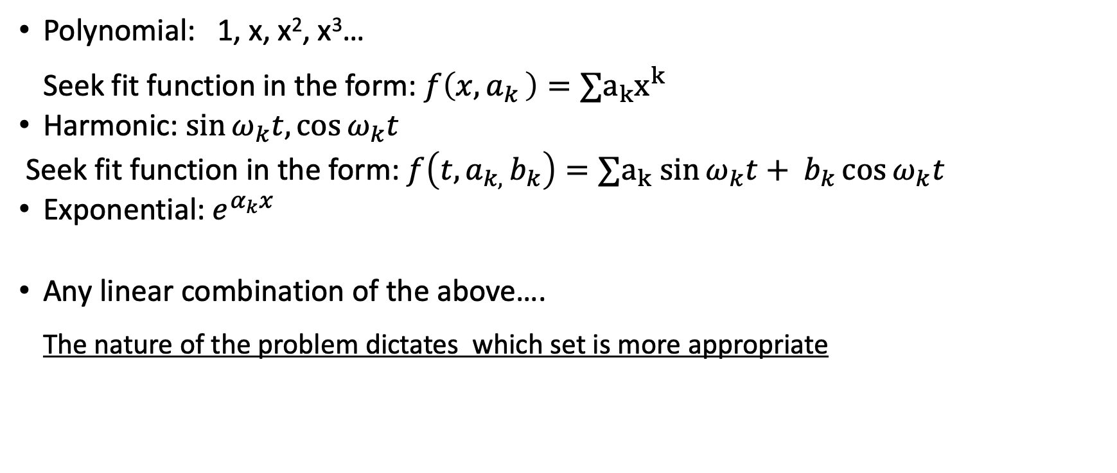
Basis sets for least square fit:
Polynomial: 1, x, x², x³…
Seek fit function in the form: $f\left(x, a_{k }\right)=∑a_{k}x^{k}$
Harmonic: $\sin{ω_{k}t,\cos{ω_{k}t}}$
Seek fit function in the form: $f\left(t, a_{k, }b_{k}\right)=∑a_{k}$ $\sin{ω_{k}t+ b_{k}\cos{ω_{k}t}}$
Exponential: $e^{α_{k}x}$
Any linear combination of the above….
The nature of the problem dictates which set is more appropriate

Slide 13
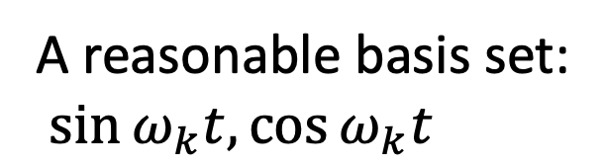
Non-linear least squares fit: choosing reasonable basis functions
A reasonable basis set:
$\sin{ω_{k}t,\cos{ω_{k}t}}$
Mathematica NonlinearModelFit[] function. Fits data with any function f(t, a,b,c…) where a,b,c are its parameters.

Slide 14
Deep Learning/Neural Network
An EXAMPLE:
A horrendously long, “self-adjusting” fit function made of simple basis components.

