Slide 1
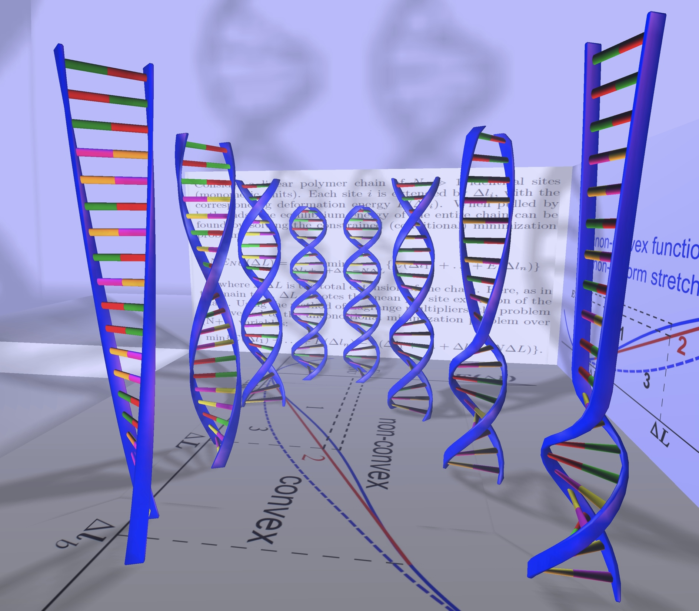
CS3414
Numerical Methods
Alexey Onufriev
Departments of CS and Physics
VT

Slide 2
Science now: a paradigm shift
Experiment
From the Greeks to the recent past,
e.g. figuring out Earth’s radius
(Eratosthenes, 240 BC)
theory
Now
Computation

Slide 3
Finding the Earth’s radius
The sun
Deep well

Slide 4
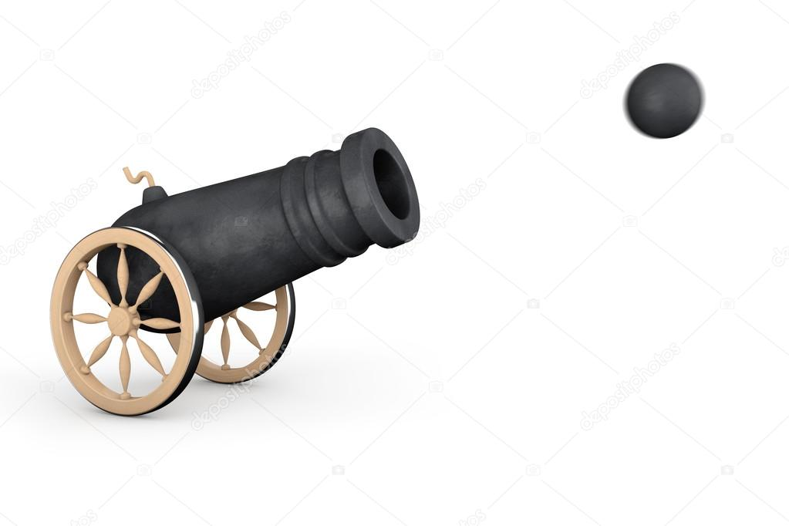
Flight path of a cannonball (from a 16th century military guide)

Slide 5
Flight path of a cannonball (from a 16th century military guide, according to Aristotelian Physics)

Slide 6
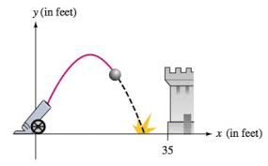
Flight path of a cannonball according to Galielo.

Slide 7
How it works
Image credit: http://www.physics.orst.edu/~rubin/INSTANCES/index.html

Slide 8
Computational Science/Scientific Computing in the grand scheme of things.
Natural Science
Computer Science
Computational Science
Math
Applied math
Computational Science:
solving science problems with computers
Pure CS: software and hardware,
Stand-alone algorithms (just like math)

Slide 9
Examples
?????

Slide 10
Examples
Human Genome
Stealth Fighter
MRI
LHS
Weather Forecasts
Protein Folding
??? (input from class)

Slide 12
Numerical methods for science:
Speed up finding a solution
Find additional solutions
Find solutions otherwise impossible to find
Discover new fundamental laws???

Slide 13
Wind generator blades: traditional

Slide 14
Wind generator blades: optimized

Slide 15
Where are numerical methods used outside of science?
EVERYWHERE
Google (image recognition, search (matrix manipulations)
Engineering (any subfields left where these methods are not used heavily? Aerospace, mechanical: differential equations, optimization, solution of equations, matrix manipulations)
Finance. (Optimization, extrapolation, data fitting, differential equations, statistical analysis)
Medicine (Modern imaging. Processing, reconstruction)
Modeling of the Covid-19 pandemic.

Slide 16
What is this class about?
Gives you the very basics of numerical methods.
Shows how numerical math is different from math.
Introduces a number of useful tools and concepts.
Hands on experience with numerical methods.

Slide 17
What this class is not:
Programming.
In-depth numerical methods, where you learn everything there is to know about one or two common methods (e.g. finite elements, CS5484).
Focused on high performance libraries (e.g. LINPACK).

Slide 18
Specifics. Course structure.
Class website
http://courses.cs.vt.edu/cs3414/onufriev

Slide 19
The nitty-gritty
TODAY: Force-Adds.
By next class:
Install latest Mathematica (VT network software)
Pre-reqs, force adds.

Slide 20
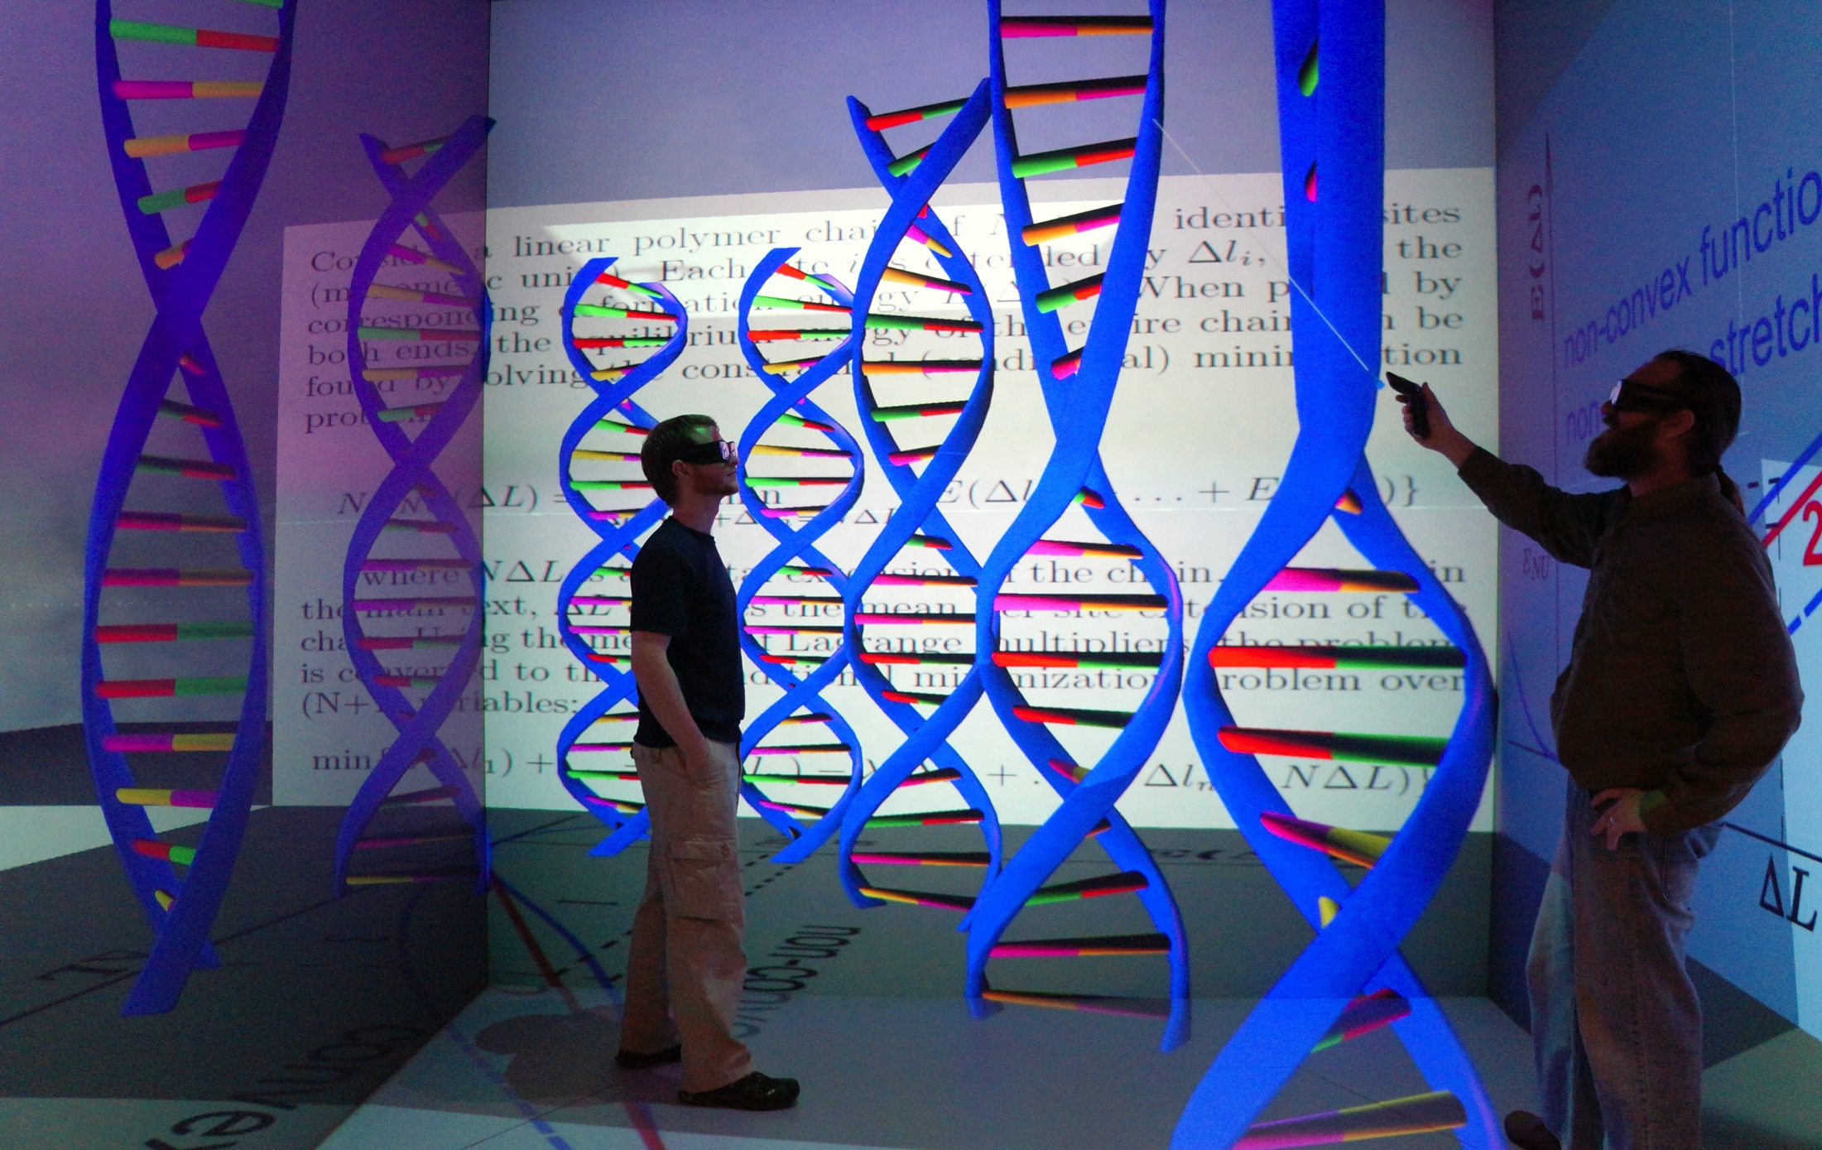
Enjoy!

