Slide 1
Interpolation and Extrapolation.

Slide 2
Motivation:
Motivation:

Slide 3
Motivation. Table occupancy in a restaurant.
Time of day

Slide 4
Modeling of trends CDC data:

Slide 5
Approximate a shape:

Slide 6
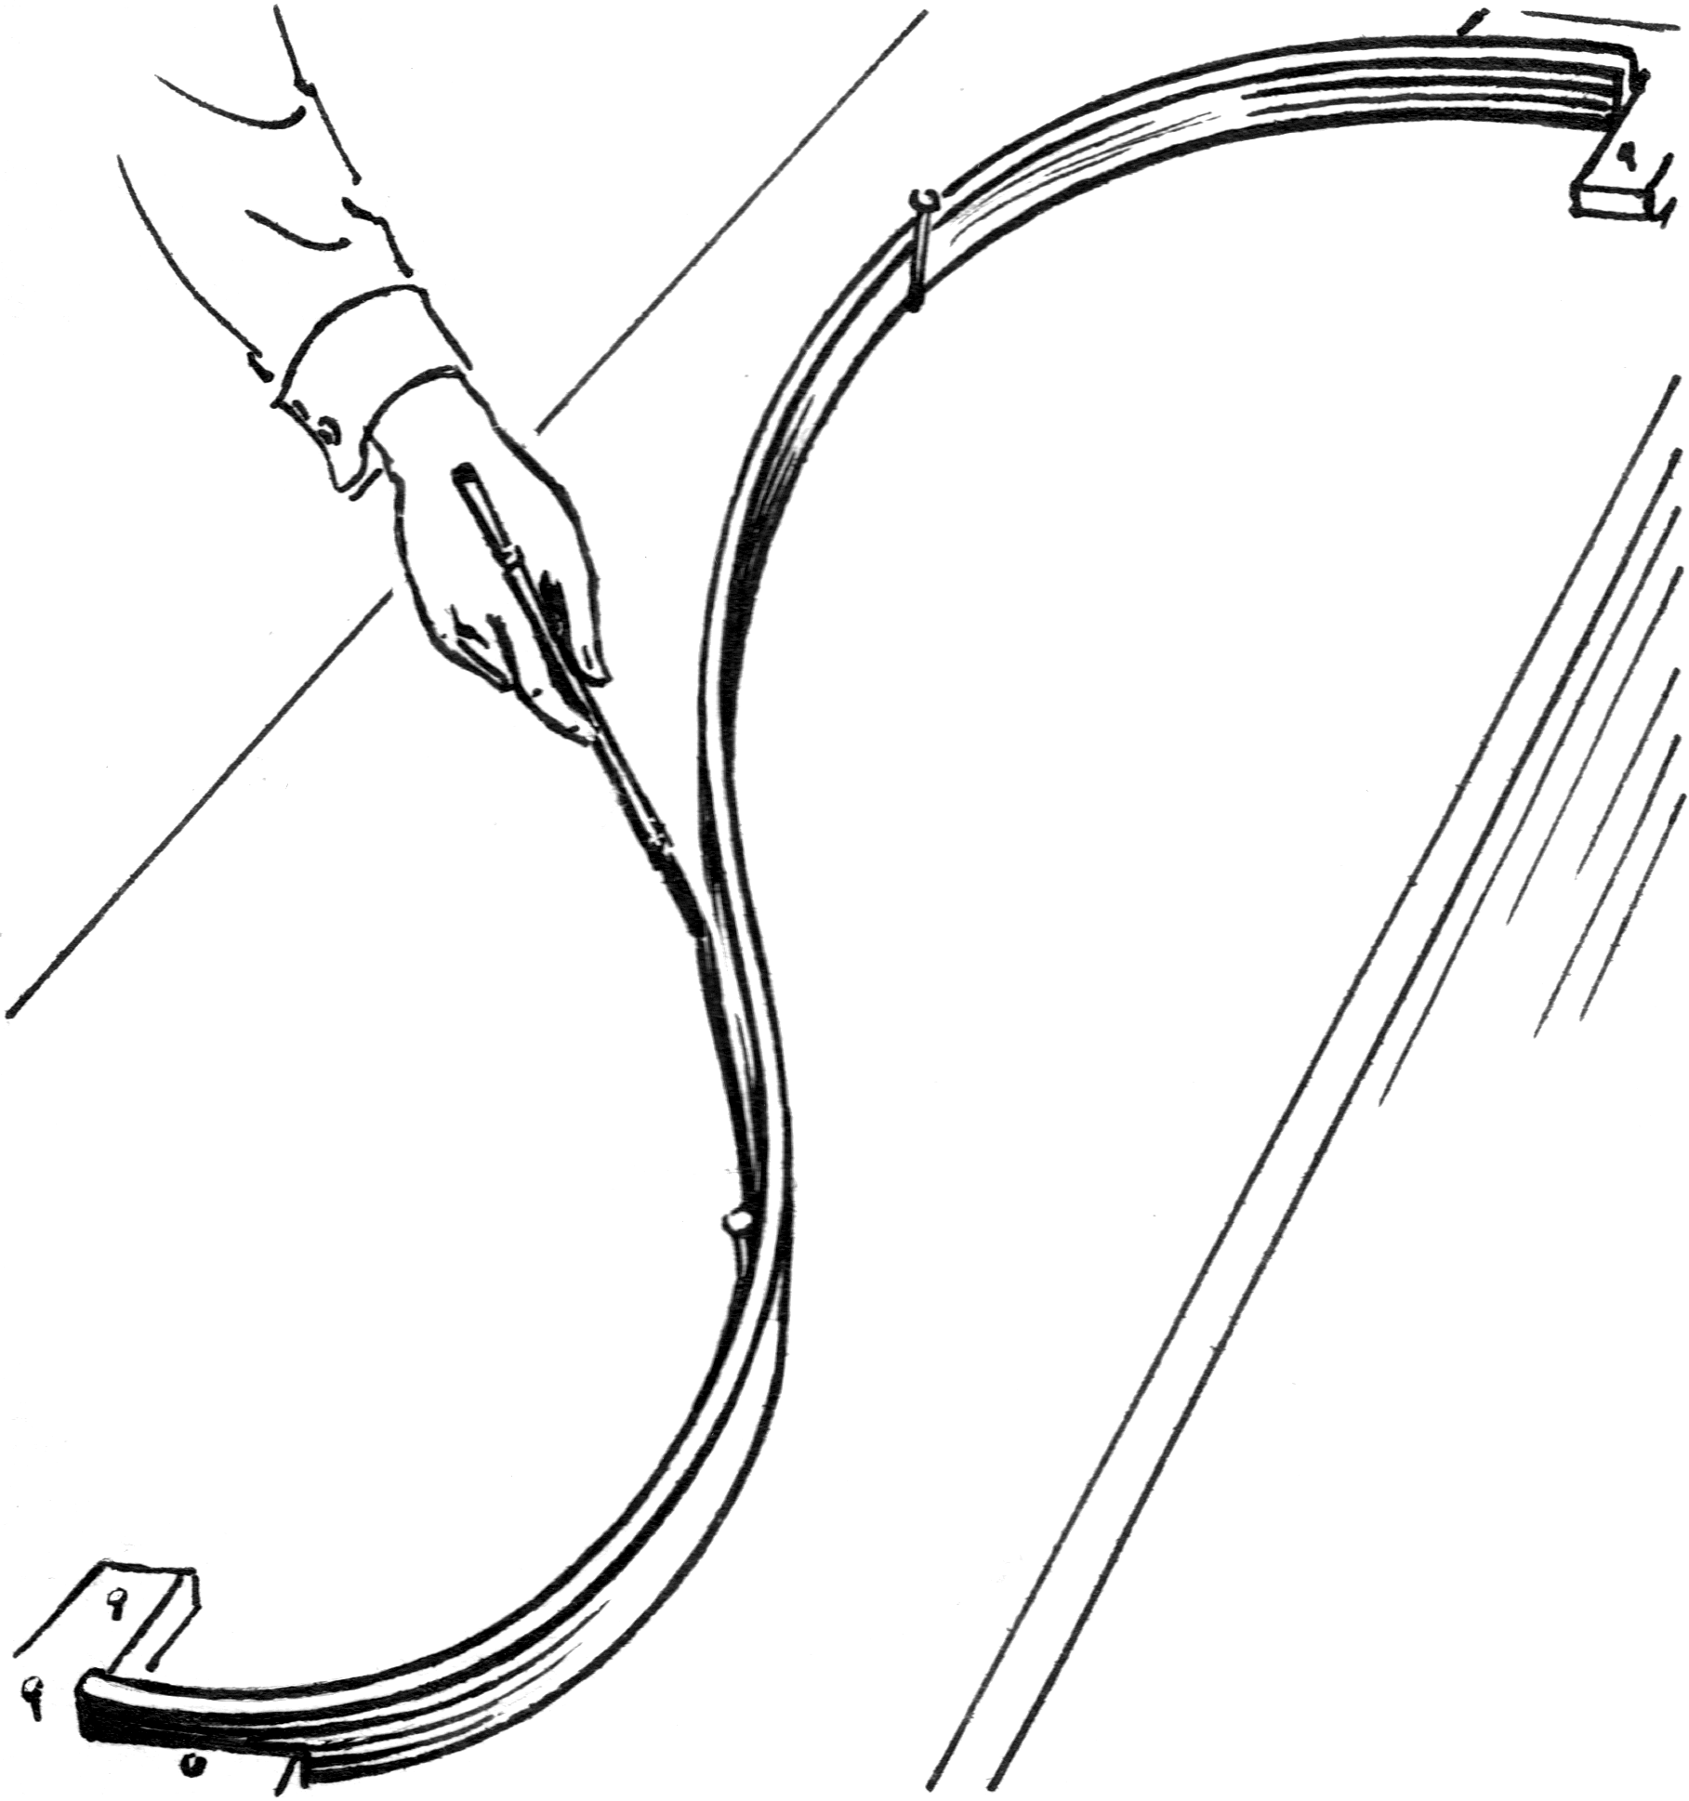
Engineering tools of yore for drawing smooth curves.

Slide 7
Two broad problems to address:
Problem one: Run a continuous line (curve) that goes through each of the give data point exactly. (``connect the dots”) .
Problem Two: Fit the existing data in a ``best” way that shows the trend.
Trend line.

Slide 8
Example of a “linear fit” to data.

Slide 9
Two problems to address:
Problem one: Run a continuous line (curve) that goes through each of the give data point exactly. (``connect the dots”) .
Problem Two: Fit the existing data in a ``best” way that shows the trend.
Makes sense if no error in the data points. No “noise”. need an exact fit.
Trend line.

Slide 10
Polynomials. Simple & Easy.

Slide 11
Polynomial interpolation
1. Linear (connect the dots)
2. Polynomial of order n.
There always exists a polynomial of order at most n-1 that runs through each point in the table.

Slide 12
Constructing an interpolating polynomial. Newtons’ form.
Good for recursive programming.

Slide 13
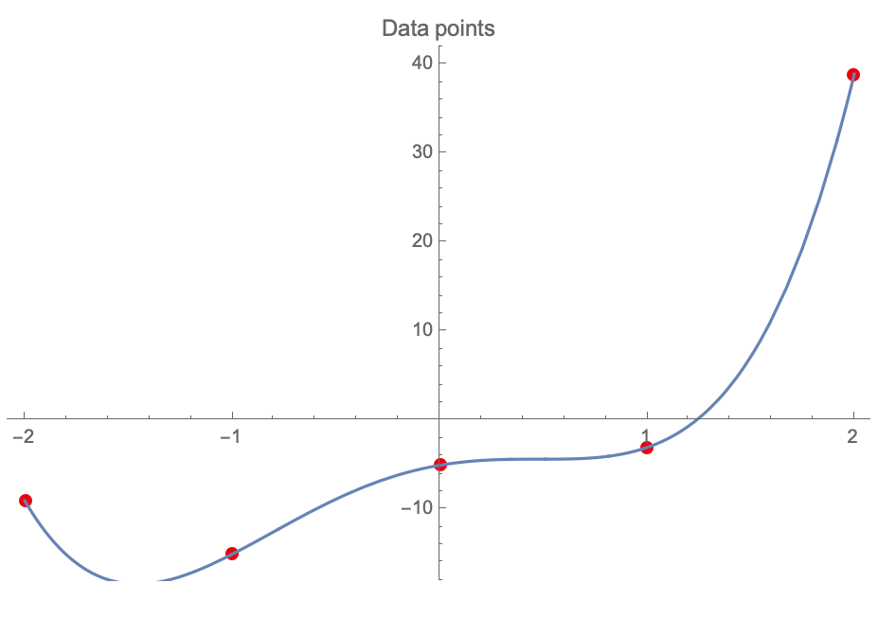
Interpolating polynomial. Newton’s form.
An example:
P(x)

Slide 14
Possible use for polynomial interpolation.
Represent a smooth shape with a polynomial?

Slide 15
How many sample points needed to “decently” approximate a curve with a polynomial?
Enough to capture the curve’s mins and maxs.
Or enough to capture its roots.
Example: 5 roots, need a polynomial of degree 5

Slide 16
For many functions, a polynomial interpolation can be very accurate

Slide 17
Polynomial interpolation works in many cases, but not always.

Slide 18
A very simple function to interpolate

Slide 19
Polynomial Approximation
Weierstrass Approximation Theorem. Suppose f is a continuous real-valued function defined on the real interval [a, b]. For every ε > 0, there exists a polynomial p such that for all x in [a, b], we have | f (x) − p(x)| < ε. Which means you can approximate any continuous function as accurately as you want, by a polynomial.
Note: nothing is said about the nodes being equidistant. Opens the possibility of using more complex, non-equidistant placing of the nodes for an accurate approximation. Compare to previously mentioned upper bound on the accuracy.
Note 2: nothing is said about the degree of the polynomial, or whether it has to pass exactly through a and b.

Slide 20
Spline Interpolation

Slide 21
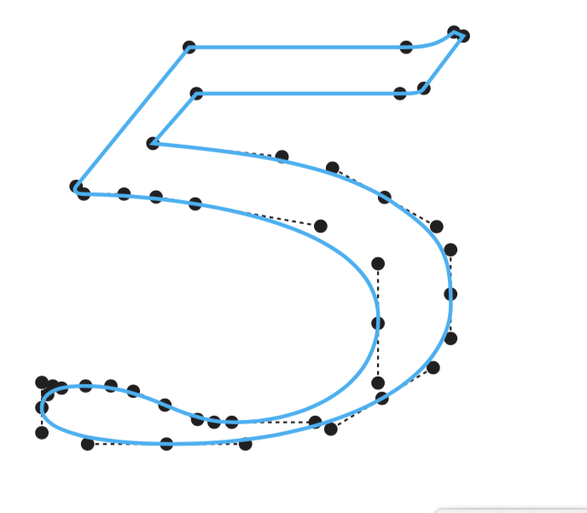
What about realistic shape modeling?

Slide 22
Autodesk design:

Slide 23
General definitions
Spline function is a real function that consists of polynomial pieces joined together with some smoothness conditions. I.e. spline is a piecewise polynomial function.
The highest order of the polynomials of the spline function is the order of the spline.
Spline of degree one (first degree spline): pieces are linear polynomials joined together to achieve continuity.
Each first degree polynomial is described by two parameters, $a_{i} and b_{i}.$
If you have n+1 data points (knots) you need n functions described by 2n parameters

Slide 25
Second degree (quadratic) spline
In addition to continuity of polynomials $S_{i}$ we have a condition of continuity for the 1-st derivative: $S_{i}^{(1)}$($t_{i+1}$)=$S_{i+1}^{(1)}$($t_{i+1}$)
Quadratic spline is a continuously differentiable piecewise quadratic function $a_{i}x^{2}+b_{i}x+c_{i}$ described by 3n coefficients.

Slide 26
An example
$Q\left(x\right)=\{ { x}^{2}, −10≤X≤0$. $−x^{2}, 0< x≤1.$ $1 −2x, 2≥ x>1.$
Is this a spline?
What kind (order) of a spline?

Slide 27
An example
$Q\left(x\right)=\{ { x}^{2}, −10≤X≤0$. $−x^{2}, 0< x≤1.$ $1 −2x, 2≥ x>1.$
Is this a spline?
What kind (order) of a spline?

Slide 28
An example
1st derivative continuous?
Continuity?
$Q\left(x\right)=\{ { x}^{2}, −10≤X≤0$. $−x^{2}, 0< x≤1.$ $1 −2x, 2≥ x>1.$
Is this a spline?
What kind (order) of a spline?

Slide 29
An example
$Q\left(x\right)=\{ { x}^{2}, −10≤X≤0$. $−x^{2}, 0< x≤1.$ $1 −2x, 2≥ x>1.$
Is this a spline?
What kind (order) of a spline?

Slide 30
An example
$Q\left(x\right)=\{ { x}^{2}, −10≤X≤0$. $−x^{2}, 0< x≤1.$ $1 −2x, 2≥ x>1.$
Is this a spline?
What kind (order) of a spline?
Example of a piece-wise function that is not a spline.

Slide 31
Cubic spline
$S_{i}$ are polynomials of degree at most 3
Condition of continuity for the first and the second derivatives:
$S_{i}^{(1)}$($t_{i+1}$)=$S_{i+1}^{(1)}$($t_{i+1}$)
$S_{i}^{(2)}$($t_{i+1}$)=$S_{i+1}^{(2)}$($t_{i+1}$)
$S_{i}{{\left(x\right)=a}_{i}x^{3}+b}_{i}x^{2}+c_{i}x+d_{i}$
Natural Cubic Spline: S’’(t₀) = S’’(t_{n})

Slide 32
An example:
$S\left(x\right) = \left\{\begin{aligned}x^{3}+x −1, −1≤x≤0. \\ x^{3}−x −1, 0≤x≤1.\end{aligned}\right.$
Is this a spline?
Which order?
Natural?

Slide 33
An example:
$S\left(x\right) = \left\{\begin{aligned}x^{3}+x −1, −1≤x≤0. \\ x^{3}−x −1, 0≤x≤1.\end{aligned}\right.$
Is this a spline?
Which order?
Natural?
Propose a fix to make it a spline.

Slide 34
_{Parametric splines:}
X = X(t) – spline defined on knots t_{n}
Y = Y(t) – spline defined on knots t_{n}
t₂
Control points
t₁

Slide 35
Power point “curve” function.
“right click” to edit points.
“Local” effect of tweaking each control point.

Slide 36
Splines in 3D
(A Mathematica example available)
GlobalBSplineSurfaceInterpolation.cdf

Slide 37
Something really cool: splines in art.
Similarity of Opposites.
Credit: Eric Standley, Professor of Studio Art,
VT.

Slide 38
The art in the making (CorelDraw)

Slide 39
Back to polynomials…

Slide 40
Polynomials are, generally, a bad idea for functions that do not look like polynomials.

Slide 41
A few fixes still exist, they may improve things, but only go so far.
(*Fix 1. Increase n*)(*Rarely works. Generally BAD idea*)
(*Fix 2. Extend range of data. May approximates well if region of interest is deep inside the new range*)
(*Fix 3. “Best”: use non-uniform or "unequally spaced" control/data points e.g. Chebyshev points: xi=cos[Pi*(2i+1)/(2n+2)],i\[LessEqual]n*)(*data=Table[N[{0.5*((a+b)+
b-a)*Cos[(i/n)*Pi]),F[0.5*((a+b)+(b-a)*Cos[(i/n)*Pi])]}],{i,0,n}]*)

Slide 42
But, the best idea is to choose a more appropriate model
Fix 4. Use more appropriate MODEL (basis functions). Gaussian in OUR case of the bell-shaped spread of data points.
fit=Fit[data,Table[Exp[-i*1.0*x^2],{i,1,n}],x]

Slide 43
Two problems to address:
Problem one: Run a continuous line (curve) that goes through each of the give data point exactly. (``connect the dots”) .
Problem Two: Fit the existing data in a ``best” way that shows the trend.
Trend line.

