Slide 1
Tree Indexing (1)
Linear index is poor for insertion/deletion.
Tree index can efficiently support all desired operations:
Insert/delete
Multiple search keys (multiple indices)
Key range search

Slide 2
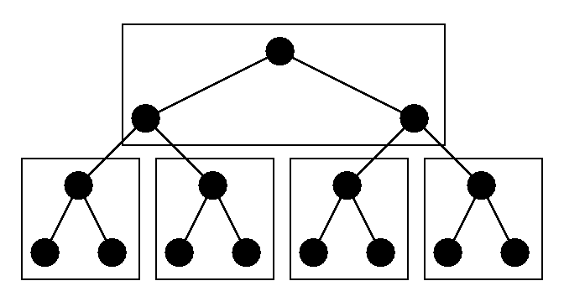
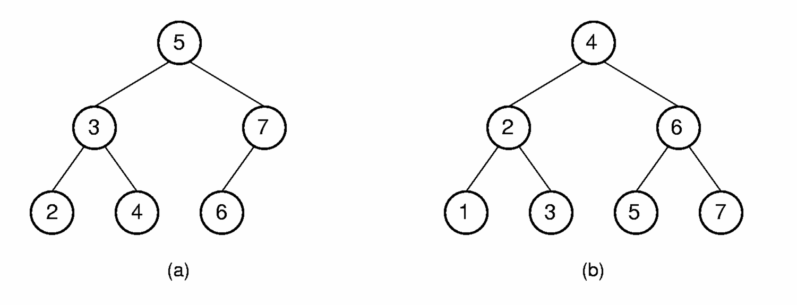
Tree Indexing (2)
Difficulties when storing tree index on disk:
Tree must be balanced.
Each path from root to leaf should cover few disk pages.
Notes:
Second figure illustrates how difficult it can be to keep a tree balanced. In this case, rebalancing the BST to maintain the complete tree shape requires that all nodes be moved. This is too expensive to be practical.

Slide 3
2-3 Tree
A 2-3 Tree has the following properties:
A node contains one or two keys
Every internal node has either two children (if it contains one key) or three children (if it contains two keys).
All leaves are at the same level in the tree, so the tree is always height balanced.
The 2-3 Tree has a search tree property analogous to the BST.

Slide 4
2-3 Tree Example
The advantage of the 2-3 Tree over the BST is that it can be updated at low cost.

Slide 5
2-3 Tree Insertion (1)

Slide 6
2-3 Tree Insertion (2)

Slide 7
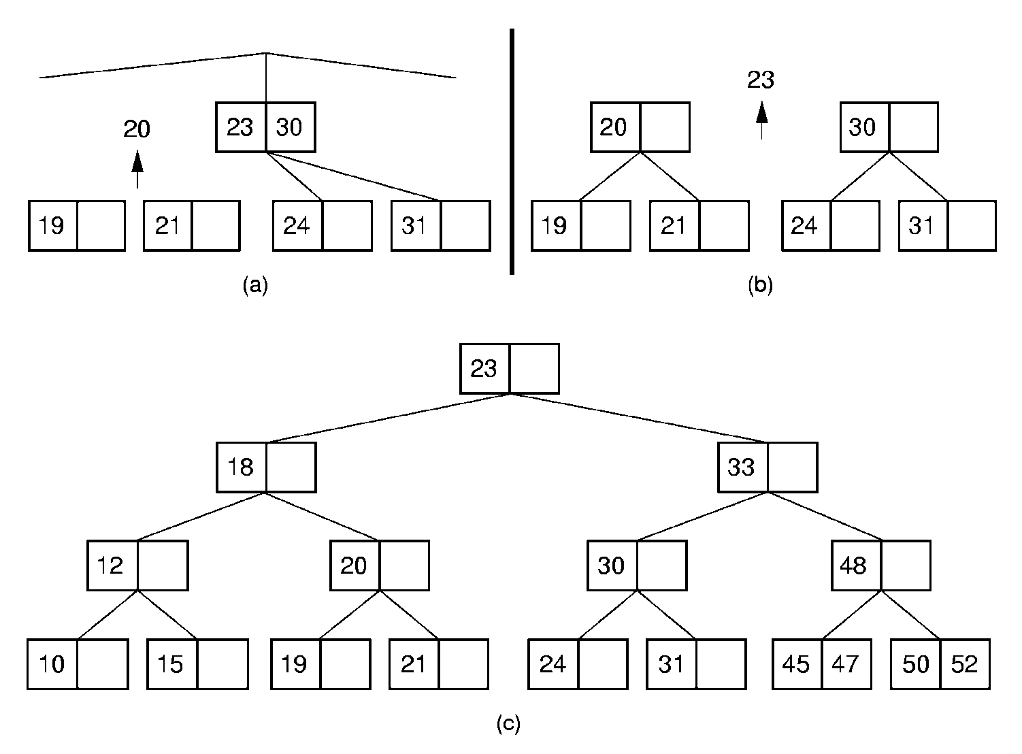
2-3 Tree Insertion (3)

Slide 8
B-Trees (1)
The B-Tree is an extension of the 2-3 Tree.
The B-Tree is now the standard file organization for applications requiring insertion, deletion, and key range searches.

Slide 9
B-Trees (2)
B-Trees are always balanced.
B-Trees keep similar-valued records together on a disk page, which takes advantage of locality of reference.
B-Trees guarantee that every node in the tree will be full at least to a certain minimum percentage. This improves space efficiency while reducing the typical number of disk fetches necessary during a search or update operation.

Slide 10
B-Tree Definition
A B-Tree of order m has these properties:
The root is either a leaf or has two children.
Each node, except for the root and the leaves, has between ⎡m/2⎤ and m children.
All leaves are at the same level in the tree, so the tree is always height balanced.
A B-Tree node is usually selected to match the size of a disk block.
A B-Tree node could have hundreds of children.

Slide 11
B-Tree Search
Generalizes search in a 2-3 Tree.
Do binary search on keys in current node. If search key is found, then return record. If current node is a leaf node and key is not found, then report an unsuccessful search.
Otherwise, follow the proper branch and repeat the process.

