Slide 1
External Sorting
Problem: Sorting data sets too large to fit into main memory.
Assume data are stored on disk drive.
To sort, portions of the data must be brought into main memory, processed, and returned to disk.
An external sort should minimize disk accesses.

Slide 2
Model of External Computation
Secondary memory is divided into equal-sized blocks (512, 1024, etc…)
A basic I/O operation transfers the contents of one disk block to/from main memory.
Under certain circumstances, reading blocks of a file in sequential order is more efficient. (When?)
Primary goal is to minimize I/O operations.
Assume only one disk drive is available.
Notes:
For sequential search to be more efficient than random access to the file
adjacent logical blocks of the file must be physically adjacent.
There must be no competition for the I/O head, either with another process, or within the same process (such as thrashing between and input buffer and an output buffer).

Slide 3
Key Sorting
Often, records are large, keys are small.
Ex: Payroll entries keyed on ID number
Approach 1: Read in entire records, sort them, then write them out again.
Approach 2: Read only the key values, store with each key the location on disk of its associated record.
After keys are sorted the records can be read and rewritten in sorted order.
Notes:
Usually the records are not rewritten in sorted order.
(1) It is expensive (random access to all records).
(2) If there are multiple keys, there is no single “correct” order.

Slide 4
Simple External Mergesort (1)
Quicksort requires random access to the entire set of records.
Better: Modified Mergesort algorithm.
Process n elements in Θ(log n) passes.
A group of sorted records is called a run.
Notes:
Usually the records are not rewritten in sorted order.
(1) It is expensive (random access to all records).
(2) If there are multiple keys, there is no single “correct” order.

Slide 5
Simple External Mergesort (2)
Split the file into two files.
Read in a block from each file.
Take first record from each block, output them in sorted order.
Take next record from each block, output them to a second file in sorted order.
Repeat until finished, alternating between output files. Read new input blocks as needed.
Repeat steps 2-5, except this time input files have runs of two sorted records that are merged together.
Each pass through the files provides larger runs.
Notes:
Usually the records are not rewritten in sorted order.
(1) It is expensive (random access to all records).
(2) If there are multiple keys, there is no single “correct” order.

Slide 6
Simple External Mergesort (3)
Notes:
Usually the records are not rewritten in sorted order.
(1) It is expensive (random access to all records).
(2) If there are multiple keys, there is no single “correct” order.

Slide 7
Problems with Simple Mergesort
Is each pass through input and output files sequential?
What happens if all work is done on a single disk drive?
How can we reduce the number of Mergesort passes?
In general, external sorting consists of two phases:
Break the files into initial runs
Merge the runs together into a single run.
Notes:
The passes are sequential. But, on a single disk drive, competition for the I/O head eliminates this advantage.
But, we can get a massive improvement by reading in a block, or several blocks, and using an in-memory sort to create the initial runs.

Slide 8
Breaking a File into Runs
General approach:
Read as much of the file into memory as possible.
Perform an in-memory sort.
Output this group of records as a single run.

Slide 9
Replacement Selection (1)
Break available memory into an array for the heap, an input buffer, and an output buffer.
Fill the array from disk.
Make a min-heap.
Send the smallest value (root) to the output buffer.

Slide 10
Replacement Selection (2)
If the next key in the file is greater than the last value output, then
Replace the root with this key
else
Replace the root with the last key in the array
Add the next record in the file to a new heap (actually, stick it at the end of the array).

Slide 11
RS Example

Slide 12
Snowplow Analogy (1)
Imagine a snowplow moving around a circular track on which snow falls at a steady rate.
At any instant, there is a certain amount of snow S on the track. Some falling snow comes in front of the plow, some behind.
During the next revolution of the plow, all of this is removed, plus 1/2 of what falls during that revolution.
Thus, the plow removes 2S amount of snow.
Notes:
How many disk drives do we need for the greatest benefit? Two -- one for input, one for output.

Slide 13
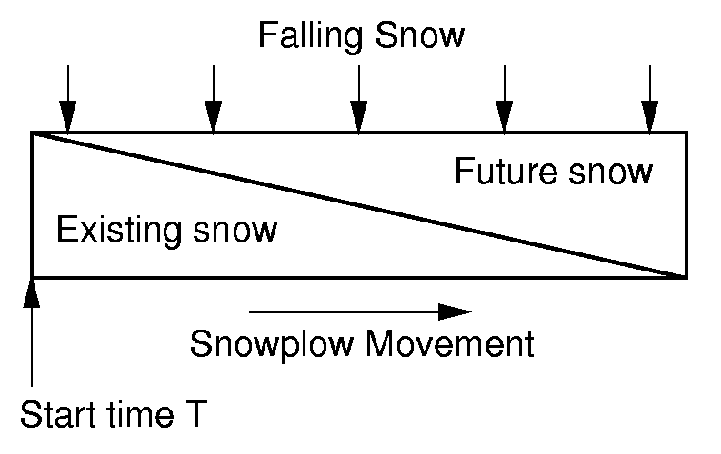
Snowplow Analogy (2)

Slide 14
Problems with Simple Merge
Simple mergesort: Place runs into two files.
Merge the first two runs to output file, then next two runs, etc.
Repeat process until only one run remains.
How many passes for r initial runs?
Is there benefit from sequential reading?
Is working memory well used?
Need a way to reduce the number of passes.
Notes:
For r initial runs, need log r passes.
We get NO benefit from sequential reading if only one disk drive is used.
Working memory is poorly used because only 2 blocks are really needed. So, we would like a way to use memory better.

Slide 15
Multiway Merge (1)
With replacement selection, each initial run is several blocks long.
Assume each run is placed in separate file.
Read the first block from each file into memory and perform an r-way merge.
When a buffer becomes empty, read a block from the appropriate run file.
Each record is read only once from disk during the merge process.

Slide 16
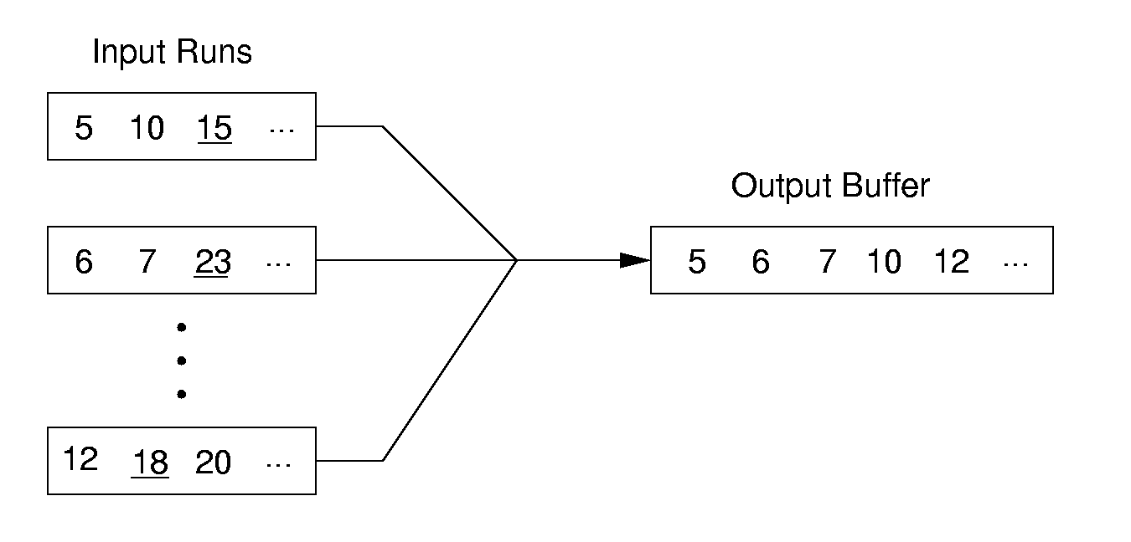
Multiway Merge (2)
In practice, use only one file and seek to appropriate block.

Slide 17
Limits to Multiway Merge (1)
Assume working memory is b blocks in size.
How many runs can be processed at one time?
The runs are 2b blocks long (on average).
How big a file can be merged in one pass?
Notes:
Merge b runs at one time (one block allocated to each run). Replacement selection makes the runs 2b blocks long on average.

Slide 18
Limits to Multiway Merge (2)
Larger files will need more passes -- but the run size grows quickly!
This approach trades (log b) (possibly) sequential passes for a single or very few random (block) access passes.
Notes:
In k merge passes, we process 2b^{(k+1)} blocks.
Example: 0.5MB working memory, 4KB blocks, yield 128 blocks for working memory. Average run size is 1MB, so 128MB can be sorted in one pass on average. 16GB in two merge passes.

Slide 19
General Principles
A good external sorting algorithm will seek to do the following:
Make the initial runs as long as possible.
At all stages, overlap input, processing and output as much as possible.
Use as much working memory as possible. Applying more memory usually speeds processing.
If possible, use additional disk drives for more overlapping of processing with I/O, and allow for more sequential file processing.
Notes:
Overlapping input, processing, and output is sometimes called double buffering. Not all operating systems allow this at the programmer’s level.

