Slide 1
Dictionary
Often want to insert records, delete records, search for records.
Required concepts:
Search key: Describe what we are looking for
Key comparison
Equality: sequential search
Relative order: sorting
Notes:
Key: When describing what we are looking for, we don’t want to be required to describe the entire record, only one field of the record. If we already knew everything about the record, we probably wouldn’t need to look for it.

Slide 2
Records and Keys
Problem: How do we extract the key from a record?
Records can have multiple keys.
Fundamentally, the key is not a property of the record, but of the context.
Solution: We will explicitly store the key with the record.
Notes:
Can’t just compare records to each other. Need to extract the key. How? Could have an explicit key field? No. Explicit key method? No. Records can have multiple keys.
Could the key method be type sensitive? No, multiple fields in the record can have the same type. There is a fundamental problem: They key is not a property of the record, it is a property of the context in which the record is being used.
Key-Value pair. This is a traditional solution to this problem.
Note that the key is overhead. But this becomes less of a problem as the relative size of the record gets large.

Slide 3
Key-Value Pair 1
Class KVPair {
int theKey;
Object theVal;
KVPair(int k, Object v) {
theKey = k;
theVal = v;
}

Slide 4
Key-Value Pair 2
int key() {
return theKey;
}
Object value() {
return theVal;
}
}
Improvements: Make it comparable, and use any comparable object for the key

Slide 5
Dictionary ADT
public interface Dictionary<Key, E> {
public void clear();
public void insert(Key k, E e);
public E remove(Key k); // Null if none
public E removeAny(); // Null if none
public E find(Key k); // Null if none
public int size();
};

Slide 6
Payroll Class
// Simple payroll entry: ID, name, address
class Payroll {
private Integer ID;
private String name;
private String address;
Payroll(int inID, String inname, String inaddr) {
ID = inID;
name = inname;
address = inaddr;
}
public Integer getID() { return ID; }
public String getname() { return name; }
public String getaddr() { return address; }
}

Slide 7
Using Dictionary
// IDdict organizes Payroll records by ID
Dictionary<Integer, Payroll> IDdict =
new UALdictionary<Integer, Payroll>();
// namedict organizes Payroll records by name
Dictionary<String, Payroll> namedict =
new UALdictionary<String, Payroll>();
Payroll foo1 = new Payroll(5, "Joe", "Anytown");
Payroll foo2 = new Payroll(10, "John", "Mytown");
IDdict.insert(foo1.getID(), foo1);
IDdict.insert(foo2.getID(), foo2);
namedict.insert(foo1.getname(), foo1);
namedict.insert(foo2.getname(), foo2);
Payroll findfoo1 = IDdict.find(5);
Payroll findfoo2 = namedict.find("John");
Notes:
UALdictionary stands for Unsorted Array-based List (implementation for a) dictionary.

Slide 8
Unsorted List Dictionary
class UALdictionary<Key, E>
implements Dictionary<Key, E> {
private static final int defaultSize = 10;
private AList<KVpair<Key, E>> list;
// Constructors
UALdictionary() { this(defaultSize); }
UALdictionary(int sz)
{ list = new AList<KVpair<Key, E>>(sz); }
public void clear() { list.clear(); }
/** Insert an element: append to list */
public void insert(Key k, E e) {
KVpair<Key,E> temp = new KVpair<Key,E>(k, e);
list.append(temp);
}
Notes:
Example implementation using the dictionary ADT.

Slide 9
Sorted vs. Unsorted List Dictionaries
If list were sorted
Could use binary search to speed search
Would need to insert in order, slowing insert
Which is better?
If lots of searches, sorted list is good
If inserts are as likely as searches, then sorting is no benefit.

Slide 10
Binary Trees
A binary tree is made up of a finite set of nodes that is either empty or consists of a node called the root together with two binary trees, called the left and right subtrees, which are disjoint from each other and from the root.
Notes:
Note that this means every node has two children, either or both of which can be empty. Technically, leaf nodes have two empty children.

Slide 11
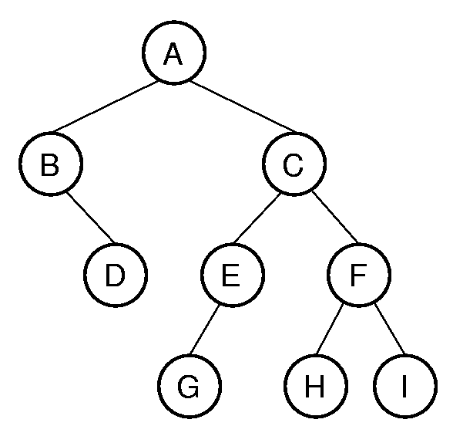
Binary Tree Example
Notation: Node, children, edge, parent, ancestor, descendant, path, depth, height, level, leaf node, internal node, subtree.
Notes:
A has depth 0. B and C form level 1. The tree has height 4. Height = max depth + 1.

Slide 12
Full and Complete Binary Trees
Full binary tree: Each node is either a leaf or internal node with exactly two non-empty children.
Complete binary tree: If the height of the tree is d, then all leaves except possibly level d are completely full. The bottom level has all nodes to the left side.
Notes:
These terms can be hard to distinguish. Students will need to remember which is which, since this notation will be used several times during the course.

Slide 13
Full Binary Tree Theorem (1)
Theorem: The number of leaves in a non-empty full binary tree is one more than the number of internal nodes.
Proof (by Mathematical Induction):
Base case: A full binary tree with 1 internal node must have two leaf nodes.
Induction Hypothesis: Assume any full binary tree T containing n-1 internal nodes has n leaves.
Notes:
This theorem is important, because it helps us to calculate space requirements. It tells us how many nodes are internal and how many are leaf. We need to know this if we have separate implementations for internal and leaf nodes

Slide 14
Full Binary Tree Theorem (2)
Induction Step: Given tree T with n internal nodes, pick internal node I with two leaf children. Remove I’s children, call resulting tree T’.
By induction hypothesis, T’ is a full binary tree with n leaves.
Restore I’s two children. The number of internal nodes has now gone up by 1 to reach n. The number of leaves has also gone up by 1.
Notes:
Note the style of induction proof: NOT “go forward from n to n+1”. Instead, it reduces an arbitrary tree to one that meets the induction hypothesis, and then restores the original tree while maintaining the proof condition. This is generally easier to do (see explanation in Chapter 2).

Slide 15
Full Binary Tree Corollary
Theorem: The number of null pointers in a non-empty tree is one more than the number of nodes in the tree.
Proof: Replace all null pointers with a pointer to an empty leaf node. This is a full binary tree.

Slide 16
Binary Tree Node Class
/** ADT for binary tree nodes */
public interface BinNode<E> {
/** Return and set the element value */
public E element();
public E setElement(E v);
/** Return the left child */
public BinNode<E> left();
/** Return the right child */
public BinNode<E> right();
/** Return true if this is a leaf node */
public boolean isLeaf();
}

