Slide 1
Coursenotes
CS3114: Data Structures and
Algorithms
Clifford A. Shaffer
Department of Computer Science
Virginia Tech
Copyright © 2008-2013

Slide 2
Scheduling
Managing large-scale projects involves scheduling activities
It is human nature to work better toward intermediate milestones.
The same concepts can/should be applied to mid-sized projects encountered in class.
For any project needing more than a week to complete, break into parts and design a schedule with milestones and deliverables.
Find some way to keep track of details.
Notes:
For me, programming takes a lot of focus and concentration. One concern for me is the many details to remember. I use “todo” lists a lot. I find things like the GitHub Issue Tracker invaluable for bigger projects (but that might be overkill for CS3114 class projects). The key thing is to write down any details that occur to you that you don’t want to deal with right this instant.

Slide 3
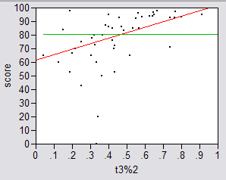
Real Results #1
Amount Done 1 Week Prior to Due Date

Slide 4
Real Results #2
Results were significant:
90% of scores below median were students who did less than 50% of the project prior to the last week.
Few did poorly who put in > 50% time early
Some did well who didn’t put in >50% time early, but most who did well put in the early time

Slide 5
Real Results #3
Correlations:
Strong correlation between early time and high score
No correlation between time spent and score
No correlation between % early time and total time

Slide 6
What is the Mechanism?
Correlations are not causal
Do they behave that way because they are good, or does behaving that way make them good?
Spreading projects over time allows the “sleep on it” heuristic to operate
Avoiding the “zombie” effect makes people more productive (and cuts time requirements)

