Slide 1
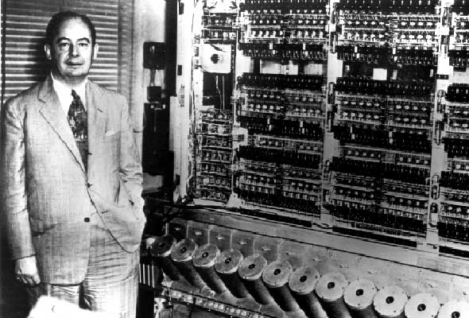
The von Neumann Machine
1945: John von Neumann
Wrote a report on the stored program concept, known as the First Draft of a Report on EDVAC
also Alan Turing… Konrad Zuse… Eckert & Mauchly…
The basic structure proposed in the draft became known as the “von Neumann machine” (or model).
a memory, containing instructions and data
a processing unit, for performing arithmetic and logical operations
a control unit, for interpreting instructions

Slide 2
The von Neumann Machine
MEMORY
stores both program instructions and data
MAR
MDR
Data
address
Data
PROCESSING UNIT
Instruction
address
REGISTERS
Machine Instruction
ALU
Control
signals
decodes current instruction,
manages processing unit to carry out instruction
CONTROL UNIT
PC
IR
program counter: points to the next instruction to be fetched
instruction register: stores current instruction

Slide 3
Intel x86 Family
Totally dominate laptop/desktop/server market
Evolutionary design
Backwards compatible to the 8086, introduced in 1978
Open architecture: 3rd party suppliers for all sorts of external hardware and software
Added more features as time went on
Complex instruction set computer architecture (CISC)
Many different instructions with many different formats
But, only small subset encountered with Linux programs
Hard to match performance of Reduced Instruction Set Architectures (RISC)
But, Intel has done just that!
In terms of speed. Less so for low power.

Slide 4
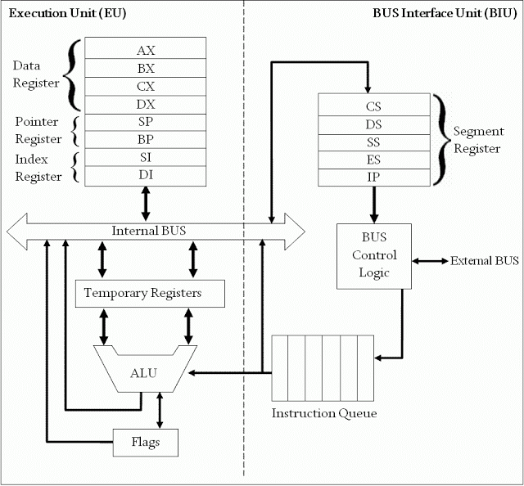
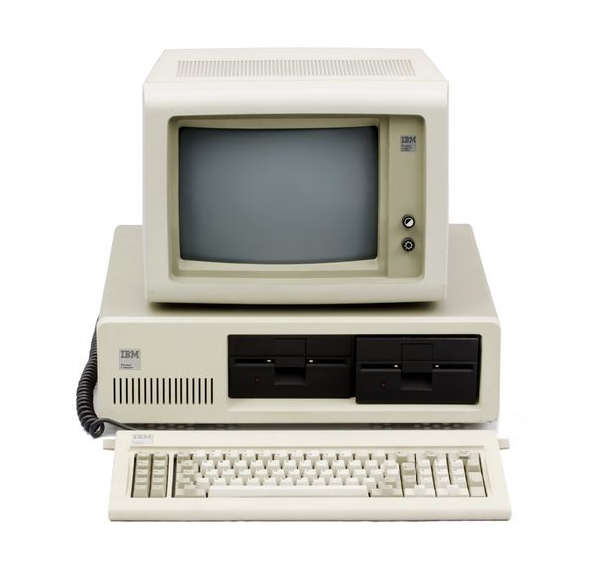
Intel x86 History
Name Date Transistors Clock rate
8086 1978 29K 5-10 MHz
First 16-bit processor. Basis for IBM PC & DOS
1MB address space
8088: slight modification of 8086 chip used in IBM PC
Quickly dominated personal computer market in sales via IBM PC

Slide 5
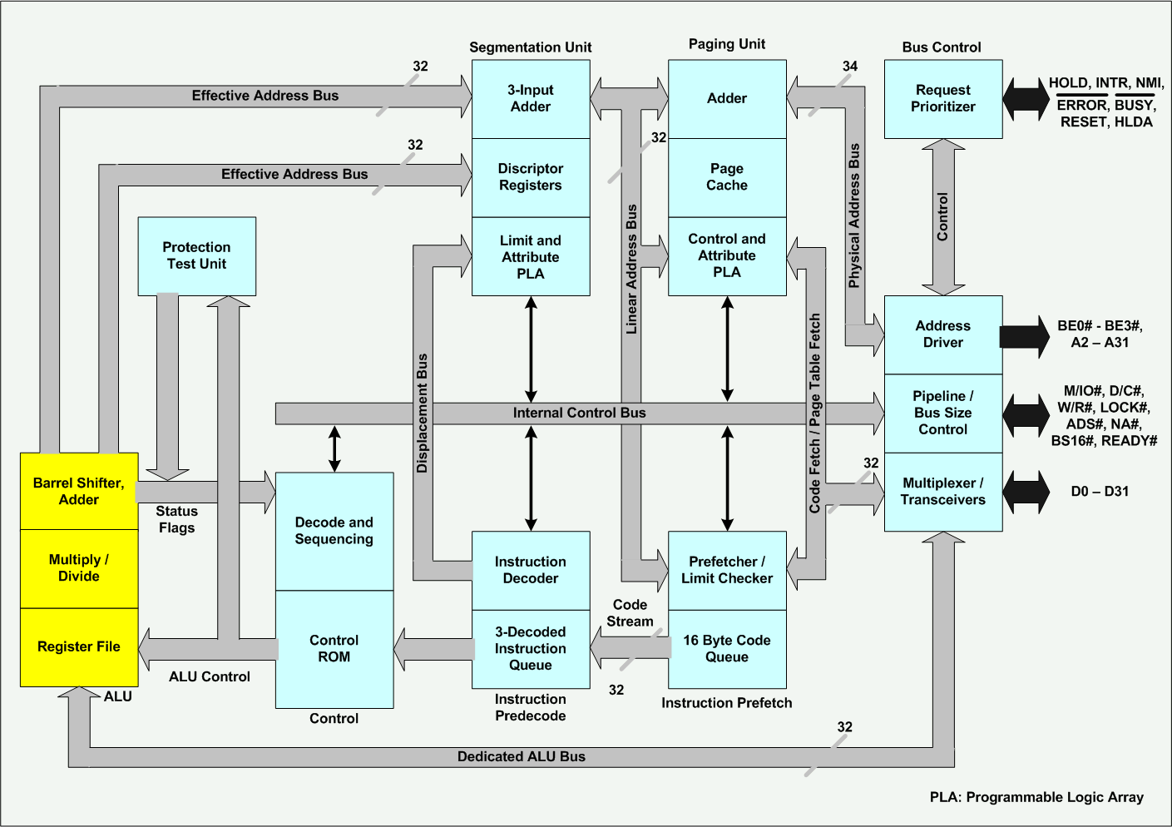
Intel x86 History
Name Date Transistors Clock rate
80386 1985 275K 16-33 MHz
First 32 bit processor , referred to as IA32 architecture
Added “flat addressing”
Capable of running Unix
32-bit Linux/gcc used no instructions introduced in later models
IBM PC superceded by 386-based machines from other vendors; explosion of "clone" vendors

Slide 6
Intel x86 History
Name Date Transistors Clock rate
Pentium 4F 2004 125M 2800-3800 MHz
First (successful) 64-bit processor (from Intel), referred to as x86-64
Based on AMD 64-bit architecture, which was derived from IA-32

Slide 7
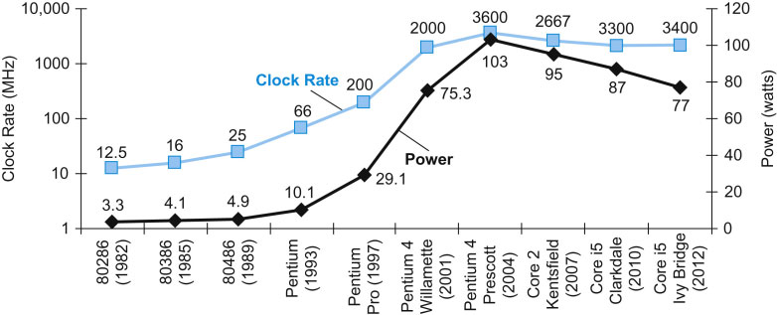
The Power Wall
"Shortly after the beginning of the 21st century an inflection point was reached: in a speech in 2001, and Intel executive pointed out that an extrapolation of increasing power density (and thus temperature) of microprocessor chips would exceed that of a rocket nozzle by 2006, and of the sun's surface by 2012."
"Clearly something had to give, and the result is that going forward we can expect an exponential increase in the number of processors (cores) available to us, but not in their individual performance."

Slide 8
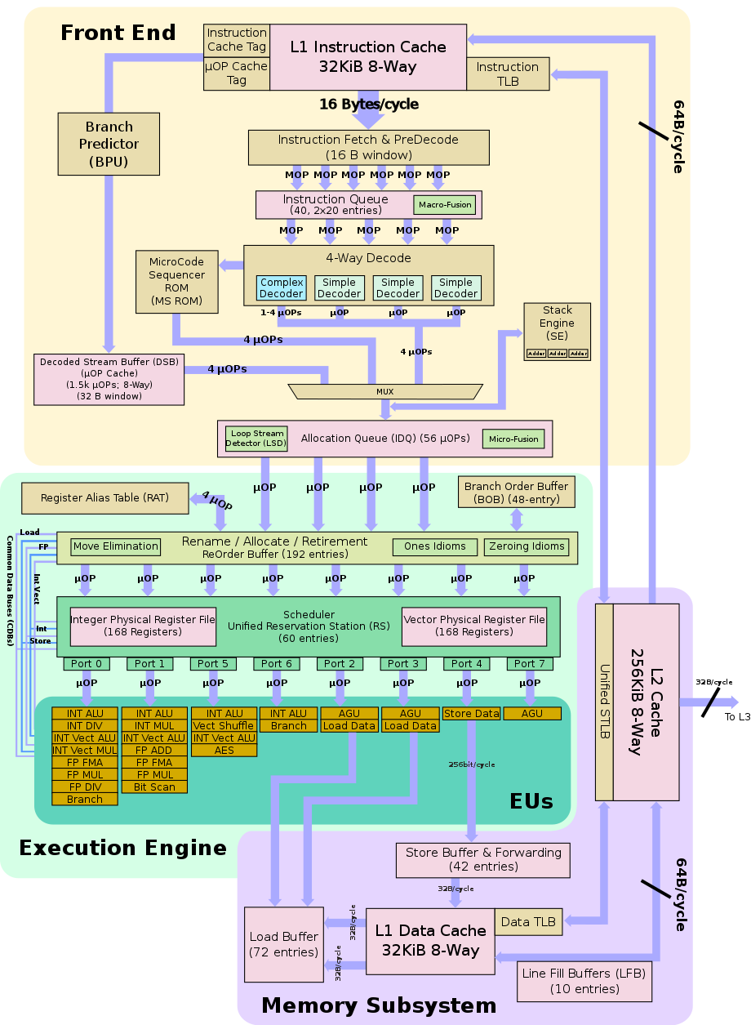
Intel x86 History
Name Date Transistors Clock rate
Core i7 2008 731M 2667-3333 MHz
Multi-core architecture (4, 6, 8 cores)
Reduced clock rates compensated for by multiple cores

Slide 9
Intel x86 History
Intel Attempted Radical Shift from IA32 to IA64
Totally different architecture (Itanium)
Executes IA32 code only as legacy
Performance disappointing
AMD Stepped in with Evolutionary Solution
x86-64 (now called “AMD64”)
Intel Felt Obligated to Focus on IA64
Hard to admit mistake or that AMD's approach is better
2004: Intel Announces EM64T extension to IA32
Extended Memory 64-bit Technology
Almost identical to x86-64!
All but low-end x86 processors support x86-64
But, lots of code still runs in 32-bit mode

Slide 10
The von Neumann Machine
MEMORY
MEMORY
MAR
MDR
Program object code
Data
address
Data
Program data
PROCESSING UNIT
Instruction
address
REGISTERS
Machine Instruction
OS object code
ALU
OS data
Control
signals
Runtime stack
CONTROL UNIT
PC
IR

Slide 11
The von Neumann Machine
Programmer-visible State:
PROCESSING UNIT
REGISTERS
PC: program counter
- stores address of next instruction
- called EIP (IA32) or RIP (x86-64)
ALU
CONDITION CODES
Register file:
- stores heavily used program data
Condition codes
- store status information about most recent arithmetic-logical operation
- used for conditional branching
CONTROL UNIT
PC
IR

Slide 12
IA32 Integer Registers
PROCESSING UNIT
16-bit virtual registers
(backwards compatibility)
REGISTERS
ALU
%eax
%ax
%ah
%al
CONDITION CODES
%ecx
%cx
%ch
%cl
%edx
%dx
%dh
%dl
%ebx
%bx
%bh
%bl
general purpose
%esi
%si
%edi
%di
%esp
%sp
%ebp
%bp

Slide 13
x86-64 Integer Registers
%rax
%r8
%eax
%r8d
%rbx
%r9
%ebx
%r9d
%rcx
%r10
%ecx
%r10d
%rdx
%r11
%edx
%r11d
%rsi
%r12
%esi
%r12d
%rdi
%r13
%edi
%r13d
%rsp
%r14
%esp
%r14d
%rbp
%r15
%ebp
%r15d
Extend existing registers. Add 8 new ones.
Make %ebp/%rbp general purpose

Slide 14
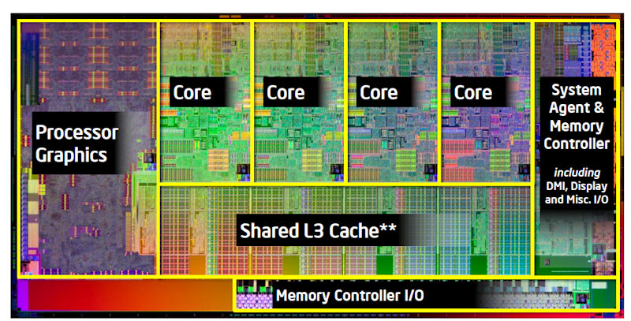
Programming the Machine
// C source code
int imax(int first, int second) {
if ( first >= second )
return first;
return second;
}
But the hardware only "understands" binary representations

Slide 15
Programming the Machine
int imax(int first, int second) {
if ( first >= second )
return first;
return second;
}
gcc -O0 -c –m64 -std=c99 imax.c
457f464c010100010000000000000000
00010003000100000000000000000000
00bc0000000000000034000000000028
0009000689558be50845453b7c0c8b05
084503eb458b5d0c00c3000047004343
203a55287562746e2f75694c616e6f72
3420352e322e382d62756e7575742934
. . .
But who wants to program in binary?

Slide 16
Programming the Machine
int imax(int first, int second) {
if ( first >= second )
return first;
return second;
}
. . .
imax:
pushq %rbp
movq %rsp, %rbp
subq $8, %rsp
movl %edi, -4(%rbp)
movl %esi, -8(%rbp)
movl -4(%rbp), %eax
cmpl -8(%rbp), %eax
jl .L4
movl -4(%rbp), %eax
jmp .L5
.L4:
movl -8(%rbp), %eax
.L5:
popq %rbp
ret
. . .
Solution:
translate high-level language code into intermediate-level code which is more human-friendly,
then translate that "assembly" code into the machine's langauge.

