Slide 1
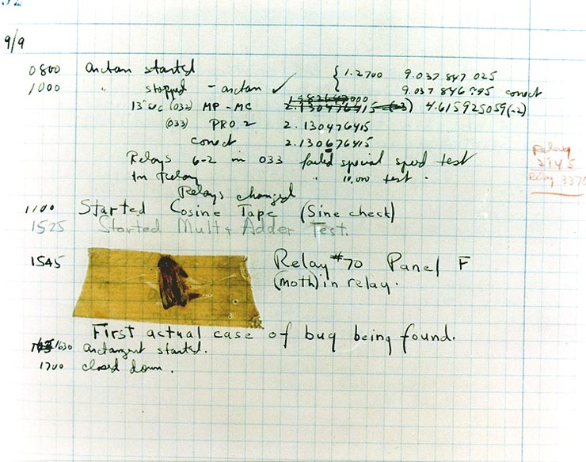
The First Real Bug

Slide 2
Debugging vs Testing
Software testing is any activity aimed at evaluating an attribute or capability of a program and determining whether it meets its specified results
All about "does it work"?
Debugging is a methodical process of finding and reducing the number of bugs, or defects, in a computer program …, thus making it behave as expected
All about "why does it not work" and "what can we do about that"?
They are fundamentally different activities.
Testing can indicate the need to debug, but often provides only superficial clues as to the location or nature of the error.

Slide 3
printf() as an Aid
Perhaps the simplest approach to debugging is to add output code to the program in order to display the values of selected variables and indicate flow of control as the program executes.
This is often referred to as instrumenting the code.
- Easy to apply.
- Use preprocessor directives to enable/disable diagnostic output.
- Lets the code tell you what is actually happening, as opposed to what you believe is happening – psychological issues often hinder debugging.
- Can be cumbersome and difficult to "tune".
This technique is often undervalued and often overvalued.

Slide 4
gdb: the GNU Debugger
gdb is a system tool that allows the user to:
- Step through the execution of a program, instruction by instruction.
- View and even modify the values of variables.
- Set breakpoints that cause the execution of a program to be halted at specific places in the code.
- Set watchpoints that cause the execution of a program to be halted whenever the value of a user-defined expression changes.
- Show a list of the active stack frames.
- Display a range of source code lines.
- Disassemble the current machine code to assembly language.
… and more.

Slide 5
Some gdb Resources
The Art of Debugging with GDB, DDD, and Eclipse,
N Matloff & P J Salzman,
No Starch Press (c)2008
ISBN 978-1-593-27174-9
Some reasonably good gdb cheatsheets:
http://darkdust.net/files/GDB%20Cheat%20Sheet.pdf
http://www.yolinux.com/TUTORIALS/GDB-Commands.html

Slide 6
Example Program
The C source for our running example follows… it is adapted from an example by Norman Matloff (http://heather.cs.ucdavis.edu/~matloff/UnixAndC/CLanguage/Debug.html):
#include <stdio.h>
#include <stdbool.h>
/* Erroneous prime-number finding program.
* Based on an example from Norman Matloff's website
*
* Will (after bugs are fixed) report a list of all primes
* which are less than or equal to the user-supplied upper
* bound.
*
* Riddled with errors!
*/
#define MAXPRIMES 100 // Badly named limit; actually the
// upper limit on the user's input
// for upperBound
void checkPrime(int K, bool Prime[]);
. . .

Slide 7
Example Program
. . .
int main() {
int N;
int upperBound; // We will check all numbers up
// through this one for primeness
bool Prime[MAXPRIMES] = {0}; // Prime[I] will be true if I is
// prime, false otherwise
printf("Enter upper bound less than %d\n", MAXPRIMES);
scanf("%d", upperBound);
Prime[2] = true; // Hardwire to "prime the pump"
printf("2 is a prime\n");
for (N = 3; N <= upperBound; N += 2)
checkPrime(N, Prime);
if ( Prime[N] ) printf("%d is a prime\n",N);
return 0;
}

Slide 8
Example Program
. . .
void checkPrime(int K, bool Prime[]) {
int J;
// The plan: see if J divides K, for all values J which are
//
// (a) themselves prime (no need to try J if it is nonprime),
// and
// (b) less than or equal to sqrt(K) (if K has a divisor
// larger than this square root, it must also have a
// smaller one, so no need to check for larger ones)
. . .

Slide 9
Example Program
. . .
J = 2;
while ( true ) {
if ( Prime[J] )
if ( K % J == 0 ) {
Prime[K] = false; // Redundant, given initialization
// of Prime[] in main()
return;
}
J++;
}
// If we get here, then there were no divisors of K, so K must
// be prime
Prime[K] = true;
}

Slide 10
Compiling for Debugging
In order to take full advantage of gdb's features, you should generally:
- disable code optimizations by using –O0.
- enable the generation of extra debugging information by using –g, or better, by using –ggdb3.
So, in this case, I compiled the preceding source code using the command line:
gcc -o matloff -std=c11 -O0 –Wall -W -ggdb3 matloff.c
This results in two compiler warnings, which I unwisely ignore…

Slide 11
Running the Program
I executed the program by typing the command matloff.
The program prompts the user for a bound on the number of values to be checked; I entered the value 20.
The continuing execution of the program resulted in the following message:
Segmentation fault
This indicates a runtime error related to an impermissible access to memory… but why?

Slide 12
Starting gdb
Start the debugger by typing the command gdb matloff.
gdb starts up with a copyright message and then displays a user prompt:

Slide 13
Runnning the Program
Begin execution of the program by entering the run command, then respond to the user prompt:
Now, this gives us some information, including the address of the (machine) instruction that caused the error, and the function in which the error occurred.
But _IO_vfscanf() is a system function, not user code…

Slide 14
Backtrace
We can get more information about how we arrived at the error by using backtrace:
This shows the stack contains three stack frames at the time the error occurs, and provides the crucial information that:
line 23 in main() called __isoc99_scanf(),
which called _IO_vfscanf()
It seems unlikely either of the latter functions is incorrect… what's line 26?

Slide 15
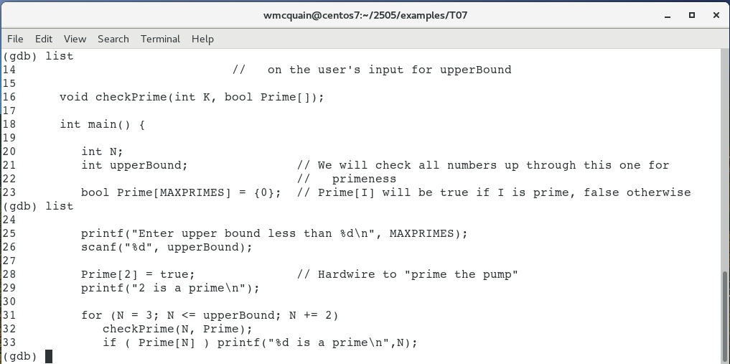
List
We can display the relevant source by using list:
&upperBound
In this case, the error should be obvious, we passed the value of upperBound to scanf() instead of passing the address of upperBound…
… and scanf() then treated that value as an address… with unpleasant results.

Slide 16
Kill
Before modifying the source code and rebuilding, we need to stop the running process, by using the kill command*:
* Actually, no. We could edit the code in a text editor, save it, and recompile it in a second terminal window. That's how I normally work.

Slide 17
Fix the First Bug
We fix the error by inserting the address-of operator:
. . .
int main() {
. . .
scanf("%d", &upperBound);
. . .
Now, rebuild as before and try running the program again…
Segmentation fault
Note: I opened a second terminal window to perform the rebuild and test the program again… that saves the time to exit and restart gdb (of course, in this case I knew in advance there were more bugs).

Slide 18
Running the Program Again
Restart the program within gdb and see what happens:
This time we got better information because the source for matloff.c is available.
We know:
- checkPrime() was called with K == 3
- The error occurred in evaluating Prime[j]

Slide 19
List
As before, let's see what the surrounding code is:
Hm… that's somewhat informative. Apparently J must be out of bounds.

Slide 20
Print
We can see the value of a variable by using the command print:
Well, Prime[] is of dimension 100, so that is certainly out of bounds… how did this happen?
Better take a somewhat wider look at the source… certainly "while (true)" looks a bit odd.

Slide 21
The Source
In this case, I find it easier to just switch to my text editor and see what's going on:
. . .
// The plan: see if J divides K, for all values J which are
//
// (a) themselves prime (no need to try J if it is nonprime),
// and
// (b) less than or equal to sqrt(K) (if K has a divisor
// larger than this square root, it must also have a
// smaller one, so no need to check for larger ones)
J = 2;
while ( true ) {
if ( Prime[J] )
if ( K % J == 0 ) {
Prime[K] = false; // Redundant, given initialization
// of Prime[] in main()
return;
}
J++;
}
. . .
The loop bears no resemblance to the stated plan… the code never tries to limit J to be less than or equal to sqrt(K).

Slide 22
The Problem
J = 2;
while ( true ) {
if ( Prime[J] )
if ( K % J == 0 ) {
Prime[K] = false;
return;
}
J++;
}
. . .
The loop never exits unless we have a value for J such that both:
- Prime[J] == true
- J divides K
But if K == 3 then the first prime that divides K would be 3 itself.
But we know that J reached the value 4640.
Why didn't the loop exit when we reached J == 3?
It must have been that Prime[3] was not true.
Examining the earlier source code, we see that Prime[3] will not have been explicitly set at this point.
We could fix this by assuming each K is prime until shown otherwise, and so setting Prime[K] to true before entering the function…

Slide 23
Fixing the Second Bug
But it's more efficient to make the loop exit once we've examined all the necessary candidates for divisors of K:
. . .
/* the plan: see if J divides K, for all values J which
are
(a) themselves prime (no need to try J if it is
nonprime), and
(b) less than or equal to sqrt(K) (if K has a divisor
larger than this square root, it must also have a
smaller one, so no need to check for larger ones)
*/
for ( J = 2; J * J <= K; J++ ) {
if ( Prime[J] )
if ( K % J == 0 ) {
Prime[K] = false;
return;
}
J++;
}
. . .

Slide 24
Trying Again
Well, no segmentation fault… but this didn't report any primes up to 20… except for 2…
What to do when we have no immediate indication of what's wrong?
It would seem useful to trace the execution of the program.

Slide 25
Breakpoints
gdb allows us to set breakpoints, that is positions at which execution will automatically halt:
Important: the displayed line of code has NOT been executed yet!

Slide 26
Stepping Through
gdb also allows us to step through the program one instruction at a time:
Since line 23 is a scanf() call, we must enter the input value and hit return before gdb resumes by displaying the next instruction.

Slide 27
More Stepping
The gdb command display is like print except that the value of the specified variable is shown after each step is taken:
But execution goes from line 31 to line 32 and back to line 31… that's not what we expected… (see the source for main()).

Slide 28
Fixing the Third Bug
Ah… missing braces around the intended body of the for loop:
. . .
int main() {
. . .
for (N = 3; N <= upperBound; N += 2)
checkPrime(N);
if ( Prime[N] ) printf("%d is a prime\n",N);
. . .
BTW, this is why I suggest you ALWAYS put braces around the body of a selection or loop structure.

Slide 29
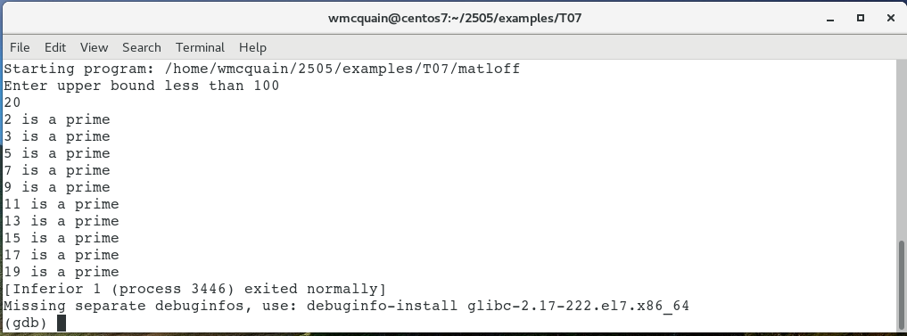
Trying Again
OK, this looks better, but we reported 9 and 15 as being prime.
See the source code, and try gdb, to diagnose the reasons for these final bugs…

Slide 30
Conditional Breakpoints
(gdb) break matloff.c:51 if J > MAXPRIMES
Breakpoint 1 at 0x400677: file matloff.c, line 51.
The breakpoint here will only trigger if execution reaches line 51 and the condition is true.
The condition is expressed using C syntax (be careful of using = for ==).
(gdb) run
Starting program: /home/wmcquain/2505/notes/matloff/matloff
enter upper bound
20
Breakpoint 1, checkPrime (K=3, Prime=0x7fffffffde90) at matloff1.c:51
51 if ( Prime[J] )
Missing separate debuginfos, use: debuginfo-install glibc-2.17-222.el7.x86_64
(gdb) p J
$1 = 101

Slide 31
Conditional Breakpoints
(gdb) run
Starting program: /home/wmcquain/2505/notes/matloff/matloff
enter upper bound
20
Breakpoint 1, checkPrime (K=3, Prime=0x7fffffffde90) at matloff1.c:51
51 if ( Prime[J] )
Missing separate debuginfos, use: debuginfo-install glibc-2.17-222.el7.x86_64
(gdb) p J
$1 = 101
(gdb) p Prime[100]
$2 = 255
(gdb) p Prime[101]
$3 = 127
(gdb) p Prime[99]
$4 = false

