Slide 1
Functions
A function is a sequence of statements that have been grouped together and given a name.
Each function is essentially a small program, with its own declarations and statements.
Some advantages of functions:
- A program can be divided into small pieces that are easier to understand and modify.
- We can avoid duplicating code that’s used more than once.
- A function that was originally part of one program can be reused in other programs.
- The memory cost of the program can be reduced if the memory needed by each a function is released when the function terminates.
The Caesar Cipher example discussed earlier provides an illustration of the use of functions in the design and implementation of a small C program.
Notes:
Students should understand the concept and basic mechanics of the function call/return pattern from CS 1114/2114, but some will not.

Slide 2
Function Definitions
General form of a function definition:
return-type function-name ( parameters )
{
declarations
statements
}
double average(double a, double b) {
return (a + b)/2.0;
}
Functions may not return arrays.
Specifying that the return type is void indicates that the function doesn’t return a value.
If the return type is omitted in C89, the function is presumed to return a value of type int.
In C99 and later, omitting the return type is illegal.

Slide 3
Function Definitions
Variables declared in the body of a function can’t be examined or modified by other functions.
In C99 and later, variable declarations and statements can be mixed, as long as each variable is declared prior to the first statement that uses the variable.
Functions that do not return a value are declared with a return type of void.
The returned valued from a call to a non-void function may be ignored.
Many void functions can be improved by using a return type of bool.
Notes:
The term function "implementation" may be clearer to students than "definition", but the latter is the correct and more common term, so they should learn it.

Slide 4
Function Declarations
C doesn’t require that the definition of a function precede its calls:
#include <stdio.h>
int main(void) {
double x, y;
printf("Enter two numbers: ");
scanf("%lf%lf", &x, &y);
printf("Average of %g and %g: %g\n", x, y, average(x, y));
return 0;
}
double average(double a, double b) {
return (a + b) / 2;
}
However, in that case, there should be a declaration of the function before the call.
Not doing so is always a bad idea… and may lead to errors…
In the absence of a function declaration, the compiler will infer one from the call…

Slide 5
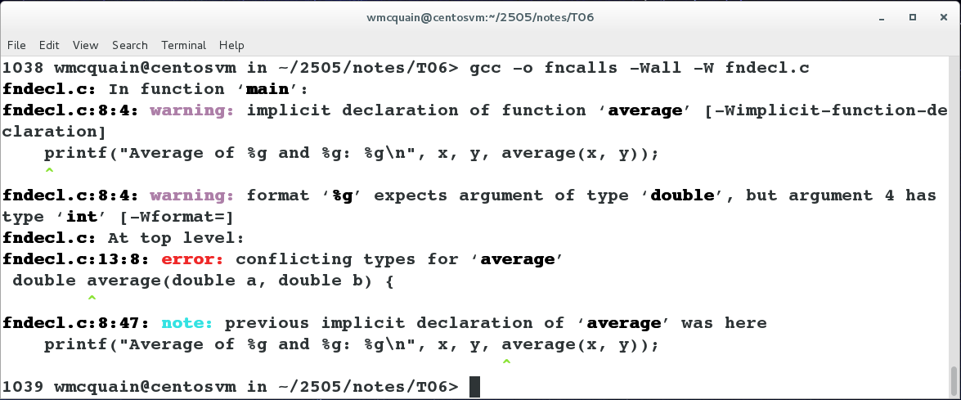
Function Declarations
The declaration that the compiler infers may clash with the definition:
#include <stdio.h>
int main(void) {
double x, y;
printf("Enter two numbers: ");
scanf("%lf%lf", &x, &y);
printf("Average of %g and %g: %g\n", x, y, average(x, y));
return 0;
}
double average(double a, double b) {
return (a + b) / 2;
}
The C compiler assumes that the function returns an int value.
Notes:
What's illustrated here is actually a GOOD thing (not the omitted declaration, but the effect on compilation).
Without the compiler warning, we may simply experience unintended behavior from the function call.

Slide 6
Function Declarations
A function declaration provides the compiler with a brief glimpse at a function whose full definition will appear later.
The general form of a function declaration:
return-type function-name ( parameters ) ;
The declaration of a function must be consistent with the function’s definition.
A function declaration looks just like the first line of the function definition:
double average(double a, double b);
Note: the parameter names can be omitted, but not the parameter types.

Slide 7
Function Declarations
The declaration of a function is usually placed at file level (or in a header file):
#include <stdio.h>
double average(double a, double b);
int main(void) {
double x, y;
printf("Enter two numbers: ");
scanf("%lf%lf", &x, &y);
printf("Average of %g and %g: %g\n", x, y, average(x, y));
return 0;
}
double average(double a, double b) {
return (a + b) / 2;
}
This version of the code will compile without issues.

Slide 8
Compiler Checks
The compiler will check whether a call to a function matches the declaration of that function:
// declaration:
double average(double a, double b);
Which will compile? Will there be errors? Warnings?
double x = 2.437, y = -3.194;
double z = average(x, y);
all types match; no problem
double x = 2.437, y = -3.194;
double z = average(x);
number of parameters in call does not agree with declaration; compilation error
int x = 2, y = -3;
double z = average(x, y);
int parameters in call converted to doubles for fn
double x = 2.437, y = -3.194;
int z = average(x, y);
return value converted from int to double
double x = 2.437, y = -3.194;
average(x, y);
parameter types match; return value is discarded
Notes:
Aside from some warnings about unused variables, only the second example will result in a diagnostic message from the compiler.
This is a good time to warn about C's support for silent type conversions…

Slide 9
Formal vs Actual Parameters
Formal parameters are the names used in the function definition.
Actual parameters are the names used in the function call.
#include <stdio.h>
double average(double a, double b);
int main(void) {
double x, y;
printf("Enter three numbers: ");
scanf("%lf%lf", &x, &y);
printf("Average of %g and %g: %g\n", x, y, average(x, y));
return 0;
}
double average(double a, double b) {
return (a + b) / 2;
}

Slide 10
Formal Parameters are Pass-by-Value
Formal parameters have automatic storage duration and block scope, just like local variables.
Formal parameters are automatically initialized with a copy of the value of the corresponding actual parameter.
There is no connection between the actual and formal parameters other than that they store the same value at the time of the function call.
int Exp = 10;
int Base = 4;
int BaseToExp = Power(Base, Exp);
printf("%d ^ %d = %d\n",
Base, // still 4
Exp, // still 10
BaseToExp);
int Power(int X, int N) {
int Result = 1;
while (N-- > 0) {
Result = Result * X;
}
return Result;
}
Notes:
Automatic storage duration: variable is created on call, destroyed on return.
Block scope: variable can be referred to only within the block where it is declared.

Slide 11
Formal Parameters are Pass-by-Value
int main() {
. . .
int Exp = 10;
int Base = 4;
int BaseToExp = Power(Base, Exp);
printf("%d ^ %d = %d\n",
Base, // still 4
Exp, // still 10
BaseToExp);
. . .
}
Exp | 10
Base | 4
BaseToExp | ??
4**10
int Power(int X, int N) {
int Result = 1;
while (N-- > 0) {
Result = Result * X;
}
return Result;
}
X
N
Result
4
10
1
X | 4
N | 0
Result | 4**10

Slide 12
Code Organization for User-defined Type
// Type definition typically goes
// in a header file (Rational.h).
struct _Rational {
int top;
int bottom;
};
typedef struct _Rational Rational;
// Declarations of "public" functions go in header file.
Rational Rational_Create(int top, int bottom);
Rational Rational_Add(Rational left, Rational right);
. . .
A "public" function is one that we intend to call from code that is in other .c files.
Any interesting C program will consist of multiple .h and .c files.

Slide 13
Code Organization for User-defined Type
// Helper functions that are only intended to be called from
// within a single .c file are typically declared and defined
// within that .c file.
//
// Declaring the function as "static" makes it callable
// only from within this file.
static Rational Rational_Normalize(Rational original);
Rational Rational_Create(int top, int bottom) {
. . .
}
. . .
static Rational Rational_Normalize(Rational original) {
. . .
}
. . .

Slide 14
Function Header Comments
Each function should be given a header comment that supplies the caller with enough information to understand what the function does, what pre-conditions are necessary for a successful call, what post-conditions are guaranteed (if appropriate), what value is returned (if appropriate).
For development purposes, it's also useful to specify callers and callees.
/**
* Computes the sum of left and right.
* Pre:
* Left and Right are proper.
* Returns:
* A proper Rational object X equal to left + right.
* Called by:
* Client code.
* Calls:
* Rational_Normalize() on result.
*/
Rational Rational_Add(Rational left, Rational right);
It's good practice to put the header comment on both the function declaration and definition.

Slide 15
Shell Side to C
C programs can receive command-line arguments from the shell:
The shell initializes an integer variable and an array of C-style strings:
int argc: 4
+---------------+
char* argv[]: | "hexer" |
+---------------+
| "Virginia" |
+---------------+
| "Polytechnic" |
+---------------+
| "Institute" |
+---------------+
| NULL |
+---------------+
Notes:
C Standard section 5.1.2.2.1 says that argv[argc] shall be NULL.

Slide 16
main() Interface
These arguments are passed as parameters to main():
int argc: 4
+---------------+
char* argv[]: | "hexer" |
+---------------+
| "Virginia" |
+---------------+
| "Polytechnic" |
+---------------+
| "Institute" |
+---------------+
| NULL |
+---------------+
// hexer.c
. . .
int main(int argc, char* argv[]) {
. . .
So, the C program can now check the number of command-line "tokens" and process them as needed.

Slide 17
C Code
// hexer.c
#include <stdio.h>
int main(int argc, char* argv[]) {
int argno = 1; // start with argument 1
while ( argv[argno] != NULL ) {
char* currArg = argv[argno]; // slap handle on current one
// echo current argument
printf("%10s: ", argv[argno]);
// print ASCII codes of characters, in hex format:
int pos = 0;
while ( currArg[pos] != '\0' ) {
printf(" %X", (unsigned char) currArg[pos]);
pos++;
}
printf("\n");
argno++; // step to next argument (if any)
}
return 0;
}
Notes:
This involves a number of C constructs we haven't formally introduced yet… a good chance to look forward and prefigure them.

Slide 18
The Stack
The execution of a C program is organized by use of a collection of stack frames (or activation records) stored in a stack structure.
Each time a function is called, a stack frame is created and pushed onto the stack.
The stack frame provides memory for storing:
- values of parameters passed into the function
- values of local variables declared within the function (unless they're static)
- the return address (of the instruction to be executed when the function terminates)
We will examine the details of the stack later.

