Slide 1
Warnings
First of all, these notes will cover only a small subset of the available commands and utilities, and will cover most of those in a shallow fashion.
Read the relevant material in Sobell!
If you want to follow along with the examples that follow, and you do, open a Linux terminal.
Second, most of the Linux commands have features that are enabled by using command-line switches; check the man pages for the commands for details!

Slide 2
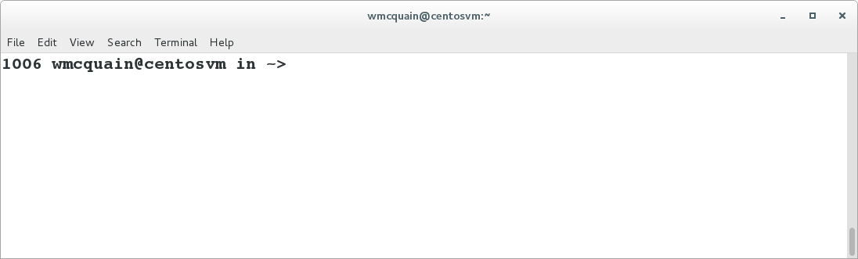
Getting Started
The Linux terminal (or command shell) allows you to enter commands and execute programs.
A terminal displays a prompt and a cursor indicating it’s waiting for user input:
The prompt itself is configurable; precisely how depends on the particular type of shell you are running.
It is likely that by default you will run the bash shell.

Slide 3
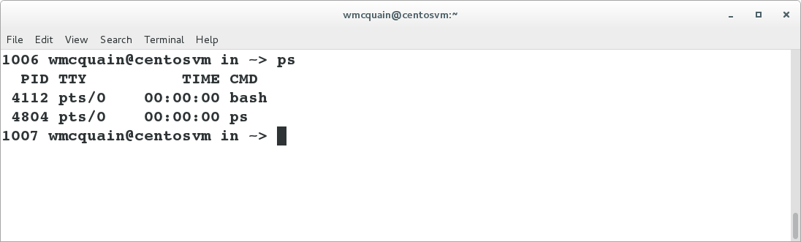
What’s Running?
The ps command displays information about processes the shell is currently running:
We see that two processes are executing, bash and ps.
Moreover, we see that:
- each is assigned a unique numeric identifier called a process ID or PID
- each is associated with a terminal (TTY) named pts/0
Try executing ps a second time… you’ll notice that the PID for bash is the same as before but the PID for ps has changed.
Why? (That’s two questions.)
Notes:
Each process is assigned a unique PID upon creation; this is the same bash process as before, but a different instance of ps, and hence a different PID.

Slide 4
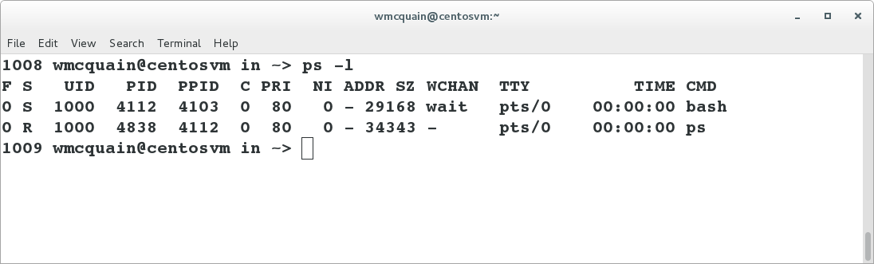
More Information
Try running ps with the –l (that’s ell, not one) switch:
Don’t worry about the meaning of all that just yet, but do notice that the results of the ps command were altered by the use of a “switch” on the command line.
This is typical of Linux commands and many user programs.

Slide 5
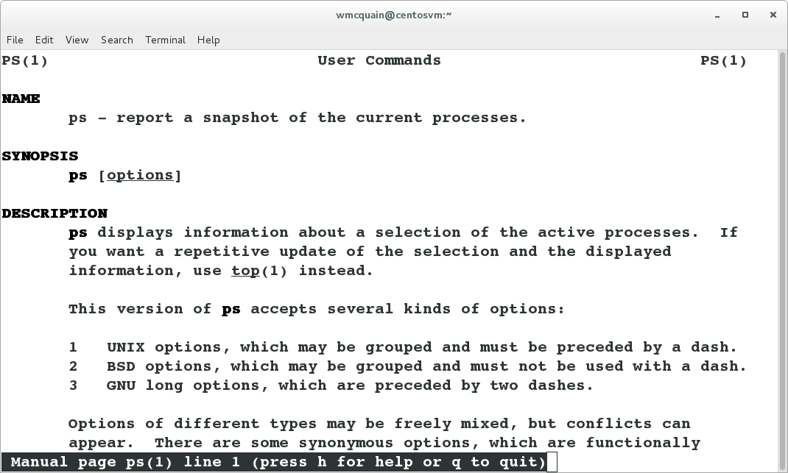
One way to find out more…
The man (manual) command can be used to obtain more information about Linux commands:
The man pages are often the first resort for discovering options.
Try running man man…

Slide 6
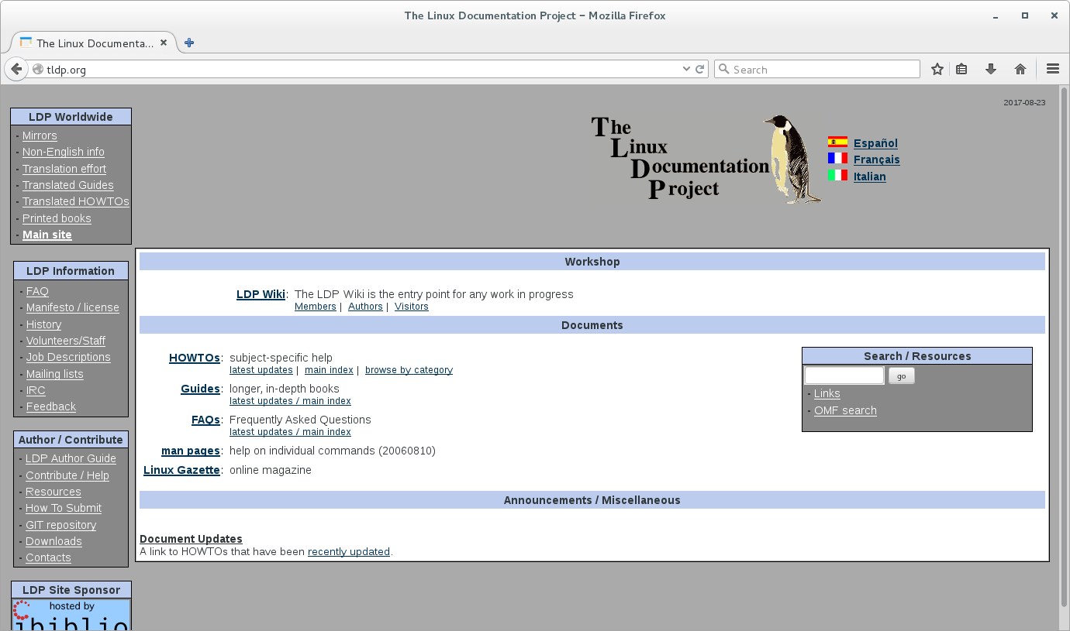
The Linux Documentation Project

Slide 7
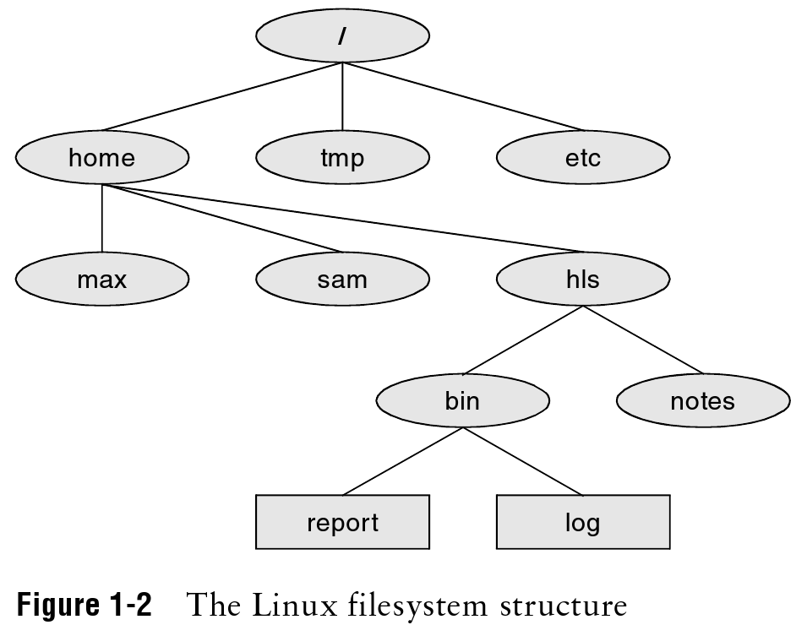
File System Basics
The file system is a set of data structures that organizes collections of files.
Files are grouped into directories (although directories are themselves files).
Here’s one possible file system organization:
root
super-directory
(parent)
sub-directory
(child)
regular file

Slide 8
File Names
Each file and directory has a name:
- names are case-sensitive
- names within the same directory must be unique
- the use of characters other than letters, digits, underscores and periods tends to cause extra work when using many commands
File names are often of the form <name.ext>, such as BashTerminal.jpg.
While file extensions are not mandatory, it is standard (and good) practice to employ them.
You are required to use appropriate file extensions in this course.
It is bad practice to employ extensions incorrectly. Common ones include:
- c C language source files
- h C language header files
- txt plain text files
- gz file compressed with gzip
- tar archive file created with tar
- html hypertext markup language file

Slide 9
Absolute Pathnames
Each file (and directory) can be specified by a unique absolute pathname:
/
/etc
/home/hls/bin/log

Slide 10
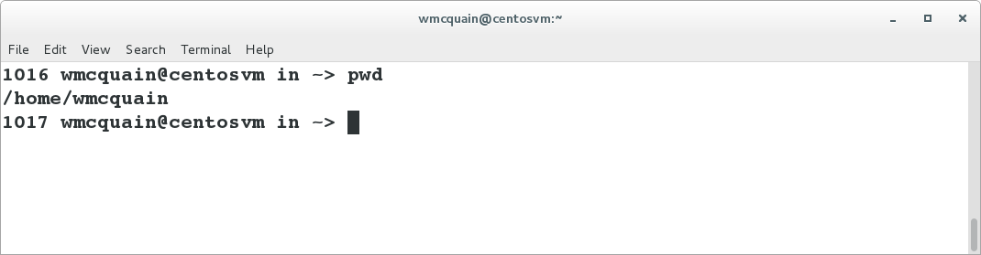
Home Directory
When you open a terminal, by default you will be in your home directory.
Typically, this will be /home/<userid>, but you can check the path to your current directory by using the pwd command:

Slide 11
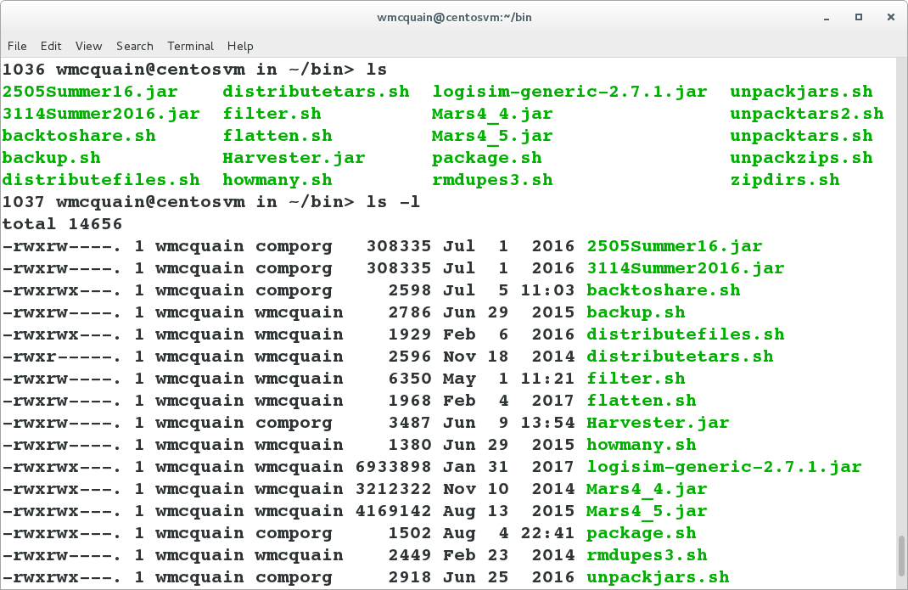
What’s in here?
The ls command lists the files in the current directory:

Slide 12
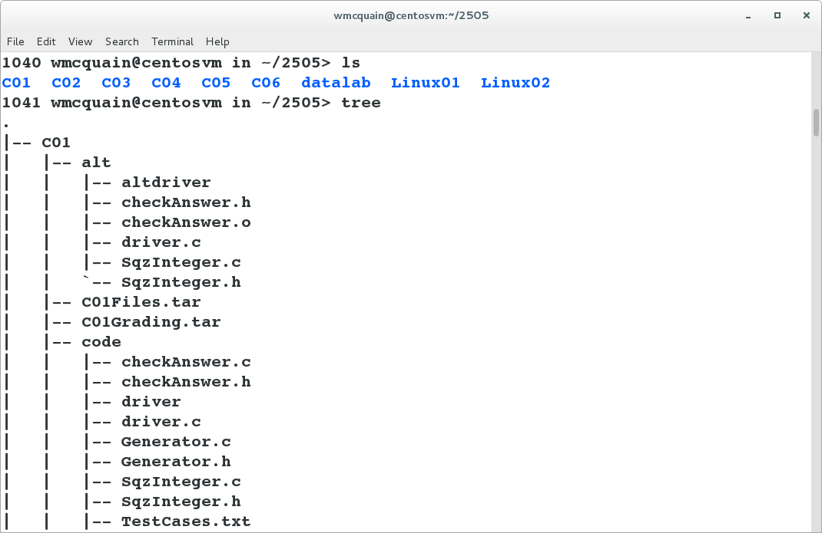
Directory Tree
You can display a map of the directory tree rooted at your current directory:
The tree program may not be installed by default; we'll cover software package installation a bit later.

Slide 13
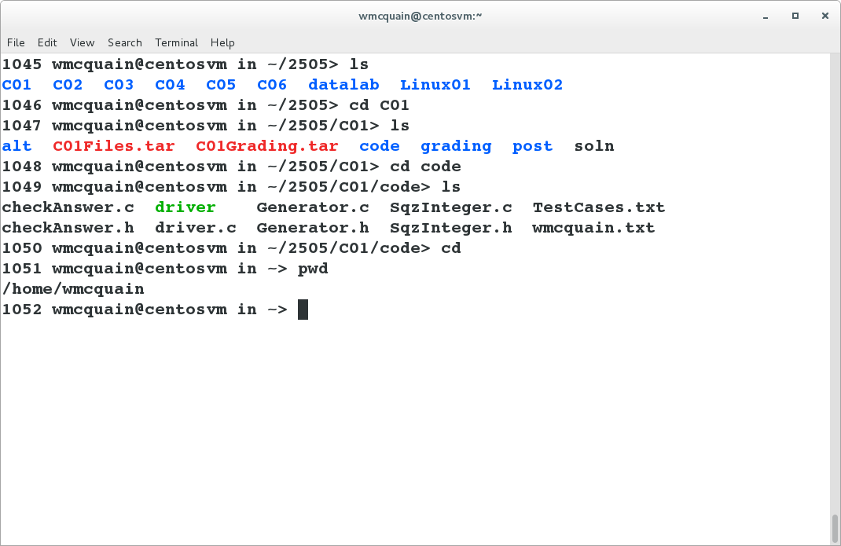
Directory Navigation
You can use the cd command to change your current (or working) directory:
Using cd with no destination moves you back to your home directory:

Slide 14
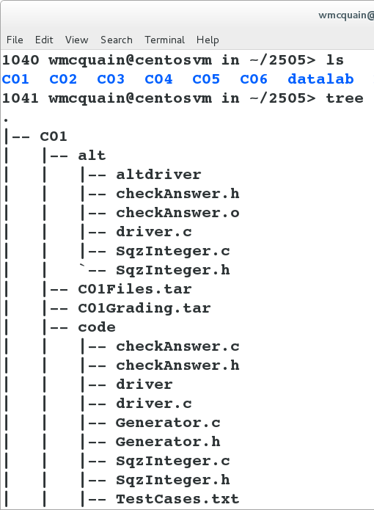
Relative Pathnames
You can also specify a pathname that’s relative to the current (working) directory.
Let’s say you’re in a directory ~/2505/C01/alt/:
../C01Grading.tar
../code/checkAnswer.c
There are two special directory names:
. refers to the current directory
.. refers to the parent of the current directory

Slide 15
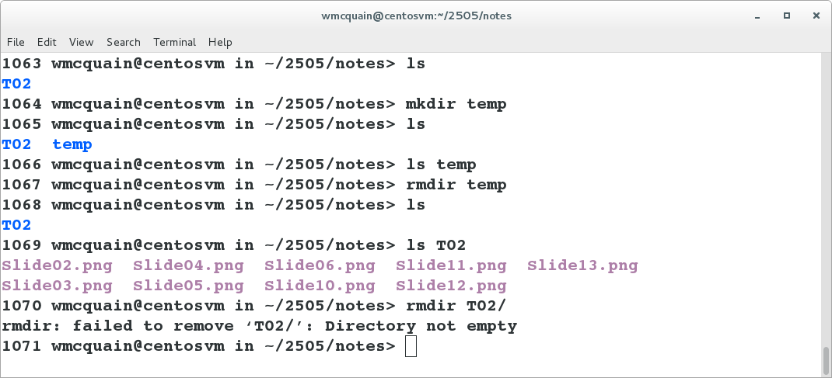
Making/Removing a Directory
mkdir: creates a new subdirectory of the current directory
rmdir: deletes a empty subdirectory
rm -Rf: deletes a subdirectory and all its contents (recursive, very dangerous!)

Slide 16
Copying Files: cp
You can create a copy of a file with the cp command.
Assume we’re in a directory containing a file named infloop.c:
cp infloop.c infloop2.c
makes a copy of infloop.c named infloop2.c in the same directory
cp infloop.c ..
makes a copy of infloop.c with the same name in the parent directory
cp infloop.c ../infloop2.c
makes a copy of infloop.c, named infloop2.c, in the parent directory

Slide 17
Renaming/Moving Files: mv
As before, assume we’re in a directory containing a file named infloop.c:
mv infloop.c infiniteloop.c
changes the name of the file infloop.c to infinitefloop.c
mv infloop.c ../attic
moves the file infloop.c to the subdirectory of the parent named attic
mv infloop.c ../infiniteloop.c
removes the file infloop.c from this directory, and creates a copy named infinitefloop.c in the parent directory

Slide 18
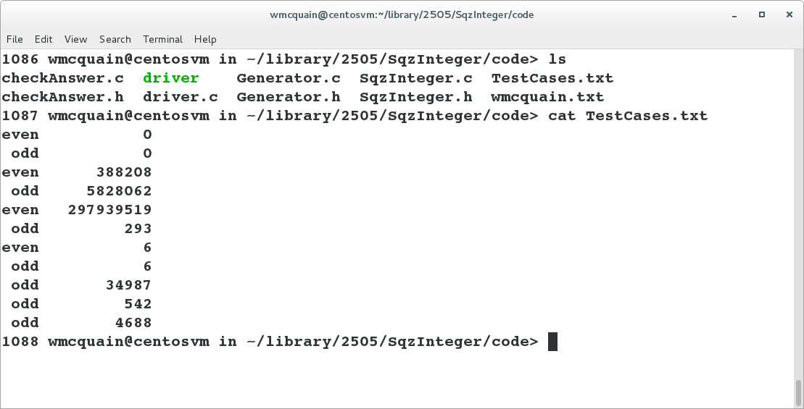
Viewing a File: cat
You can use the cat command to display the contents of a file to the terminal:

Slide 19
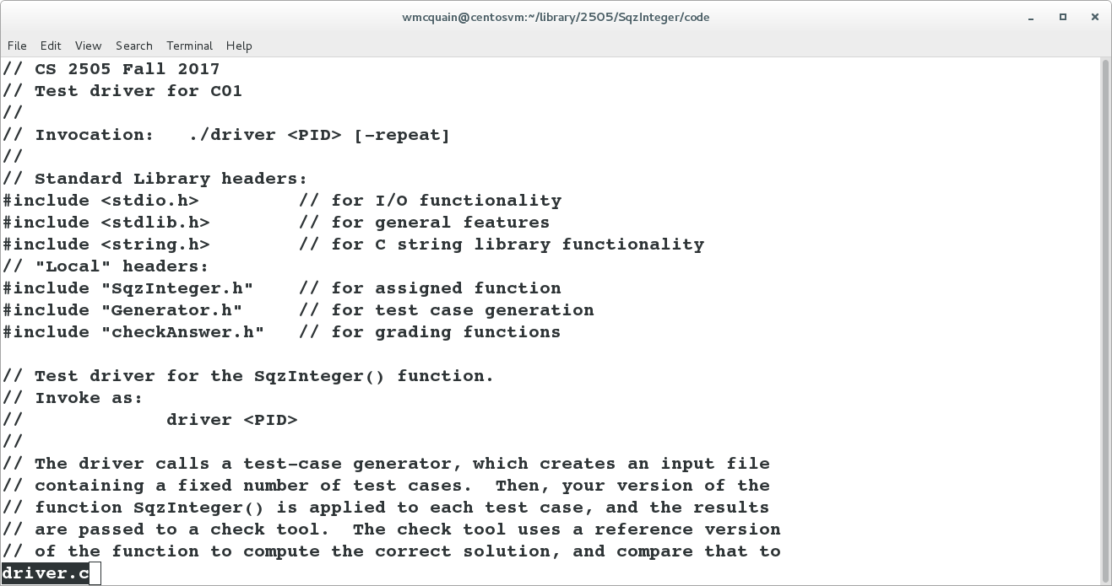
Viewing a File: less
You can use the less command to display the contents of a file to the terminal, one screenful at a time; here we entered less driver.c:
Just hit <space> or f to advance, b to back up, and q to quit.

Slide 20
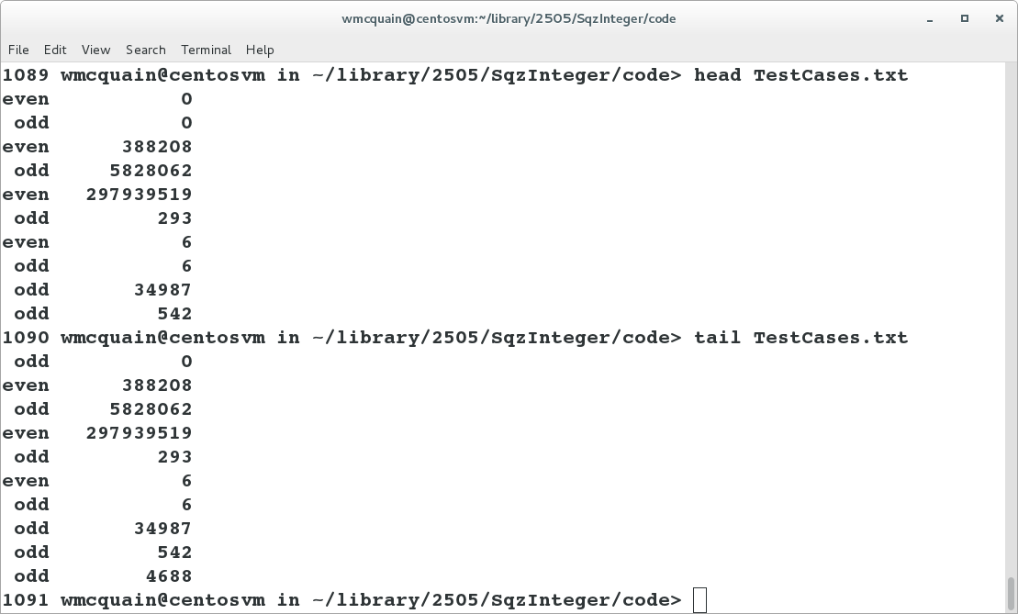
Viewing a File: head and tail
You can view the first (or last) few lines of a file by using the head (or tail) command:
You can control how many lines are shown; see the man page.

Slide 21
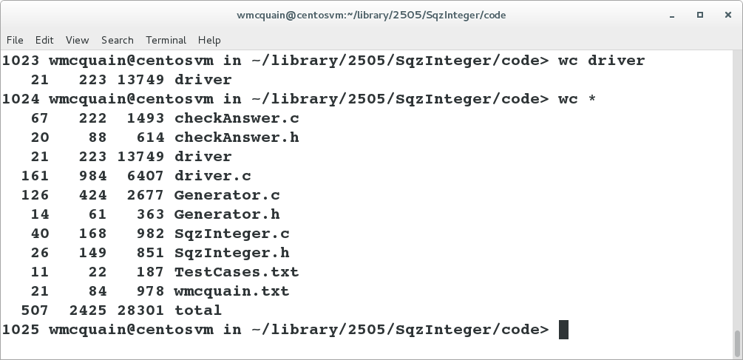
Counting Words… and More
The wc command reports the number of lines, "words", and bytes in a file:

Slide 22
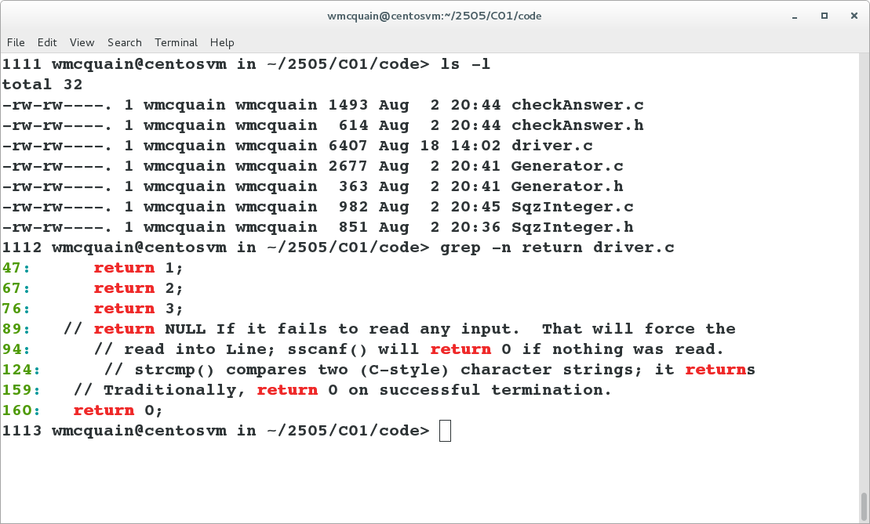
Searching File Contents: grep
The grep command can be used to display lines of a file that match a pattern:

Slide 23
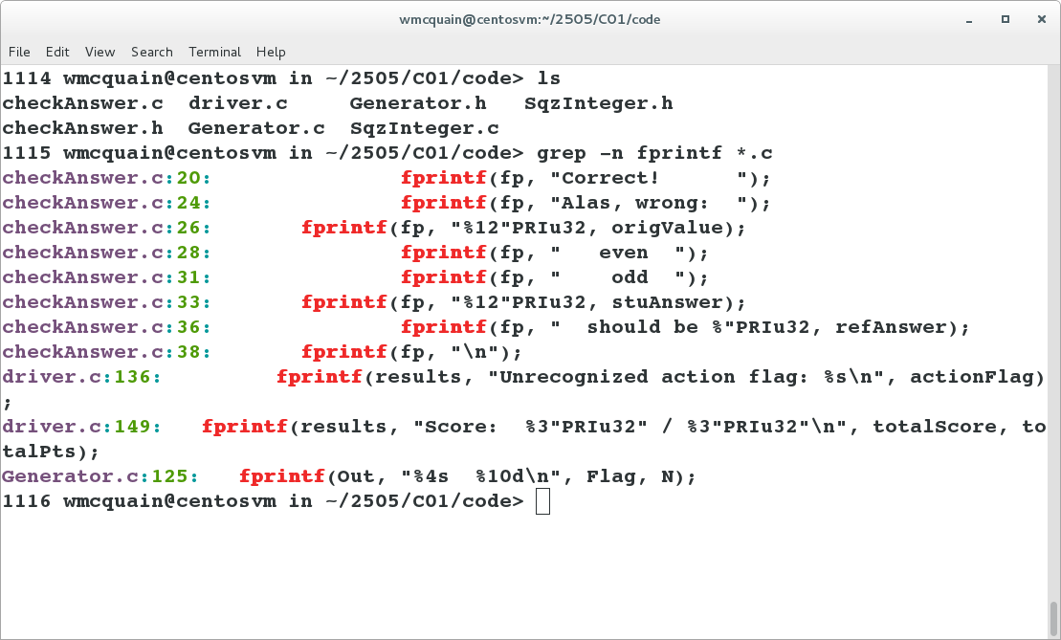
Searching File Contents: grep
The grep command can also be used to examine a collection of files:

Slide 24
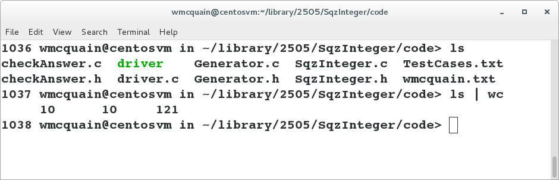
Chaining Commands
The pipe symbol (|) connects standard output from one command to standard input for the next command:

Slide 25
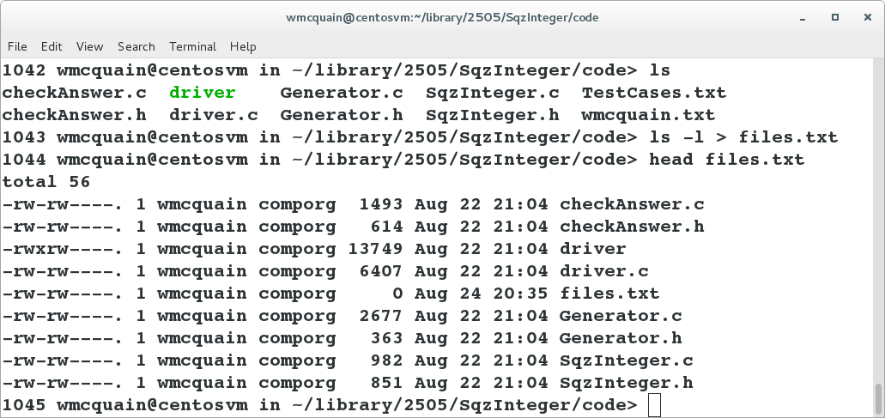
Redirecting Output
The output a program writes to standard output (the terminal) can be sent to a file by using an output redirection operator (> or >>):

Slide 26
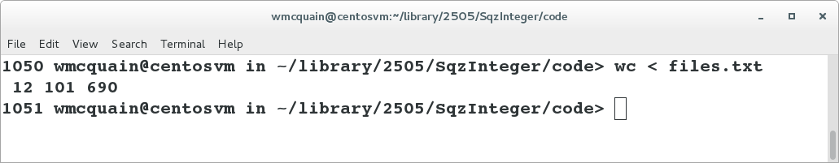
Redirecting Input
The contents of a file can be sent, as standard input, to a program by using an input redirection operator (< or <<):

Slide 27
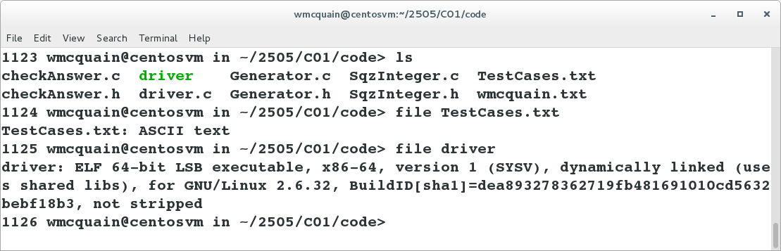
Checking the File Type: file
You can obtain information about a file with the file command:

Slide 28
Traditional Access Permissions
There are three types of users:
- owner (aka user)
- group
- other (aka world)
A user may attempt to access an ordinary file in three ways:
- read from
- write to
- execute
Use ls –l to view the file permissions:
1143 wmcquain@centosvm in ~/2505> ls -l C04/code
total 48
-rw-rw----. 1 wmcquain comporg 4653 Aug 7 21:45 comparator.c
-rwxr-xr-x. 1 wmcquain comporg 13340 Aug 7 21:45 compare
-rw-rw----. 1 wmcquain comporg 2612 Aug 7 21:45 driver.c
-rw-rw----. 1 wmcquain comporg 451 Aug 10 19:30 Intersection.h
-rw-rw----. 1 wmcquain comporg 1944 Aug 7 21:45 Intersection.o
drwxrwxr--. 1 wmcquain comporg 3073 Aug 7 21:45 tmpbackup

Slide 29
Traditional Access Permissions
File type
File permissions (owner group other)
Number of links to file
Owner
Group
Size
Modification time
File name
-rwxr-xr-x. 1 wmcquain comporg 13340 Aug 7 21:45 compare
drwxrwxr--. 1 wmcquain comporg 3073 Aug 7 21:45 tmpbackup

Slide 30
Changing Access Permissions: chmod
Use the chmod command to set or alter traditional file permissions:
1143 wmcquain@centosvm in ~/2505> ls -l C04/code/comparator.c
-rw-rw----. 1 wmcquain comporg 4653 Aug 7 21:45 comparator.c
1144 wmcquain@centosvs in ~/2505> chmod g-rw C04/code/comparator.c
1143 wmcquain@centosvm in ~/2505> ls -l C04/code/comparator.c
-rw-------. 1 wmcquain comporg 4653 Aug 7 21:45 comparator.c
chmod also allows the use of numeric arguments:
0 no access permissions
1 execute permissions
2 write to permissions
4 read from permissions
So, chmod 740 would set
owner permissions to r w x
group permissions to r- -
other permissions to - - -
WHY?

Slide 31
Changing Access Permissions: chmod
Binary representations:
none 0 000
x 1 001
w 2 010
r 4 100
Now notice that 7 = 111 which is the logical OR of 001 and 010 and 100
And, 740 thus specifies permissions 7 for the owner, 4 for the group and 0 for others.

Slide 32
The Importance of Access Permissions
When working on a shared environment, like the rlogin cluster, it is vital that you make sure that your access permissions are set correctly.
As a general rule, you will rely on the default access permissions, which are controlled via shell configuration files we will discuss later.
When in doubt, use ls –l to check!

Slide 33
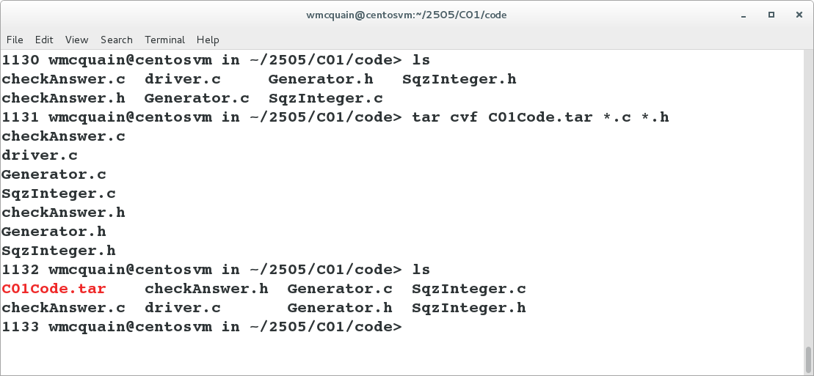
Bundling Files into an Archive: tar
You can create a single file that contains a collection of files, including a directory structure with the tar utility:
cvf create archive, be verbose, write to a file
Note the name of the new tar file is listed before the target (files to be tar'd up).
DO NOT get that backwards!

Slide 34
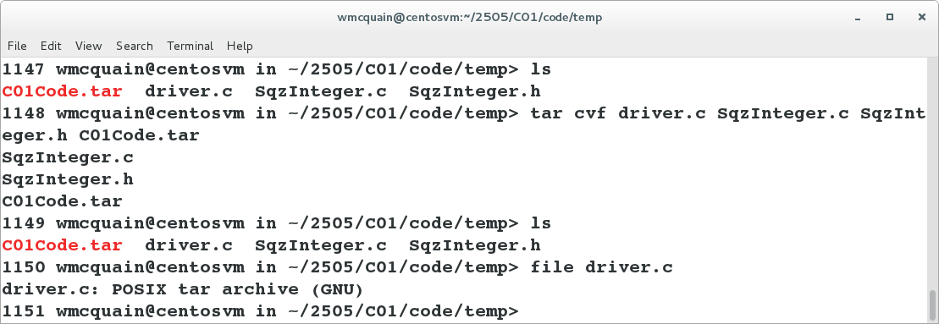
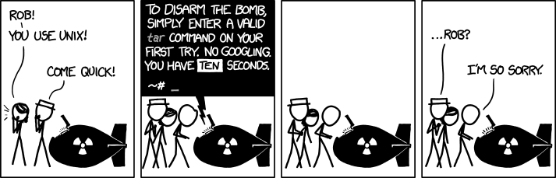
Applied Terror: tar
As with all commands, your syntax must be precise… but the tar command has the potential to destroy files:
xkcd.org

Slide 35
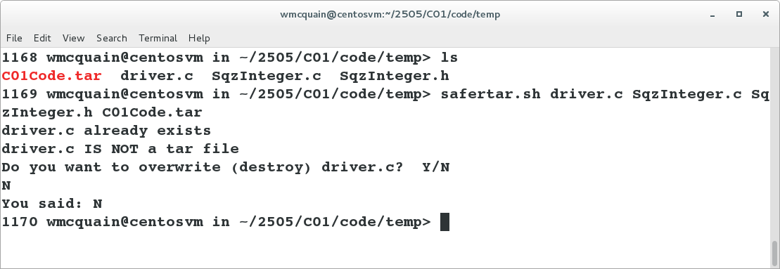
A Safer Way
There is a bash shell script on the Resources page that provides a safer alternative:
Download safertar.sh, put it in a directory in your path, and make it executable.
This comes with the usual software license…

Slide 36
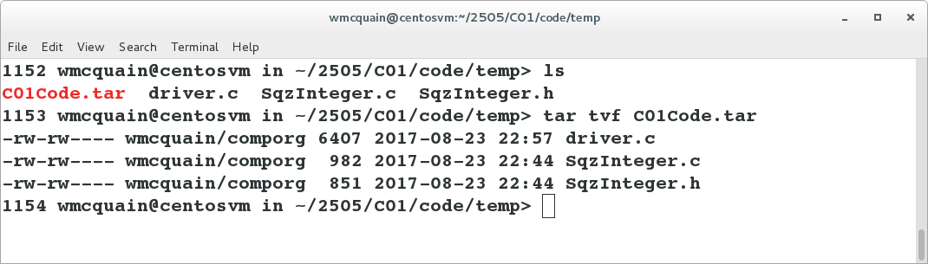
Checking Contents
You can check the contents of a tar file:
This is an example of a flat tar file.
That is, there is no directory structure in the tar file.

Slide 37
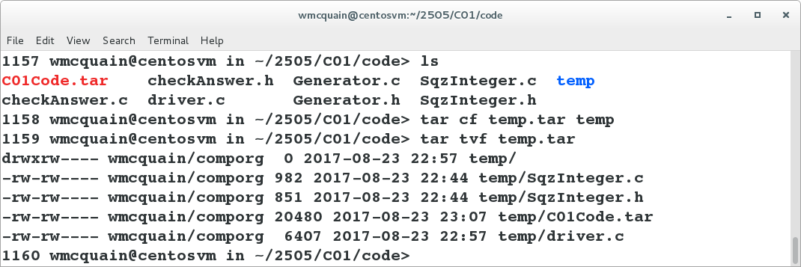
A tar File That Is Not Flat
If you tar a directory tree, the tar file will (by default) contain directory information:
Some situations require a flat tar file, some require creating one that preserves a directory structure.
Be sure you pay attention to what's required, and create the correct type of tar.

Slide 38
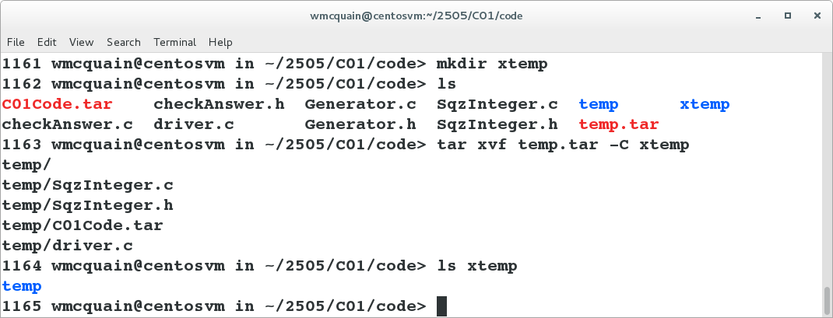
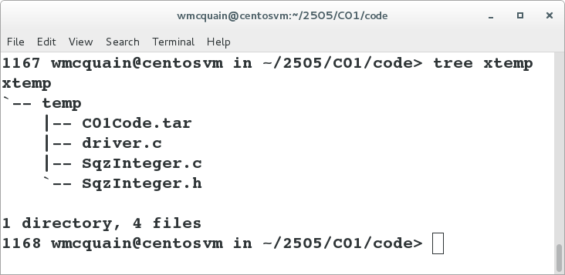
Extracting a tar File
Use the x switch to extract the contents of a tar file, and -C to specify a destination:

Slide 39
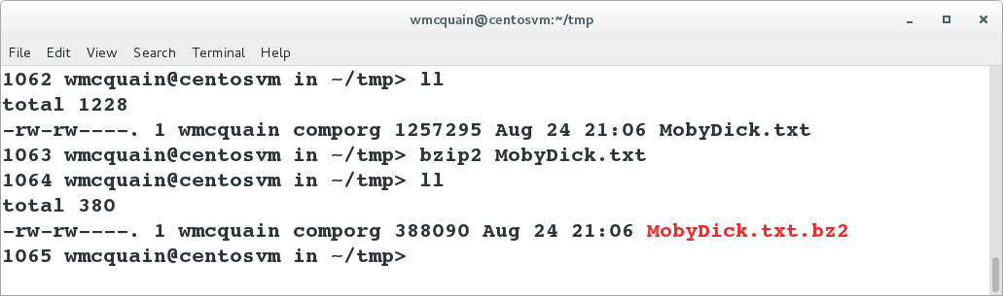
Compressing Files: gzip, bzip2, etc.
A compression tool can frequently reduce the amount of space a file occupies:
A common, older alternative is gzip.
Both of these suffer the same limitation: they can compress, but not bundle.
Therefore, it's common to create a tar archive and then compress that.

Slide 40
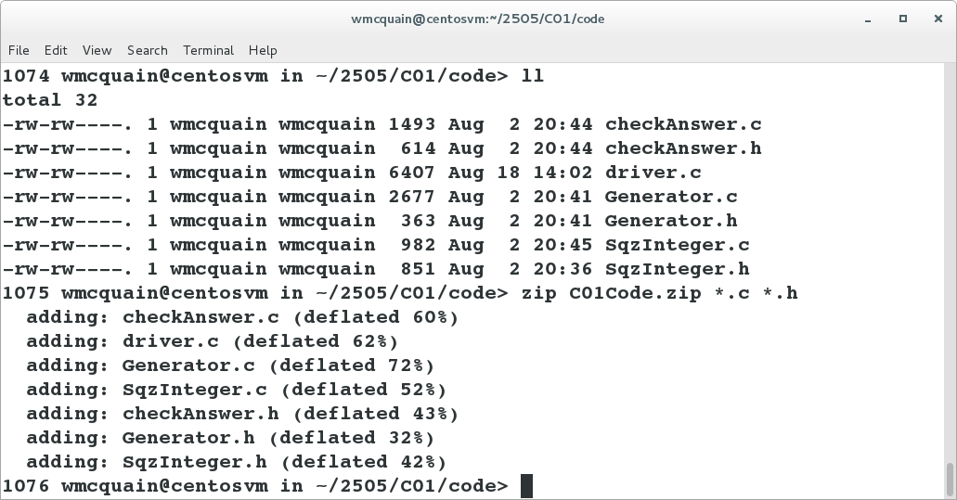
Compressing Files: zip
The zip utility also compresses, but will bundle as well:

Slide 41
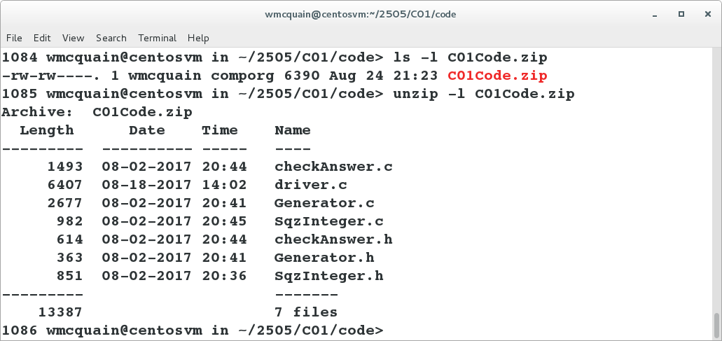
Compressing Files: zip
The degree of compression depends on the nature of the file(s) being compressed:

Slide 42
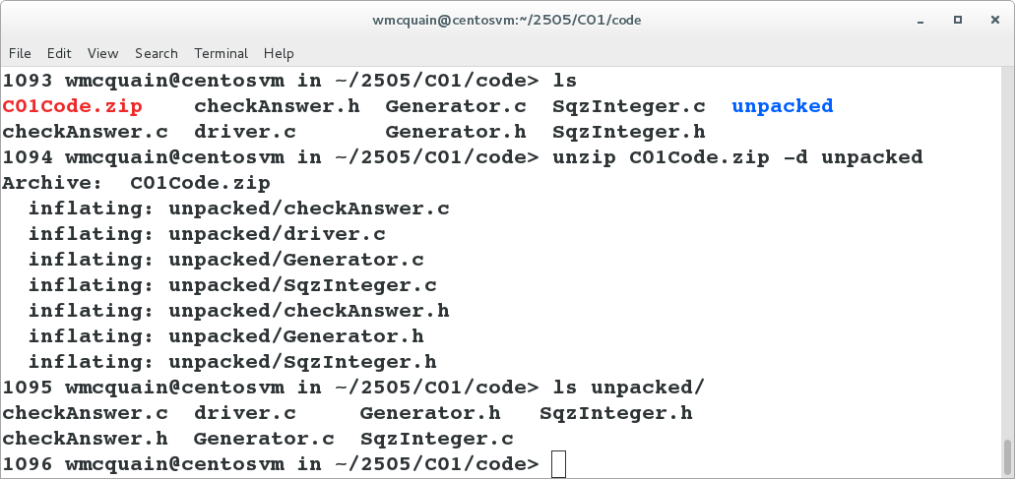
Uncompressing: gunzip, bunzip2, unzip
Each compression tool has an analog that will uncompress; for example:

Slide 43
Removing a File: shred and dd
rm does not actually delete file contents from your drive; it just deindexes the file.
You can securely remove a file by using the shred command, but see Sobell for a discussion of the limitations.
See the discussion of dd in Sobell for an alternative way to wipe a file.

Slide 44
Special Characters
Many Linux commands support the use of special characters (aka wildcards) to specify a pattern that identifies a set of files:
? matches any single character (in the name of an existing file)
* matches zero or more characters (in the name of an existing file)
[ ] matches any of the characters within the braces (in the name of an existing file)
*.txt
matches any file with extension "txt"
foo?.*
matches a file with any extension and name consisting of "foo" followed by a single character
[abc]foo.html
matches a file with extension "html" and name "afoo" or "bfoo" or "cfoo"

Slide 45
Copying a File Remotely: scp
scp can be used to copy a file between the local machine and a remote machine (or between two remote machines).
For example, the following command would copy GettysburgAddress.txt from my computer to a directory named documents on rlogin:
scp GettysburgAddress.txt wmcquain@rlogin.cs.vt.edu:documents
If you haven’t set up password-less login, you’ll be prompted for the necessary authentication information.
And the following command would copy GettysburgAddress.txt from my rlogin account to my current directory on my machine:
scp wmcquain@rlogin.cs.vt.edu:documents/GettysburgAddress.txt .

Slide 46
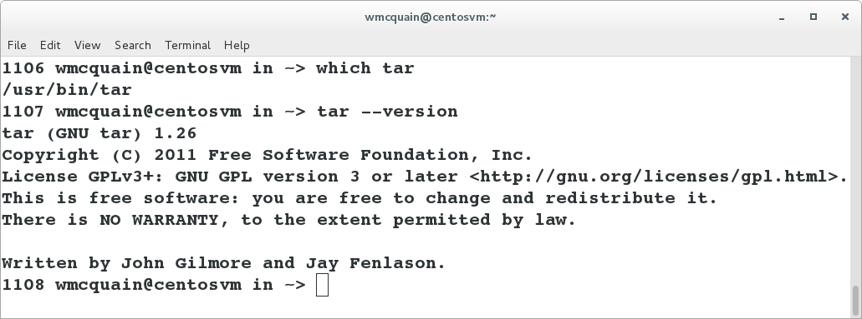
Identifying a Command: which
If you’re not sure where a command resides, the which command will tell you:
Many Linux applications also support a --version switch which can help identify which specific version of an application you’re invoking.

Slide 47
Foreground vs Background
By default when you execute a command in a shell, the shell program waits (doesn’t provide a prompt and allow entry of another command) until the current command completes (or is otherwise interrupted).
Here, the command is running in the foreground:
1141 wmcquain@centosvm in ~/tmp> sleeper 5 hi
0 995: hi
1 997: hi
2 1: hi
3 7: hi
4 15: hi

Slide 48
Foreground vs Background
We may run the command in the background:
1143 wmcquain@centosvm in ~/tmp> sleeper 5 hi > sleeper.txt &
[1] 8672
1144 wmcquain@centosvm in ~/tmp> ps
PID TTY TIME CMD
3928 pts/0 00:00:01 bash
8672 pts/0 00:00:00 sleeper
8676 pts/0 00:00:00 ps
1145 wmcquain@centosvm in ~/tmp>
[1]+ Done sleeper 5 hi > sleeper.txt
1145 wmcquain@centosvm in ~/tmp> cat sleeper.txt
0 270: hi
1 272: hi
2 276: hi
3 282: hi
4 290: hi

Slide 49
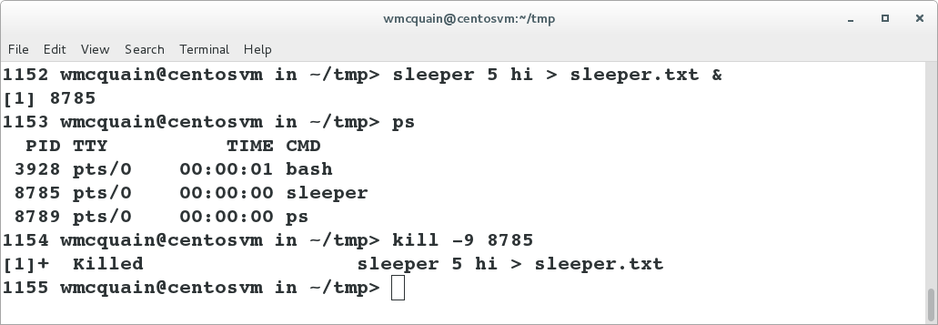
Killing a Process
A (foreground) running process can be killed by using Ctrl-C.
A (background) running process or a suspended process can be killed by using the kill command:

