Slide 1
Programming Tools
Most of the programming assignments will require using the C language.
We will use a current version of the GCC C compiler.
What’s GCC?
- the Gnu Compiler Collection (see gcc.gnu.org)
- a collection of freeware software development tools, including support for C, C++, Objective-C, Fortran, Java, and Ada
- available as part of all Linux and most UNIX-derived operating systems
How do you get it?
- run Linux on your own computer
- use a remote Linux environment (rlogin cluster)
You will have to use the CS Department’s rlogin cluster for some assignments in any case.

Slide 2
Linux
Read Chapter 1 of the Sobell book for a history of Linux… really…
There are many Linux distributions (distros)… superiority is a matter of religion.
- the CS Department’s rlogin cluster and other servers (more later) are running CentOS
- I use CentOS
- CentOS will be the official platform for testing your assignments
- If you run another distro, any difficulties that arise will be your problem
Linux distributions come in 32-bit and 64-bit versions; I require running 64-bit, but that will entail your installing some additional packages.
In any case, we require you to run 64-bit CentOS 7 on your own computer.
If you do not do so, expect to have problems.

Slide 3
Linux Installation Choices
There are (at least) four options for setting up Linux on your computer:
Using a software virtualization tool to run Linux concurrently with your host OS
- well-supported options are available
- easy to back up your Linux installation in case of problems
- allows straightforward transfer of data between Linux and your host OS
- does not disrupt your current OS setup
Using Hyper-V virtualization support to run Linux concurrently with your host OS
- supported on most x86-64 processors
- does not disrupt your current OS setup
Creating a dual-boot environment for Linux and your current OS
- requires rebooting to change from Linux and your current OS
- fiddly, may break your current OS setup
Running Linux as your only OS
- makes your current OS, and all its apps, unavailable on your computer
- provides the fastest runtime experience
Notes:
I would STRONGLY advise taking one of the first two options.
Some students (especially with Surface books) may have to choose the second option (notes on that should be available soon).

Slide 4
Running Linux on a Windows Host
Here’s my advice:
- Install VirtualBox (virtualbox.org).
- I'm using version 6.0, but recent earlier versions should be fine.
- follow the VirtualBox/CentOS Installation notes carefully.
- Download a CD/DVD image for installing your chosen distro.
- I used CentOS-7-x86_64-DVD-1804.iso.
- Install CentOS 7 as a guest OS:
- follow the VirtualBox/CentOS Installation notes carefully.
- for installing the VirtualBox Guest Additions (these are essential)
Once you’re done, you can boot and run Linux within a virtual machine.
This minimizes your chances of disrupting your existing system setup.
This works best if your computer has at least 8GB of RAM.
1810 ISO contains a bug – avoid it!

Slide 5
Running Linux on Hyper-V
Hyper-V is a Microsoft technology for supporting virtual machines.
It's a Type-1 hypervisor: it runs directly on the hardware and prevents other hypervisors from doing the same
So, Hyper-V and VirtualBox do not coexist peacefully.
This is true despite Oracle's claim that VirtualBox 6 does so…
What to do…?

Slide 6
Hyper-V
Hyper-V is not an issue if you are running:
OS-X
Linux
Windows 7 (most likely OK)
Windows 8 (most likely OK)
Windows 10 Home
(possibly other low-end versions of Windows 10
If running these, I recommend just using VirtualBox.

Slide 7
Avoiding Hyper-V
Hyper-V may be an issue if you are running:
Windows 10 Pro, Business or Enterprise
Best tactic: don't turn Hyper-V on;
use VirtualBox
Hyper-V can be turned off:
https://www.petri.com/how-to-disable-hyper-v-completely-in-windows-10
If you do this, read ALL of the discussion and follow it carefully.

Slide 8
Living with Hyper-V
What if you need Hyper-V?
Why would you need Hyper-V?
- to use Docker
- to use some of an ever-expanding list of Windows 10 feature updates
Device Guard, Credential Guard, Sandbox, . . .
So… now what?
Option 1: switch back and forth
Turn Hyper-V off when you need to use VirtualBox
Turn Hyper-V back on when you need to use it
Note: disabling Hyper-V requires the steps described on the page linked form the previous slide, AND performing a hard reboot.
IOW, you must shutdown and then reboot your machine.
Simply doing a Windows restart will NOT be sufficient.

Slide 9
Living with Hyper-V
Option 2: forget running a CentOS VM and dual-boot instead
https://www.tecmint.com/install-centos-7-alongside-windows-10-dual-boot/
Be warned:
- raises specter of hosing your machine and having to reinstall everything
- therefore, backup all your files first!
- requires hard reboot to switch from your primary OS to CentOS

Slide 10
Living with Hyper-V
Option 3: set up a CentOS VM using Hyper-V
https://linuxhint.com/install_centos_hyperv/
Be warned:
- fiddly, IMO
- follow the instructions carefully!
- the CentOS VM seems to be slower when running this way
- I've had display scaling issues with my attempts to do this… YMMV

Slide 11
Living with Hyper-V
Option 4: use rlogin instead
Be warned:
- less convenient (network latency, no GUI tools)
- requires an SSH client if you are running Windows
(see software.cs.vt.edu for SSH Secure Shell Client)
OTOH:
- you'll have to do some assignments on rlogin anyway
- CS 3214 requires using rlogin for more or less everything

Slide 12
Running Linux on an OS X Host
Essentially, follow the instructions for a Windows Host, but install the version of VirtualBox for OS X.
Note:
- OS X is not Linux (or UNIX), and that prior students have experienced issues when trying to use the OS X native version of the GCC C compiler in this course.
- Those problems will go away if you run Linux.
- If you decline to do that, you may have to use the rlogin cluster (more later) for all of the UNIX-related and C programming assignments.

Slide 13
SLO Accounts
The CS Department uses a single-logon system (SLO) for many of its resources:
- rlogin cluster
- CS software site
If you are a CS major and have previously taken a CS course at VT, you should already have an account.
If not, or if you’ve forgotten your SLO password, go to the following link and rectify the problem:
https://admin.cs.vt.edu/
Note that you will need this to access some of the resources necessary for this course.

Slide 14
SSH: secure shell for remote access
Secure shell is a network protocol for secure communication.
An SSH client is supplied with UNIX/Linux, and with OS X.
Windows users should Google for “SSH Secure Shell Client” or for “PuTTY”, which are freely available for non-commercial use.
See software.cs.vt.edu for downloads.
You will use an SSH client to access the rlogin cluster for certain assignments.

Slide 15
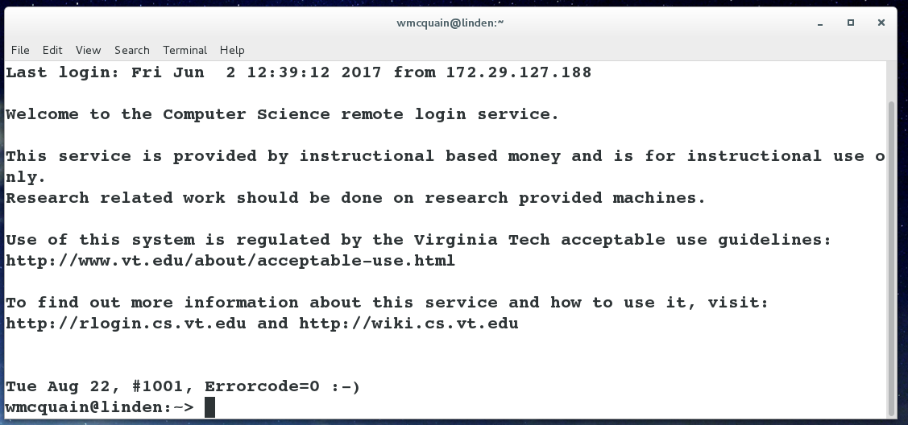
rlogin Cluster
The rlogin cluster is a collection of computers, each running CentOS, that are available to for students taking CS courses at VT.
To access the cluster, open a Linux terminal and enter the following command using your VT email PID:
ssh <PID>@rlogin.cs.vt.edu
Status and other information can be found at:
http://rlogin.cs.vt.edu/

Slide 16
SSH: login without a password
You can set up keys that allow you to ssh to your rlogin account without using a password.
From a Linux or Cygwin terminal on your machine, use the ssh-keygen command to create a key pair; the session will resemble this:
1003 wmcquain@centosvm in ~> ssh-keygen
Generating public/private rsa key pair.
Enter file in which to save the key (/home/wmcquain/.ssh/id_rsa):
Enter passphrase (empty for no passphrase):
Enter same passphrase again:
Your identification has been saved in /home/wmcquain/.ssh/id_rsa.
Your public key has been saved in /home/wmcquain/.ssh/id_rsa.pub.
The key fingerprint is:
38:ca:59:93:13:e7:94:41:7d:d9:21:a0:a0:54:2e:fc wmcquain@centosvm
The key's randomart image is:
+--[ RSA 2048]----+
| ..o.o....o.. |
| o o . +. o.. |
| + o = . |
| o B |
| E S |
| . + + |
| + |
| |
| |
+-----------------+
Convenient, not mandatory

Slide 17
SSH: login without a password
Then, use the ssh-copy-id command to install the key on the remote system:
1004 wmcquain@centosvm in ~> ssh-copy-id -i ~/.ssh/id_rsa.pub rlogin.cs.vt.edu
. . .
wmcquain@rlogin.cs.vt.edu's password:
. . .
Now try logging into the machine, with: "ssh 'rlogin.cs.vt.edu'"
and check to make sure that only the key(s) you wanted were added.
1005 wmcquain@centosvm in ~> ssh rlogin.cs.vt.edu
Last login: Mon Jun 26 20:04:56 2017 from c-73-251-28-86.hsd1.va.comcast.net
Welcome to the Computer Science remote login service.
. . .
Tue Aug 22, #1001, Errorcode=0 :-)
wmcquain@hornbeam:~>
Convenient, not mandatory

Slide 18
SSH: login without a password
You should now ssh to your rlogin account and see if your key file only contains what you would expect:
wmcquain@hornbeam:.ssh> cat authorized_keys
ssh-rsa
. . . wmcquain@centosvm
wmcquain@hornbeam:.ssh> A
The only authorized key entry corresponds to my login from my local machine.
Now, I can ssh to the cluster without having to provide a password.
Convenient, not mandatory

Slide 19
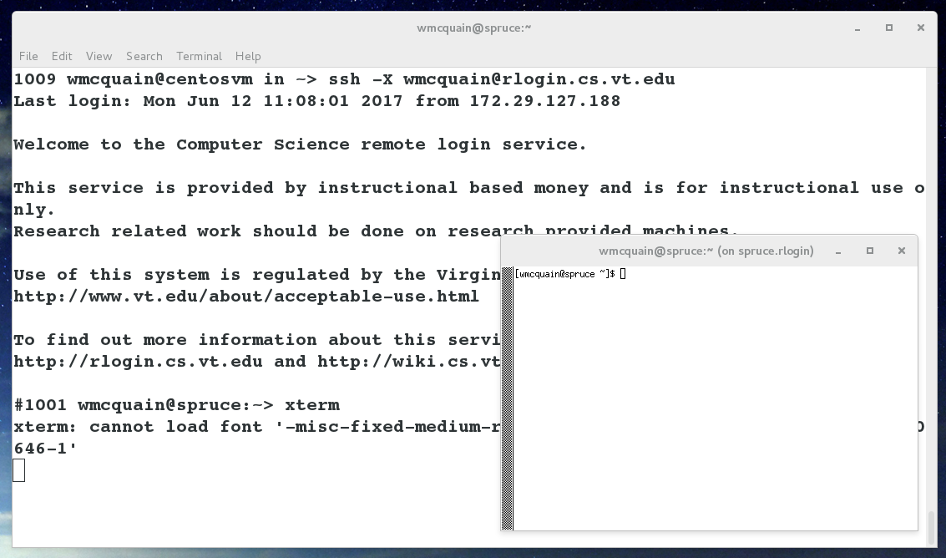
SSH: opening an X tunnel
Many Linux applications have a graphical user interface; you can execute those on the server (rlogin cluster machine) by using the –X switch when you invoke ssh:

Slide 20
So…
Get to work!
Create an installation of Linux on your laptop/tablet.
- Use VirtualBox or not, your choice.
- Use CentOS 7
Get an SLO account (if you don't already have one) and make sure you know your password.
If you like, set up password-free login (via ssh) to your rlogin.cs.vt.edu account.
See the first assignment on the course website!!

