Slide 1

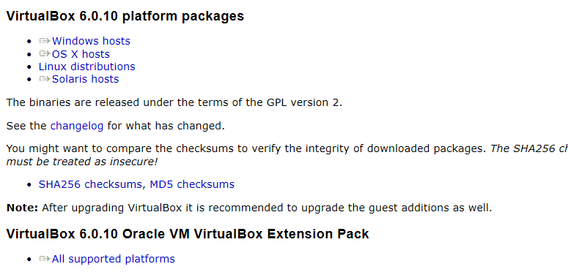
Get VirtualBox
Go to www.virtualbox.org and select:
Note:
- the OS on which you will install VirtualBox is called the host OS.
- the OS you will install on VirtualBox (later) is called the guest OS.
* These notes are based on VirtualBox 5.2 and CentOS 7 (ISO version 1804).
* VirtualBox 6 seems fine, but CentOS 7 (ISO version 1810) has a serious kernel bug

Slide 2
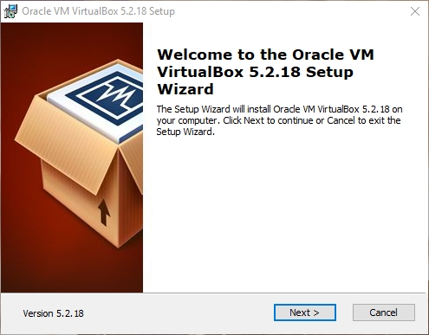
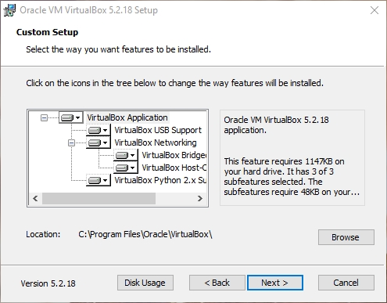
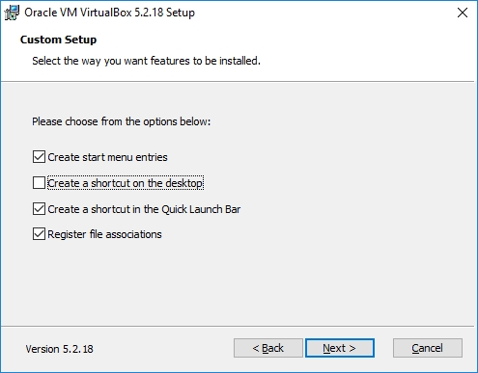
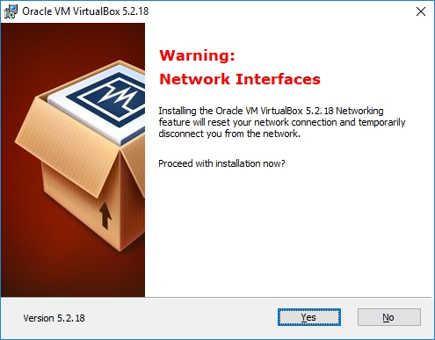
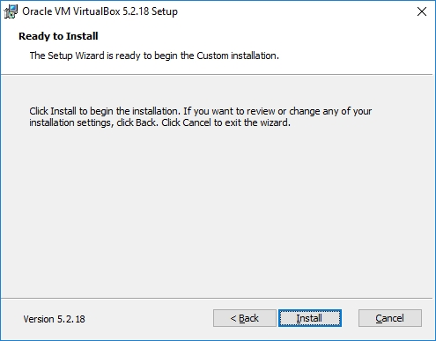
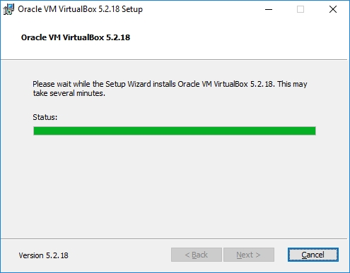
Begin the VirtualBox Installation
Run the VirtualBox installer. The first few screens are typical and probably do not require you to make any changes to the default options:

Slide 3
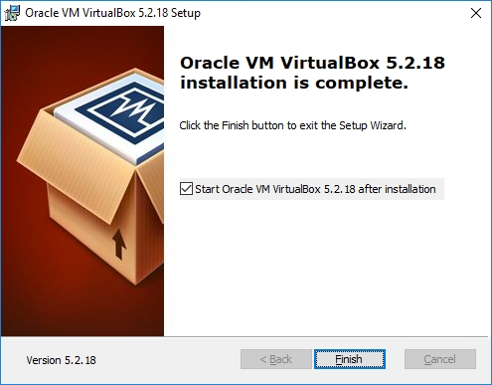
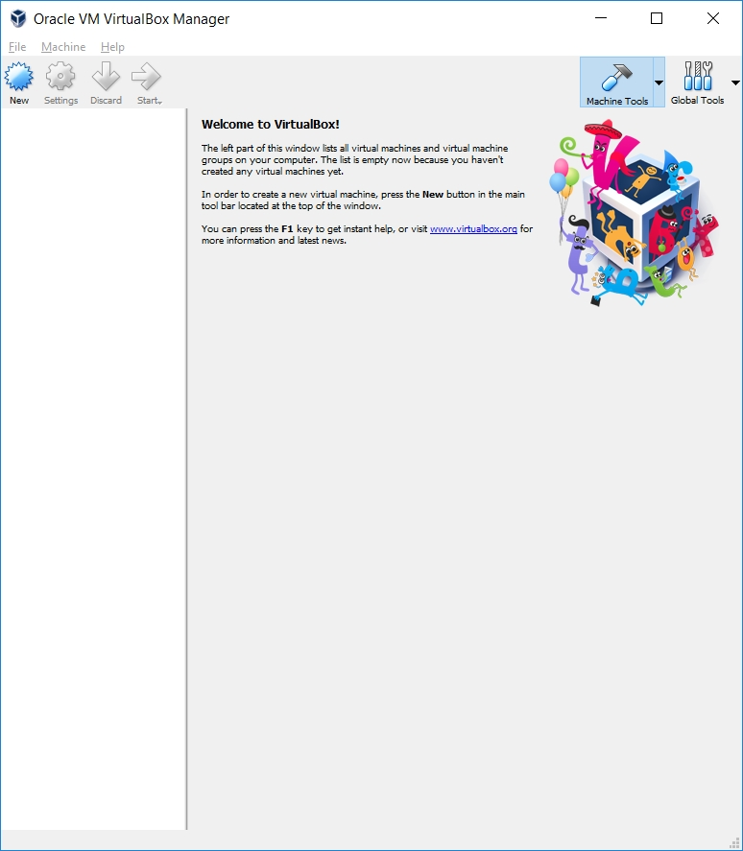
Start VirtualBox
Once the base installation is complete, start VirtualBox:

Slide 4
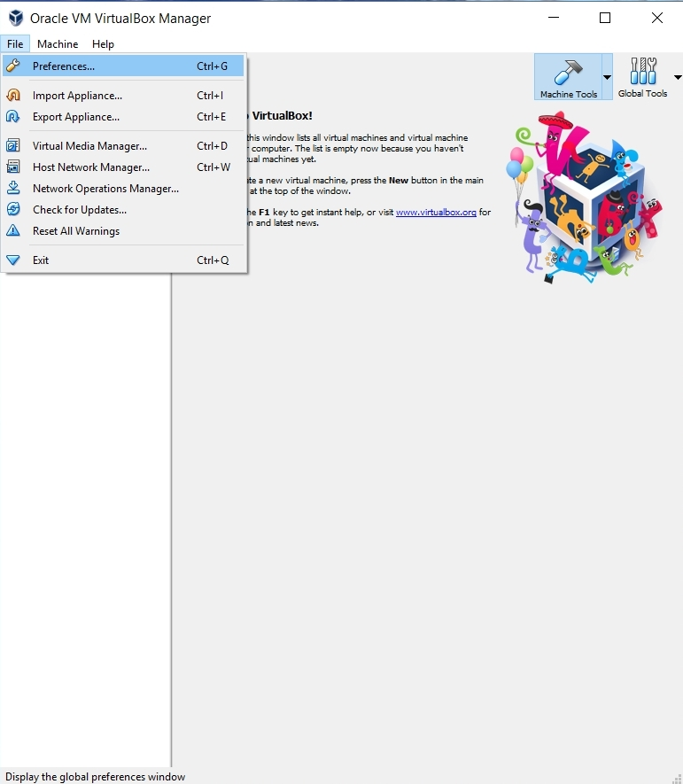
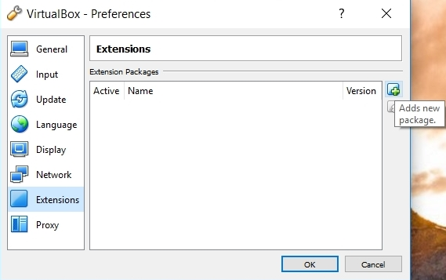
Install the VirtualBox Extensions
Select File/Preferences and select the Extension Pack file you downloaded:
… and install it…

Slide 5
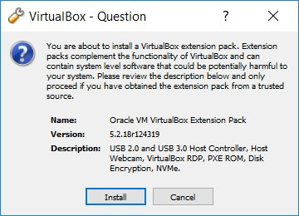
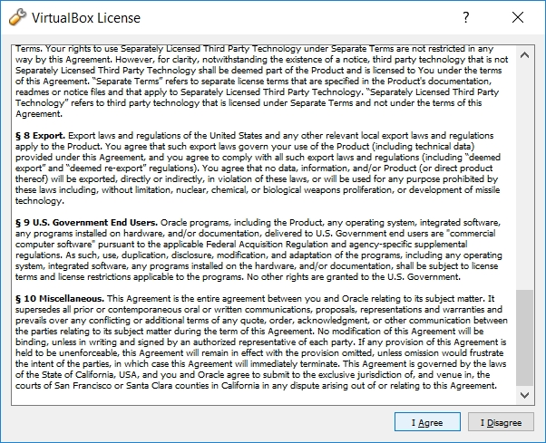
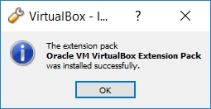
Install the VirtualBox Extensions
Authorize the installation …
… accept the license …
... and wait for …

Slide 6
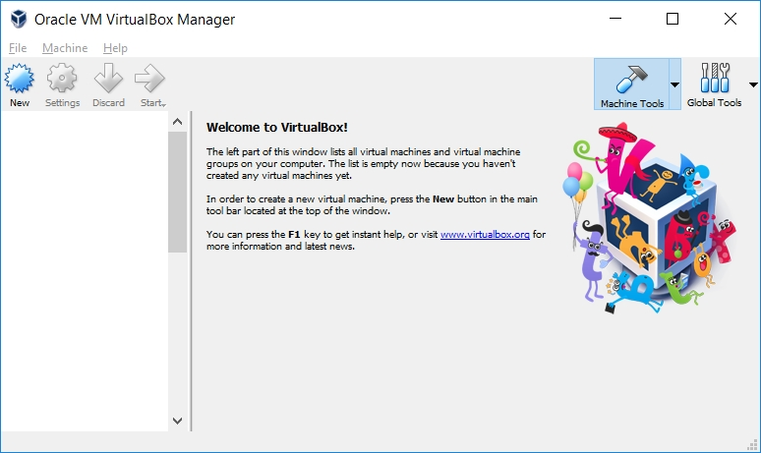
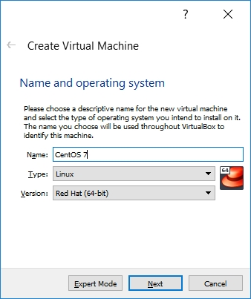
Starting VirtualBox
Restart VirtualBox.
Select New to create your virtual machine:
Enter a Name:
If you use a descriptive name for the VM, VirtualBox should auto-detect the proper OS type and Version.

Slide 7
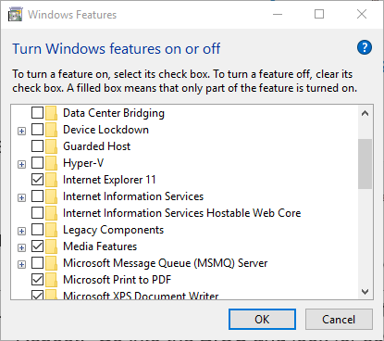
No 64-bit Options?
What if you only have 32-bit options listed?
There are two likely possibilities:
Hardware virtualization support is not enabled on your system.
Reboot. Go into the BIOS and look for something like VT-X and turn it on.
You are running Win8 or Win10 Pro or Enterprise and Hyper-V is turned on:
Follow the instructions at:
https://www.petri.com/how-to-disable-hyper-v-completely-in-windows-10

Slide 8
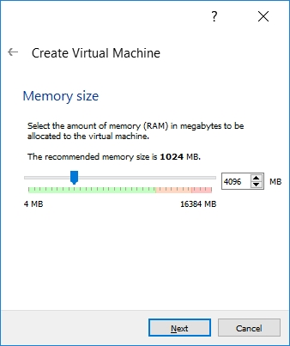
Configuring Memory for the VM
Specify the amount of memory you'll give the VM.
In this example, I'm installing on a host machine with 8GB of RAM; with less, I'd probably given the VM 1GB.
On my current working laptop, I have 16GB of RAM and gave my VM 4GB.

Slide 9
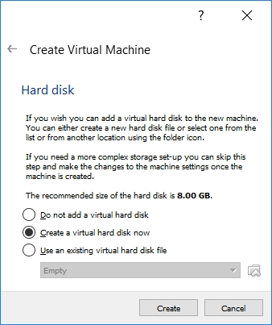
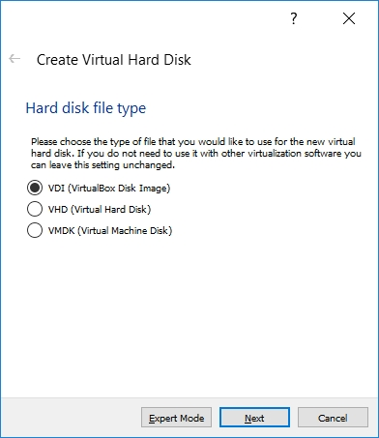
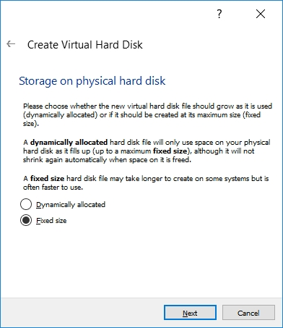
Configuring a Virtual Hard Disk
In the next dialog, select the option to create a new virtual hard drive now.
Take the default hard drive file type in the next dialog unless you're concerned about being compatible with some other virtualization tool like VMWare.
Next, I recommend choosing a fixed-size hard disk.

Slide 10
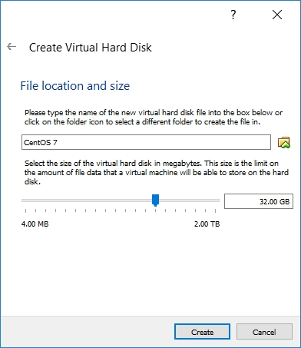
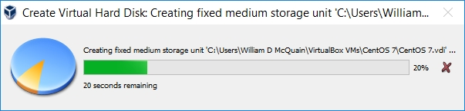
Configuring a Virtual Hard Disk
I generally make this 32GB, but make it smaller if you're short on space.
That said, the virtual HD should be 20GB or more.

Slide 11
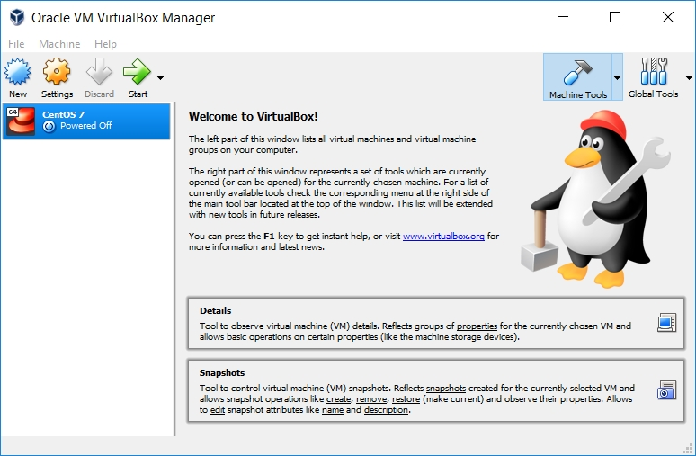
An Empty VM
Now, you have an empty virtual machine/
That is, a formatted (virtual) hard disk and no OS installation on it.

Slide 12
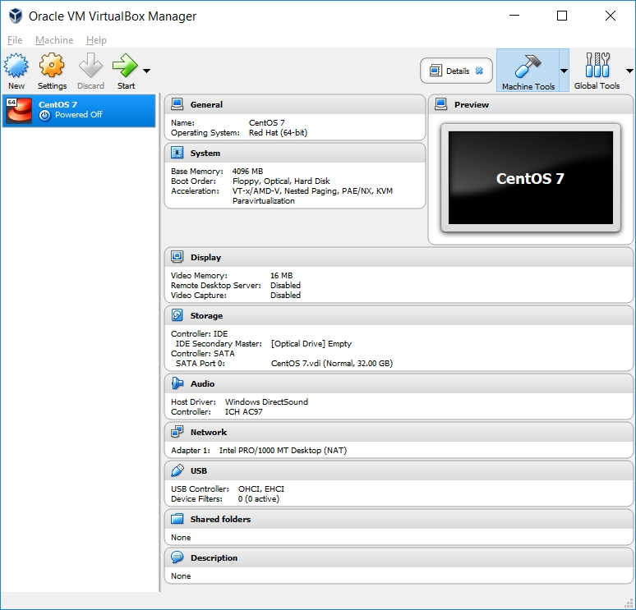
An Empty VM
Click on Details to bring up a more information about your empty VM:

Slide 13
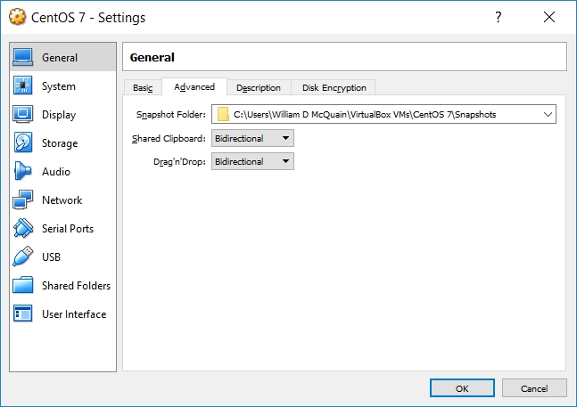
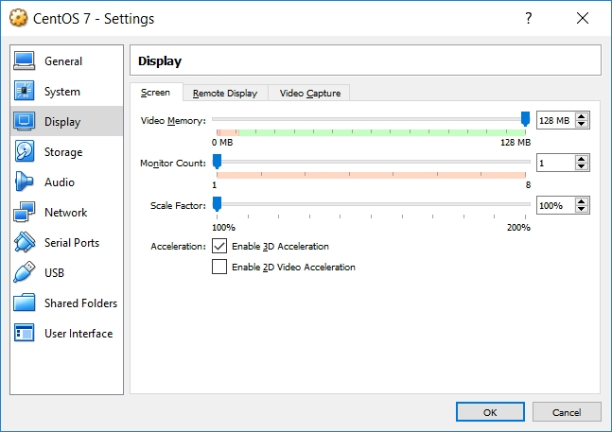
VM Settings
There are a couple of crucial VM settings; right-click on your VM and bring up the Settings dialog:
Under Display, enable 3D Acceleration.
Under General/Advanced, make the shared clipboard and Drag'n Drop Bidirectional.

Slide 14

Get CentOS
CentOS matches the department’s servers, including the rlogin cluster, so that is what you should install.
All our servers run CentOS 7.
That's where we will evaluate all of your assignments.
When downloading an ISO for CentOS, be aware that the file is fairly large…
Be sure you've gotten all of it…
Disclaimer: the following notes illustrate one session installing CentOS 7 on VirtualBox 5.2, running on Windows 10 Enterprise, on a particular underlying hardware system.
YMMV. Mine certainly has…

Slide 15
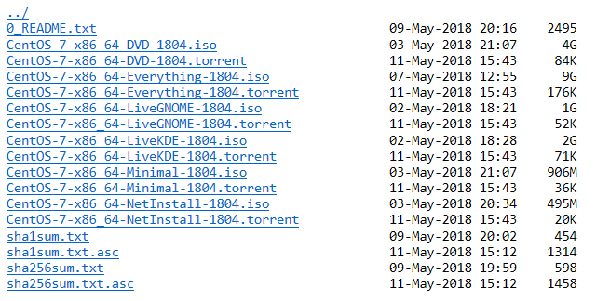
Get CentOS
Go to centos.org, use the Get CentOS link at the top of the page, and select the link for the distribution option you want (I recommend DVD ISO):
The 1804 ISO is buried in the CentOS archives:
http://archive.kernel.org/centos-vault/7.5.1804/isos/x86_64/

Slide 16
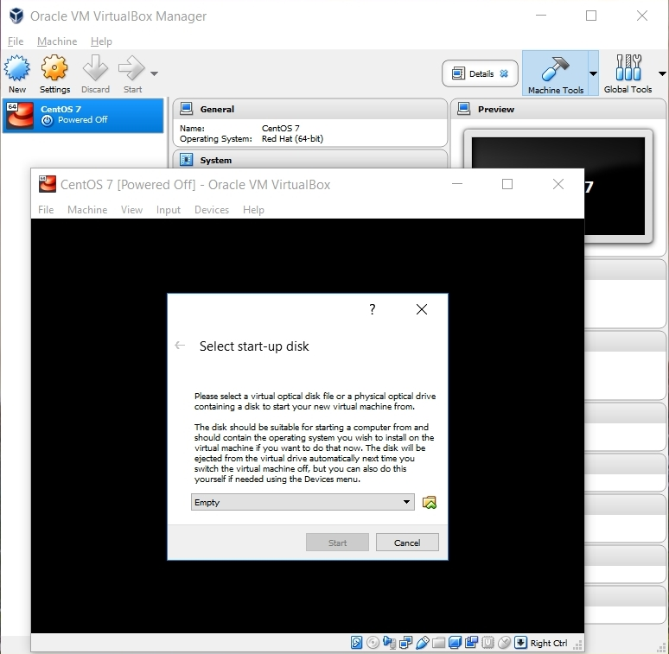
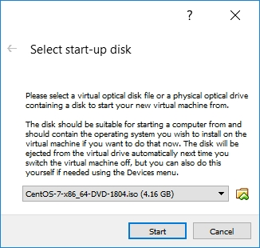
Beginning the CentOS Installation
Select the VM and click Start.
VirtualBox will recognize the empty system and prompt you to select an installation disk.
Click the folder icon.
Select your CentOS ISO file; then click Start...

Slide 17
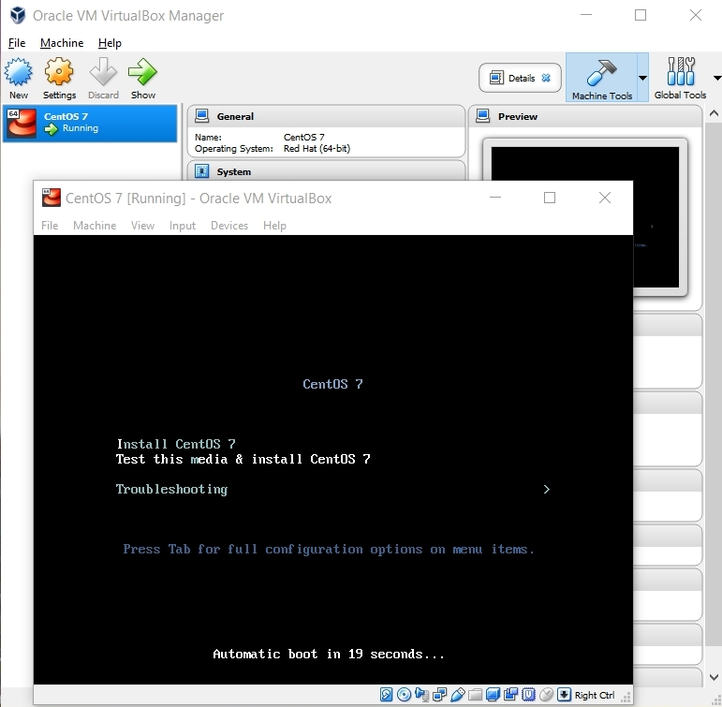
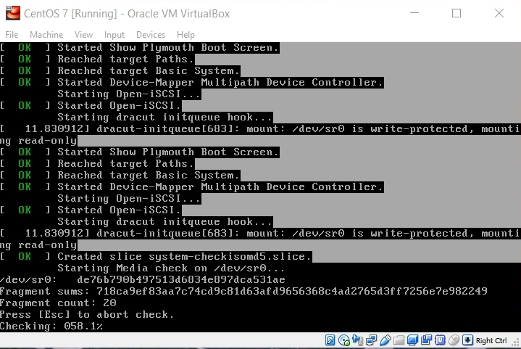
Running the Installation Code
The following sequence of screen shots are mostly self-explanatory…
Select Install CentOS 7...
… and it grinds away awhile…

Slide 18
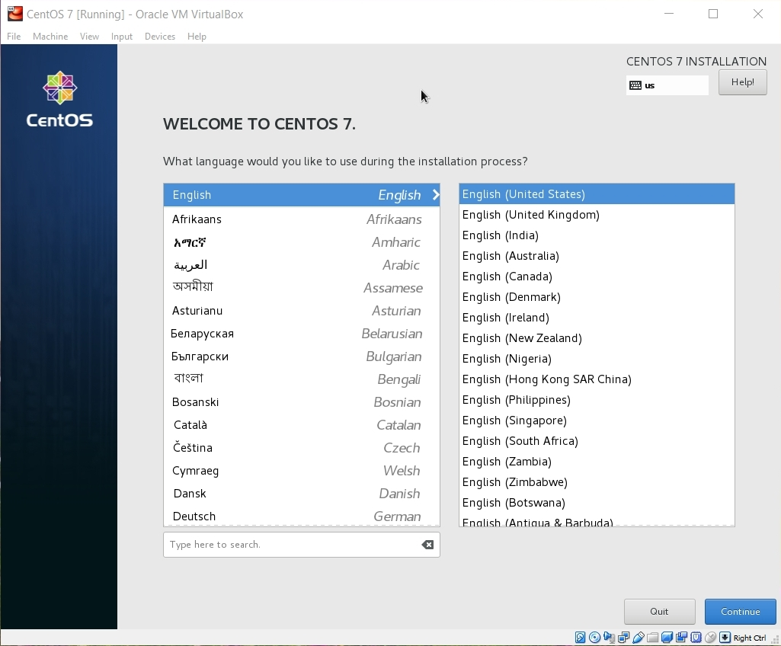
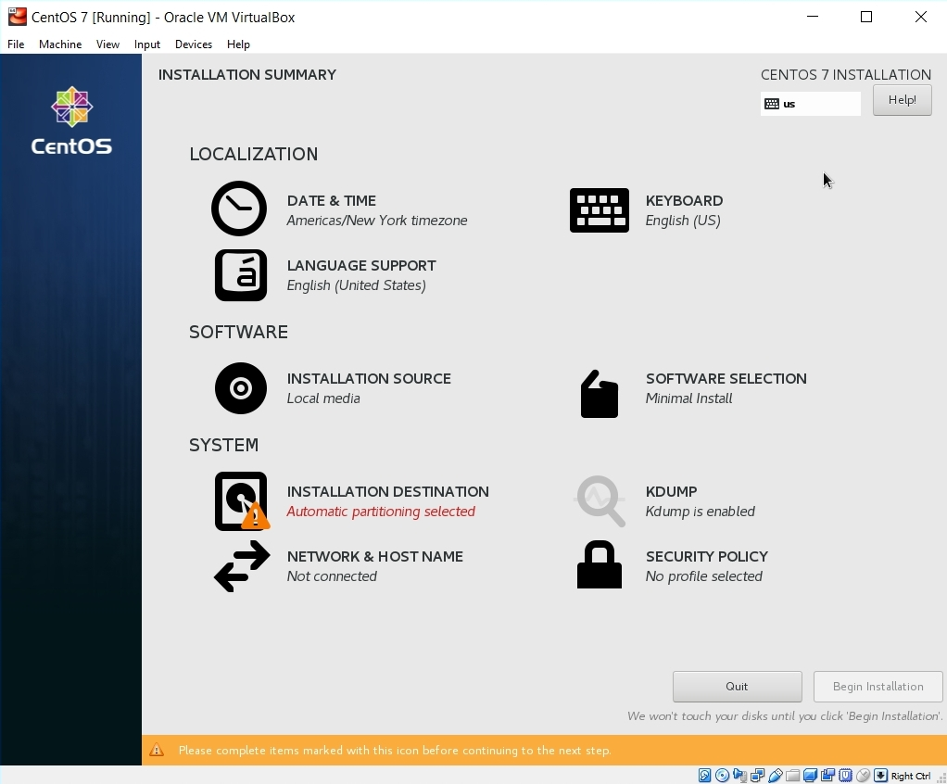
Running the Installation Code
Some basic settings need to be established:
Installation site
Initial software configuration
Language

Slide 19
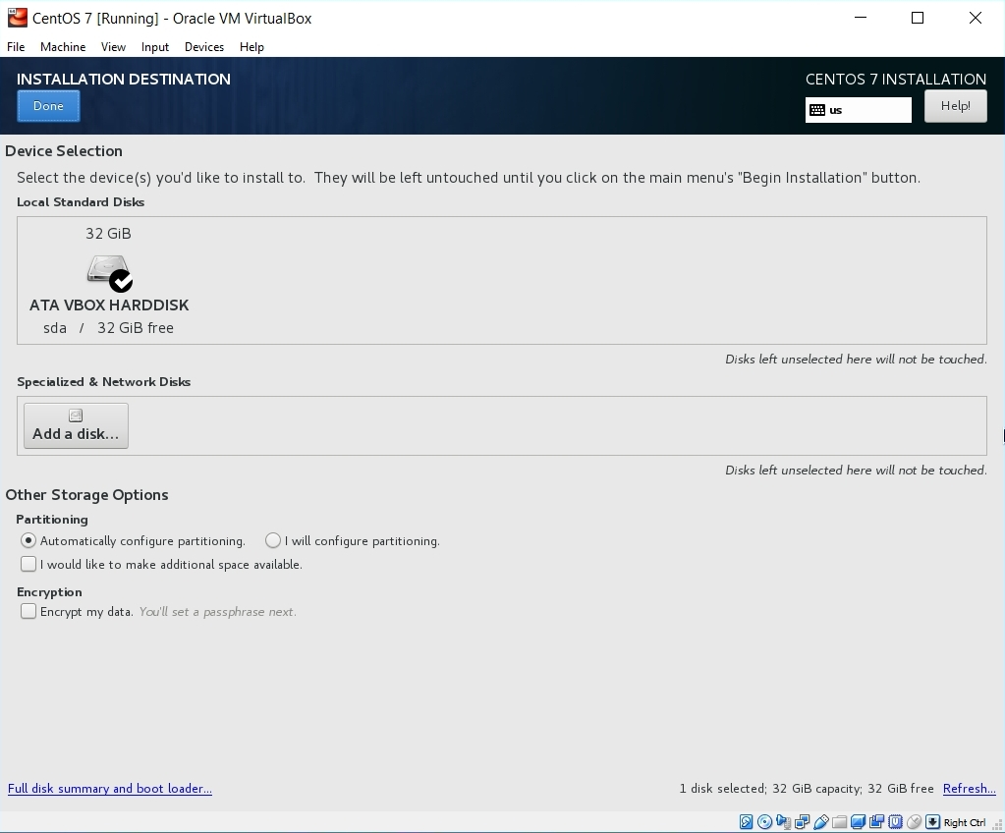
Installation Destination
This will be the virtual harddrive you just created... take the defaults.

Slide 20
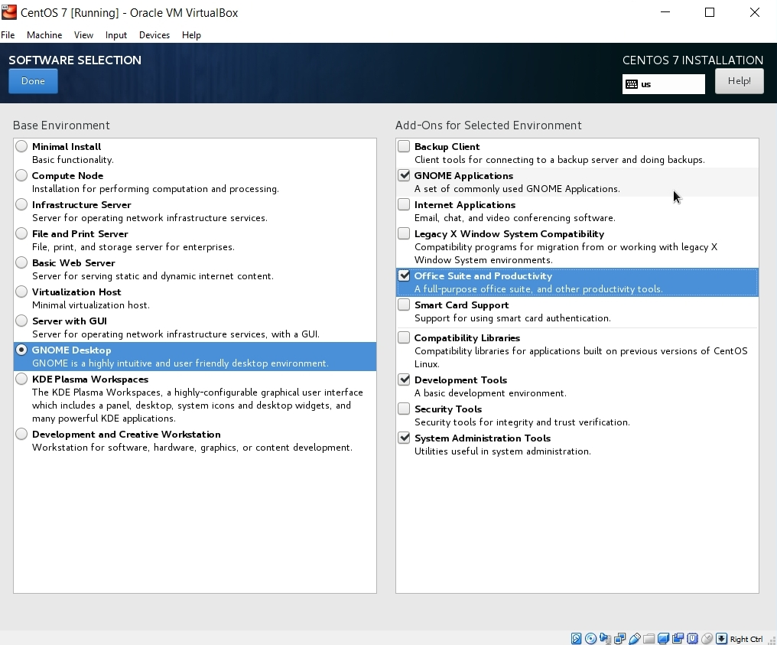
Software Selection
Here, I prefer the GNOME desktop and I want to be sure that I install the development tools (compiler, etc).
Make other choices as you like... more packages can be installed later.

Slide 21
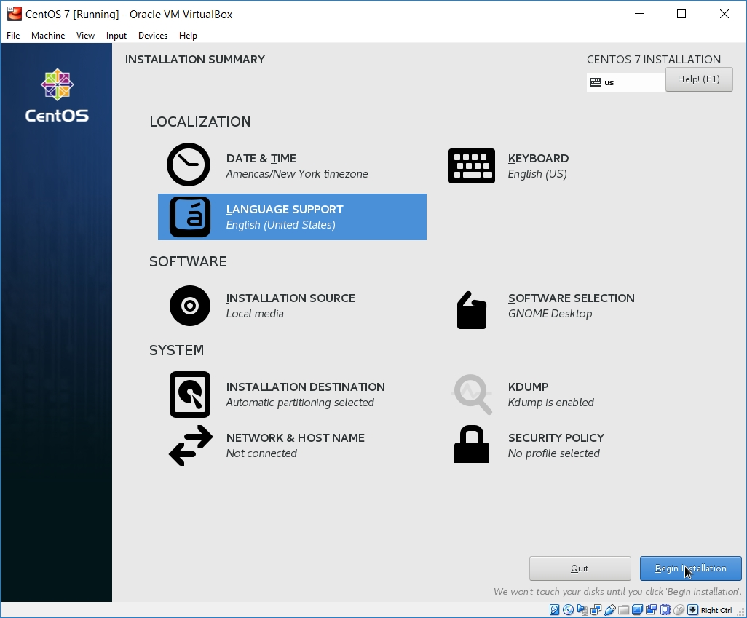
Initiate Installation
Fire up the installation routine...

Slide 22
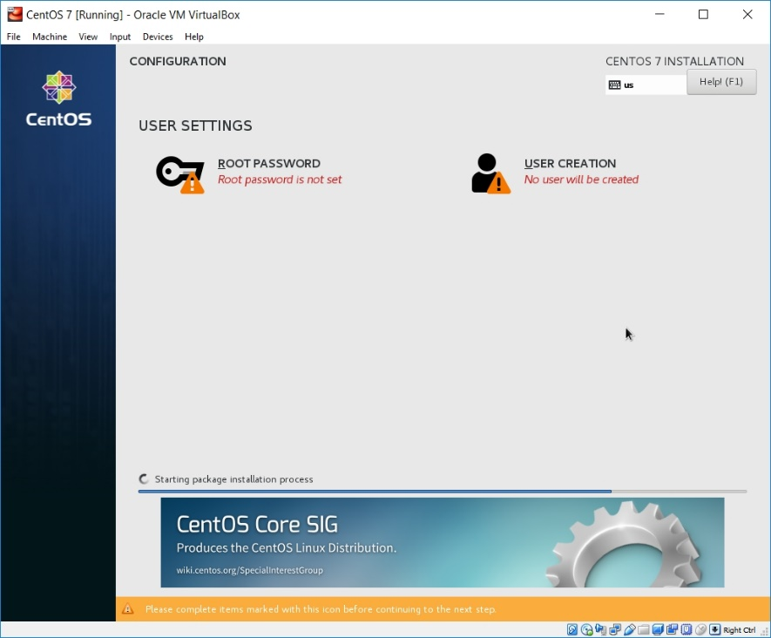
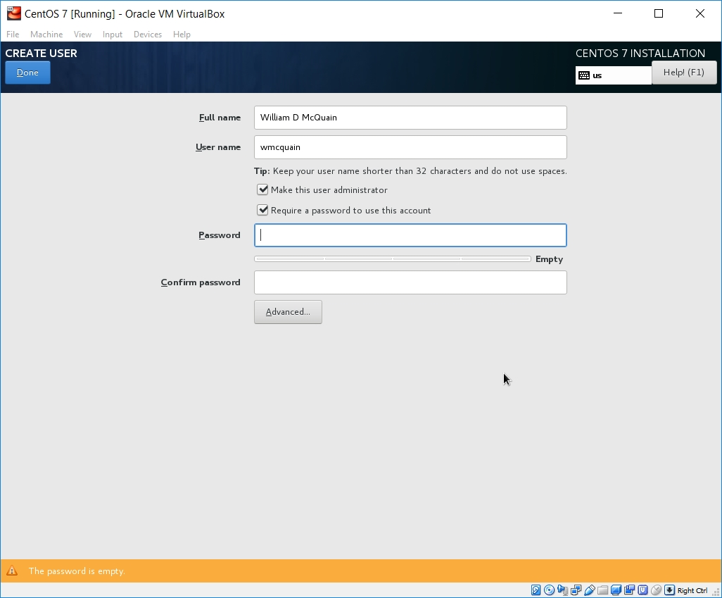
root Account Setup
While the installation is running, set the password for the root (superuser) account.
root is the administrative account.
You will use that for most software installs and some other activities.
Do not forget this password!

Slide 23
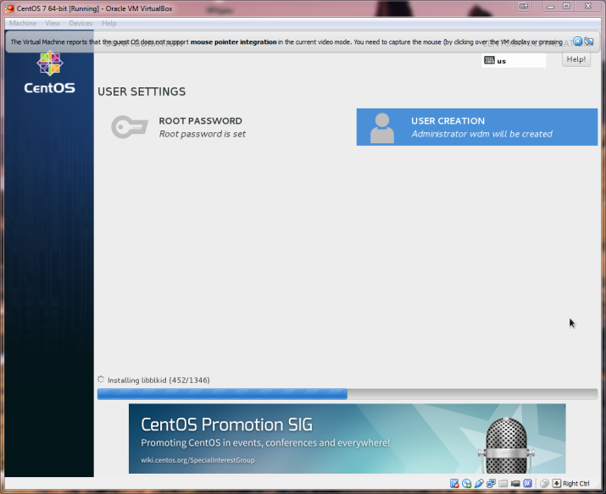
User Account Setup
I also set up a user account for my personal use.
Security advice notwithstanding, I prefer to run as an admin… this is NOT the same as being root.

Slide 24
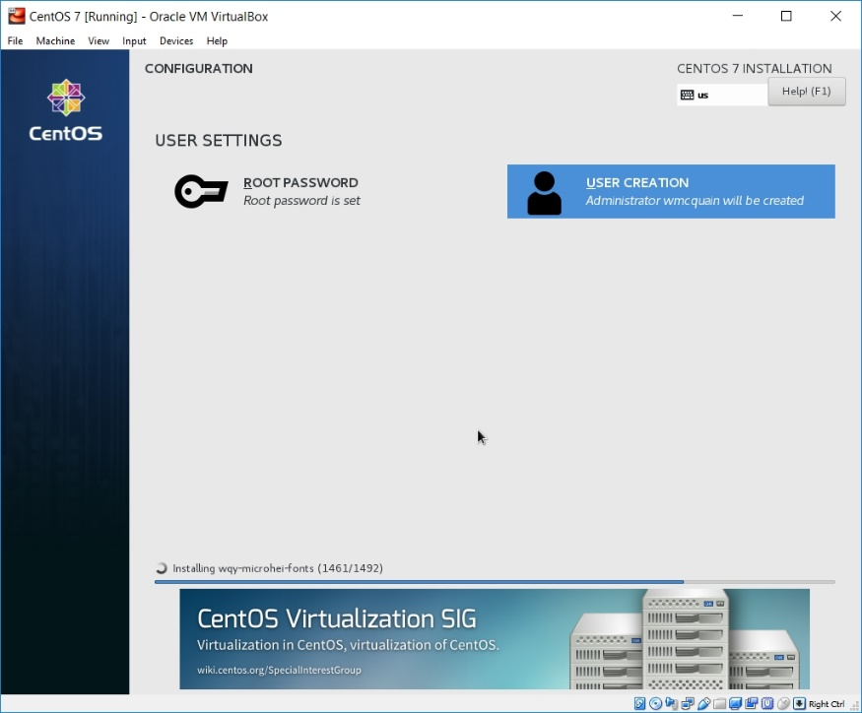
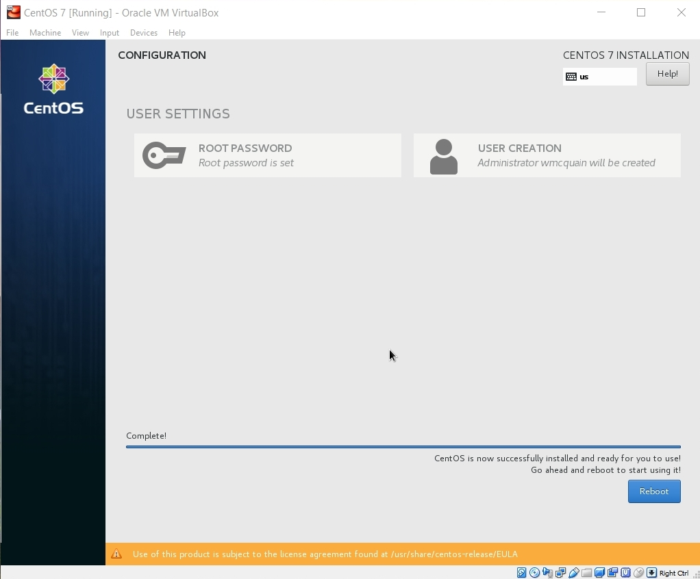
Reboot
Eventually you should see the completion screen (it takes awhile, depending on how many software packages you chose, the speed of your machine, etc).
Now, you need to restart the virtual machine...

Slide 25
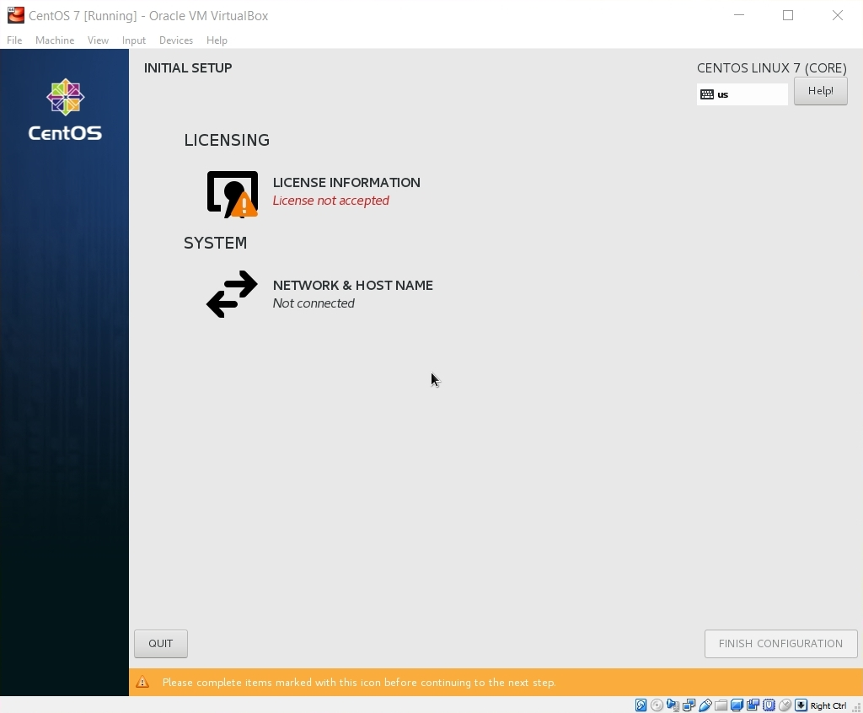
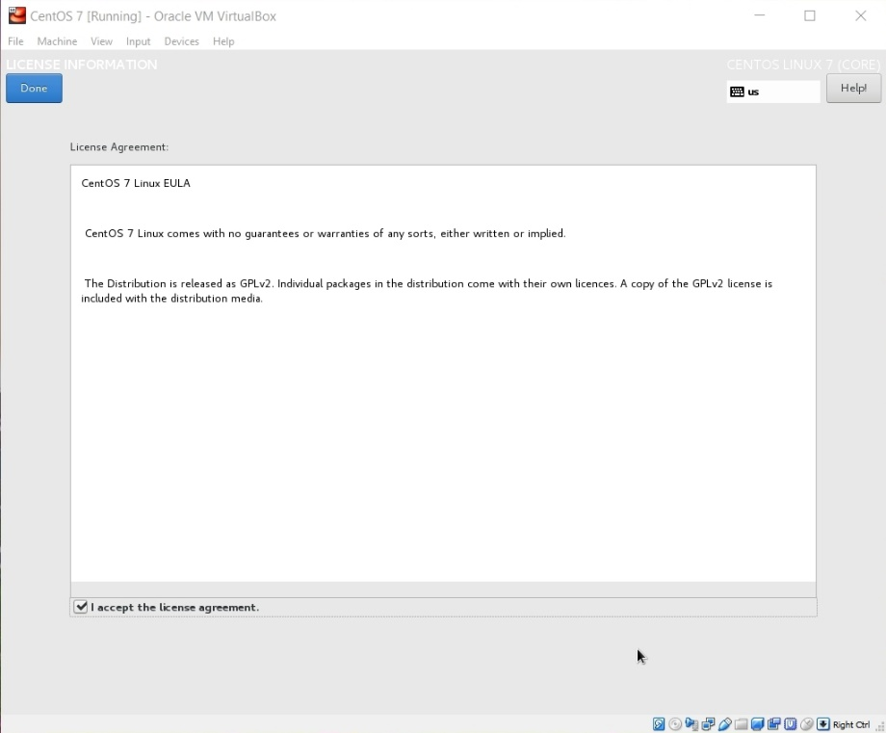
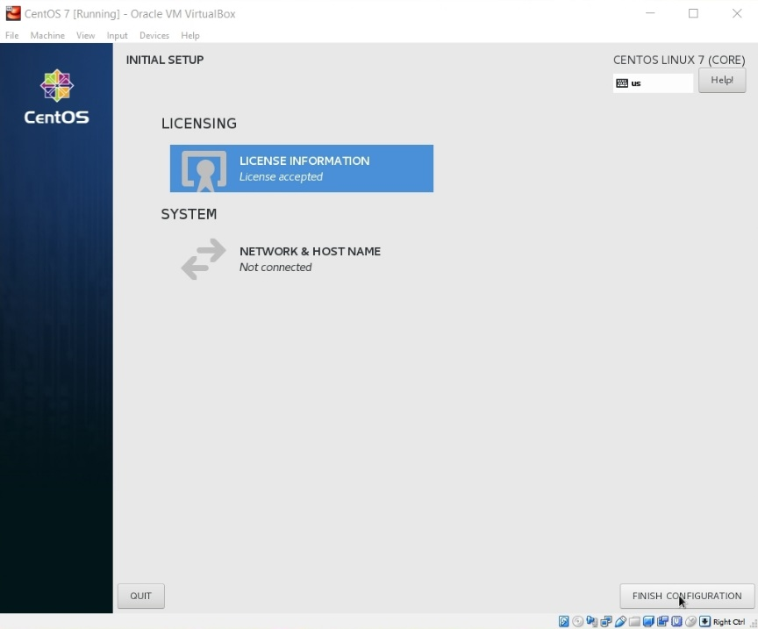
License Screen
The restart will bring you to the license screens:
Skip network setup for now…

Slide 26
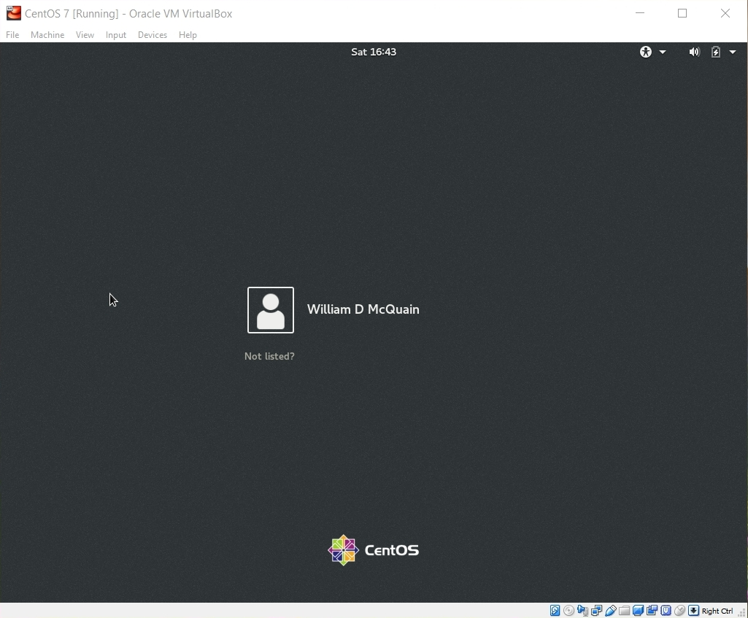
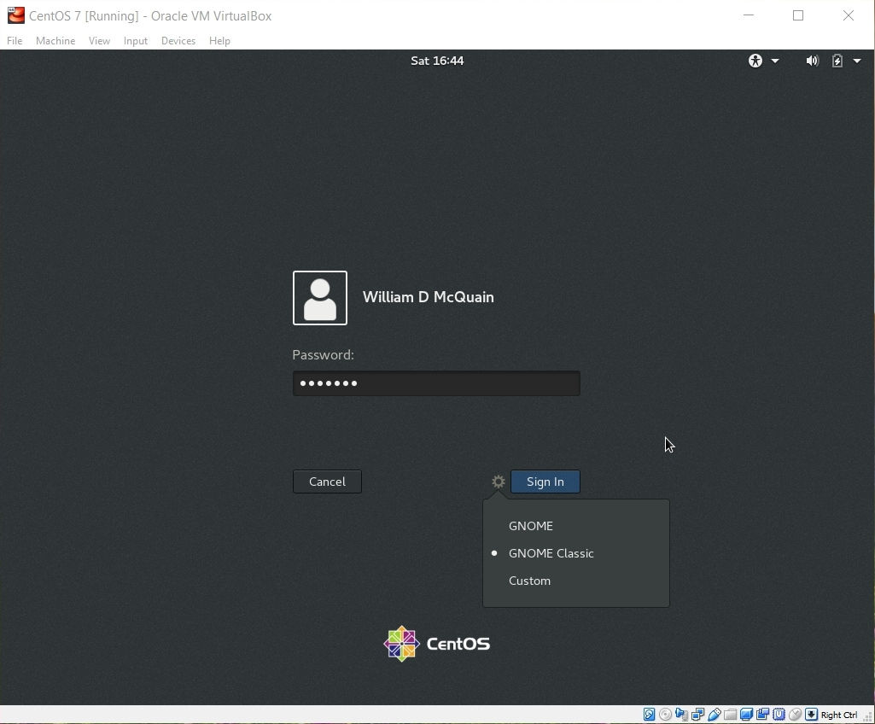
Login Screen
The restart will now bring you to the login screen:
I prefer Gnome Classic… the slides that follow assume that.

Slide 27
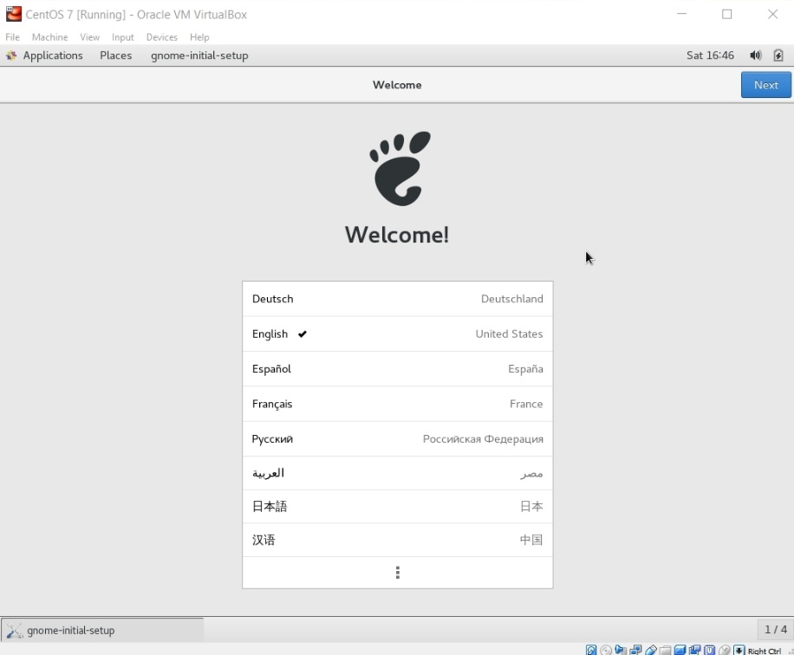
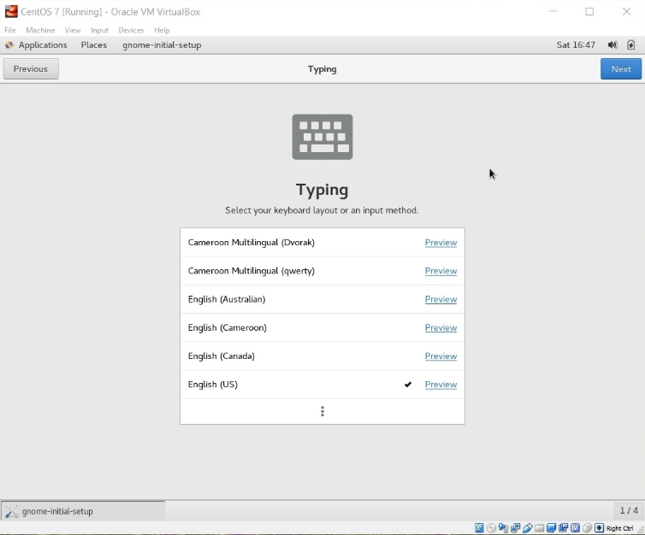
Initial Options
CentOS starts with some basic language and keyboard configuration:

Slide 28
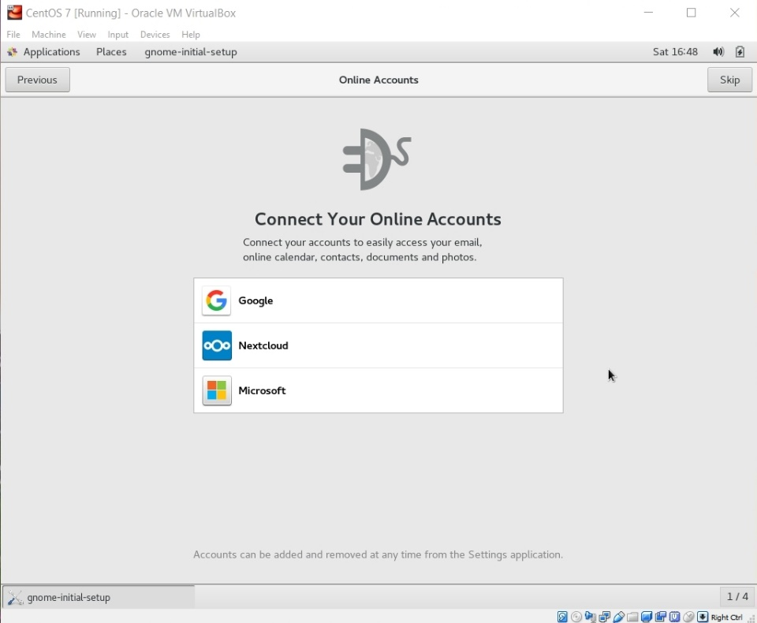

Initial Options
You may setup access to online accounts… or not…
You may configure some privacy settings …

Slide 29


Initial Options
Eventually you will reach completion:

Slide 30

GNOME Help
On first startup, you'll be offered help for the Linux environment:
Ignore this or explore it, as you like... it's all available at any time.

Slide 31


Starting the Network
Click the Network icon and turn on the network... the default settings are usually OK.

Slide 32

Make the Network Automatic
Click the gear icon for settings, and enable the network to be on automatically.

Slide 33


Shutdown CentOS
At this point, shut CentOS down.
It is IMPORTANT to always shutdown correctly… improper shutdowns may render the VM unbootable!

Slide 34


Back it Up!!
I recommend making a total backup of your virtual machine right now!
This gives you an emergency, pristine VM when things go wrong…
Do this with the VM shut down!
Do it frequently!

Slide 35


Exporting a Virtual Machine
The process creates a single file backup of your entire VM.
I suggest tagging the name with the date you made the backup… and keeping more than one backup around.
You can:
use Import Appliance to reload this if your VM is damaged later
copy this to another computer and import it to a VirtualBox installation there

Slide 36


Exporting a Virtual Machine
Just use the default settings and they will most likely suffice.
Back It Up!!

Slide 37

Software Updates
Restart your VM.
I recommend running a general software update at this point.
Go to the Application/System Tools menu and pick Software Update...

Slide 38


Software Updates
There will be a lot of available updates at this point… I'd just take all of them:

Slide 39


Software Updates
You'll have to use the root password again…
Restart after the updates complete…
And… I recommend making another full backup of your VM at this point.
This is a better starting option if things go wrong later.
If everything seems to still work:
Back It Up Again!!

Slide 40
VirtualBox Guest Additions
The VirtualBox Guest Additions provide additional functionality for your VM.
One note: until you install the VirtualBox Extension Pack (slide 5) and the Guest Additions, some things like mouse capture and scaled displays may not work.
Another note: if you run the system updater or install other software on your VM, you may have to reinstall the Guest Additions.

Slide 41


VirtualBox Guest Additions
The CD image is included in the VirtualBox installation package.
You must mount the CD image:
CentOS should recognize the installer once the image is mounted:

Slide 42

VirtualBox Guest Additions
Pay attention to the console window during the installation.
If there are error messages, the Guest Addition may not have been installed properly.
Restart the VM again.
At this point, I often encounter problems… which are often resolved by performing several restarts of the VM…

Slide 43


New Options
Selecting Scaled Mode allows you to cleanly resize the VM window; I find this to be very handy:
At this point, I sometimes encounter problems… which are often resolved by performing several restarts of the VM… however, the vast number of different video cards makes this a bit twitchy…
Sometimes, toggling back to regular mode and retrying scaling resolves issues.

Slide 44


Shared Folders
The most efficient way to transfer files between your VM and the host OS is to set up a shared folder that both OSes can see.
Pick the folder you want to share; I'll use C:\share on my Windows 10 host.
In the VirtualBox Manager, click on Shared Folders and select the Add Folder button, then enter the path to the shared folder and make it permanent:
Linux is somewhat unhappy with spaces in file/directory names…

Slide 45
Shared Folders
Then, in CentOS become root and execute the commands:
mkdir /media/windows-share
mount.vboxsf share /media/windows-share
The first command creates a directory on your CentOS installation.
The second command links that directory to the one you selected earlier.

Slide 46

Accessing Files
The Gnome desktop has a file manager, that is similar to those in Windows and OS X:

Slide 47

Accessing rlogin
The Gnome File tool provides drag-and-drop file transfers with rlogin:
Note how I am including the path to my rlogin home directory

Slide 48
Additional Stuff: yum
As you use your CentOS system, you'll probably discover new tools you'd like that are not included by default.
In most cases, if you know the name of the software package you'd like to install, you can do so by running the yum tool. yum has many options and you should skim its man page.
For instance, we can use yum to determine what version of a package is installed:
[wmcquain@localhost ~]$ yum list installed gcc
Loaded plugins: fastestmirror, langpacks
Loading mirror speeds from cached hostfile
* base: mirror.es.its.nyu.edu
* extras: centos.mirror.constant.com
* updates: mirror.umd.edu
Installed Packages
gcc.x86_64 4.8.5-28.el7_5.1 @updates
[wmcquain@localhost ~]$

Slide 49
Additional Stuff: yum
We can use yum to install or update a package:
[wdm@Centos65 ~]$ yum install tree
. . .
You need to be root to perform this command.
[wdm@Centos65 ~]$ su
Password:
[wmcquain@localhost ~]$ su
Password:
[root@localhost wmcquain]# yum install tree
. . .
Resolving Dependencies
. . .
Dependencies Resolved
. . .
Transaction Summary
====================================================
Install 1 Package
Total download size: 46 k
Installed size: 87 k
Is this ok [y/d/N]: y
You need to be root to install or update a package:
Now I am root ... bwa ha ha!
yum has determined what needs to be installed, shown me that info, and now wants confirmation...

Slide 50
Additional Stuff: yum
We can use yum to install or update a package:
. . .
Downloading packages:
tree-1.6.0-10.el7.x86_64.rpm | 46 kB 00:00:00
Running transaction check
Running transaction test
Transaction test succeeded
Running transaction
Installing : tree-1.6.0-10.el7.x86_64 1/1
Verifying : tree-1.6.0-10.el7.x86_64 1/1
Installed:
tree.x86_64 0:1.6.0-10.el7
Complete!
[root@localhost wmcquain]# exit
yum triggers the installation..
Now I will cease to be root ... that much privilege can be dangerous.

Slide 51
Additional Stuff: yum
Sometimes yum cannot find a package:
root@localhost wmcquain]# yum install geany
Loaded plugins: fastestmirror, langpacks
Loading mirror speeds from cached hostfile
* base: mirror.es.its.nyu.edu
* extras: mirror.team-cymru.com
* updates: mirror.math.princeton.edu
No package geany available.
Error: Nothing to do
yum queries a collection of online repositories... in this case it doesn't find the package I wanted.
It's possible to direct yum to search additional repositories. See a good Linux reference or the man pages for full information.

Slide 52
Adding a Repository
[root@localhost wmcquain]# yum install epel-release
. . .
Resolving Dependencies
. . .
Dependencies Resolved
=============================================================
Package Arch Version Repository Size
=============================================================
Installing:
epel-release noarch 7-11 extras 15 k
Transaction Summary
=============================================================
Install 1 Package
Total download size: 15 k
Installed size: 24 k
Is this ok [y/d/N]: y
Downloading packages:
. . .
Here, I'm adding another common repository to those yum queries by default.

Slide 53
Installing Geany
root@localhost wmcquain]# yum install geany
. . .
Dependencies Resolved
==========================================================================
Package Arch Version Repository Size
==========================================================================
Installing:
geany x86_64 1.31-3.el7 epel 2.5 M
Installing for dependencies:
geany-libgeany
x86_64 1.31-3.el7 epel 1.0 M
vte3 x86_64 0.36.5-1.el7 base 337 k
Transaction Summary
===========================================================================
Install 1 Package (+2 Dependent packages)
Total download size: 3.8 M
Installed size: 13 M
Is this ok [y/d/N]: y
...
Here, I'm installing a programmer's editor, geany.

Slide 54

Additional Stuff: Geany
geany is a programmer-oriented editor:
It's my (current) favorite text editor for programming on Linux.
It's also available for Windows.

Slide 55
Useful Libraries
By default, 64-bit Linux distros do not install some libraries that are needed in order to compile 32-bit binaries.
We may want that capability later on. The following worked for me:
root@localhost wmcquain]# yum install glibc-devel.i686 libgcc.i686
. . .
Others have reported success with:
root@localhost wmcquain]# yum install glibc-devel.i686 libgcc.i686 libstdc++-devel.i686 ncurses-devel.i686
. . .

