Slide 1
An Empirical Study of Multi-Entity Changes in Real Bug Fixes
Ye Wang, Na Meng, Hao Zhang
Presented by:
Niti Sharma, Department of Computer Science

Slide 2
Important Terms and Definitions
Empirical Study:
Empirical research/study is research using empirical evidence. It is a way of gaining knowledge by means of direct and indirect observation or experience.
Bugs:
A software bug is an error, flaw, failure or fault in a computer program or system that causes it to produce an incorrect or unexpected result, or to behave in unintended ways. Therefore, bux-fix is a code revision to fix a bug.

Slide 3
Prior Research

Slide 4
Prior Research
Observations : Developers applied “repeated bug fixes”,which were textually similar or identical, to multiple locations
Prior Work : Observing these repeated bug-fixing patterns, researchers proposed tools that:
Generate bug fixes (PAR by Kim et al.)
Suggest new edit locations and customized edits for each suggested location (LASE by Meng et al.)
.

Slide 5
Limitations of Prior Research
These tools provide fixes that focus on code changes within a single method or solving a single software fault
Whereas studies like that of Zhong and Su shows that around 80% of real bugs are fixed when multiple program locations are edited together.
That means majority of real fixes solve multiple software faults together.

Slide 6
Problem Statement
In Multi-fault fixes: If there exists any repeated bug-fixing pattern that repetitively applies similar sets of relevant edits to multiple program entities (e.g. classes, methods, and fields)
THEN
researchers can further build automatic tools to generate multifault patches that change at least two entities each time.

Slide 7
Wang et al.’s approach

Slide 8
Wang et. al’s approach
Examine if there are also repeated bug fixes that change multiple program entities (classes, methods and fields)
IF YES - How can we leverage such recurring change patterns to help the developers
Conducted a comprehensive study on 2,854 bug fixes from 4 projects: Aries, Cassandra, Derby, and Mahout
Characterized multi-entity fixes in terms of their frequency, composition and semantic meanings
Findings provide insights for future directions of IDE support, APR and automatic code change suggestion

Slide 9
Tool Used: InterPart
Why need InterPart?
Tufano et al showed that only 38% commits are compilable, therefore, most of the static analysis tools cannot make use of these commits.
tool that supports interprocedural static analysis on bug-fixing commits even if they are not compilable.
Efficiently resolves bindings in the changed code
extract change dependency graphs (CDGs)—graphs that connect multiple changed entities based on their syntactic dependencies.

Slide 10
Major Research Questions

Slide 11
Major Research Questions
RQ1 : (FREQUENCY)What is the frequency of the bug fixes involving multiple entity changes?
Developers modify multiple file/entities in a single commit
Unknown: What % of bug fixes change multiple entities in single commits and how these co-changed entities are related to each other?
By finding answers to the above questions, we can bridge the gap between bug fix provided by the existing ARPs and the actual fixes
Also, to assess the importance of exploring recurring change patterns in multi-entity fixes

Slide 12
Major Research Questions
RQ2: (COMPOSITION)What patterns are contained by multi-entity fixes?
Our point of interest is Recurring changing patterns in the bug fixes which are repeatedly co-changed entities.
These atomic co-changes may be more closely related than the others, and may occur repetitively in multiple commits of the same or different projects.
Hence, they help us understand on how to repair multi-fault programs.

Slide 13
Major Research Questions
RQ3: (SEMANTIC MEANINGS )Why do programmers make multiple-entity changes, when they fix real bugs?
The paper explored why the multi-entity change patterns happened and how they revised program semantics.
Helps to characterize the scenarios where new tools may suggest nontrivial edits based on semantic similarity to further help developers fix bugs.

Slide 14
Methodology

Slide 15
CDG Construction
Step 1: Extracting Changed Entities
Wang et al. extended ChangeDistiller, which is a tree differencing tool for fine-grained source code change extraction, to identify all atomic changes or changed entities.
Need to extend ChangeDistiller:
It can reports method-level, field-level, and statement-level changes but not the class-level changes like Added Classes and Deleted Classes.
Therefore, modified to also report these two type of changes

Slide 16
CDG Construction (Continued)
Step 2: Correlating Changed Entities
To find if the changed entities E1 and E2 are syntactically dependent, the authors checked for:
Containment: If E2’s code region is fully covered by E2’s region
Overriding: If E1 in a Java class redefines implementation of E2
Access: If E1’s implementation refers(method or field) to E2
With ChangeDistiller’s output, we can easily discern “Containment” but for the other two, bindings need be resolved. “Interpart” does that.

Slide 17
B. Design and Implementation of InterPart
Implementation strategy:
Static Analysis:
No need to execute programs
No need to cover a changed entity by one or more test runs
Class Hierarchy Analysis, a well-defined interprocedural analysis technique, is needed to statically infer the binding information of field or method references.

Slide 18
2) Incomplete Static Analysis
Tufano et al. analyzed the commits of 100 Apache projects, finding
that only 38% of commits were compilable. This requires manual removal of all the compilation errors before doing whole-program analysis.
Another study shows that a bug fix rarely edits many source files. If we analyze the whole program for a bug fix, the majority of our analysis is wasted on unchanged code.
To efficiently resolve bindings in changed files, it was decided to conduct
inter-procedural analysis on incomplete programs.

Slide 19
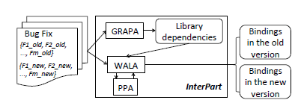
InterPart

Slide 20
InterPart
relies on WALA to resolve bindings in both old and new versions. WALA uses Eclipse ASTParser
PPA is used to heuristically recover binding information by applying various inference strategies to an Eclipse AST. This works even in the case of incomplete program whose AST cannot be processed by WALA directly.
WALA is extended to take in PPA’s AST output and properly handle “null bindings” instead of simply throwing runtime errors.
GRAPA is used to precompute and record mapping between each fix and the library version pairs it depends on. These mappings help InterPart to locate the relevant library data to load to WALA

Slide 21
C. Recurring Change Pattern Extraction
Why? To know what kind of changes are co-applied and how atomic changes are usually related
How? Given two commits’ CDGs: GS1 = {cdg11,....., cdg1m} and GS2 = {cdg21,....., cdg2n}, every pair of CDGs across commits (e.g., < cdg11; cdg21 >) compared in an enumerative way.
Atomic change labels: The comparison of each pair starts with matching individual nodes based on their atomic change labels
Edge matching : If two edges (e.g., e1 and e2) have identical source changes, target changes, and edge directions, we consider them as matched.

Slide 22
3) Identify the largest common subgraph:
used JGraphT, a Java graph library with a builtin implementation of VF2 (isomorphism algorithm).
known node matches as initially identified common subgraphs.
Iteration:
incrementally add node or edge matches that do not conflict with the existing match(es).
Continue until no extra match can be added
:end
Recurring change pattern: After multiple common subgraphs are identified, recorded the one covering the largest number of nodes

Slide 23
Empirical Results & Findings

Slide 24
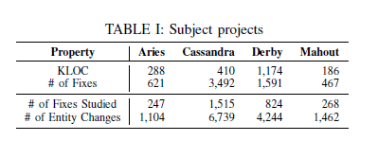
Subject Projects
Four open source projects: Aries(OSGi model), Cassandra(noSQL), Derby(relational), Mahout(ML algorithms library)
Diverse: different program domains
Well-maintained issue tracking systems and version control systems
Many bug-fixing commits refer to the corresponding bug reports via issue IDs

Slide 25
RQ1: What is the frequency of multi-entity bug fixes?

Slide 26
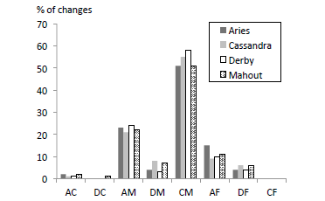
Finding #1
Similar to the fixes generated by APR approaches, real bug fixes also mainly consist of CMs.
Real fixes usually involve a much more diverse set of entities and change types, such as AMs and AFs.

Slide 27
Finding #2
Differing from the fixes generated by APR approaches, over half of the real fixes(58%-52%) mainly involve multi-entity instead of single-method changes.
15-16% of the fixes include two-entity changes, and 8-9% of the fixes involve three-entity changes.
Number of fixes decreases as number of changed entities increase.

Slide 28
In this figure, bug fixes are clustered according the number of changed entities they contain

Slide 29
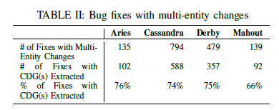
Finding #3
Among the fixes with multi-entity changes, 66-76% of the fixes contain related changed entities, and 76-83% of such fixes have entities connected in one or more CDGs.
This indicates that comparison/recommendation tools that relate co-applied changes will be valuable.

Slide 31
RQ2: What patterns are contained by multi-entity fixes?

Slide 32
Already found the largest common subgraph of each pair
Identified patterns are RCP = {rcp1, rcp2, …….., rcps). Frequency of these patterns were investigated by matching each of these patterns with all commits’ CDGs. This was done to check whether a CDG contains one or more subgraphs matching the pattern.
Duplicacy removed if two rcps are found matches in the same CDG.

Slide 33
Finding #4
The fix patterns of multi-entity changes commonly exist in all the investigated projects. This indicates that such patterns may be usable to guide APR approaches and to generate patches changing multiple entities.
There are many more matched subgraphs than matched fixes, indicating that many fixes contain multiple matched subgraphs.

Slide 34
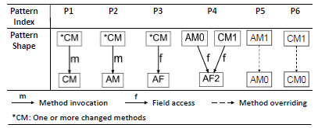
Six recurring patterns

Slide 35
Six recurring patterns
P1: A callee method experiences a CM change, while one or more of its caller methods also experience CM changes.
P2: A callee class experiences an AM change, while one or more of its caller methods go through CM changes.
P3: A field experiences an AF change, while one or more methods accessing the field experience CM changes.
P4: A field experiences an AF change, one method undergoes an AM change, and another method undergoes a CM change.

Slide 36
Six recurring patterns
P5: A method experiences an AM change (e.g., m0 is added),while another method overriding m0 also undergoes an AM change.
P6: A method experiences a CM change (e.g., m0 is changed), while another method overriding m0 also undergoes a CM change.

Slide 37
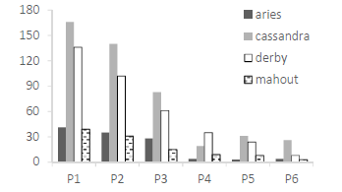
Finding #5
Four out of the six most frequent fix patterns apply multiple CM changes.
It indicates that existing APR approaches can be extensible to generate multi-entity fixes by modifying several methods that call the same changed method or access the same added field.

Slide 38
RQ3: Why do programmers make multiple-entity changes,
when they fix real bugs?

Slide 39
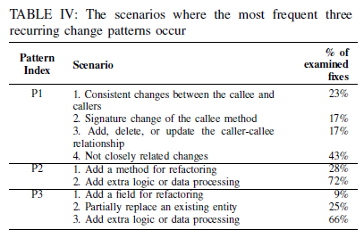
a) Case Study I—Exploration of Recurring Change Patterns:
P1: (*CM ->CM)
23% consistent changes
43% not closely related changes
2) P2: (*CM -> AM)
28% cases : new method added for refactoring purposes (extracting a method, moving a method between classes)
72% cases: new method added to implement new changes

Slide 40
3) P3: (*CM -> AF)
9% cases: developers added a field for refactoring, such as declaring a field for an expression or a constant.
25% cases : Enhancement of existing features. They declared a new field to partially replace the usage of an existing field or method invocation in certain methods
66% cases: addition of new features, such as adding extra condition checks or data processing.
P2 and P3 support previous research that code refactoring is donw when doing multiple bug fixing.
Multi-entity fixes seldom overlap in textual content.

Slide 41
Finding #6
Among P1-P3, no identical fixes were seen. It means that APR approaches are unlikely to independently suggest a correct multi-entity fix purely based
on past fixes, although it is still feasible for new tools to
help complete developers’ fixes.
Extra domain knowledge is required for APR tools to generate correct multi-entity fix.

Slide 42
b) Case Study II—Examination of Repetitively Co-Changed Entities:
To examine this, entity pairs that were co-changed in at least two fixes were extracted.
Majority of the co-changed pairs are methods
Selected 5 entity pairs(CM) from each project whose change types were preserved across the fixes.
54 fixes were checked to characterize the 20 pairs

Slide 43
Seven method pairs contain similar statements, and thus the two methods of each pair were usually changed similarly together.
Five pairs contain similar or relevant usage of fields.
Four pairs invoke the same sets of methods
Four method pairs were co-changed for some unknown reasons as the commonality in the program context or textual edits could not be found.

Slide 44
Finding #7
The repetitively co-changed entities usually share common characteristics like similar content, relevant field usage, or identical method invocations, among which the similar usage of fields or methods has not been leveraged to automatically complete developers’ fixes.

Slide 45
Threats to Validity

Slide 46
Threat to External Validity: The observations based on the empirical results are from four open source projects. which may not generalize to other projects. Authors plan to collect more projects with different approaches to identify bug fixes even when commit messages do not refer to issue IDs.
Threat to Construct Validity: The manual inspection to explore the rationale behind recurring change patterns and repetitively co-changed entities, is not scalable and may be subject to human bias. The future plan suggested was to design new approaches to automate the inspection process and to uncover more insights in an efficient way.
Threats to Internal Validity: InterPart may miss some dependency relations between co-applied changes, due to the limited analysis scope and static analysis nature. As future work, InterPart will be extended to correlate the edits in source code and other types of files.

Slide 47
Authors have leveraged the syntactic dependence relationship to link relevant changes. It is possible that developers may correlate changes based on other kinds of dependencies.
In the future, Wang et al. plan to conduct a user study with developers to investigate (1) how syntactic dependence relationship is helpful, and (2) what other relations developers consider when grouping relevant changes.

Slide 48
Related Work

Slide 49
A. Empirical Studies on Code Changes
Yue et al. found that 15-20% of bugs were fixed with code changes involving repetitive edits.
Nguyen et al. reported that 17%-45% of bug fixes were recurring.
Mcintosh et al. mined co-changed source files and built files from version control repositories to characterize the co-change relationship between both types of files.
Zimmerman et al. mined cochanged rules between software entities, and then predicted changes based on the mined rules.
Herzig et al. found that a non-trivial portion of program commits contained more than one bug fix, feature, or refactoring.

Slide 50
Barnett et al. correlated one program commit’s edited lines based on the def-use relationship of types, fields, methods, and local variables; and reported that a significant fraction of commits included multiple groups of correlated changes [25].

Slide 51
B. Change Impact Analysis
Chianti analyzes two versions of a program and decomposes their difference into atomic changes such as CM and AF [60].

Slide 52
C. Automatic Program Repair (APR)
GenProg generates candidate patches by replicating, mutating, or deleting single line code randomly in the existing program.
Prophet trains a machine learning model with successfully applied human patches obtained from open source repositories, and then generates a space of candidate patches to fix bugs.
Genesis generates program transformations (e.g., wrapping existing code with a try-catch construct) from past fixes, and then uses the transformations to guide automatic patch creation
Angelix leverages constraint solving to synthesize multi-line patches to correct multiple if-condition checks in one fix.

Slide 53
Conclusion

Slide 54
In 66-76% of the multi-entity fixes, the co-changed entities are closely related to each other via syntactic dependencies. Hence, we need program diff tools that visualize the relationship.
There are three major recurring patterns that frequently connect relevant co-changed entities. As multiple entities are usually co-changed in bug fixes, it is worthwhile exploring how to synthesize fixes that can change multiple syntactically related entities together.
Although a multi-entity fix is never identical to other fixes, the fix may apply similar or divergent edits to the entities with similar textual content, field usage, or method invocations. This indicates that future tools can suggest missing changes based on the similar content of edited locations, similar usage of fields, or common method invocations between software entities.

Slide 55
Discussion Questions

Slide 56
D1: Limitations of InterPart
InterPart may miss some of the static dependencies as it examines only the changed code(source files). (Example case- overridden methods)
Suggestions to improve this?
alternate approach?
D2: Were all the bug fixes effective?
A study by Yin et al. reveals that all bugs are not fixed effectively.[1] They might even introduce new bugs.
How can we factor them in?

Slide 57
Questions?

Slide 58
SOURCES
[1] “How do fixes become bugs?”, https://dl-acm-org.ezproxy.lib.vt.edu/citation.cfm?id=2025121

