Slide 1
ClDiff: Generating Concise Linked Code Differences
Presented by:
Neelma Bhatti
CS6704: Software Engineering Research
Februrary 20, 2019

Slide 2
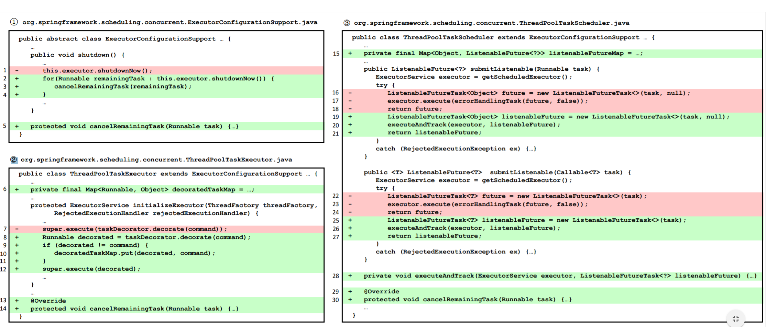
Introduction
Analyzing and understanding source code changes is important in a variety of software maintenance tasks. To this end, many code differencing and code change summarization methods have been proposed to represent code changes at different granularity.
GumTreeDiff, Diffchecker, Code Compare, LSDiff, Winmerge,
Notes:
Developers often spend a significant amount of time to comprehend code changes during code review to improve software quality
code change knowledge is required during software merging to resolve merging conflicts
code change information is useful for selecting the test cases that need to be rerun during regression testing to efficiently find regression bugs

Slide 3
Problem statement:
Differencing methods generate too fine-grained representation of code changes.
Text-based methods are unaware of the syntactic structure of source code.
Tree-based methods directly work at the abstract syntax tree (AST) granularity for generating fine-grained syntactic code differences
Summarization methods generate coarse-grained representation of code changes.
Natural language summaries to describe code changes, commit message for code changes in a commit, and the release note for code changes in a release.
Too coarse-grained to be useful for in-depth analysis and understanding of code changes.
Do not consider the relationships among code changes.
Generated differences or summaries make it not easy to analyze and understand code changes in some software maintenance tasks
Notes:
In particular, for code differencing, text-based methods are unaware of the syntactic structure of source code and compute textual differences that are not easy for further analysis and understanding
The differences between two ASTs are in the form of an edit script, a sequence of edit actions to transform the AST before changes to the AST after changes. Such edit scripts can be too fine-grained, too scattered, and too long to understand code changes in some applications (e.g. code review and software merging), especially for large code changes [24]
Moreover, the relationships among code changes (e.g. a change to the signature of a method can result in changes to all the invocations of the method) are missing, which are in fact important for code change analysis and understanding (e.g. the related code changes need to be considered together during code review or software merging).

Slide 4
Approach overview
The inputs of ClDiff are a set of pairs of source code files before and after changes (e.g. in a commit, patch or release).
The outputs can be visualized by the webbased tool.
ClDiff works in three steps, pre-processing, generating concise code differences and establishing links between those code differences.
Notes:
First, ClDiff pre-processes the source code files by pruning unchanged declarations from parsed ASTs. The purpose is to avoid unnecessary differencing analysis on unchanged AST elements in the second step.
Then it generates concise code differences via grouping the fine-grained code differences, generated by GumTree [17], at or above the statement level and describing high-level changes in each group. The underlying idea is to put together the fine-grained code differences that are scattered but related to a high level AST element.
Third, ClDiff links the related concise code differences according to five pre-defined links. The motivation is to consider such related code changes as a whole in some tasks.

Slide 5
GumTree
GumTree is a complete framework to deal with source code as trees and compute differences between them.
converting a source file into a language-agnostic tree format
export the produced trees in various formats
compute the differences between the trees
export these differences in various formats
visualize these differences graphically
Compared to classical code differencing tools:
it works on a tree structure rather than a text structure,
it can detect moved or renamed elements in addition of deleted and inserted elements.

Slide 6
Methodology: Pre-processing
Take as inputs source code files before and after changes (e.g. in a patch, commit or release) to prune some unchanged declarations from parsed ASTs.
Traverse AST’b to compute two hash values for the node whose label is a field, enumeration, method, inner class, or initializer declaration, and store the AST node to a map whose key is the two hash values.
Finally, AST’a is traversed to compute the two hash values for each declaration node and prune the node (including all its descendant nodes) from both AST'b and AST'a if the two hash values find a match in the map.
The output is a pruned AST pair ⟨AST ′ b ,AST ′ a ⟩.
Notes:
Given each pair of source code files ⟨fb , fa⟩, we parse it into an AST pair ⟨ASTb ,ASTa⟩, where ASTb is the AST of the file before code changes and ASTa is the AST of the file fa after code changes.
The purpose is to avoid unnecessary differencing analysis on unchanged AST elements in the second
One hash value is calculated over the canonical name of the residing class and is used to distinguish the same declaration in both outer and inner classes. Another hash value is calculated over the corresponding declaration code (i.e. the subtree rooted at the node).
Notice that as comments and Javadocs are not treated as code, they are removed from ASTs beforehand.

Slide 7
Generating Concise Code Differences
Phase 1
A move action can already reflect high-level concise code change.
Different from update, add and delete actions that only affect one atomic node but not its descendant nodes, move actions move the whole subtree rooted at one node.
Phase 2
Add or a delete action on a statement or declaration AST node is mostly accompanied by simultaneous add or delete actions on its composing elements.
Edit actions are grouped with respect to the composing elements of a statement or declaration, by distinguishing whether a whole or a part of a composing element is added or deleted together
Notes:
In the second step, we generate concise code differences from fine grained code differences. Our underlying idea is to put fine-grained code differences within a statement or declaration AST element to a group and describe high-level changes in the group

Slide 8
Generating Concise Code Differences
All statements and declarations into two categories and define their base and composing elements.
C1 : Includes statements and declarations whose child nodes N can contain statements or declarations.
IfStatement, TryStatement, MethodDeclaration and TypeDeclaration
C2: Contains statements and declarations whose child nodes do not contain statements or declarations
ExpressionStatement, VariableDeclarationStatement, ReturnStatement and FieldDeclaration.
Defined as a base element and do not have composing elements.

Slide 9
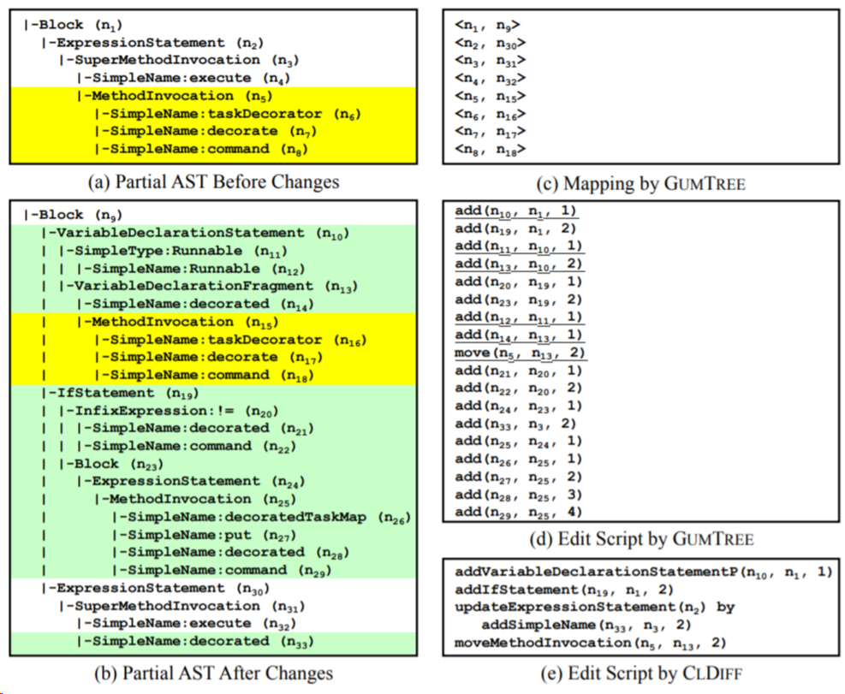
Generating Concise Code Differences
Notes:
After Phase 1 and Phase 2, the remaining actions in A are only add, delete and update actions on non-statement and non-declaration AST nodes.
Given a pruned AST pair ⟨AST ′ b ,AST ′ a ⟩, they use GumTree [17] to generate the mapping M and the edit script A between the two ASTs.
M maintains the mapped AST node pairs and A stores the edit actions (Section 2)

Slide 10
Generating Concise Code Differences
Phase 3.
Only add, delete and update actions on non-statement and non-declaration AST nodes.
Grouped together with respect to their common ancestor statement or declaration.
Given a pruned AST pair ⟨AST ′ b ,AST ′ a ⟩, they use GumTree [17] to generate the mapping M and the edit script A between the two ASTs.
M maintains the mapped AST node pairs and A stores the edit actions.
Notes:
After Phase 1 and Phase 2, the remaining actions in A are only add, delete and update actions on non-statement and non-declaration AST nodes.

Slide 11
Linking Code Differences
Def-Use Link. If the declaration of a variable, field or method is changed (i.e. added, deleted, updated or moved) by code difference d1, the usage of the variable, field or method can be changed by d2.
Abstract-Method Link. If the declaration of an abstract method in a class is changed by d1, the implementation of the abstract method in each sub-class must be changed by d2.
Override-Method Link. If the declaration of a method in a class is changed by d1, the implementation of the method might be changed through override in each sub-class by d2.
Implement-Method Link. If the declaration of a method in an interface is changed by d1, the implementation of the method must be changed in each class that implements the interface by d2.
Systematic-Change Link. If two code differences d1 and d2 are similar, they might be caused by systematic changes (e.g. refactoring [35] and recurring bug fixes [47]).
Notes:
Establish code change links among the generated concise code differences according to five pre-defined links. Such links reflect the causality of code changes.
Within scope, all other changes to the same variable declaration are related. It establishes links between same file.
Detects SImilar number of statements or lines have been detected having a same parent statement, compute the bi-gram similarity. If it is more than 0.8, they are related.

Slide 12
Linking Code Differences
Notes:
Lindah
Asterisk: This is where we are beginning, it imay not be where we are ending

Slide 13
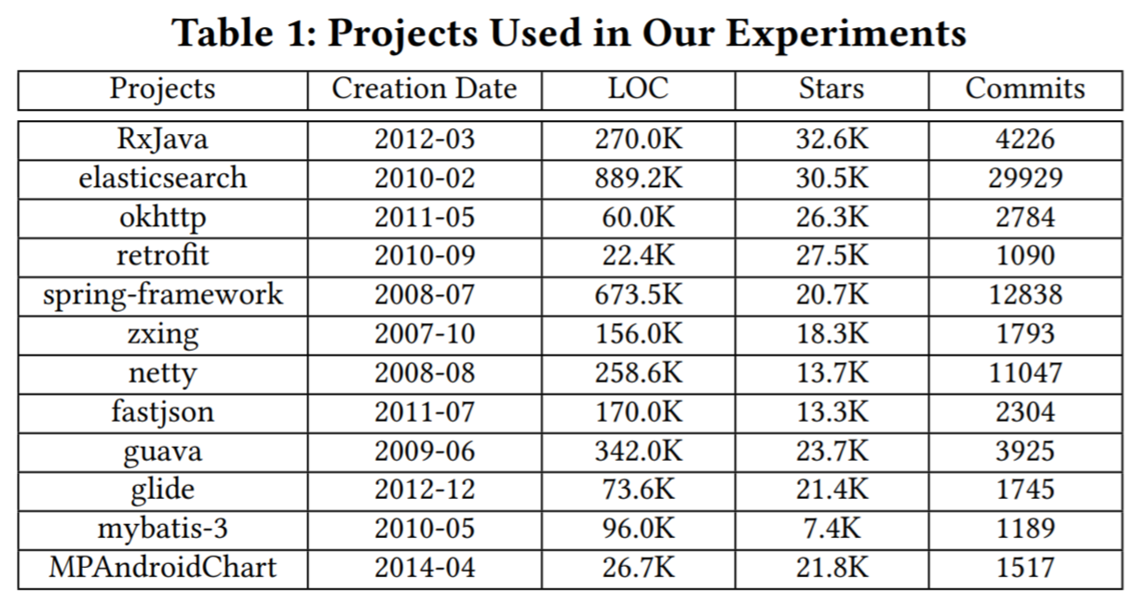
Evaluation
RQ1: How is the accuracy of the generated concise code differences and the established links by ClDiff?
RQ2: How is the size of the generated concise code differences of ClDiff compared to GumTree?
RQ3: How is the performance overhead of ClDiff compared to GumTree?
RQ4: How is the usefulness of ClDiff in understanding code changes compared to GumTree?
The number of commits is computed by removing the commits that are not related to code changes (e.g. changes to configuration files) or only related to testing code changes. In total, 74,387 commits are used.
Notes:
Table 1 reports the statistics about projects, including project name, creation date, lines of code, the number of stars, and the number of commits.. We can see that these projects are all large-scale and popular, and have a long evolution history. So these projects contain rich and diverse code changes.

Slide 14
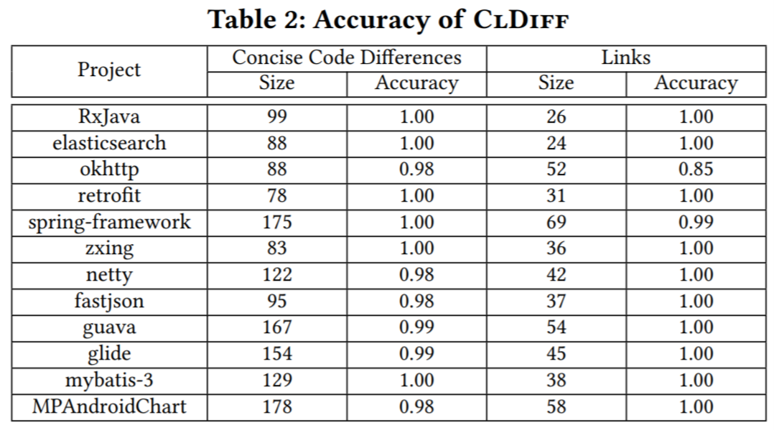
Accuracy Evaluation (RQ1)
Randomly chose 10 commits from each project, and manually analyzed the results of ClDiff on them.
ClDiff had a high accuracy of 99% and 98% for the generated concise code differences and established links.
12 inaccurate code differences were found to be caused by the inaccurate mapping in GumTree (because ClDiff uses the mapping that is heuristically generated byGumTree).
Notes:
Table 2 shows the accuracy results, w
reported the total number of generated code differences for the 10 commits and the total number of established links under column Size.
This high accuracy is surprising but still reasonable as code changes are often focused and our simple strategy only analyses those changed code that contain small sources of inaccuracy.
In total, they analyzed 1,456 code differences, and achieved an accuracy of 99%; and we analyzed 512 links and achieved an accuracy of 98%.
In detail, 10 of them were caused by missed mappings, i.e. two AST nodes that should have been mapped are actually not mapped. As a result, GumTree generates a delete and an add action instead of a move action, making ClDiff fail to generate a move action as well. In addition, two of them were caused by wrong mappings, i.e. two AST nodes that should not have been mapped are actually mapped. Thus, both GumTree and ClDiff generate a code difference that does not reflect the real code change, confusing the change understanding

Slide 15
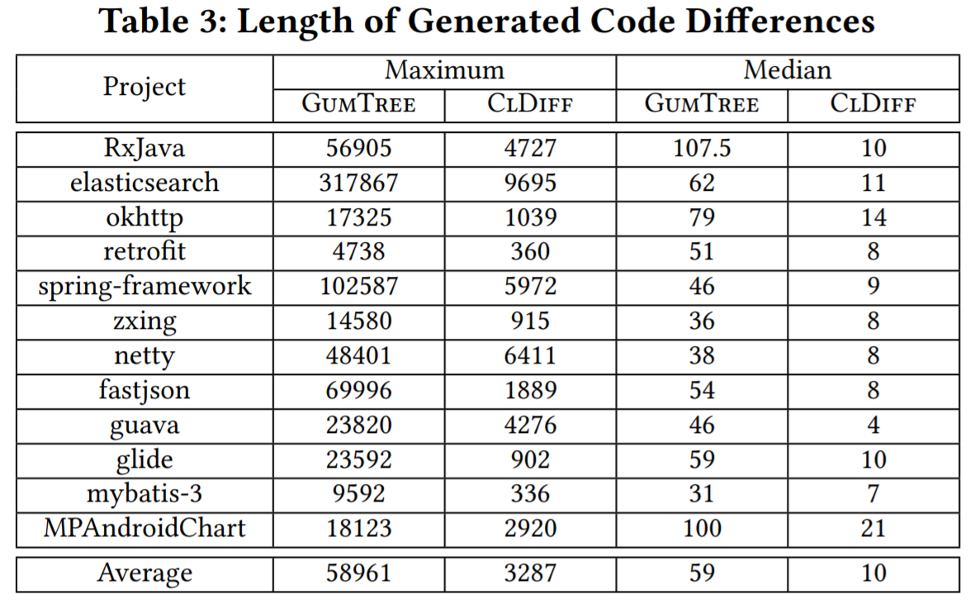
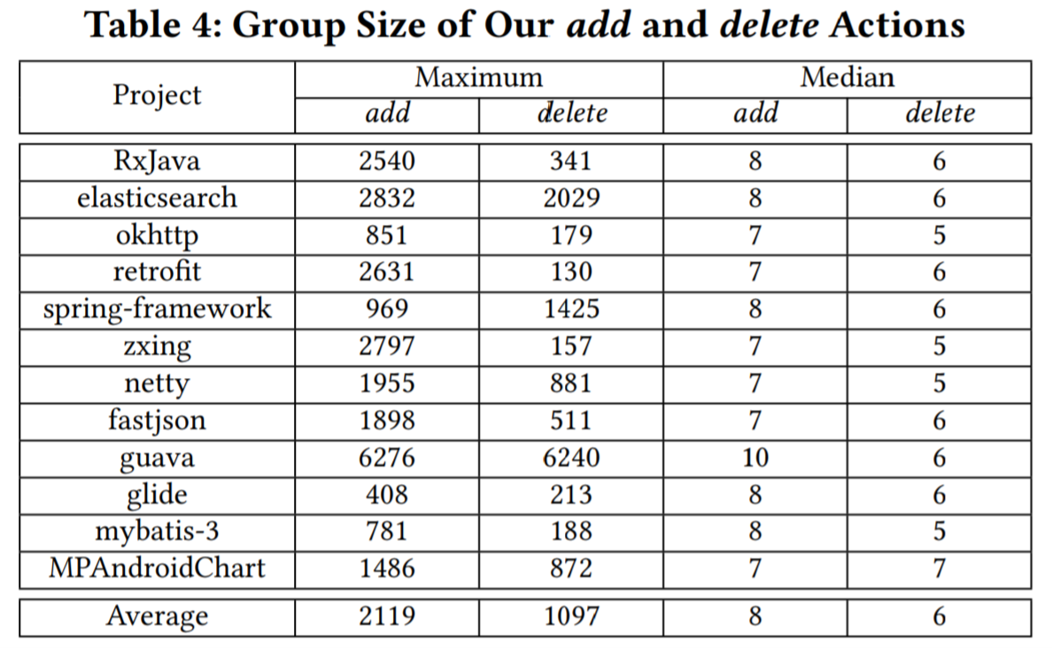
Conciseness Evaluation (RQ2)
Notes:
To analyze whether ClDiff generates concise (or short) code differences compared to GumTree, measured the length of the edit script (i.e. the number of actions in the script) for each commit.
Since the update actions in ClDiff simply put a set of fine-grained actions together but not represent a complete action like our add and delete actions do, we used the number of those fine-grained actions for the counting for our update actions to have a fair comparison.
Table 3 presents the maximum and median length for each project (the minimum lengths are omitted as they are all one), which shows that ClDiff significantly shortened the edit script.
Table 4 lists the maximum and median group size for add and delete actions. These maximum cases often correspond to the addition or deletion of an entire method declaration. The median size was respectively 8 and 6 for our add and delete actions.

Slide 16
Conciseness Evaluation (RQ2)
ClDiff generated more than 80% shorter edit scripts for 48% commits than GumTree.
Overall, for 90% commits, ClDiff generated shorter edit scripts than GumTree. For the remaining 10% commits, ClDiff had the same length as GumTree, meaning that the fine-grained edit actions cannot be grouped at or above the statement level.
Fig. 6 further shows the length ratio of ClDiff to GumTree with respect to each commit in each project. For all the projects, the median ratio was around 0.2. Numerically, for 48% commits, ClDiff shortened edit scripts by more than 80%. This owes to our high-level add and delete actions, describing a group of fine-grained add and delete actions.
Notes:
Based on the results in Table 3 and 4 and Fig. 6, ClDiff generated more than 80% shorter edit scripts for 48% commits than GumTree.
Overall, for 90% commits, ClDiff generated shorter edit scripts than GumTree. For the remaining 10% commits, ClDiff had the same length as GumTree, meaning that the fine-grained edit actions cannot be grouped at or above the statement level.
Fig. 6 further shows the length ratio of ClDiff to GumTree with respect to each commit in each project. For all the projects, the median ratio was around 0.2. Numerically, for 48% commits, ClDiff shortened edit scripts by more than 80%. This owes to our high-level add and delete actions, describing a group of fine-grained add and delete actions.

Slide 17
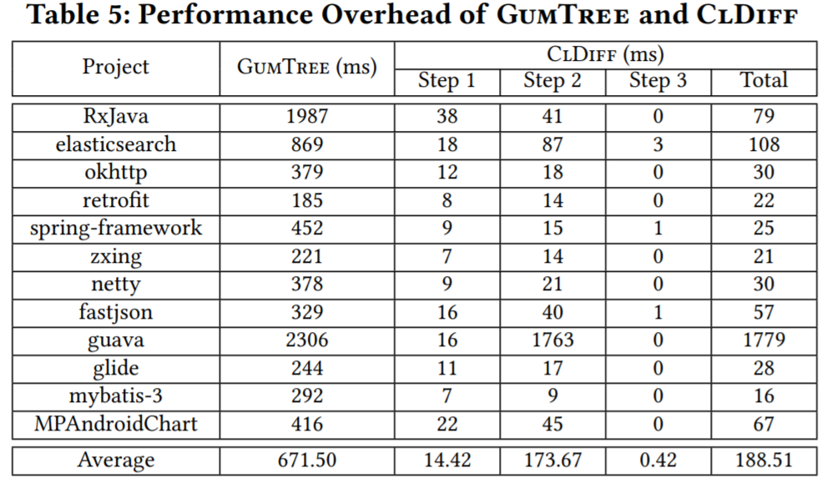
Performance Evaluation (RQ3)
Reports the performance overhead of each step in ClDiff.
ClDiff spent 72% shorter time than GumTree
On average, ClDiff spent 188.51 milliseconds for a commit.
Notes:
Table 5 compares the average performance overhead (in milliseconds) of ClDiff andGumTree in generating code differences for the set of changed source code files in each commit.
We can see that ClDiff took 72% shorter time than GumTree. The reason is that, in ClDiff, we prune unchanged declarations in the AST pairs before applying GumTree to generate fine-grained code differences, while GumTree directly works on raw ASTs. Besides, the second step of ClDiff is the most expensive step, spending 92% of the time. The third step is the cheapest step, only taking 0.42 milliseconds for a commit. This actually owes to our heuristic-based strategy to build links, which also achieves high accuracy.

Slide 18
Usefulness Evaluation
10 participants participated in a blind study to understand the changes in 10 commits (i.e. to finish 10 tasks) with the help of ClDiff and GumTree.
Groups of equally divided participants used ClDiff and GumTree to understand the changes for the five tasks respectively.
Every participant reported changes in each task, summary of his/her understanding about the changes in each task and time required to finish each task.
Used three indicators to compare ClDiff with GumTree.
Score to assess the degree of understanding the changes in each task, time required to finish each task and qualitative results about the questionnaire.
Notes:
used three indicators to compare ClDiff with GumTree. The first indicator is a score to assess the degree of understanding the changes in each task. Two of the authors manually assigned a score between 0 and 2 to both the task-specific questions and the summary of each task for each participant. Thus a full score is 4. As task-specific questions had deterministic answers, 0.5 was deducted for one wrong answer. The summary was scored based on whether code changes were understood. Due to the subjective nature, the two authors finalized the summary’s score through discussion. The second indicator is the time required to finish each task. The third is the qualitative results about the questionnaire.
Table 6 reports the results of the four questions in the questionnaire. The first column lists the question, and the other four columns report the number of participants choosing the corresponding options. Generally, all the participant felt that ClDiff was helpful (Q1), and was more helpful than GumTree (Q3), while some participants felt that GumTree was not very helpful (Q2). Besides, seven participants thought that our concise code differences were helpful, and eight participants thought that our links were helpful (Q4).

Slide 19
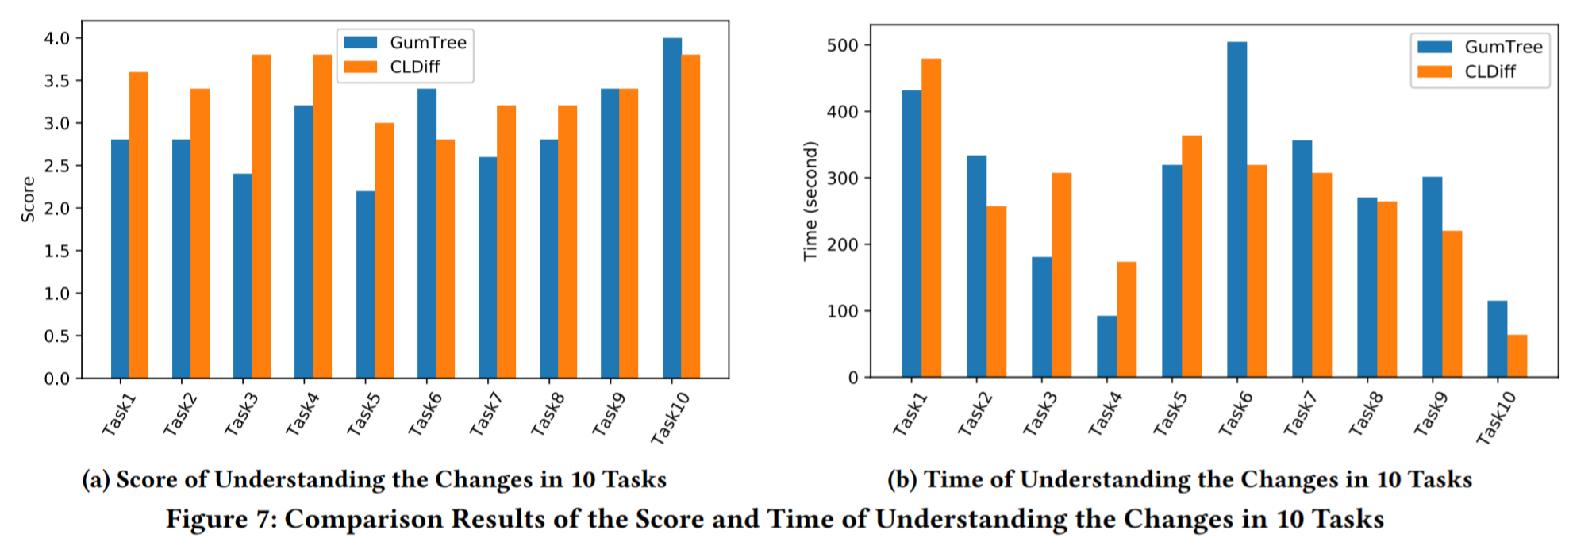
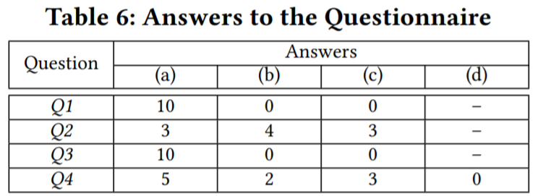
Usefulness Evaluation
ClDiff was more useful than GumTree in understanding code changes for all participants; with concise code differences and their links being helpful for most participants.
Notes:
Fig. 7 shows the results of the two indicators score and time. The x-axis in Fig. 7 denotes each task, the y-axis in Fig. 7a and 7b respectively denote the average score of understanding the changes in each task and the average time to finish each task. Overall, the average total score of ClDiff and GumTree for 10 tasks was respectively 34.0 and 29.6; and there was a significant difference in score between ClDiff and GumTree according to the Wilcoxon Signed-Rank Test. The average total time of ClDiff and GumTree for 10 tasks was respectively 1,539 and 1,865 seconds. However, there was no significant difference in time between ClDiff and GumTree. Specifically, in four tasks, ClDiff took more time but had higher score; in two tasks, ClDiff took less time but had lower score; and in four tasks, ClDiff took less time and had higher score.

Slide 20
Related work: Code Differencing
Text-based approaches are often fast and language-independent;
however, they fail to compute syntactic code changes, hindering code review, automatic analysis and tool development based on their code differences.
Tree-based approaches generate syntactic code changes.
Most of these tree-based approaches generate low-level fine-grained representations of code changes, whereas ClDIff first computes high-level abstracted code changes and then establishes potential links among code changes.
Graph-based differencing approaches are proposed to deal with graph representations of source code, e.g., extended control flow graph and abstract syntax tree with program semantics, and class model with UML semantics.
Some advances have been made to achieve semantic differencing based on input-output behaviors, which provide good insight to understand the semantics behind syntactic code changes.
Notes:
Text-based approaches [44, 46] are first proposed to compute differences (in the form of inserted, removed or changed lines of code) between two versions of a source file, followed by several advances [4, 9, 50] that further identify moved lines of code. These approaches are often fast and language-independent; however, they fail to compute syntactic code changes [39], hindering code review, automatic analysis and tool development based on their code differences.
Diff/TS [21] can work on raw ASTs. It extends a tree differencing algorithm [58] to generate a fine-grained edit script. A more recent approach is GumTree [17], which also works on raw ASTs. The goal is to find an edit script that well reflects the developer intent based on several heuristics. Higo et al. [24] extend GumTree by introducing copy-and-paste as a new kind of edit actions to make edit scripts shorter and more easily understandable. Dotzler and Philippsen [16] propose some general optimizations to improve the accuracy of the previous tree-based approaches in detecting moved code.

Slide 21
Related work: Code Change Summarization
DeltaDoc [8] captures the behavioral changes for every method and the conditions under which they occur to generate natural language descriptions of code changes.
ChangeScribe [14, 37] generates a commit message by providing a general description of a commit and detailed descriptions of code changes in the commit based on predefined rules.
Jiang et al. [27] and Loyola et al. [38] adapt a neural encoder-decoder architecture to automatically generate commit messages from code differences.
Rastkar and Murphy [49] propose a machine learning-based technique to extract descriptions from a set of relevant documents (e.g., commit messages or bug reports).
Integrating the ideas of [37] and [49], ARENA [45] summarizes code changes at the system level and links to issues to generate release notes.
Notes:
These change summarization techniques are mostly designed for the ease of documentation of code changes, while ClDiff generates more fine-grained code changes at the syntactic level.

Slide 22
Related work: Code Change Decomposition
Kawrykow and Robillard [30] detect non-essential changes (e.g., local variable extractions) in a commit based on fine-grained code change analysis.
Herzig and Zeller [23] report the first empirical study on the frequency and impact of tangled changes by using a multilevel graph-partition algorithm [29] to decompose tangled changes based on a set of features.
Barnett et al. [5] use def-use information from added or changed code to decompose tangled changes.
Tao and Kim [53] develop three heuristics to decompose tangled changes into changes for formatting, changes with static dependencies, and changes with similar patterns.
Guo and Song [20] apply program slicing and AST searching to interactively decompose tangled code changes for code review and regression testing.
Notes:
These approaches inspire us to explicitly establish links among code changes.

Slide 23
Related work: Systematic Code Changes
Systematic code changes (i.e., similar, related code changes) can be caused by crosscutting concerns [31], API evolution [22, 28], recurring bug fixes [47] or refactoring [35].
Kim et al. [33] first identify such systematic code changes at the method signature level and represent them as logic rules and then [32, 34] extend [33] to describe changes within a method body and at a field level.
Zhang et al. [59] propose an interactive approach to allow developers to customize a generated change template and to match the template to summarize systematic changes and locate potential inconsistent or missing changes.
Given a systematic code change, McIntyre and Walker [40] discover locations where this change should be applied (if any exist); and Meng et al. [41, 42] further automatically apply this change to the discovered locations with different contexts.
Notes:
Different from these approaches that focus on a specific kind of code changes (i.e. systematic code changes), our approach focuses on a broader range of code changes. Further, we plan to use them to improve the construction of Systematic-Change links.

Slide 24
Conclusion
ClDiff is a code differencing approach which is designed to generate a concise, linked representation of code differences whose granularity is in between the existing code differencing and code change summarization methods.
Experiments with 12 open-source Java projects as well as a human study with 10 participants demonstrated ClDiff’s accuracy, conciseness, performance and usefulness.
ClDiff generates concise code differences and established their links with an accuracy of 99% and 98%, respectively
Compared to GumTree, ClDiff generates more than 80% shorter edit script for 48% commits with 72% shorter time and was more useful in change understanding.
ClDiff not only generates short and informative code differences, but also establishes their relationships.
Notes:
Subil

Slide 25
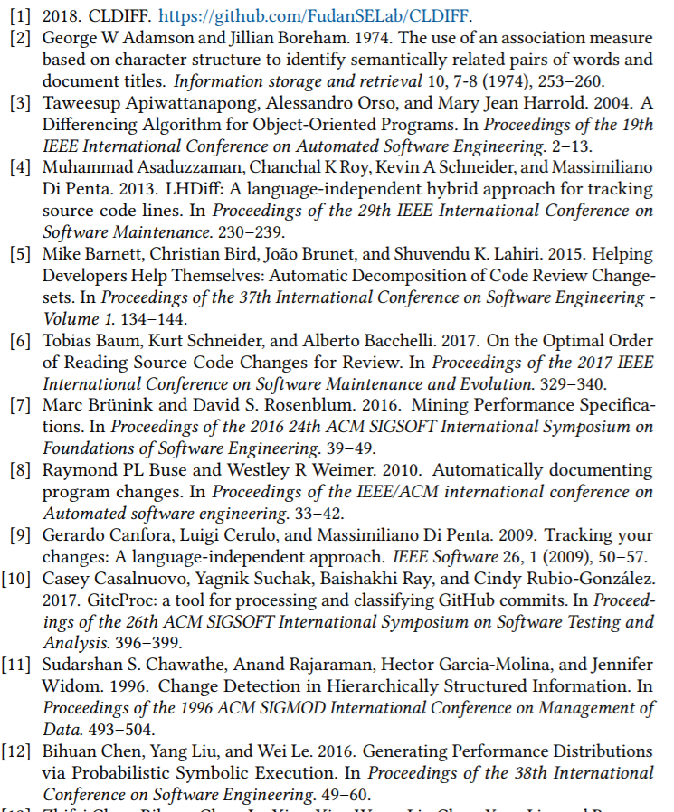
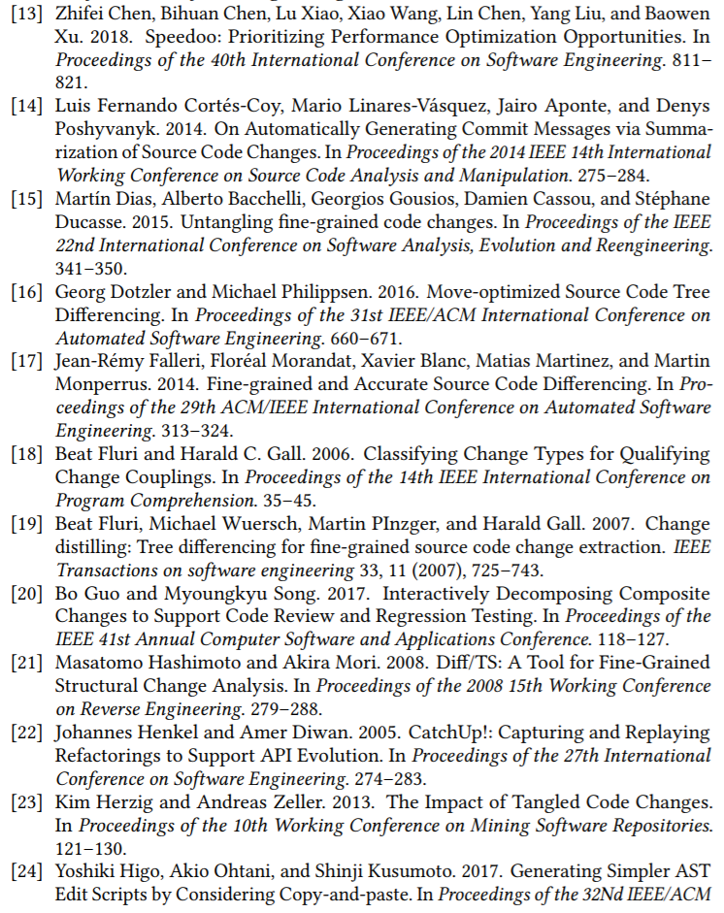
References
Notes:
Subil

Slide 26
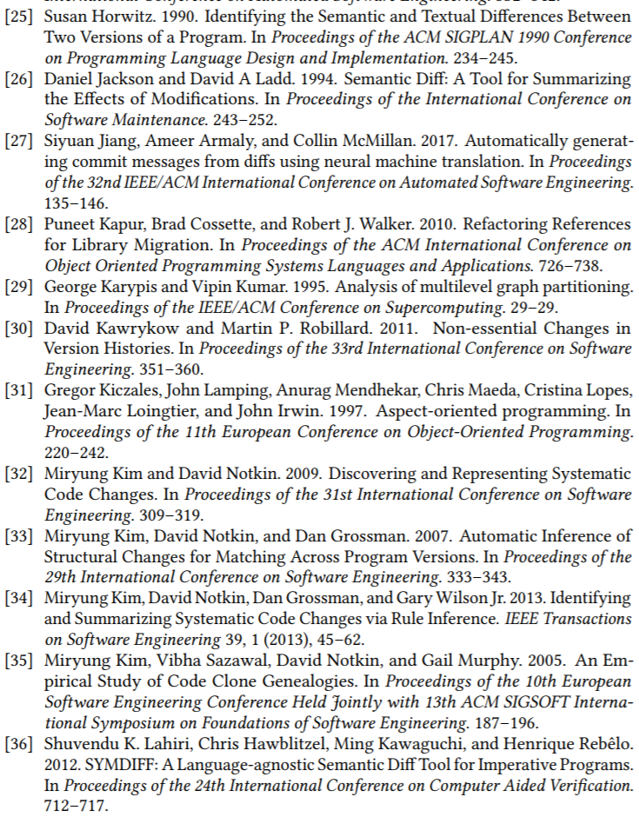
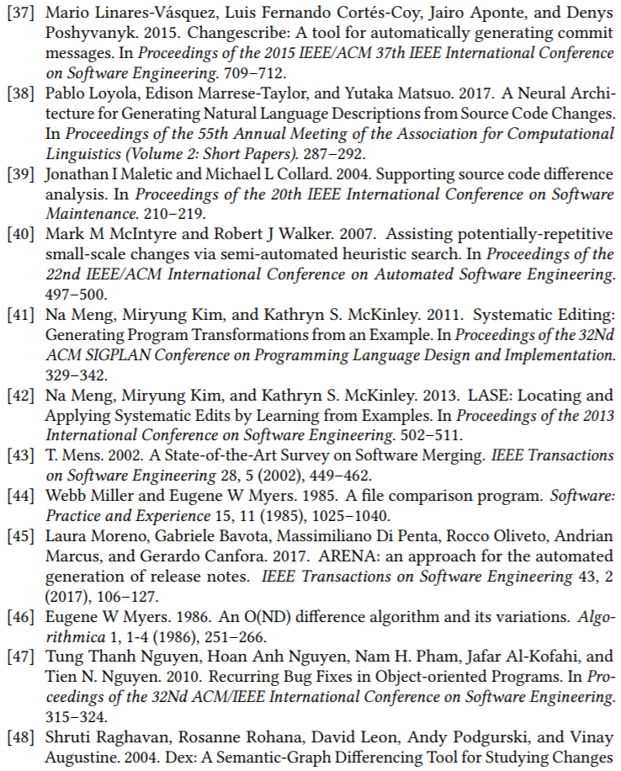
References
Notes:
Subil

Slide 27
References
Notes:
Subil

Slide 28
DIscussion
Authors have chosen highly starred Java projects for their evaluation, which are possibly well structured and written by experienced programmers. Do you think a better approach to evaluate would’ve been to use smaller projects/projects by novice programmers whose code is not as structured?
This tool provides a visualization of the differences for better understanding of code changes and summarization; however programmers usually prefer console-based tools. Would a console-based version of this tool be as effective or useful? Why and why not?
For linking code differences, authors define 5 pre-defined links, some of which are well suited only for OO programming languages. Will this approach be suitable for imperative or functional languages?
What links can be included for Linking Code Differences better?

Slide 29
Thank You
Suggestions are welcome

