Slide 1
Fine-grained and Accurate Source Code Differencing
Jean-Rémy Falleri, Floréal Morandat, Xavier Blanc, Matias Martinez, Martin Monperrus

Slide 2
Outline
Problem statement
Background knowledge
Approach
Evaluation
Related work
Conclusion
Discussion questions

Slide 3
Problem Statement
Understanding how software systems evolve
Understanding how source code ﬁles evolve
The sequences of edit actions made to a source code ﬁle (edit scripts)
Notes:
The authors are addressing the problem of understanding how the ..
Specifically understanding how …
Focusing on the ….

Slide 4
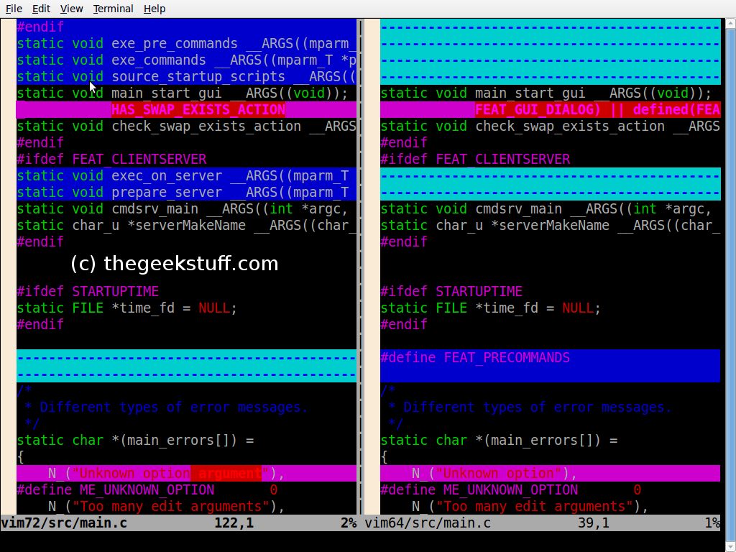
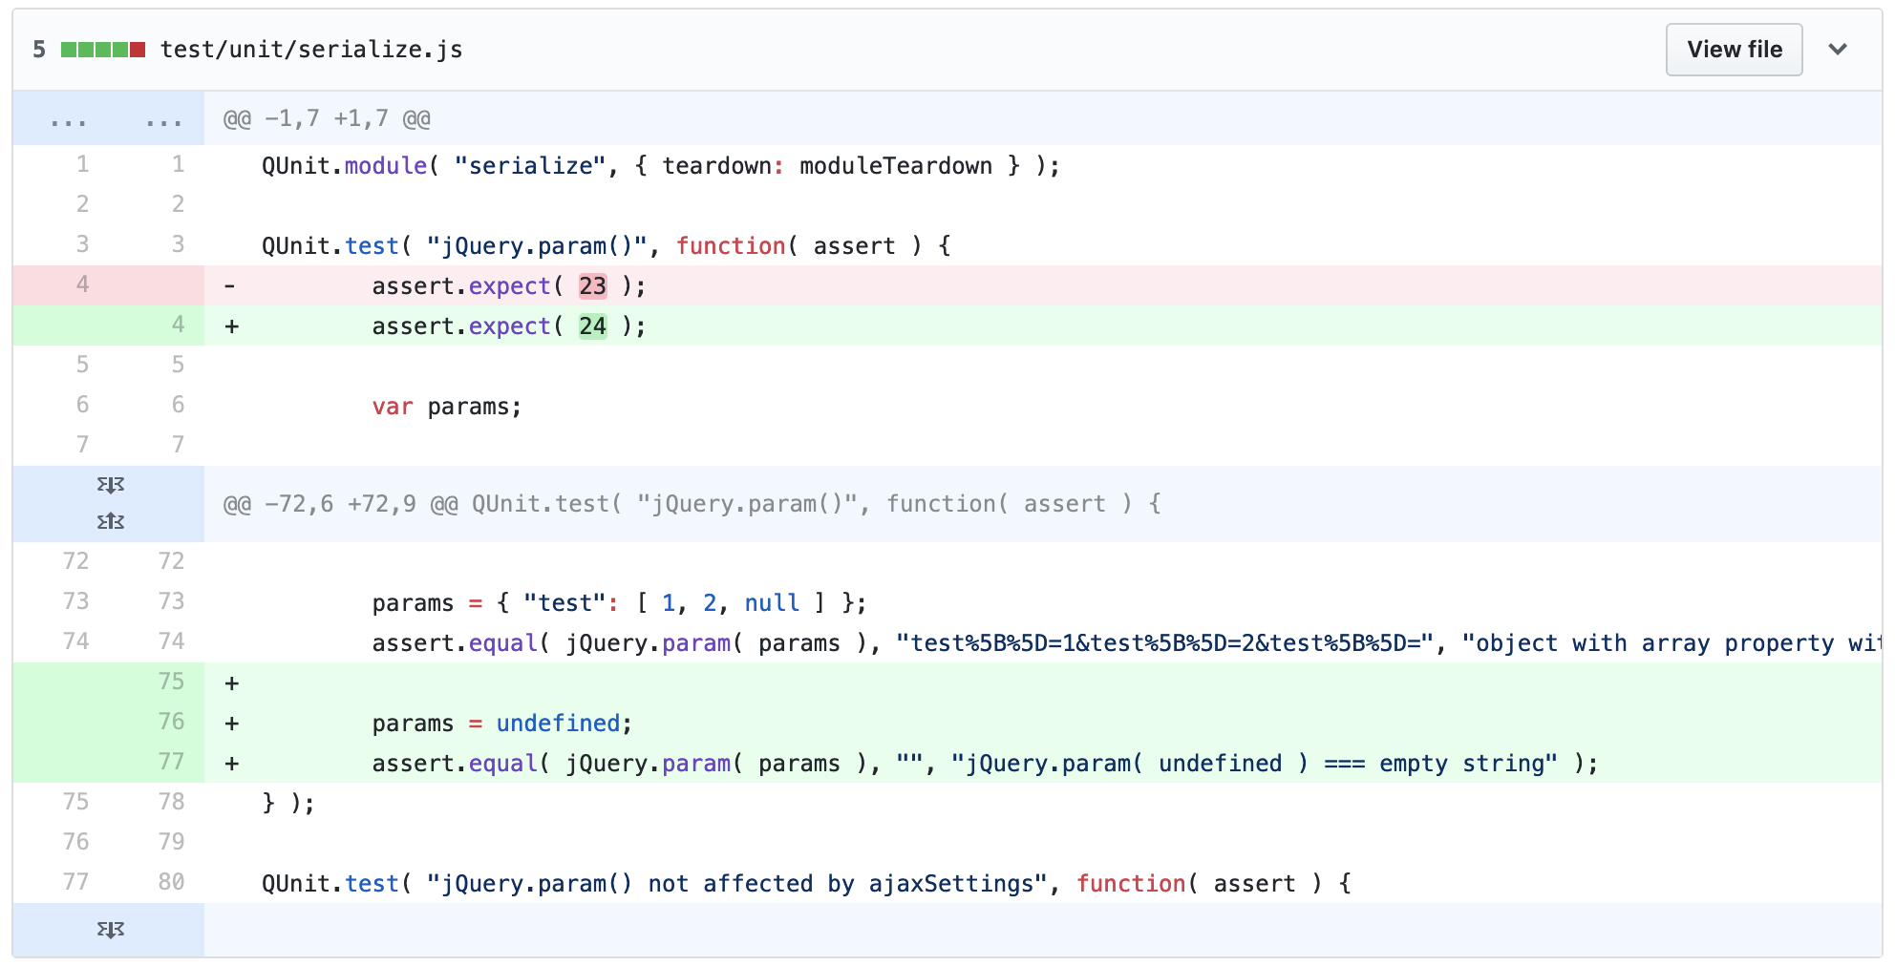
Problem Statement
To accurately reﬂect the file actual changes
Software developers seek edit scripts on a daily basis
Unix diﬀ tool
GitHub commit file diﬀ
https://www.thegeekstuff.com/2010/06/vimdiff-file-diff-tool/
https://github.com/jquery/jquery/commit/0645099e027cd0e31a828572169a8c25474e2b5c?diff=unified
Notes:
So, the goal of is to accurately reﬂect the actual change that has been performed on a ﬁle by generating an edit script .
Edit scripts are used by developers on a daily basis.
Examples are Unix diff and Github
These tools provide text line granularity edit scripts
Which lines added and deleted
The authors point at the limitation of this approach and the need for code structure edit scripts including update and move actions

Slide 5
Background Knowledge
Files in version control systems
Source: https://blog.cpanel.com/git-version-control-series-what-is-git/
Notes:
Here is some background information that think we need to know before discussing the paper approach and evacuation
Version-Control-System-02.png
https://invisiblepublishing.com/2017/07/12/my-friend-git/
image2018-2-8_17-46-1.png
https://blog.cpanel.com/git-version-control-series-what-is-git/
Git-work-flow.png
https://www.unixmen.com/git-stretch/

Slide 6
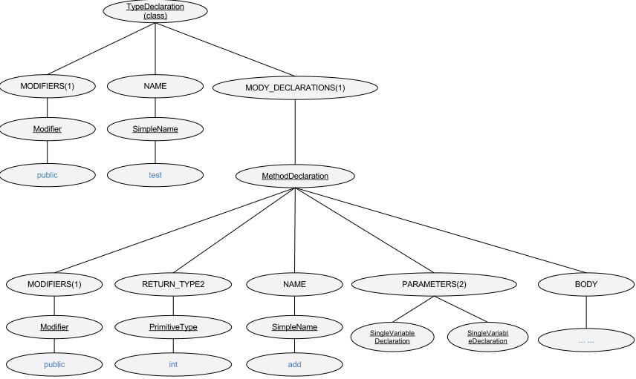
Background Knowledge
Abstract Syntax Tree (AST)
https://www.programcreek.com/2012/04/represent-a-java-file-as-an-astabstract-syntax-tree/
Notes:
Here is some background information that think we need to know before discussing the paper approach and evacuation

Slide 7
Background Knowledge
Text based differencing
https://github.com/jquery/jquery/commit/0645099e027cd0e31a828572169a8c25474e2b5c?diff=unified
Notes:
Here is some background information that think we need to know before discussing the paper approach and evacuation

Slide 8
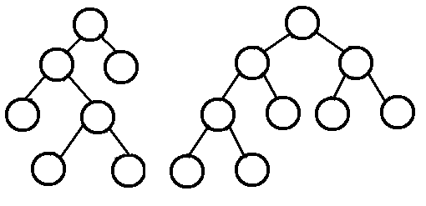
Background Knowledge
Structure based differencing
https://www.cs.cmu.edu/~adamchik/15-121/lectures/Trees/trees.html
Notes:
Here is some background information that think we need to know before discussing the paper approach and evacuation

Slide 9
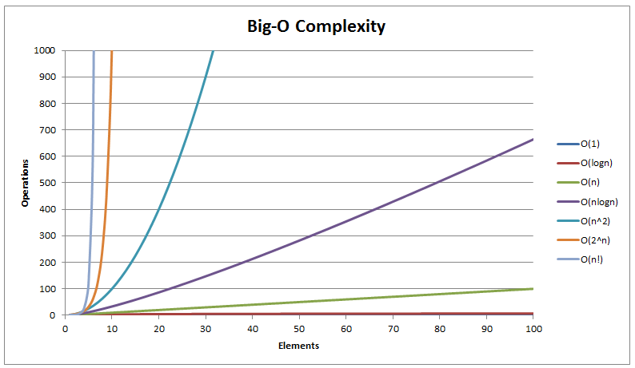
Background Knowledge
Algorithm complexity
https://www.hackerearth.com/practice/notes/sorting-and-searching-algorithms-time-complexities-cheat-sheet/
Notes:
Here is some background information that think we need to know before discussing the paper approach and evacuation

Slide 10
Approach
AST Differencing
Labeled ordered rooted tree
Node label → name of production rule in the grammar (e.g. StringLiteral)
Node value → actual tokens in the code (e.g. foo)
AST edit actions
Update node
Add node
Delete node
Move node
AST edit script
Nodes mappings
Edit transformation
Notes:
What technique is proposed?
Please provide sufficient details to facilitate understanding and discussion of the approach.

Slide 11
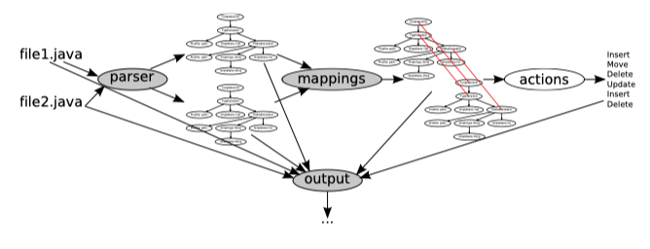
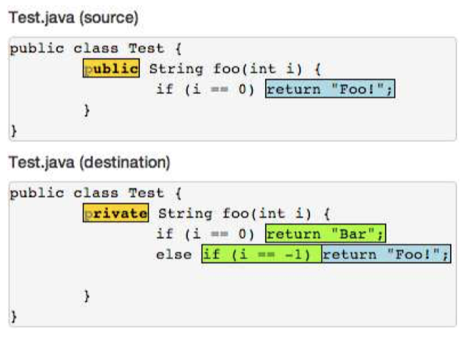
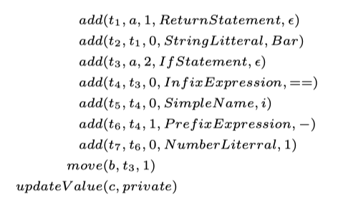
Approach
AST based file differencing
A
Notes:
What technique is proposed?
Please provide sufficient details to facilitate understanding and discussion of the approach.

Slide 12
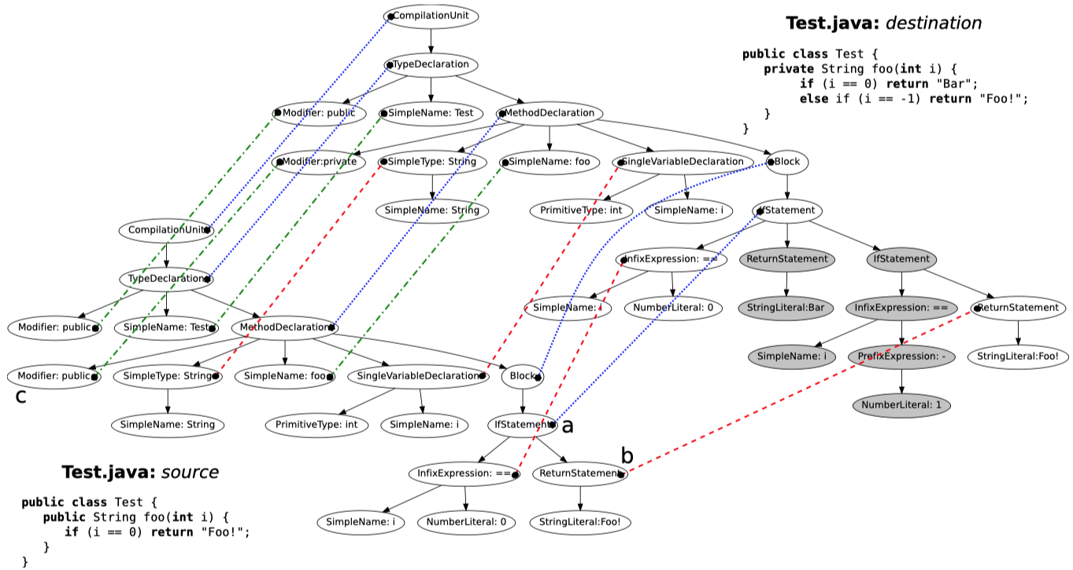
Approach
AST based file differencing
A
Notes:
What technique is proposed?
Please provide sufficient details to facilitate understanding and discussion of the approach.

Slide 13
Approach
AST based file differencing
Mapping
Top-down Phase
Bottom-up Phase
A
Notes:
What technique is proposed?
Please provide sufficient details to facilitate understanding and discussion of the approach.

Slide 15
Approach
AST based file differencing
Edit script
A
Notes:
What technique is proposed?
Please provide sufficient details to facilitate understanding and discussion of the approach.

Slide 16
Evaluation
Runtime Performances
Jenkins and JQuery.
Running time ratio base on text diﬀ running time
Manual Evaluation
Revisions from the software history of 16 open source projects
Compare Diff vs. GumTree
Automatic Evaluation
1000 revision pairs from 16 Java open source projects
GumTree(GT), ChangeDistiller (CD), and RTED
Compare number of mappings and edit script size
Notes:
How is the approach evaluated?

Slide 17
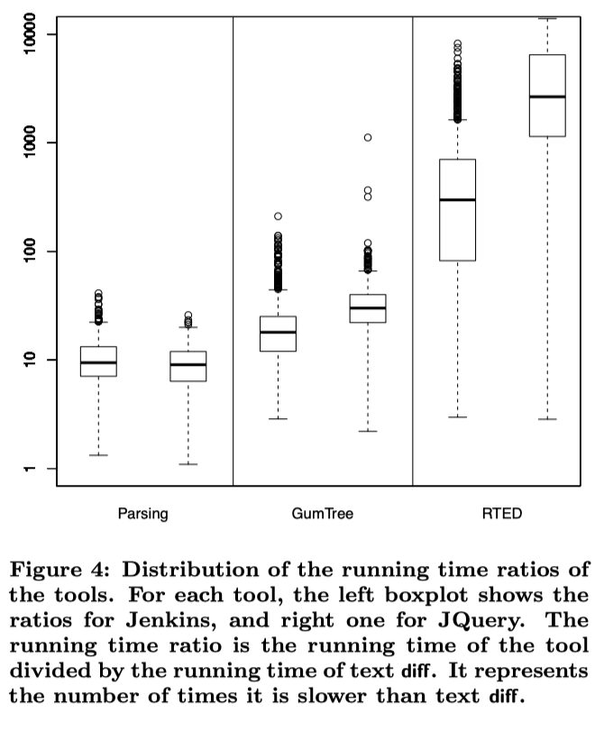
Evaluation
Runtime Performances
Notes:
How is the approach evaluated?

Slide 18
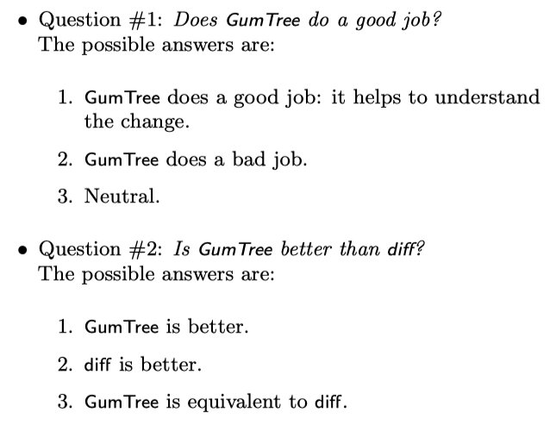
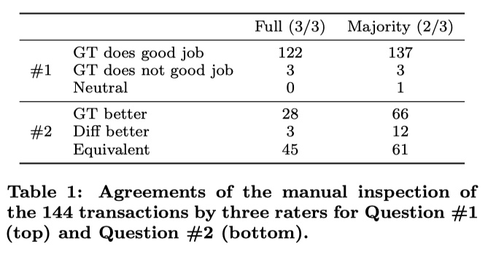
Evaluation
Manual Evaluation
Notes:
How is the approach evaluated?

Slide 19
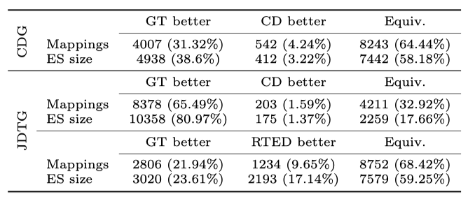
Evaluation
Automatic Evaluation
Notes:
How is the approach evaluated?

Slide 20
Related work
Text Differencing
AST Differencing
Graph Differencing and Origin Analysis

Slide 21
Conclusion
Problem
accurately reﬂect the file actual changes
Approach
AST differencing
Evaluation
Runtime Performances
Manual Evaluation
Automatic Evaluation

Slide 22
Discussion Questions
Problem
How frequent do you personally need to understand code changes?
Approach
What are the weaknesses of the presented approach?
How can we improve the presented approach?
Evaluation
What do you think of the evaluation of the work?
The limits set for the runtime performances test?
The authors own manual evaluation?
The results of the automatic evaluation?
Notes:
What are the points you would like people to discuss about?
The questions may interleave with other sections of your talk.

