Slide 1
How Reliable is the Crowdsourced Knowledge of Security Implementation?

Slide 2
Contents
Introduction and Background
Methodology
Results and Finding
Conclusion
Related work

Slide 3
Introduction
Stack Overflow - the most popular online Q and A site for solving programming related issues.
Developers trust these answers and use suggestions to solve the issues.
Although the issue is solved, but is the answer correct from a security point of view ?
Research has shown vulnerabilities in code in popular answer threads.
On a broader scale, the paper tries to answer if the posts are reliable and if not then till what extent are they not reliable.

Slide 4
Research Questions
Q1. How prevalent are insecure coding suggestions on Stack Overflow ?

Slide 5
Research Questions
Q2. Do the community dynamics help developers choose secure answers over insecure ones?
Notes:
Stack overflow reputation mechanism

Slide 6
Research Questions
Q3. Do secure coding suggestions have more duplicates than insecure ones?
Notes:
Stack overflow reputation mechanism

Slide 7
Research Questions
Q4. Why did users suggest duplicated secure or insecure answers on Stack Overflow?
Notes:
Stack overflow reputation mechanism

Slide 8
Background – Crowdsourced
Crowdsourcing is the practice of engaging a ‘crowd’ or group for a common goal — often innovation, problem solving, or efficiency.
Millions of people, connected by the Internet, contributing ideas and information to solve issues.
Leveraging crowd wisdom.

Slide 9
Stack Overflow as a Crowdsourcing Platform
Stack Overflow uses this crowdsourcing model coupled with some reward system to help programmers.
Common ways in which crowd participates
Posting questions.
Posting answers.
Commenting
Voting (upvote/ downvote)

Slide 10
Discussion thread - question

Slide 11
Discussion thread - answer

Slide 12
Stack Overflow – Reputation system

Slide 13
Stack Overflow – Reputation system

Slide 14
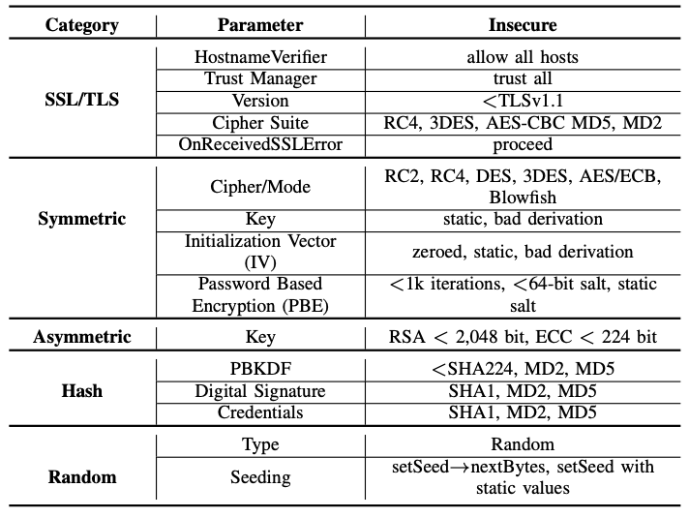
Categories of Java Security Implementations
There are five defined categories of Java Security issues relevant to library API misuse

Slide 15
SSL/TLS security vulnerability example

Slide 16
Symmetric security vulnerability example

Slide 17
Methodology
Four main steps
Code Extraction
Clone Detection
Code Labeling
Verifying prevalence of sample posts

Slide 18
Methodology – Code Extraction
Extract security-related posts.
Download raw data as XML, parse and upload to Postgres database.
Each row in database corresponds to one post.
Filter large amounts of data using two filters.
Filter using tags
Filter using API terms.

Slide 19
Code Extraction – Filter using tags

Slide 20
Code Extraction – Filter using API usage
Use baker to find if any code snippet calls any security API.
API’s considered
Java platform security: org.jetf.jgss.*, android.security.*, com.sun.security.*, java.security.*, javax.crypto.*, javax.net.ssl.*, javax.security.*, javax.xml.crypto.*;
Third-party security libraries: BouncyCastle, GNU Crypto, jasypt, keyczar, scribejava, SpongyCastle.

Slide 21
Code Extraction – Baker
Extract
Extract all APIs of types, methods and fields from the libraries
Remove
Remove noise to prevent false positive triggers.
Extract
Extract names of types, methods and fields from code snippets
Deduce
Iteratively deduce identifier mappings between the extracted information.
Include
Include snippet if baker finds at least one match.

Slide 22
Methodology - Clone Detection
Previous step yields about 25,000 code snippets form 23,000 posts.
To manually check so many snippets is very time consuming.
So, sample representative code using clone detection first and then manually label them
Result: 2657 clone groups that consisted of 8,690 code snippets.

Slide 23
Code Labelling
Manually examine 8,690 code snippets from the previous steps and label them secure or insecure.
If a snippet meets any criteria of insecure code, labels as “insecure”.
If a snippet uses the security API but does not meet any criteria of insecure code, label as “secure”.
Everything else is labelled as “irrelevant”.
One post may have multiple answer snippets, if any answer in the thread is “insecure”, the post is labelled “insecure”.

Slide 24
Code Labelling - Labelled data

Slide 25
Code Labelling - Findings
About 64% clone groups from “refined data” where irrelevant to security -> implying that even after using Baker, precisely identifying security implementations is still difficult.
Any other way to improve this ? [DISCUSSION]
Alternative approaches to sift through noisy Stack Overflow data.

Slide 26
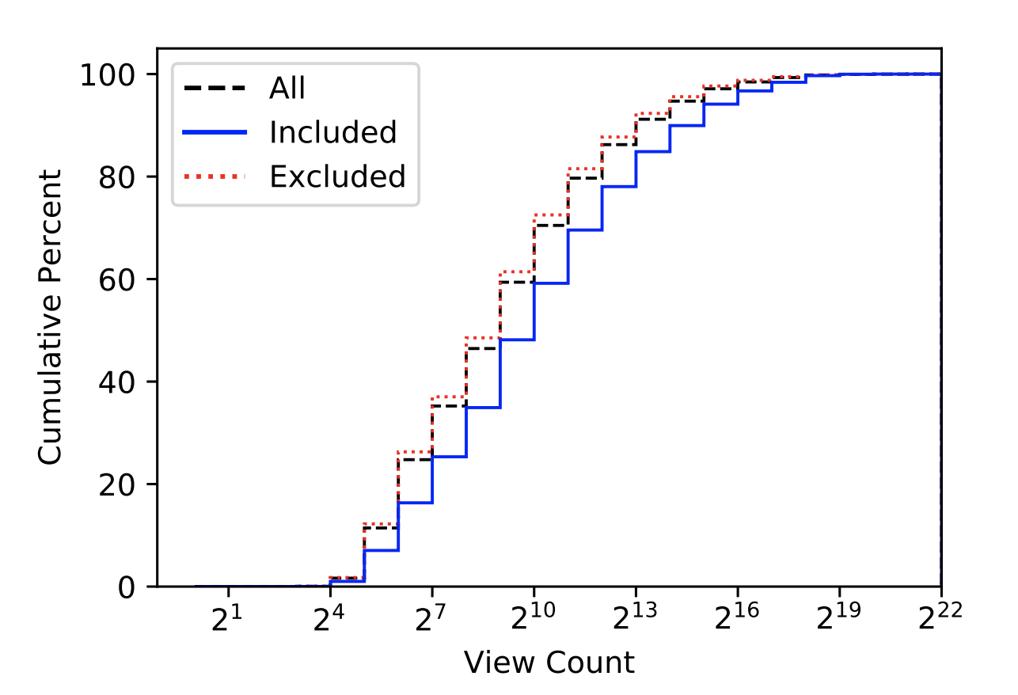
Methodology - Verifying prevalence of Sampled Posts
Check whether clone based approach actually included representative Stack Overflow posts.
Use CDF of view counts for included and excluded posts.
“Included” curve is beneath ”excluded” curve and “all” curve. Implying -> highly viewed answers take up a higher percent in the Sample set.

Slide 27
Results and Findings
Popularity of secure and insecure code suggestions.
644 out of the 1,429 inspected answer posts (45%) are insecure, meaning that insecure suggestions popularly exist on SO. Insecure answers dominate, in particular, the SSL/TLS category.

Slide 28
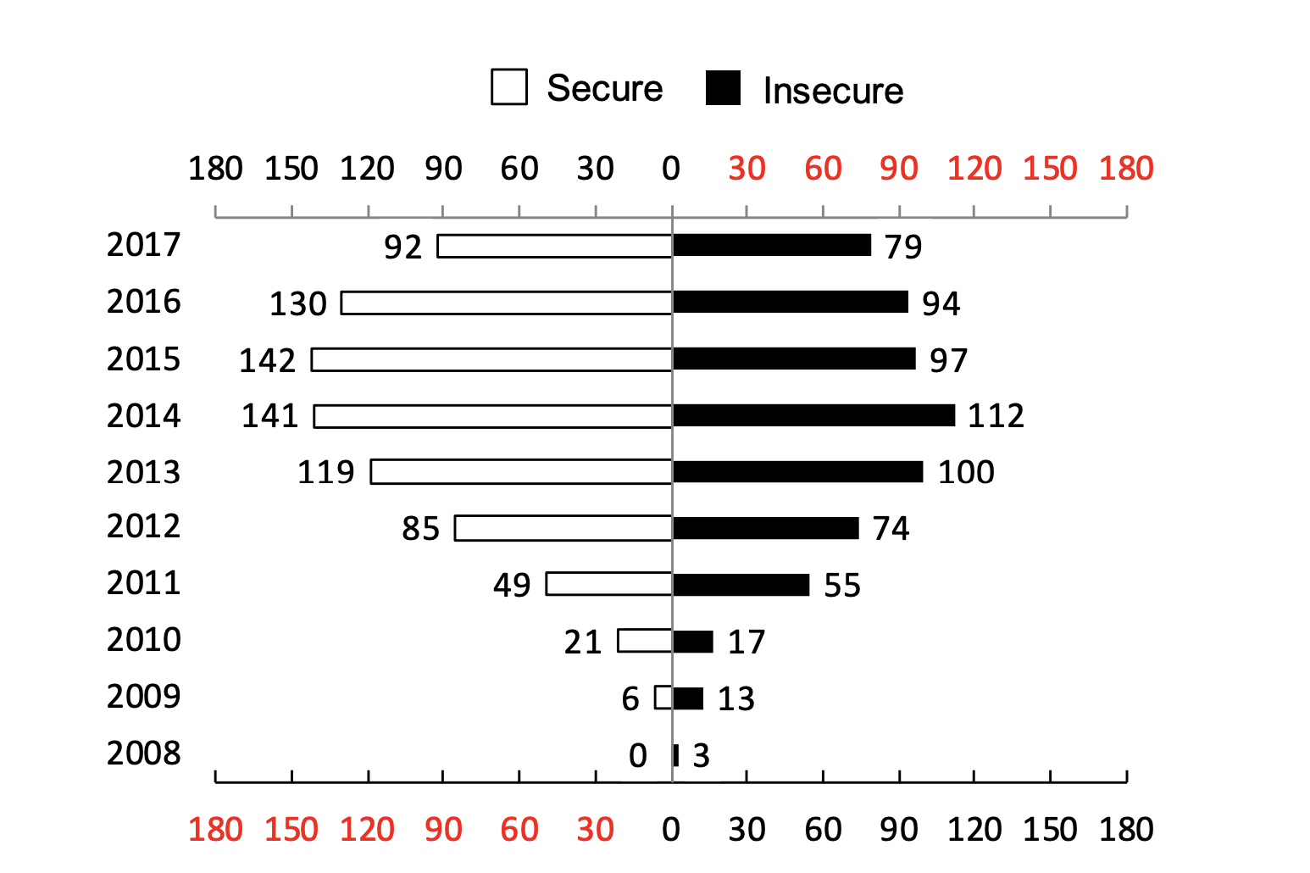
Results and Finding
Distribution of posts over time.

Slide 29
Results and Finding
Secure answers are MORE RECENT than insecure one.
Reasons:
Some vulnerabilities were recently revealed.
Secure answers were posted to correct the insecure ones.
[DISCUSSION]

Slide 30
Findings – Community Dynamics Towards Secure and Insecure Code

Slide 31
Finding – Distribution among different reputation groups
Therefore, high reputation scores DO NOT guarantee secure answers.
Why?
Users earned scores for being an expert in areas other than security.

Slide 32
Finding – Comparisons of Accepted answers
Out of 1429 posts - 536 were “Accepted answers”.
Almost 38%
Among the accepted answers - 297 are secure – 40% secure.
Accepted answers are also not reliable to identify secure coding suggestions

Slide 33
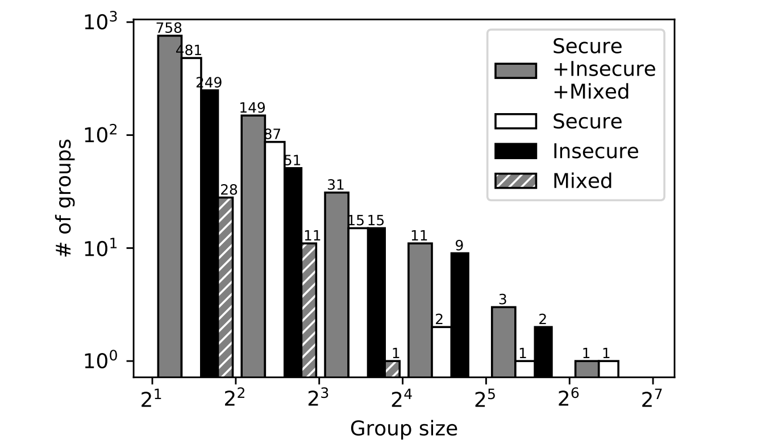
Finding – Duplication of secure and insecure code.
Frequently mentioned code snippets are not necessarily more secure than less frequent ones.

Slide 34
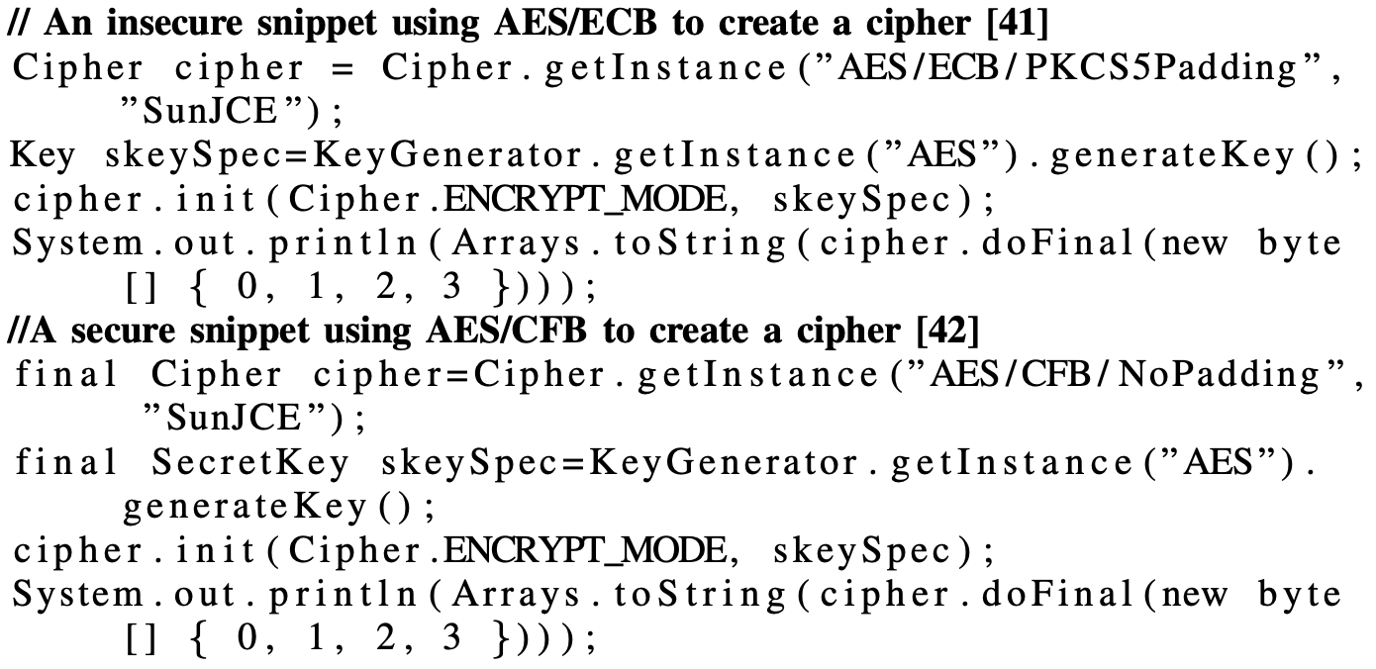
Finding – Why are there mixed groups?
Secure code snippets differ from insecure ones by using distinct parameters.

Slide 35
Finding – Duplicated Secure and Insecure code
Case Study 1: Duplicate answers by different users.
Examined the largest secure and insecure group.
This group contained answer to question on – how to enable an Android app to log into Facebook.
Majority of duplicated suggestions are relevant to questions, but cannot solve the issue.
Stack overflow users – provided “generally best practices” – probably to earn rep points.
Only one answer warns “DO NOT implement this in production code”.

Slide 36
Finding – Duplicated Secure and Insecure code
Case Study 2: Duplicate answers by same users.
In total, 109 users reused code snippets to answer multiple questions.
66 users repeatedly posted secure answers and 49 users posted duplicated insecure ones.
6 users posted both secure and insecure answers.
One user who posted 9 insecure snippets has a reputation of 17.7k and is an expert in Android.
Duplicate answers were created because (1) users asked similar questions and (2) some users blindly copied and pasted code to answer more questions and earn points.

Slide 37
Related work – Security API misuses
Prior studies show API misuses causing security vulnerabilities.
Almost 83% vulnerabilities are caused by API misuses.
On checking Android applications against well defined Android cryptographic API usage rules, Egele et al. found 88% Android applications violated at least one rule.
Fischer et al. analyzed secure and insecure code snippets on Stack Overflow to search for code clones in Android Applications.

Slide 38
Related work – Developer Studies
Nadi et al. surveyed 48 developers and revealed that developers found it difficult to use cryptographic algorithms correctly.
Xie et al. interviewed 15 developers, and found that (1) most developers had reasonable knowledge about software security, but (2) they did not consider security assurance as their own responsibility.
Acar et al. surveyed 295 developers and conducted a lab user study with 54 students and professional Android developers. They observed that most developers used search engines and SO to address security issues.

Slide 39
Related work – Empirical studies on Stack Overflow
Zhang et al. studied the JDK API usage recommended by SO, and observed that 31% of the studied posts misused APIs.
Meng et al. manually inspected 503 SO discussion threads related to Java security - revealed various secure coding challenges. Eg. Hard-to-configure frameworks. And vulnerable coding suggestions.
Mamykina et al. revealed several reasons (e.g., high response rate) to explain why SO is one of the most visible venues for expert knowledge sharing.
Vasilescu et al. studied the associations between SO and GitHub, and found that GitHub committers usually ask fewer questions and provide more answers.
Bosu et al. analyzed the dynamics of reputation building on SO, and found that answering as many questions as possible can help users quickly earn reputation

Slide 40
Recommendations based on analysis
For tool builders : Explore approaches that accurately and flexibly detect and fix security bugs.
For Stack Overflow developers :
Integrate static checkers to scan existing corpus and SO posts under submission.
Automatically add warning messages or special tags to any post that has vulnerable code.
Encourage moderators or trusted users to exploit clone detection technologies in order to efficiently detect and remove both duplicated questions and answers.

Slide 41
Recommendations based on analysis
For Designers of crowdsourcing platforms:
Integrate static checkers to scan existing corpus and SO posts under submission.
Automatically add warning messages or special tags to any post that has vulnerable code.
Encourage moderators or trusted users to exploit clone detection technologies in order to efficiently detect and remove both duplicated questions and answers.

Slide 42
Conclusion
Secure and insecure posts balance each other. Users without security knowledge rely heavily on community to provide feedback. Apparently, community’s feedback is almost useless.
Reputation mechanism is powerless to remove or discourage insecure suggestions. Insecure answers are considered easy fixes for programming errors.
Motivation to earn reputation by answering more questions, Stack Overflow encourages contributors to provide duplicated, less useful or insecure coding suggestions.

Slide 43
QUESTIONS ?

