Slide 1
Secure Coding Practices in Java: Challenges and Vulnerabilities¹
Present by: Ying Zhang
¹Meng, Na, et al. "Secure coding practices in java: Challenges and vulnerabilities." 2018 IEEE/ACM 40th International Conference on Software Engineering (ICSE). IEEE, 2018.

Slide 2
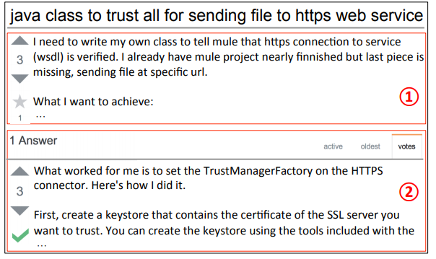
Background
Stack Overflow
Question & Answers
Security issues
Java platform security
Java EE security
Third-party frameworks

Slide 3
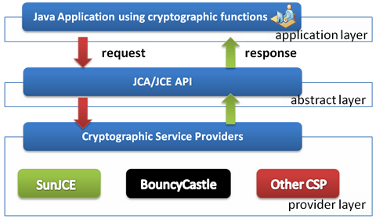
Background
Java Platform security
Java Cryptography Architecture (JCA)
Java EE security
Third-party security
https://www.google.com/url?sa=i&source=images&cd=&cad=rja&uact=8&ved=2ahUKEwjvsLPmurfgAhVBdt8KHW7PDSgQjRx6BAgBEAU&url=http%3A%2F%2Fwww.itcsolutions.eu%2F2011%2F08%2F22%2Fhow-to-use-bouncy-castle-cryptographic-api-in-netbeans-or-eclipse-for-java-jse-projects%2F&psig=AOvVaw0TNrSKrd1bDQGk9Ho11qtI&ust=1550104159828120

Slide 4
Methodology
Crawl posts from Stack Overflow
Filtering posts
Characterized relevant posts based on their security concerns, programming challenges, and security vulnerabilities
Figure1: Taxonomy of StackOverflow posts¹

Slide 5
Questions
What are the common security concerns of developers?
What are the common programming challenges?
What are the common security vulnerabilities?

Slide 6
Common Security Concerns-Distribution
Implementation questions
Developers need more help to secure Java enterprise applications

Slide 7
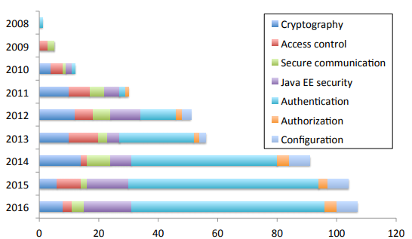
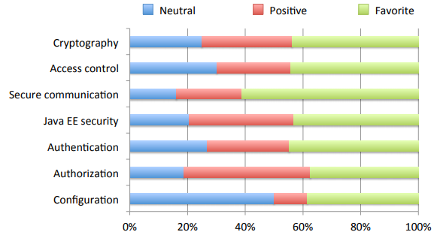
Common Security Concerns - Interests
Security related posts number increased
Developers’ security interests shifted to enterprise application security
Secure communication posts received the highest percentage of favorite vote
Figure 3: posts distribution during 2008 to 2016, developers’ interests towards the security features ¹

Slide 8
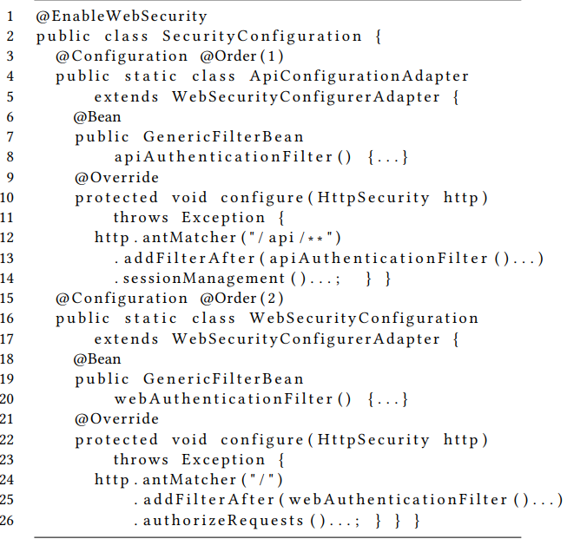
Program Challenges
Authentication
Integrate Spring Security with different application servers and frameworks
Configure Spring Security using XML or Java
Convert XML-based configurations to Java-based ones

Slide 9
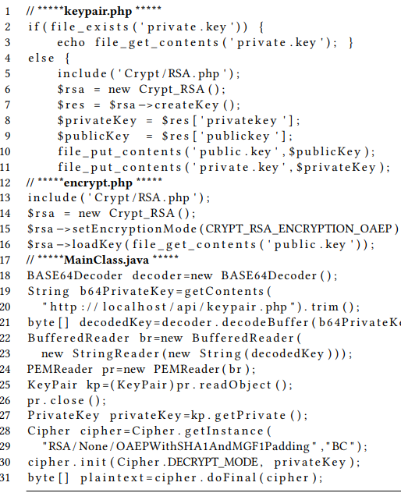
Program Challenges
Cryptography
Poor error messages
Difficult to implement security with multiple programming languages
Implicite constraints on API usage

Slide 10
Program Challenges
Java EE security
Authentication & Authorization
Access control
Secure Communication
SSL/TLS

Slide 11
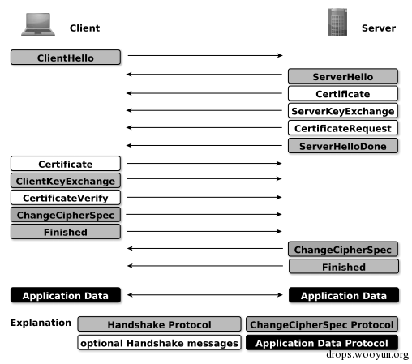
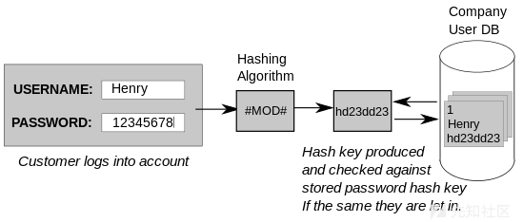
Security Vulnerabilities
Spring Security’s csrf()
Disabling CSRF pretection
SSL/TLS
Password Hashing

Slide 12
Recommendations
Developers should conduct security testing to check whether features work as expected.
Library designers should deprecate APIs not intended to be used anymore
Tool builders can help by creating automatic tools to diagnose security errors

Slide 13
Questions ?

