Slide 1
CS 6704 Software Engineering Research Spring 2019
Automated Decomposition of Build Targets
Bowen Shen
bowenshe@vt.edu

Slide 2
Background
Build process
Dependency graph
Continuous Integration

Slide 3
Build System
Notes:
A build system is responsible for transforming source code into libraries, executable binaries, and other artifacts. The build system takes as input a set of targets that programmers declare in build files. When a programmer issues a command to build a target, the build system first ensures that the required dependencies of the target are built. Then, it builds the desired target from its sources and dependencies. The final artifact depends on the kind of the target. For example, this chart show a typical process of C program. But for Java targets, the build system should produces JAR files.

Slide 4
Java Build Process
Notes:
Java is a little difference between it contains both compiler and interpreter. Java is compiled into Java bytecode to be interpreted by JVM. In this paper’s scope, it only deal with the left part.

Slide 5
Build Automation Software
For JAVA
Ant
Maven
Gradle
Notes:
There are several build automation software tools for java. Most used are Ant, Maven and Gradle. Even we have these tools to facilitate our build process, there are still problems bothering developers.

Slide 6
Dependency Graphs
Notes:
Here is a dependency graph of C++ program.

Slide 7
Dependency Graphs
Notes:
This is figure 1. Dependency graph of Java.

Slide 8
Continuous Integration
Notes:
In software engineering, continuous integration (CI) is the practice of merging all developer working copies to a shared mainline. Basically it provide a complete procedure to ensure software development. More specific here, CI will trigger build and execution as long as the build target changed.

Slide 9
Issues
Some numbers here:
On average, the Google code repository receives over 5,500 code changes per day, which make the CI system run over 100 million test cases per day.
Research suggests that build maintenance accounts for 27% and 44% of code and test development, respectively.
Notes:
Despite the sophisticated caching and parallelism of Google’s build system, slow builds, CI, and IDEs are still major issues.

Slide 10
Problem
This paper focuses underutilized targets.
Definition:
An underutilized target is one with files not needed by some of its dependents.
Notes:
Underutilized targets reduce modularity, make the builds and IDEs slower, increase the size of executables, and increase the load on the CI system by triggering unnecessary builds and tests.

Slide 11
A Motivating Example
Notes:
Look back the figure 2. Target network is underutilized by one test target (client_tests). As a result, if a change affects only the files in S1(f1~f7), the CI system will unnecessarily trigger the build and execution of one test target (client_tests). How to solve this problem? Dependency granularity matters.

Slide 12
Dependency Granularity
In theory, a CI system can save triggers by tracking dependencies at the file-level instead of target-level.
File-level dependency example
f8 depend on f9 and f10
Target-level dependency example
Library server depend on library network

Slide 13
Drawbacks of file-level dependency
Maintaining the latest file-level dependencies is more expensive than that of target-level dependencies
Sound inference of all runtime dependencies and dependencies on data files and generated code is undecidable in general
Compared to file-level dependencies, target-level dependencies will improve modularity
Notes:
1. the number and change frequency of file-level dependencies is larger. Google service have issues with performance and accuracy

Slide 14
Target Decomposition
A refactoring to remove underutilized targets is to decompose them into smaller targets.
By default, DECOMPOSER proposes a decomposition of a given target into exactly two constituents.
Nonetheless, DECOMPOSER can be configured to propose decompositions to more constituents.
Notes:
Set the default number of 2 is kind of compromise from both sides.

Slide 15
Trigger Saving
Let $τ∕\left\langle τ_{1}，τ_{2}\right\rangle$denote a decomposition of target $τ$ into two constituent targets $τ_{1}$ and $τ_{2}$
Let $∆(τ∕\left\langle τ_{1}，τ_{2}\right\rangle )$denote the quantitative benefit of $τ∕\left\langle τ_{1}，τ_{2}\right\rangle$, trigger saving of $τ∕\left\langle τ_{1}，τ_{2}\right\rangle$
Count benefit of a decomposition by the number of binary and test triggers that it saves.
Notes:
We need to measure the benefits got from the target decomposition. To get a quantitative criteria, we count the number of binary and test files dependent on those source files.

Slide 16
A Motivating Example
Notes:
Look back example here. Here we have only client_tests and server_binary are binary and test. After decomposing the program into two parts S1 and S2, we saved a trigger from S1 part, if anything from S1 part changed, we don’t need to build client_tests because it’s not influencedd at all.

Slide 17
Formal Equation
Notes:
Now we can give a formal definition of the benefit we got from target decomposition. Notice here p1 is the probability that a change affects only a file in S(τ1). We approximate p1 by count the number of files in S1 ratio (|S(τ1)|/(|S(τ1)|+ |S(τ2)|) ) because their accurate computations are expensive.

Slide 18
Hardness of Decomposition
Notes:
This is proved by another report by the same authors. They reduced the decomposition problem to maximum clique problem in graph theory.

Slide 19
Alternative Solution
Instead of finding the best decomposition, the paper propose an efficient greedy algorithm that finds effective decompositions in practice.
1. Compute the strongly connected components (SCCs) of the cross references graph of the given target.
2. Find the binary and test targets that transitively depend on each SCC.
3. Partition the SCCs of the target into two sets with a goal of maximizing the trigger saving.
4. Update the build specifications to apply the decomposition.

Slide 20
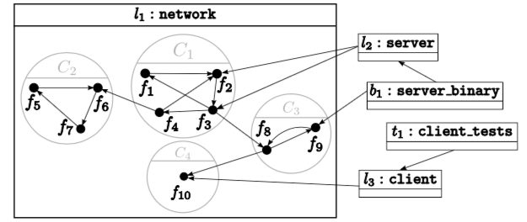
Strongly Connected Components (SCCs)
A directed graph$G$ is strongly connected if and only if for each pair of vertices $v_{1},v_{2}∈ V\left(G\right),$ $v_{1}⇝G{ v}_{2} and v_{2}⇝G{ v}_{1}$
Notes:
The SCCs of G(τ) form the smallest units of decomposing target τ. That is, any valid decomposition must assign all files of an SCC to the same constituent target. Otherwise, there will be a cyclic dependency between the constituent targets.

Slide 21
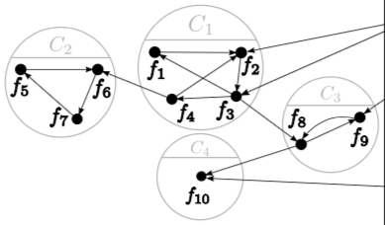
Condensation Graph
Notes:
If there is no limit on the number of constituent targets, the condensation graph is the best decomposition because this is the finest granularity.

Slide 22
Unifying Components
Notes:
Different choice of unifying will lead to different decomposition.

Slide 23
Avoiding Invalid Decompositions
How to avoid circular dependency ?
Lemma 1: Contracting two vertices that are adjacent in a topological ordering of a DAG results in another DAG.
Lemma 2: Contracting two root vertices (i.e., vertices without incoming edges) or two leave vertices (i.e., vertices without outgoing edges) of a DAG results in another DAG.

Slide 24
Invalid Examples

Slide 25
Iterative Unification
Minimize the bad impact of unifying component
Let $δ(τ, C_{1}, C_{2})$ be the cost of unifying components $C_{1}$ and $C_{2}$ of $G(τ)$.
Notes:
Reverse computation of the benefit, here we want to minimize the effect of unifying.

Slide 26
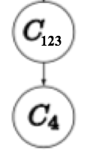
Valid Examples

Slide 27
Constituent Targets
Semi-automated:
Automated Part:
The iterative unification of the components of $τ$ terminates when only two components are left.
Manual Part:
Programmer has to set S$(τ)$ to $∅$. and specify the constituent targets whose source files correspond to those of the two components.
The programmer has to set $d(τ_{1})$to $τ_{2}$, $d(τ_{2})$to $d(τ)$ ,and $d(τ)$ to $\left\{τ_{1},τ_{2}\right\}$.
Finally, the programmer has to run a separate tool that removes unneeded dependencies of targets and converts indirect dependencies to direct ones.
Notes:
All working on the configuration files.

Slide 28
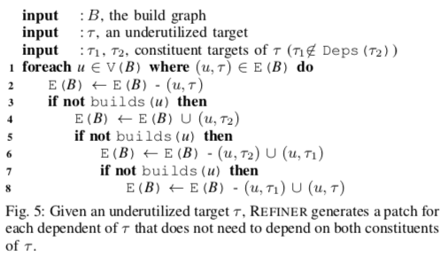
Dependency Refinement
REFINER is the automation tool to replace the manual effort.
Notes:
How long it will take? The bottleneck is in building all the dependents affected by the decomposition. If pass all tests, the patch is reviewed by the programmers that own the build specifications affected by the patch

Slide 29
Soundness
Soundness of DECOMPOSER
file-level and target-level dependency graphs are sound
Soundness of REFINER
target-level dependencies are sound

Slide 30
Empirical Results
RQ1: What percentage of targets can be decomposed?
RQ2: How effective are the decompositions that DECOMPOSER suggests?
RQ3: How efficient is DECOMPOSER?
RQ4: How receptive are programmers to the changes that DECOMPOSER and REFINER propose?

Slide 31
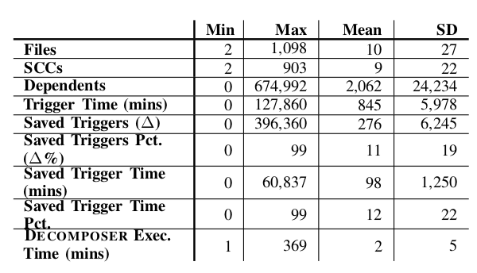
Empirical Results
RQ1: What percentage of targets can be decomposed?
Notes:
We ran DECOMPOSER on a random sample of targets at Google comprising of 40,000 Java library targets. DECOM- POSER reported that 19,994 (50%) of the analyzed targets were decomposable. A target is decomposable if and only if its cross references graph has at least two SCCs.

Slide 32
Empirical Results
RQ2: How effective are the decompositions that DECOMPOSER suggests?

Slide 33
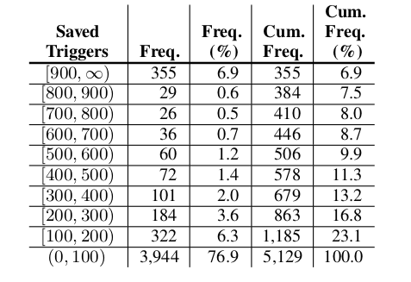
Empirical Results
RQ2.1: How many triggers can DECOMPOSER save?

Slide 34
Empirical Results
RQ2.1: How many triggers can DECOMPOSER save?

Slide 35
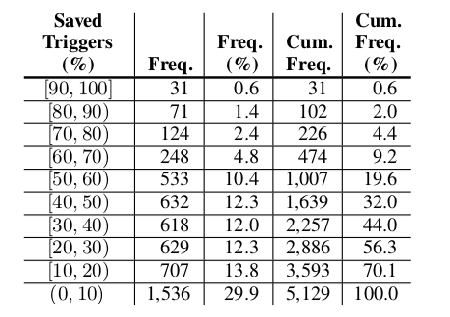
Empirical Results
RQ2.2: What percentage of triggers can DECOMPOSER save?

Slide 36
Empirical Results
RQ2.2: What percentage of triggers can DECOMPOSER save?

Slide 37
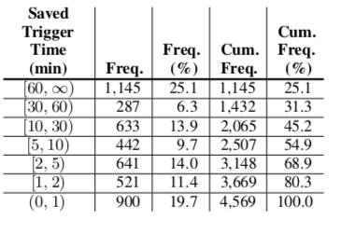
Empirical Results
RQ2.3: How much test execution time can DECOMPOSER save?

Slide 38
Empirical Results
RQ2.3: How much test execution time can DECOMPOSER save?

Slide 39
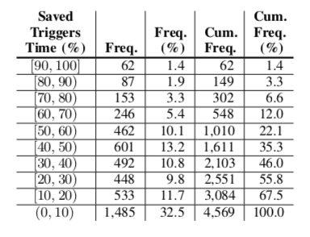
Empirical Results
RQ2.4: What percentage of test execution time can DECOMPOSER save?

Slide 40
Empirical Results
RQ2.4: What percentage of test execution time can DECOMPOSER save?

Slide 41
Empirical Results
RQ3: How efficient is DECOMPOSER?
If sequentially processed, DECOMPOSER takes more than 55 days to finish
In parallel, only one night.

Slide 42
Empirical Results
RQ4: How receptive are programmers to the changes that DECOMPOSER and REFINER propose?
DECOMPOSER
Seven targets was selected for decomposition
Six code changes got reviewed, four of which got approved.
Two code changes got rejected, because the reviewer expected the target to change rarely.
REFINER
Two code changes created by REFINER, both of which got approved

Slide 43
Thank you

Slide 44
Discussion Questions
In this paper, the quantitative criteria of trigger saving is simply the numbers of binary and test files, how can we improve this standard?
Extension to other program language?
Is there any better solution than greedy algorithm?
How to improve the degree of automation in build specifications?
Is there any algorithm to find the best number of decomposed constituent ?

