Slide 1
CS 6704 Software Engineering Research Spring 2019
Conflict Resolution for Structured Merge via Version Space Algebra
Bowen Shen
bowenshe@vt.edu

Slide 2
Background
Code Merge
Abstract Syntactic Tree(AST)
Version Space Algebra(VSA)

Slide 3
Version Control System

Slide 4
Code Merge

Slide 5
Code Merge Rule

Slide 6
Three way merge
Three-way merge
A three-way merge is performed after an automated difference analysis between a file "A" and a file "B" while also considering the origin, or common ancestor, of both files "C". It is a rough merging method, but widely applicable since it only requires one common ancestor to reconstruct the changes that are to be merged.
The three-way merge looks for sections which are the same in only two of the three files. In this case, there are two versions of the section, and the version which is in the common ancestor "C" is discarded, while the version that differs is preserved in the output. If "A" and "B" agree, that is what appears in the output. A section that is the same in "A" and "C" outputs the changed version in "B", and likewise a section that is the same in "B" and "C" outputs the version in "A".

Slide 7
Illustration of merge scenario

Slide 8
Change from one side

Slide 9
Change from both sides

Slide 10
Deletion from one side

Slide 11
Insertion from one side

Slide 12
Abstract Syntax Tree

Slide 13
Abstract Syntax Tree

Slide 14
Version Space Algebra
Initially, it’s designed to perform a searching strategy for learning generalization by Mitchell in 1982
Basically, version space means a set of qualifying hypothesis.
More specific, it contain a lower bound and a upper bound.
Based on the input instance, the space between lower bound and upper bound with get smaller and smaller.

Slide 15
Version Space Algebra

Slide 16
Version Space Algebra

Slide 17
Version Space Algebra
Later, in 2000 , Tessa extend this method to more general cases. Instead of learning generality, here it allows arbitrary partial orders.
Additional, it also allow no boundary-set representable(BSR) space.

Slide 18
A Motivating Example

Slide 19
High Level Idea
Underlying Assumption:
Expected version provided by developer is always a combination of the left and the right versions.
This assumption is reasonable and holds for most of the practical cases, as evidenced by our evaluation results.
Notes:
It the develop decide to use other methods, such as adding some new statement, we can do nothing here.

Slide 20
High Level Idea
Notes:
Trying to generate the possible solution based on mutation of left and right branch. And give choice to developers based on ranking.
Hole means a instance of conflict.

Slide 21
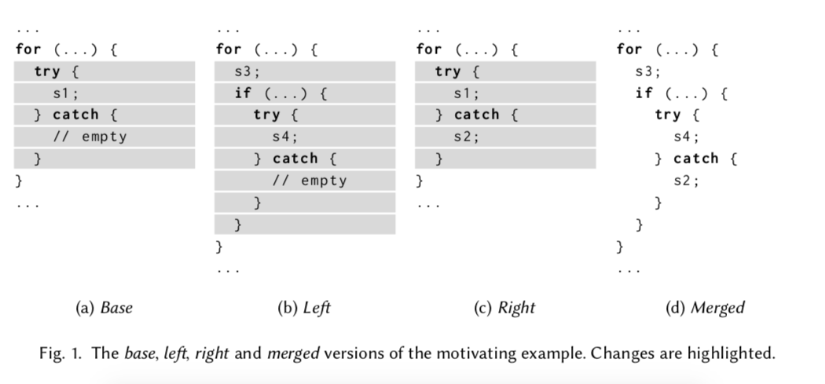
1. Conflict detection
Conflict detection. A structured merger is applied on the merge scenario (B, L, R) to generate a target program T_{h} with a set of holes H (line 4). In case of conflicts, the structured merger inserts a hole in the target program, and records the relevant segments in B, L and R that cause the conflict. In the motivating example, the highlighted statements in base, left and right (Figure 1) form a hole.

Slide 22
2. Program space representation
$Program space representation. For each hole h ∈ H ,$
$we construct a VSA \tilde{S_{h}} \left(line 7\right),$
$which represents all possible resolutions that can instantiate the hole h.$

Slide 23
3. Resolution ranking
$generate a candidate program, which is then presented to the developer.$
$If the developer rejects this candidate program, then we instantiate the hole$
$with the next ranked resolution and generate the next candidate program.$
$We count the number of presented candidate programs until the developer$
$accepts a result. Finally, we instantiate the hole h with the accepted$
$resolution P \left(line 9\right). Our approach fails if the developer rejects all$
$candidate programs defined by the constructed VSA \tilde{ S_{h} }$

Slide 24
How to convert AST to VSA

Slide 25
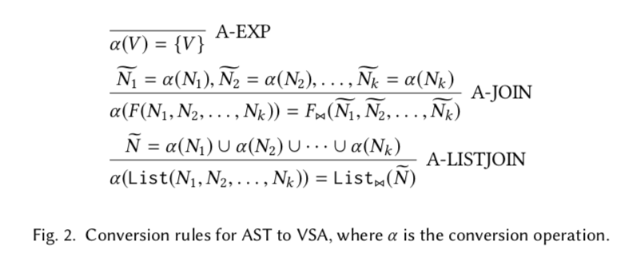
How to convert AST to VSA

Slide 26
How to convert AST to VSA

Slide 27
How to convert AST to VSA

Slide 28
How to convert AST to VSA

Slide 29
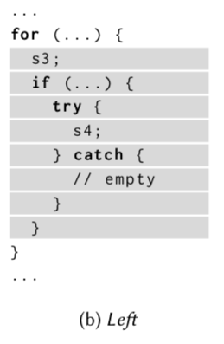
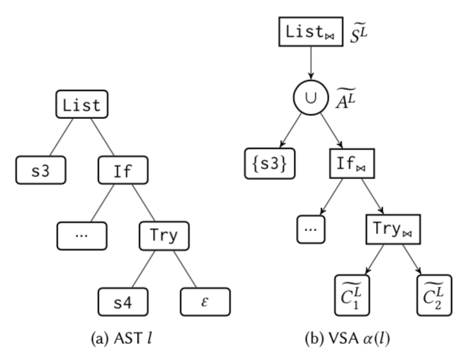
Left version

Slide 30
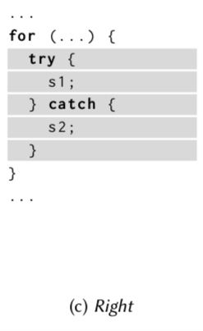
Right version

Slide 31
VSA Construction Algorithm

Slide 32
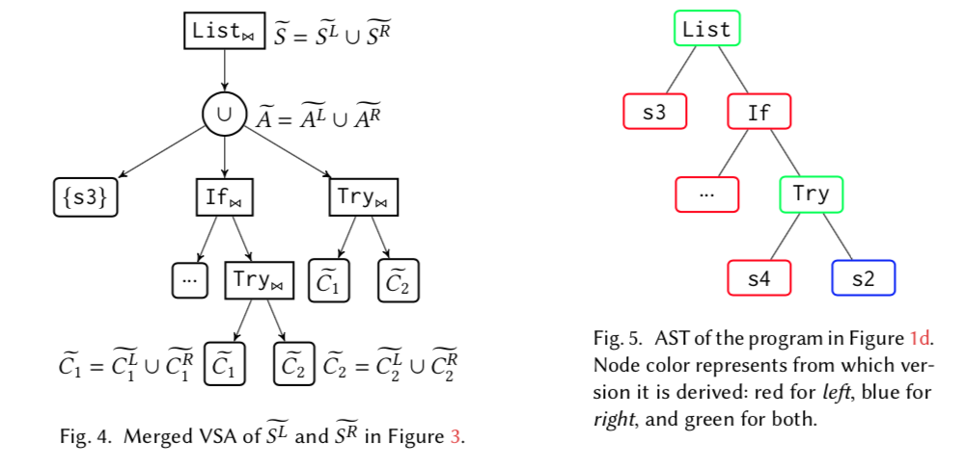
Motivating Example

Slide 33
Mapper
$V ←f(F,i,N)$
$F$, the type of the constructor
$i$, the index of the argument
$N$, the context in which the mapper is invoked
Notes:
A mapper is a function that maps an argument node to an identifier.

Slide 34
Mapper
Direct Mapper
Block Mapper
Expression Mapper

Slide 35
Direct Mapper

Slide 36
Block Mapper

Slide 37
Expression Mapper
Notes:
Formally, if t1,t2 ∈ {And,Or}, then f3(t1, _, _) = f3(t2, _, _) is always held

Slide 38
Resolution Ranking
Notes:
Given two identifiers V1, V2, we define V1 ≺ V2 if
Lower score means higher chance to be the solution.

Slide 39
Examples of Ranking

Slide 40
Evaluation
RQ1: How effective and efficient is AutoMerge at resolving conflicts?
RQ2: How do various mappers affect the effectiveness and efficiency of our approach?

Slide 41
Experiment Setup
Notes:
Mention here it only covers conflicts that Jdime cannot handle.

Slide 42
Evaluation on Conflict Resolution (RQ1)
Notes:
Mention here it only covers conflicts that Jdime cannot handle.
P.S means the size of program space, basically means the average of possible solutions we can chose.
In total, 232 holes of 244 are successfully resolved: the resolution rate is as high as 95.1%.
In all projects, k = 18 at most, and k = 1.79 in average

Slide 43
Evaluation on Conflict Resolution (RQ1)
Notes:
Remember here the algorithm in VSA construction have a maximum depth of D. If we limited the depth, the search space will be also smaller.

Slide 44
Evaluation on Conflict Resolution (RQ1)
Analysis of the failure cases:
assumption violation (8 cases)
insufficient expressiveness (2 cases)
huge program space (2 cases)
Notes:
insufficient expressiveness
The constructed VSA requires the root of the AST must have the identical kind with either the left or the right version. However, in these failure cases, we find the expected AST is actually a subtree of some candidate.

Slide 45
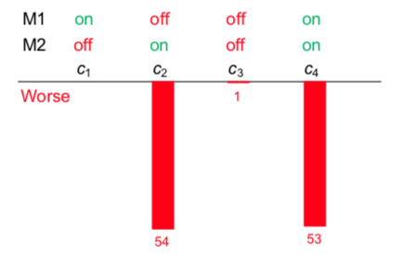
Evaluation on Configurations (RQ2)
Baseline Configuration
C1 (M1 on, M2 off)
Notes:
block mapper (M1)
expression mapper (M2)
We argue that the usage of the block mapper increases the number of successful cases, and improves the usability of our approach in practice.
Originally, we intended to enhance the expressiveness of the VSA by this mapper so that more complicated resolutions can be discovered.

Slide 46
Related Work
Software Merge
VSA-based Program Synthesis
Program Transformation

Slide 47
Conclusion
1.Present a VSA-based conflict resolution approach. First constructing a program space consists of possible resolutions and then discovering the expected result with a ranking mechanism.
2. Experiment prove the efficiency of AutoMerge.

Slide 48
Thank you

Slide 49
Discussion Questions
What the complexity of this algorithm?
How does this method deal with renaming problem?
Why dose enabling mappers lead to worse performance?
Is there any better ranking algorithm?

