Slide 1
Recommending Adaptive Changes for Framework Evolution
Presenter: Ying Zhang

Slide 2
Motivation
In software development, engineers tend to use framework to shorten the time.
Using internal class is a common scenario during the development.
A complete re-architecture of a framework can break client programs.
Not all framework changes are written in the document.
Tedious changes need to be conducted in client programs.

Slide 3
Problem Definition
Provide a tool that can provide adaptations to client programs which are affected by the non-trivial evolution of framework.

Slide 4
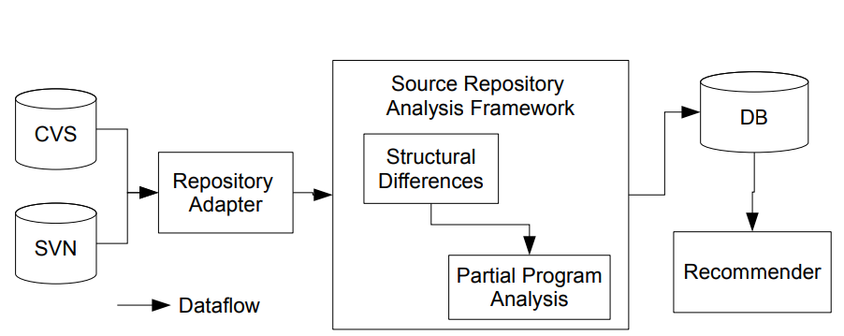
Approach: SemDiff
A recommendation system suggests adaptations to client programs

Slide 5
Adaptive Change Recommendations
Confidence metric
Change chains
Caller stability
Spurious call removal
Complexity

Slide 6
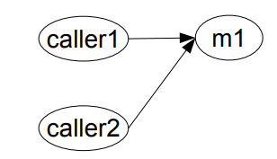
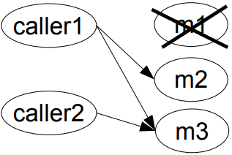
Confidence Metric
n1
m1
n1, n2
n2
caller1, caller2
m2, m3

Slide 7
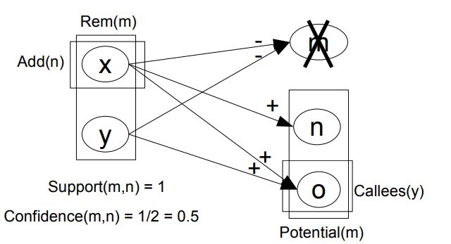
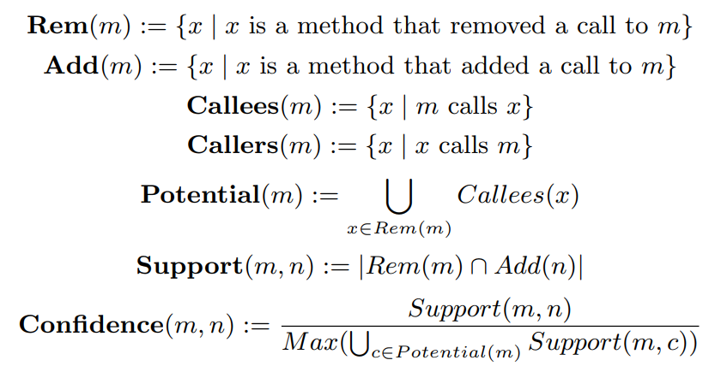
Confidence Metric

Slide 8
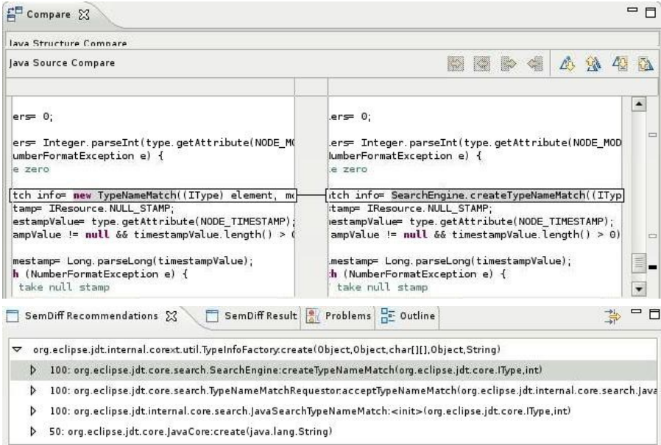
Deprecated method
Recommended replacement

Slide 9
Change Chains
A method is replaced several times
Some methods removed the call VS All method removed the call
Discard the recommendation in a change chain
reapply the call difference analysis described above to find a more relevant recommendation

Slide 10
Caller stability
Both caller and requested method are replaced
Find a replacement for the deleted caller
Recommend the methods that are called by the caller replacement minus the methods that were previously called by the deleted caller.

Slide 11
Spurious Call Removal
A call to a method is removed in one place and added in another place in the same change set
SemDiff will ignore all change sets where the requested method call was removed from one caller and added in another caller.

Slide 12
Analyzing source code history
Retrieving
Retrieving the files and change data for each version of the framework
Running
Running several analyses to infer high-level changes such as structural and method call differences
Storing
Storing those high-level changes in a database for future use by our recommendation system

Slide 13
Evaluation
Can SemDiff recommend to a client program adaptive changes that replace a functionality deleted during a framework’s evolution?
Is the confidence value good enough to discriminate relevant recommendations from false positives?
Can SemDiff detect changes more complex than refactorings?

Slide 14
Evaluation
Eclipse Java Development Tool (JDT) platform
org.eclipse.jdt.core and org.eclipse.jdt.ui plug-ins from version 3.1 to 3.3
SemDiff to analyze the source history of the Eclipse framework
RefactoringCrawler detects refactorings as baseline

Slide 15
Result
The execution of the repository analysis framework took 16 hours on a Pentium D 3.2 Ghz with 2 Gb of RAM and running Ubuntu Server 7.04.
each request took 1 second to complete. Running the three analysis with RefactoringCrawler took 13 hours.

Slide 16
Result
Relevant recommendations
SemDiff found relevant recommendations for 89% of the problematic calls in the client programs
Confidence Value
SemDiff produced an average of 7.1 recommendations per request
confidence value was necessary to discriminate relevant replacements from false positives
Non-trivial changes
RefactoringCrawler found 319 refactorings between JDT releases 3.1 and 3.3, only one related to errors within study scope. SemDiff works in the face of non-trivial changes

Slide 17
Related Works
K. Chow and D. Notkin. Semi-automatic update of applications in response to library changes. In Proc. of the Int’l Conference on Software Maintenance, pages 359–369, 1996.
J. Henkel and A. Diwan. Catchup!: capturing and replaying refactorings to support API evolution. In Proc. of the 27th international conference on Software engineering, pages 274–283, 2005.
D. Dig, C. Comertoglu, D. Marinov, and R. Johnson. Automated detection of refactorings in evolving components. In Proc. of the European Conference on Object-Oriented Programming, pages 404–428, 2006.
M. W. Godfrey and L. Zou. Using origin analysis to detect merging and splitting of source code entities. IEEE Transactions on Software Engineering, 31(2):166–181, 2005.

Slide 18
Conclusion
SemDiff automatically recommends adaptive changes in the face of non-trivial framework evolution
SemDiff is able to track a framework’s evolution and infer non-trivial changes
An historical study of the Eclipse JDT framework and three of its client programs showed the effectiveness for their system

Slide 19
Discuss Questions
The framework cannot issue recommendations for root methods
SemDiff does not group the recommendations together, how to automatically inferring those relationships
Adaptive changes proposed by SemDiff might not be semantically equivalent to features that need to be replaced
Long call chains are likely to decrease the precision of the call difference analysis

Slide 20
Thanks!

