Slide 1
MAPO: Mining and Recommending API Usage Patterns
Authors: Hao Zhong, Tao Xie, Lu Zhang, Jian Pei, and Hong Mei (2006)
Presented By: Aabhas Bhatia

Slide 2
Motivating Examples
Reading File
Pre-written APIs in every language
Can simply use them
Need to look them up

Slide 3
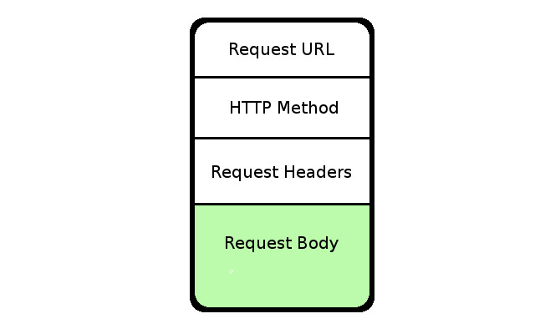
Create HTTP Request
API keys encoded

Slide 4
Add file to body of HTTP request
Reading File
Pre-written APIs in every language
Can simply use them
Need to look them up

Slide 5
The Problem
APIs exist for reuse, but
Complex and difficult to reuse
How to organize different API methods together?

Slide 6
Search for code snippets?
Why not look at existing code snippets?
Which one is relevant?
More APIs to call?
Look at more snippets?

Slide 7
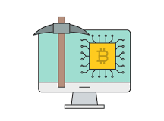
Solution
MAPO - Mining API usage Patterns from Open source repositories
Offline mining (scalable??)
Real time recommendations

Slide 8
Approach
Code Extraction
Pattern Mining
Recommendation

Slide 9
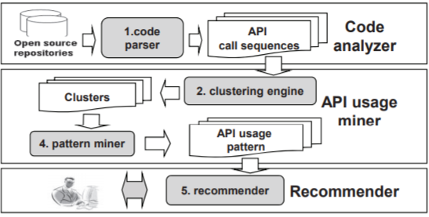
Overview

Slide 10
Code Analyzer
Extracts API usage information from code snippets
Organizes information according to the methods

Slide 11
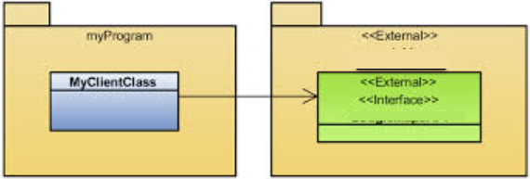
Code Analyzer - parsing code
Looks at following locations for API method calls
Super constructor call
Class cast expression
Method call
Class instance creations

Slide 12
Code Analyzer - selecting API sequences
asas

Slide 13
Code Analyzer - selecting API sequences
Choose a subset that covers all API calls
Avoid Method and Common-path overweight
Greedy way - select longest first
Recursive Method Inlining for developer’s methods

Slide 14
API usage miner
Groups API usage information into cluster
Mines patterns from each cluster

Slide 15
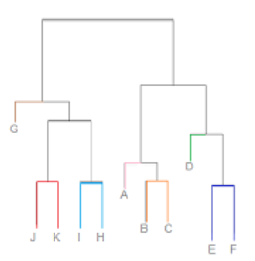
API usage miner - clustering
Precursor for mining-
Reduce the total scenarios by clustering similar
ones
Different API usage scenarios might interfere
while mining

Slide 16
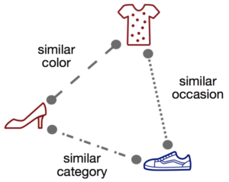
Clustering - similarity metrics
Use average of 3 (equal weights??)
Class Name
Method Name
Called API methods

Slide 17
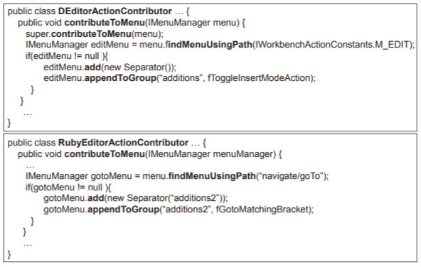
Similarity metrics - names

Slide 18
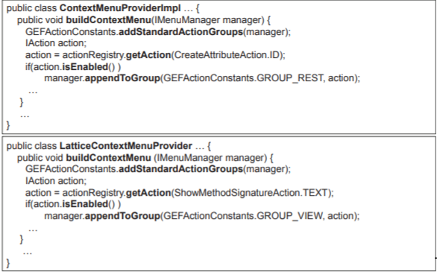
Similarity metrics - names

Slide 19
Similarity metrics - Called API methods
Similar feature but with different set of API methods called
For two sequences s1 and s2 :

Slide 20
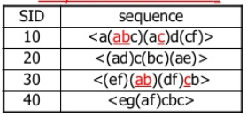
API Usage miner - mining from each cluster
Mines frequent API method calls
Sequences with support greater than threshold reported(??)

Slide 21
Recommender
Recommends API usage pattern upon requests
Eclipse plugin ranks and shows code snippets

Slide 22
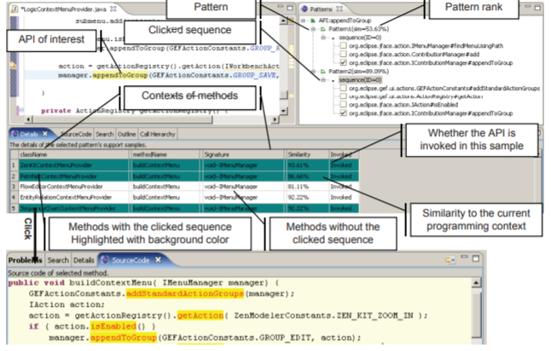

Slide 23
Evaluation
Experimental Study - is MAPO effective
Empirical Study - can MAPO lead to lesser bugs

Slide 24
Experimental Study - setup
Mined 20 projects that use Eclipse’s Graphical Editing Framework
Support value 0.7
Filtered out clusters not calling any GEF APIs
93 patterns, 157 API sequences, 856 API methods explored

Slide 25
Experimental Study - quantitative comparison
Results were compared against code
Snippet searching tools:
Strathcona
Google code Search with limited search
scope(??)
13 tasks created from a book on GEF

Slide 26
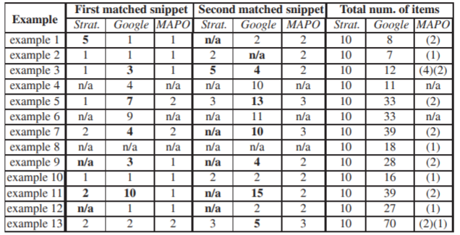
Experimental Study - results

Slide 27
Experimental Study - design decisions validation
Greedy subsequence selection
Inlining
Clustering

Slide 28
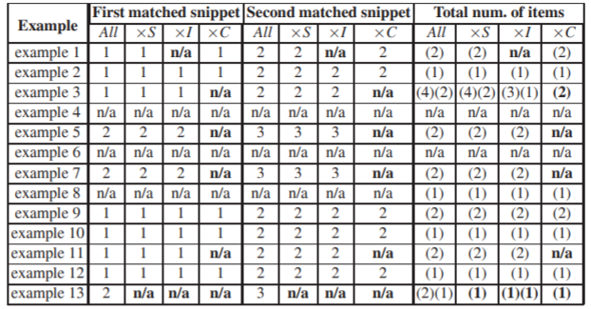
Experimental Study - design decisions validation

Slide 29
Empirical Study - setup
Goal - min bugs for tasks in 1 hour
Task implemented by authors and then code removed to form an incomplete code base(??)
Users can refer MAPO, Google and Strathcona

Slide 30
Empirical Study - setup

Slide 31
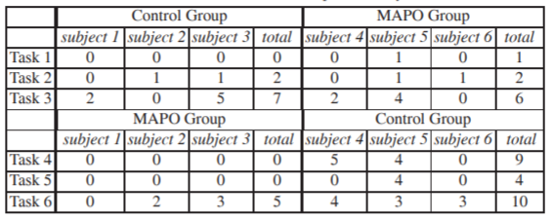
Empirical Study - results

Slide 32
Related Work
Recommending Code Snippets
Mining API properties

Slide 33
Recommending Code Snippets
Strathcona locates a set of relevant code snippets from a repository
Prospector synthesizes solution jungloids from a jungloid query.
XSnippet extends Prospector and adds additional queries, ranking heuristics, and mining algorithms to query a repository for relevant code snippets.
PARSEWeb mines snippets from Google code search to find solution jungloids.

Slide 34
Mining API properties
Mine Association Rules among software artifacts:
-But properties mined without any temporal information -MAPO mines more complicated API usage patterns
Mine frequent call sequences from API client code or traces: -MAPO mines patterns related to multiple APIs. -MAPO takes programming context into consideration

Slide 35
Conclusion
Mined patterns
Easier to find snippets
Less snippets to look at
Reduction in bugs
Eclipse IDE integration

Slide 36
Discussion
Design decisions
Experiments

Slide 37
Design Decisions
Equal weights to similarity metrics?
What about uncommon and security APIs?
What happens when API upgrades?
State of the art clustering schemes?
Threshold for support score?

Slide 38
Experiments
Limited Google code search over 20 repos
Scalability issues with offline mining
Skeletal of tasks was written by authors
Can I actually use this when writing code from scratch?

Slide 39
Thanks
Questions

