Slide 1
Object Based Transactional Memory
Ali Saoud

Slide 2
Introduction
Resent trends go towards object based SMT because it’s dynamic
Word-based STM systems are more suitable for data structures that may require concurrent access at a high level of granularity (e.g. multi-dimensional arrays).

Slide 3
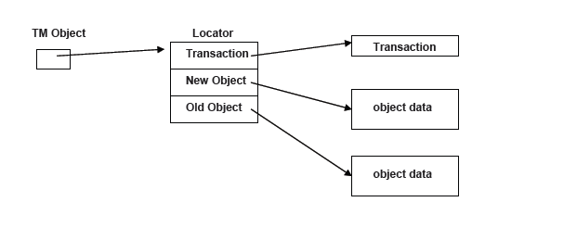
Dynamic Software Transactional Memory (DSTM)
Handler
The locator is the main key to the design of the DSTM.
Every pointer goes through a level of indirection.

Slide 4
Dynamic Software Transactional Memory (DSTM)
Active
committed
Aborted
Handler
If the transaction is ACTIVE or ABORTED, the most recent valid version of the data object is the old version referenced by the locator.
If the transaction is COMMITTED, the most recent valid version of the data object is the new version referenced by the locator.

Slide 5
Dynamic Software Transactional Memory (DSTM)
Active
Committed
Aborted
Handler
Data to be Modified
Current Data

Slide 6
Open For Writing
Handler
T1(open)

Slide 7
Open For Writing
Handler
Transaction
T0: committed
New object
Object Data
Old object
T1(open)
Object Data

Slide 8
Open For Writing
Handler
Transaction
T0: committed
CAS
New object
Object Data
Old object
T1(open)
Object Data
Copy
Transaction
T1 active
New object
Object Data
Old object
A successful CAS guarantees that the current transaction is visible to the entire concurrent system. A failure in CAS implies that some other transaction has opened (acquired) the TM Object in between.

Slide 9
Open For Writing
Handler
Transaction
T0: Aborted
New object
Object Data
Old object
T1(open)
Object Data

Slide 10
Open For Writing
Handler
Transaction
T0: aborted
New object
Object Data
Old object
T1(open)
Object Data
Copy
Transaction
T1 active
New object
Object Data
Old object

Slide 11
Open For Writing
Handler
Transaction
T0: Active
New object
Object Data
Old object
T1(open) Active
Object Data
A transaction goes through a novel contention management protocol to decide whether to abort itself or the TM Object's current ACTIVE owner transaction.
aggressive –always/immediately aborts conflicting transaction
polite –adaptive back-off
contention reduced by “early release”: reference to object dropped before transaction commits and subsequent changes to the released object does not jeopardize consistency

Slide 12
Open For Reading
Handler
Transaction
T0: Committed
New object
Object Data
Old object
T1 Active
Object Data
Read only list
Object
Value
Next

Slide 13
Open For Reading
Handler
Transaction
T0: Committed
New object
Object Data
Old object
T1 Active
Object Data
Read only list
Object
Value
Next

Slide 14
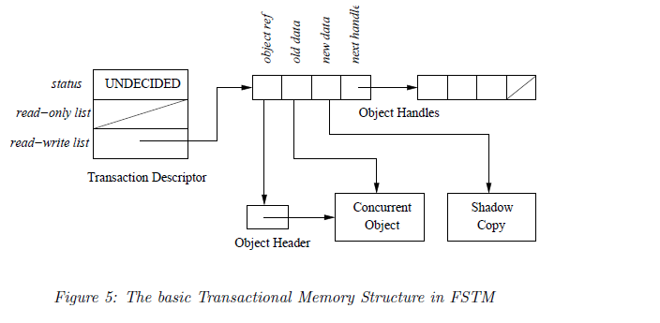
FSTM
Conflicts among transactions are detected and resolved at commit-time

Slide 15
FSTM
Read_checking
Committed
Aborted

Slide 16
Commit
Acquire
Acquire each object in the read-write list in global total order using atomic CAS for each object
Abort if conflict with committed transaction detected
Help if conflict with uncommitted transaction detected

Slide 17
Commit 2
Read-checking
Verify consistency of each object in the read-only list
Abort if change is detected in object held by Undecided transaction
If conflict detected with Read-checking transaction:
Help if other transaction precedes current transaction
Abort if current transaction precedes other transaction
Release acquired transactions

Slide 18
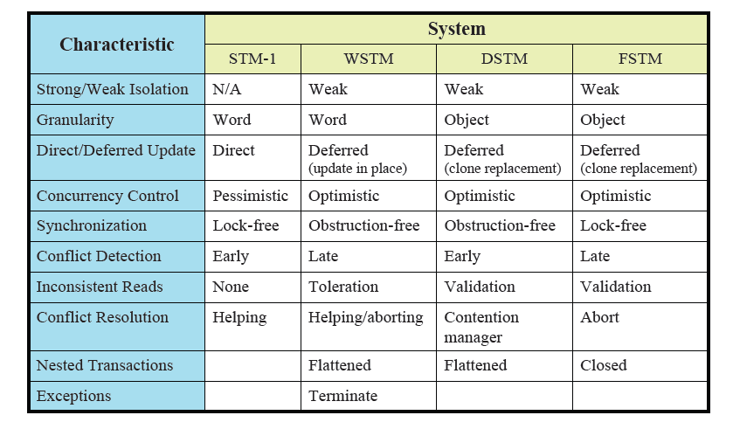
Comparison

