Slide 1
Transactional Memory: Architectural Support for Lock-Free Data Structures
Maurice Herlihy (DEC), J. Eliot & B. Moss (UMass)
Presenter: Mariano Diaz

Slide 2
Part 1: Concepts and Hardware-based Approaches
Introduction
What’s a transaction?
Transaction: a finite sequence of machine instructions, executed by a single process, that satisfies the following:
Serializability/Isolation
Atomicity
Concept “borrowed” from databases..

Slide 3
Introduction con’t
So what’s transaction memory?
Allows for concurrent, lock-free synchronization of shared memory using transactions on a multicore platform.
Why lock-free?
Priority inversion
Convoying
Deadlock
Nasty programming!..

Slide 4
Introduction con’t
Approaches
Hardware (faster, size-limitations, platform dependent)
Software (slower, unlimited size, platform independent)
Hybrid (common cases resolved in hardware, exceptions in software)
Object-based (course-grained)
Word-based (fine-grained)..

Slide 5
Intended Use
To replace short critical sections.
Instructions for accessing memory:
LT (Load-transactional)
LTX (Load-transactional-exclusive)
ST (Store-transactional)
Instructions to manipulate transaction state:
Commit
Abort
Validate

Slide 6
Intended Use con’t
Typical process:
LT/ LTX to read from locations
Validate
ST to modify locations
Commit
If fail rinse and repeat
When contention is high, use adaptive backoff before retrying.

Slide 7
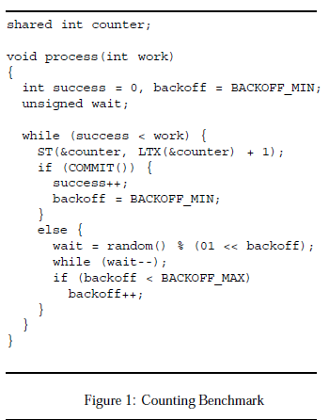
Example

Slide 8
Cache Implementation
What hardware are we working with?
Two types of cache:
Regular
Transactional
. . .
address
value
state
tag
cache
Bus
Shared Memory

Slide 9
Cache Implementation con’t
Caches “snoop” on shared bus and react via cache coherence protocol. Since already built in, allows for free transaction conflict detection.
Cache coherence keeps the an address/value pair consistent across a set of caches.
Cache lines can be in either regular or transactional caches, both not both (same processor)..

Slide 10
Line States
Name | Access | Shared? | Modified?
invalid | none | --- | ---
valid | R | yes | no
dirty | R, W | no | yes
reserved | R, W | no | no
. . .
address
value
state
tags
cache
Bus
Shared Memory

Slide 11
Transactional Tags
Name | Meaning
EMPTY | contains no data
NORMAL | contains committed data
XCOMMIT | discard on commit
XABORT | discard on abort
. . .
address
value
state
tags
cache
Bus
Shared Memory

Slide 12
Bus Cycles
. . .
address
value
state
tags
cache
Bus
Shared Memory
Name | Kind | Meaning | New access
READ | regular | read value | shared
RFO | regular | read value | exclusive
WRITE | both | write back | exclusive
T_READ | transaction | read value | shared
T_RFO | transaction | read value | exclusive
BUSY | transaction | refuse access | unchanged

Slide 13
Processor Flags
Processor maintains two flags:
Transaction active (TACTIVE)
Transaction status (TSTATUS)
TSTATUS indicates whether the transaction is active (True)
TACTIVE is set when first transactional operation is executed within transaction.
Used directly by Commit, Abort, Validate instructions.

Slide 14
Scenarios
LT instruction
If XABORT entry in transactional cache: return value
If NORMAL entry
Change NORMAL to XABORT
Allocate second entry with XCOMMIT (same data)
Return value
Otherwise
Issue T_READ bus cycle
Successful: set up XABORT/XCOMMIT entries
BUSY: abort transaction
LTX instruction
Same as LT instruction except that T_RFO bus cycle is used instead and cache line state is RESERVED
ST instruction
Same as LTX except that the XABORT value is updated

Slide 15
Scenarios & Transaction States
Validate
Returns TSTATUS flag
False: set TACTIVE to False
set TSTATUS to True
Abort
Sets TSTATUS to True
Sets TACTIVE to False
Commit
Returns TSTATUS
Sets TSTATUS to True
sets TACTIVE to False

Slide 16
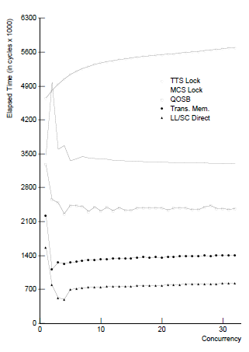
Performance (Counting Benchmark)
TTS Lock
MCS Lock
QOSB
TM
LL/SC Direct

